Slide 1
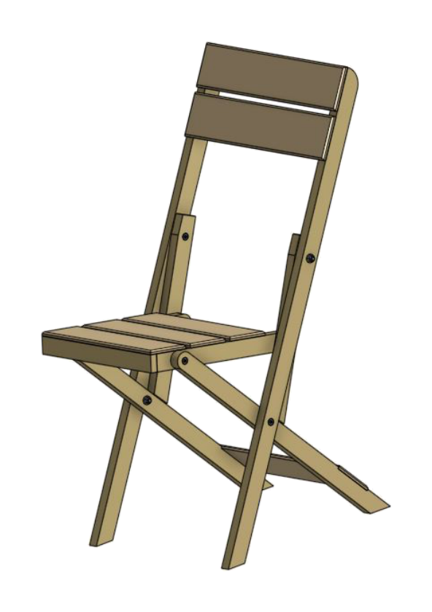
FOLDING CHAIR
Weeks 19–20 · 1/8
Final quality assurance, correction, workshop handover, submission and reflection
Weeks 19–20 guided learning
Read the theory. Check your understanding. Save useful evidence.
Notes:
Introduce the module purpose and connect it to the current project stage.
[Sources]
- Authorised local course theory: weeks19-20/index.html

Slide 2
FOLDING CHAIR
Weeks 19–20 · 2/8
What you will learn
Use the module in order. Each idea supports the checks and written evidence that follow.
1
A systematic final inspection follows the chair from structure to surface
4
Final submission is a quality-assurance task
2
Correct the cause, not only the symptom
5
Reflection asks what happened, why and what changes next
3
Cleaning, maintenance and repair are different responsibilities
6
Care of the finished folding chair
Notes:
Preview the learning sequence without giving check answers.
[Sources]
- Authorised local course theory: weeks19-20/index.html

Slide 3
FOLDING CHAIR
Weeks 19–20 · 3/8
A systematic final inspection follows the chair from…
A systematic final inspection follows the chair from structure to surface
Randomly looking for faults usually finds only the most visible issue.
Correct the cause, not only the symptom
A stiff pivot may result from excessive locknut tension, finish build-up, a missing washer, misaligned holes or a twisted member.
Return to the module page for the full explanation, visual and section video.
Notes:
Teach the source-grounded theory for A systematic final inspection follows the chair from structure to surface and Correct the cause, not only the symptom.
[Sources]
- Authorised local course theory: weeks19-20/index.html

Slide 4
FOLDING CHAIR
Weeks 19–20 · 4/8
Cleaning, maintenance and repair are different…
Cleaning, maintenance and repair are different responsibilities
Cleaning removes dust, waste and residue.
Final submission is a quality-assurance task
Prepare the chair under good light and remove loose dust using the approved method.
Return to the module page for the full explanation, visual and section video.
Notes:
Teach the source-grounded theory for Cleaning, maintenance and repair are different responsibilities and Final submission is a quality-assurance task.
[Sources]
- Authorised local course theory: weeks19-20/index.html

Slide 5
FOLDING CHAIR
Weeks 19–20 · 5/8
Reflection asks what happened, why and what changes next…
Reflection asks what happened, why and what changes next
Reflection is useful when it links experience to a future action.
Care of the finished folding chair
The chair should be used only for its intended purpose, stored dry and protected from conditions unsuitable for the timber and selected finish.
Return to the module page for the full explanation, visual and section video.
Notes:
Teach the source-grounded theory for Reflection asks what happened, why and what changes next and Care of the finished folding chair.
[Sources]
- Authorised local course theory: weeks19-20/index.html

Slide 6
FOLDING CHAIR
Weeks 19–20 · 6/8
Pause and check your understanding
What is the controlling idea?
A systematic final inspection follows the chair from structure to surface
Which check would prevent a mistake?
Final submission is a quality-assurance task
What evidence would show your decision?
Care of the finished folding chair
Notes:
Use these prompts for retrieval before students open the interactive checks.
[Sources]
- Authorised local course theory: weeks19-20/index.html

Slide 7
FOLDING CHAIR
Weeks 19–20 · 7/8
Build a stronger written response
Read
Underline the command word and the project detail.
Select
Return to the exact theory section and choose relevant evidence.
Explain
Connect the decision, reason and likely result.
Check
Make sure the response answers the question and stays source-accurate.
Notes:
Model the response process without supplying an answer to a live student question.
[Sources]
- Authorised local course theory: weeks19-20/index.html

Slide 8
FOLDING CHAIR
Weeks 19–20 · 8/8
Exit ticket
Before you finish this module, answer these in your own words:
1. One idea I can now explain: A systematic final inspection follows the chair from structure to…
2. One practical check I must remember before the next stage
3. One piece of evidence I should save or improve
Return to the module page to complete the checks, written response and folio evidence.
Notes:
Students complete the exit ticket, then return to the website to save evidence.
[Sources]
- Authorised local course theory: weeks19-20/index.html

