Slide 1
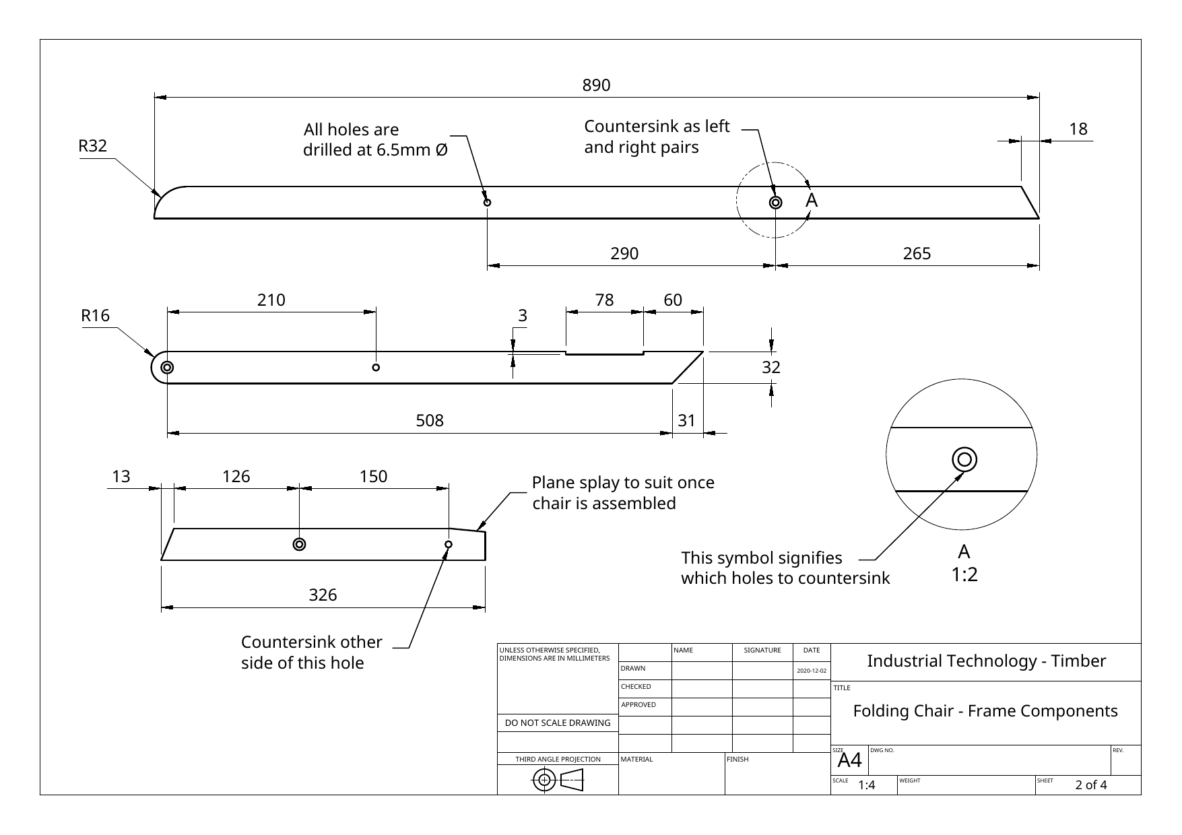
FOLDING CHAIR
Weeks 3–4 · 1/8
Cutting lists, timber preparation, FEWTEL and joinery foundations
Weeks 3–4 guided learning
Read the theory. Check your understanding. Save useful evidence.
Notes:
Introduce the module purpose and connect it to the current project stage.
[Sources]
- Authorised local course theory: weeks3-4/index.html

Slide 2
FOLDING CHAIR
Weeks 3–4 · 2/8
What you will learn
Use the module in order. Each idea supports the checks and written evidence that follow.
1
From working drawing to cutting list
4
How a mortise-and-tenon joint works
2
Selecting timber and recognising distortion
5
Hollow-chisel mortiser: setup, operation and test fitting
3
Dressing timber with the FEWTEL sequence
Notes:
Preview the learning sequence without giving check answers.
[Sources]
- Authorised local course theory: weeks3-4/index.html

Slide 3
FOLDING CHAIR
Weeks 3–4 · 3/8
From working drawing to cutting list + Selecting timber…
From working drawing to cutting list
A cutting list is a manufacturing document produced from the working drawings.
Selecting timber and recognising distortion
Grain direction, growth rings, knots, moisture and storage conditions influence strength, appearance, machining behaviour and dimensional stability.
Return to the module page for the full explanation, visual and section video.
Notes:
Teach the source-grounded theory for From working drawing to cutting list and Selecting timber and recognising distortion.
[Sources]
- Authorised local course theory: weeks3-4/index.html

Slide 4
FOLDING CHAIR
Weeks 3–4 · 4/8
Dressing timber with the FEWTEL sequence + How a…
Dressing timber with the FEWTEL sequence
FEWTEL—Face, Edge, Width, Thickness, End and Length—is a controlled sequence for producing timber that is flat, straight, square and consistently sized.
How a mortise-and-tenon joint works
The mortise is a rectangular cavity cut into one component.
Return to the module page for the full explanation, visual and section video.
Notes:
Teach the source-grounded theory for Dressing timber with the FEWTEL sequence and How a mortise-and-tenon joint works.
[Sources]
- Authorised local course theory: weeks3-4/index.html

Slide 5
FOLDING CHAIR
Weeks 3–4 · 5/8
Hollow-chisel mortiser: setup, operation and test fitting
Main idea
A hollow-chisel mortiser combines a rotating auger bit with a square outer chisel.
Check 2
The auger removes most of the waste and carries chips upward, while the chisel pares the corners square.
Check 3
Correct clearance between the bit and chisel is essential so the bit can rotate freely and chips can escape.
Return to the module page for the full explanation, visual and section video.
Notes:
Teach the source-grounded theory for Hollow-chisel mortiser: setup, operation and test fitting.
[Sources]
- Authorised local course theory: weeks3-4/index.html

Slide 6
FOLDING CHAIR
Weeks 3–4 · 6/8
Pause and check your understanding
What is the controlling idea?
From working drawing to cutting list
Which check would prevent a mistake?
Dressing timber with the FEWTEL sequence
What evidence would show your decision?
Hollow-chisel mortiser: setup, operation and test fitting
Notes:
Use these prompts for retrieval before students open the interactive checks.
[Sources]
- Authorised local course theory: weeks3-4/index.html

Slide 7
FOLDING CHAIR
Weeks 3–4 · 7/8
Build a stronger written response
Read
Underline the command word and the project detail.
Select
Return to the exact theory section and choose relevant evidence.
Explain
Connect the decision, reason and likely result.
Check
Make sure the response answers the question and stays source-accurate.
Notes:
Model the response process without supplying an answer to a live student question.
[Sources]
- Authorised local course theory: weeks3-4/index.html

Slide 8
FOLDING CHAIR
Weeks 3–4 · 8/8
Exit ticket
Before you finish this module, answer these in your own words:
1. One idea I can now explain: From working drawing to cutting list
2. One practical check I must remember before the next stage
3. One piece of evidence I should save or improve
Return to the module page to complete the checks, written response and folio evidence.
Notes:
Students complete the exit ticket, then return to the website to save evidence.
[Sources]
- Authorised local course theory: weeks3-4/index.html

