Slide 1
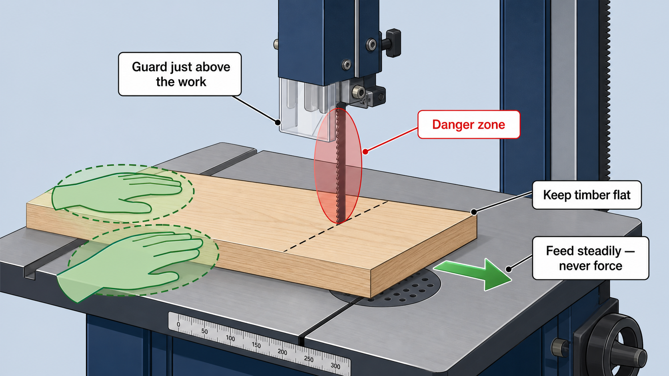
FOLDING CHAIR
Weeks 5–6 · 1/8
Bandsaw shaping, safe operating procedures and controlled joinery refinement
Weeks 5–6 guided learning
Read the theory. Check your understanding. Save useful evidence.
Notes:
Introduce the module purpose and connect it to the current project stage.
[Sources]
- Authorised local course theory: weeks5-6/index.html

Slide 2
FOLDING CHAIR
Weeks 5–6 · 2/8
What you will learn
Use the module in order. Each idea supports the checks and written evidence that follow.
1
How the bandsaw cuts—and why setup matters
4
Refining mortise-and-tenon fit without creating a loose joint
2
Planning curved cuts, relief cuts and paired components
5
Quality gates prevent cumulative error
3
A bandsaw SOP from pre-start to shutdown
Notes:
Preview the learning sequence without giving check answers.
[Sources]
- Authorised local course theory: weeks5-6/index.html

Slide 3
FOLDING CHAIR
Weeks 5–6 · 3/8
How the bandsaw cuts—and why setup matters + Planning…
How the bandsaw cuts—and why setup matters
A bandsaw uses a continuous toothed blade running around two wheels.
Planning curved cuts, relief cuts and paired components
A radius should be marked from a template, compass construction or another approved method.
Return to the module page for the full explanation, visual and section video.
Notes:
Teach the source-grounded theory for How the bandsaw cuts—and why setup matters and Planning curved cuts, relief cuts and paired components.
[Sources]
- Authorised local course theory: weeks5-6/index.html

Slide 4
FOLDING CHAIR
Weeks 5–6 · 4/8
A bandsaw SOP from pre-start to shutdown + Refining…
A bandsaw SOP from pre-start to shutdown
A Standard Operating Procedure (SOP) sets out the expected checks and behaviours for one machine or process.
Refining mortise-and-tenon fit without creating a loose joint
A joint that starts crooked may have unequal tenon cheeks, an out-of-square shoulder or a mortise that is not aligned with the reference face.
Return to the module page for the full explanation, visual and section video.
Notes:
Teach the source-grounded theory for A bandsaw SOP from pre-start to shutdown and Refining mortise-and-tenon fit without creating a loose joint.
[Sources]
- Authorised local course theory: weeks5-6/index.html

Slide 5
FOLDING CHAIR
Weeks 5–6 · 5/8
Quality gates prevent cumulative error
Main idea
A quality gate is a checkpoint that must be passed before the component moves to the next process.
Check 2
It is cheaper and easier to correct a radius before drilling than after a pivot hole has been located from the wrong end.
Check 3
Small inaccuracies that appear harmless can combine into a larger mechanism fault.
Return to the module page for the full explanation, visual and section video.
Notes:
Teach the source-grounded theory for Quality gates prevent cumulative error.
[Sources]
- Authorised local course theory: weeks5-6/index.html

Slide 6
FOLDING CHAIR
Weeks 5–6 · 6/8
Pause and check your understanding
What is the controlling idea?
How the bandsaw cuts—and why setup matters
Which check would prevent a mistake?
A bandsaw SOP from pre-start to shutdown
What evidence would show your decision?
Quality gates prevent cumulative error
Notes:
Use these prompts for retrieval before students open the interactive checks.
[Sources]
- Authorised local course theory: weeks5-6/index.html

Slide 7
FOLDING CHAIR
Weeks 5–6 · 7/8
Build a stronger written response
Read
Underline the command word and the project detail.
Select
Return to the exact theory section and choose relevant evidence.
Explain
Connect the decision, reason and likely result.
Check
Make sure the response answers the question and stays source-accurate.
Notes:
Model the response process without supplying an answer to a live student question.
[Sources]
- Authorised local course theory: weeks5-6/index.html

Slide 8
FOLDING CHAIR
Weeks 5–6 · 8/8
Exit ticket
Before you finish this module, answer these in your own words:
1. One idea I can now explain: How the bandsaw cuts—and why setup matters
2. One practical check I must remember before the next stage
3. One piece of evidence I should save or improve
Return to the module page to complete the checks, written response and folio evidence.
Notes:
Students complete the exit ticket, then return to the website to save evidence.
[Sources]
- Authorised local course theory: weeks5-6/index.html

