Slide 1
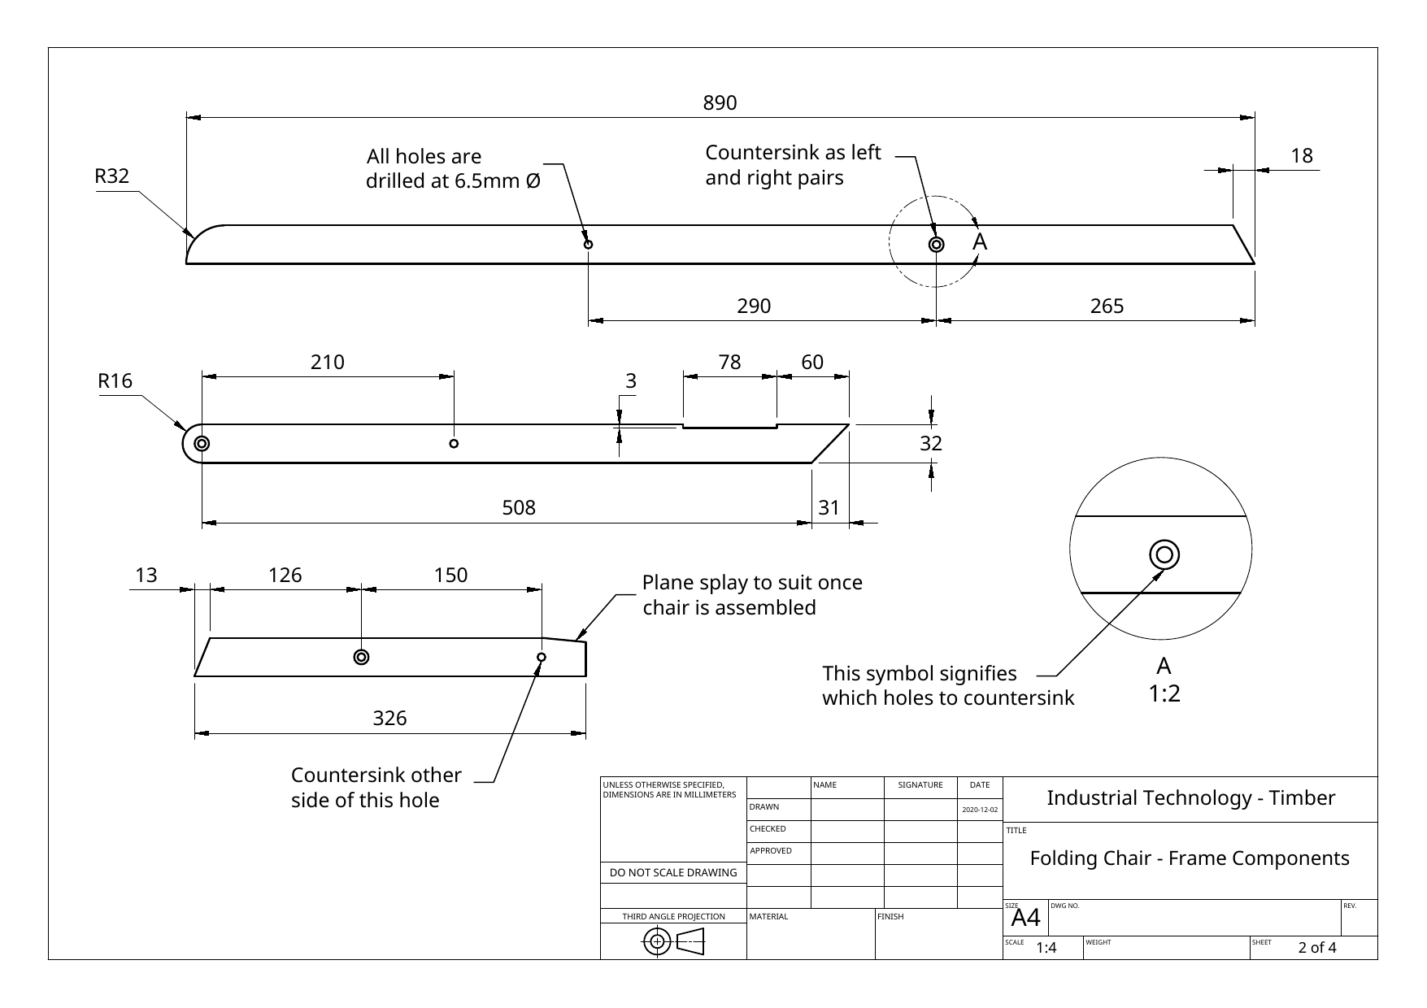
FOLDING CHAIR
Weeks 7–8 · 1/8
Drilling, countersinking, pivot hardware, dry assembly and work-method planning
Weeks 7–8 guided learning
Read the theory. Check your understanding. Save useful evidence.
Notes:
Introduce the module purpose and connect it to the current project stage.
[Sources]
- Authorised local course theory: weeks7-8/index.html

Slide 2
FOLDING CHAIR
Weeks 7–8 · 2/8
What you will learn
Use the module in order. Each idea supports the checks and written evidence that follow.
1
Locate hole centres from datums—not from the shape
4
How the pivot hardware stack controls movement
2
Produce a perpendicular, clean and controlled hole
5
Dry assembly is a diagnostic test—not a ceremonial step
3
Countersinking mirrored components correctly
6
Work Method Statement versus Standard Operating Procedure
Notes:
Preview the learning sequence without giving check answers.
[Sources]
- Authorised local course theory: weeks7-8/index.html

Slide 3
FOLDING CHAIR
Weeks 7–8 · 3/8
Locate hole centres from datums—not from the shape +…
Locate hole centres from datums—not from the shape
Hole centres must be transferred from the written dimensions and established reference faces.
Produce a perpendicular, clean and controlled hole
A drilling operation has three separate accuracy requirements: the centre must be correct, the hole must be perpendicular to the reference face, and the entry and exit surfaces must…
Return to the module page for the full explanation, visual and section video.
Notes:
Teach the source-grounded theory for Locate hole centres from datums—not from the shape and Produce a perpendicular, clean and controlled hole.
[Sources]
- Authorised local course theory: weeks7-8/index.html

Slide 4
FOLDING CHAIR
Weeks 7–8 · 4/8
Countersinking mirrored components correctly + How the…
Countersinking mirrored components correctly
A countersink creates a conical recess so a countersunk bolt head can sit flush or slightly below the surface.
How the pivot hardware stack controls movement
The bolt acts as the axle, but the timber members should not be crushed tightly together.
Return to the module page for the full explanation, visual and section video.
Notes:
Teach the source-grounded theory for Countersinking mirrored components correctly and How the pivot hardware stack controls movement.
[Sources]
- Authorised local course theory: weeks7-8/index.html

Slide 5
FOLDING CHAIR
Weeks 7–8 · 5/8
Dry assembly is a diagnostic test—not a ceremonial step…
Dry assembly is a diagnostic test—not a ceremonial step
A dry assembly brings the parts together without permanent adhesive or finish.
Work Method Statement versus Standard Operating Procedure
An SOP explains how to operate a specific machine or complete a standard process safely and consistently.
Return to the module page for the full explanation, visual and section video.
Notes:
Teach the source-grounded theory for Dry assembly is a diagnostic test—not a ceremonial step and Work Method Statement versus Standard Operating Procedure.
[Sources]
- Authorised local course theory: weeks7-8/index.html

Slide 6
FOLDING CHAIR
Weeks 7–8 · 6/8
Pause and check your understanding
What is the controlling idea?
Locate hole centres from datums—not from the shape
Which check would prevent a mistake?
How the pivot hardware stack controls movement
What evidence would show your decision?
Work Method Statement versus Standard Operating Procedure
Notes:
Use these prompts for retrieval before students open the interactive checks.
[Sources]
- Authorised local course theory: weeks7-8/index.html

Slide 7
FOLDING CHAIR
Weeks 7–8 · 7/8
Build a stronger written response
Read
Underline the command word and the project detail.
Select
Return to the exact theory section and choose relevant evidence.
Explain
Connect the decision, reason and likely result.
Check
Make sure the response answers the question and stays source-accurate.
Notes:
Model the response process without supplying an answer to a live student question.
[Sources]
- Authorised local course theory: weeks7-8/index.html

Slide 8
FOLDING CHAIR
Weeks 7–8 · 8/8
Exit ticket
Before you finish this module, answer these in your own words:
1. One idea I can now explain: Locate hole centres from datums—not from the shape
2. One practical check I must remember before the next stage
3. One piece of evidence I should save or improve
Return to the module page to complete the checks, written response and folio evidence.
Notes:
Students complete the exit ticket, then return to the website to save evidence.
[Sources]
- Authorised local course theory: weeks7-8/index.html

