Slide 1
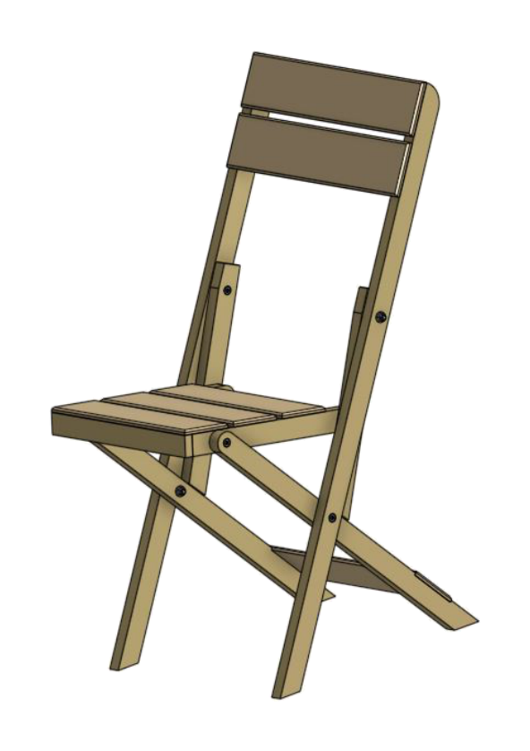
FOLDING CHAIR
Weeks 9–10 · 1/8
Design features, justified decisions, orthogonal projection and CAD communication
Weeks 9–10 guided learning
Read the theory. Check your understanding. Save useful evidence.
Notes:
Introduce the module purpose and connect it to the current project stage.
[Sources]
- Authorised local course theory: weeks9-10/index.html

Slide 2
FOLDING CHAIR
Weeks 9–10 · 2/8
What you will learn
Use the module in order. Each idea supports the checks and written evidence that follow.
1
Design criteria turn preference into a defensible decision
4
Orthogonal projection separates shape into aligned views
2
Structural, mechanical and ergonomic design zones
5
Line types, dimensions and notes carry different information
3
Use a decision matrix—but do not let the numbers think for you
6
CAD improves revision—but it cannot detect a confident wrong number
Notes:
Preview the learning sequence without giving check answers.
[Sources]
- Authorised local course theory: weeks9-10/index.html

Slide 3
FOLDING CHAIR
Weeks 9–10 · 3/8
Design criteria turn preference into a defensible…
Design criteria turn preference into a defensible decision
“I like it” is a starting reaction, not a design justification.
Structural, mechanical and ergonomic design zones
Not every surface is equally available for decoration.
Return to the module page for the full explanation, visual and section video.
Notes:
Teach the source-grounded theory for Design criteria turn preference into a defensible decision and Structural, mechanical and ergonomic design zones.
[Sources]
- Authorised local course theory: weeks9-10/index.html

Slide 4
FOLDING CHAIR
Weeks 9–10 · 4/8
Use a decision matrix—but do not let the numbers think…
Use a decision matrix—but do not let the numbers think for you
A decision matrix compares alternatives against the same criteria.
Orthogonal projection separates shape into aligned views
Orthogonal drawings show an object using views projected at right angles.
Return to the module page for the full explanation, visual and section video.
Notes:
Teach the source-grounded theory for Use a decision matrix—but do not let the numbers think for you and Orthogonal projection separates shape into aligned views.
[Sources]
- Authorised local course theory: weeks9-10/index.html

Slide 5
FOLDING CHAIR
Weeks 9–10 · 5/8
Line types, dimensions and notes carry different…
Line types, dimensions and notes carry different information
Good dimensioning provides enough information to manufacture the part without duplication or contradiction.
CAD improves revision—but it cannot detect a confident wrong number
Computer-aided drawing supports accurate geometry, copying, mirroring, layers, constraints and rapid revision.
Return to the module page for the full explanation, visual and section video.
Notes:
Teach the source-grounded theory for Line types, dimensions and notes carry different information and CAD improves revision—but it cannot detect a confident wrong number.
[Sources]
- Authorised local course theory: weeks9-10/index.html

Slide 6
FOLDING CHAIR
Weeks 9–10 · 6/8
Pause and check your understanding
What is the controlling idea?
Design criteria turn preference into a defensible decision
Which check would prevent a mistake?
Orthogonal projection separates shape into aligned views
What evidence would show your decision?
CAD improves revision—but it cannot detect a confident wrong number
Notes:
Use these prompts for retrieval before students open the interactive checks.
[Sources]
- Authorised local course theory: weeks9-10/index.html

Slide 7
FOLDING CHAIR
Weeks 9–10 · 7/8
Build a stronger written response
Read
Underline the command word and the project detail.
Select
Return to the exact theory section and choose relevant evidence.
Explain
Connect the decision, reason and likely result.
Check
Make sure the response answers the question and stays source-accurate.
Notes:
Model the response process without supplying an answer to a live student question.
[Sources]
- Authorised local course theory: weeks9-10/index.html

Slide 8
FOLDING CHAIR
Weeks 9–10 · 8/8
Exit ticket
Before you finish this module, answer these in your own words:
1. One idea I can now explain: Design criteria turn preference into a defensible decision
2. One practical check I must remember before the next stage
3. One piece of evidence I should save or improve
Return to the module page to complete the checks, written response and folio evidence.
Notes:
Students complete the exit ticket, then return to the website to save evidence.
[Sources]
- Authorised local course theory: weeks9-10/index.html

