Slide 1
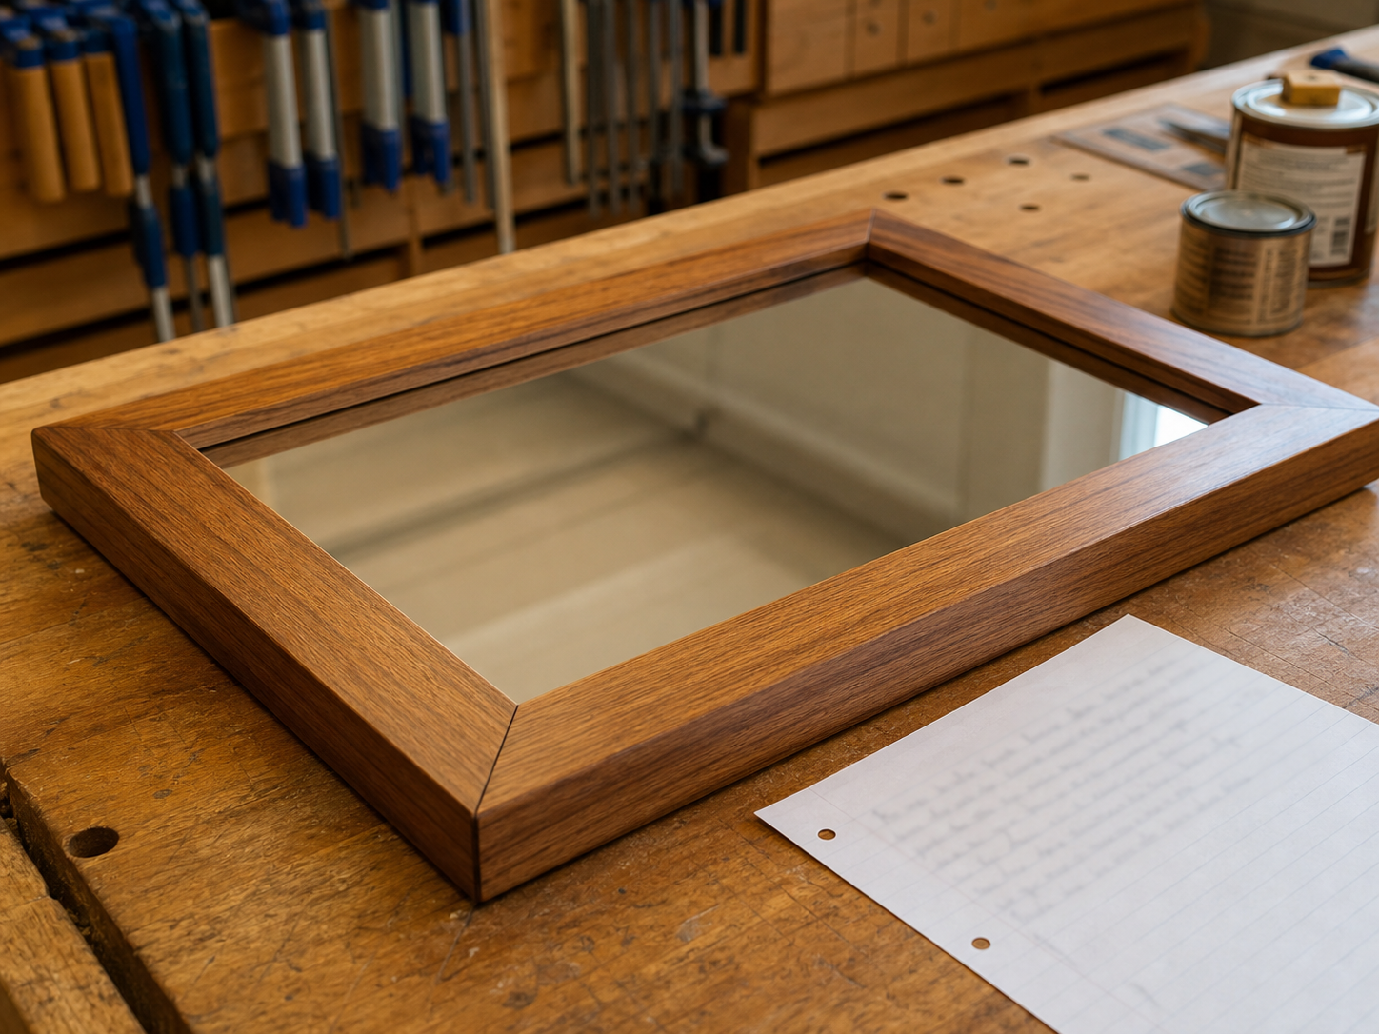
MIRROR
module–01 · 1/8
Read the drawing, plan the materials and sequence, then make safe decisions before cutting timber.
module–01 guided learning
Read the theory. Check your understanding. Save useful evidence.
Notes:
Introduce the module purpose and connect it to the current project stage.
[Sources]
- Authorised local course theory: mirror_theory_safety.html

Slide 2
MIRROR
module–01 · 2/8
What you will learn
Use the module in order. Each idea supports the checks and written evidence that follow.
1
Learning purpose
2
Use written dimensions
3
Teacher check
Notes:
Preview the learning sequence without giving check answers.
[Sources]
- Authorised local course theory: mirror_theory_safety.html

Slide 3
MIRROR
module–01 · 3/8
Learning purpose
Main idea
Before making the timber mirror, use the drawing to identify the requirements, plan the materials and choose a safe, accurate construction sequence.
Check 2
A project drawing controls the work.
Check 3
By the end of this section, you should be able to read the plan, identify the parts and materials needed, prepare a cutting list, and explain how planning improves…
Return to the module page for the full explanation, visual and section video.
Notes:
Teach the source-grounded theory for Learning purpose.
[Sources]
- Authorised local course theory: mirror_theory_safety.html

Slide 4
MIRROR
module–01 · 4/8
Use written dimensions
Main idea
By the end of this section, you should be able to read the plan, identify the parts and materials needed, prepare a cutting list, and explain how planning improves…
Check 2
Use the measurements and notes printed on the supplied drawing.
Check 3
Do not measure a plan from a screen or printout because it may not be displayed at full scale.
Return to the module page for the full explanation, visual and section video.
Notes:
Teach the source-grounded theory for Use written dimensions.
[Sources]
- Authorised local course theory: mirror_theory_safety.html

Slide 5
MIRROR
module–01 · 5/8
Teacher check
Main idea
Confirm cutting sizes, joints and machining details with your teacher before cutting timber.
Check 2
A small planning error is much easier to correct than a wrong cut.
Check 3
The drawing tells you the overall frame size, mirror opening, rebate details, component shapes and construction notes.
Return to the module page for the full explanation, visual and section video.
Notes:
Teach the source-grounded theory for Teacher check.
[Sources]
- Authorised local course theory: mirror_theory_safety.html

Slide 6
MIRROR
module–01 · 6/8
Pause and check your understanding
What is the controlling idea?
Learning purpose
Which check would prevent a mistake?
Use written dimensions
What evidence would show your decision?
Teacher check
Notes:
Use these prompts for retrieval before students open the interactive checks.
[Sources]
- Authorised local course theory: mirror_theory_safety.html

Slide 7
MIRROR
module–01 · 7/8
Build a stronger written response
Read
Underline the command word and the project detail.
Select
Return to the exact theory section and choose relevant evidence.
Explain
Connect the decision, reason and likely result.
Check
Make sure the response answers the question and stays source-accurate.
Notes:
Model the response process without supplying an answer to a live student question.
[Sources]
- Authorised local course theory: mirror_theory_safety.html

Slide 8
MIRROR
module–01 · 8/8
Exit ticket
Before you finish this module, answer these in your own words:
1. One idea I can now explain: Learning purpose
2. One practical check I must remember before the next stage
3. One piece of evidence I should save or improve
Return to the module page to complete the checks, written response and folio evidence.
Notes:
Students complete the exit ticket, then return to the website to save evidence.
[Sources]
- Authorised local course theory: mirror_theory_safety.html

