Slide 1
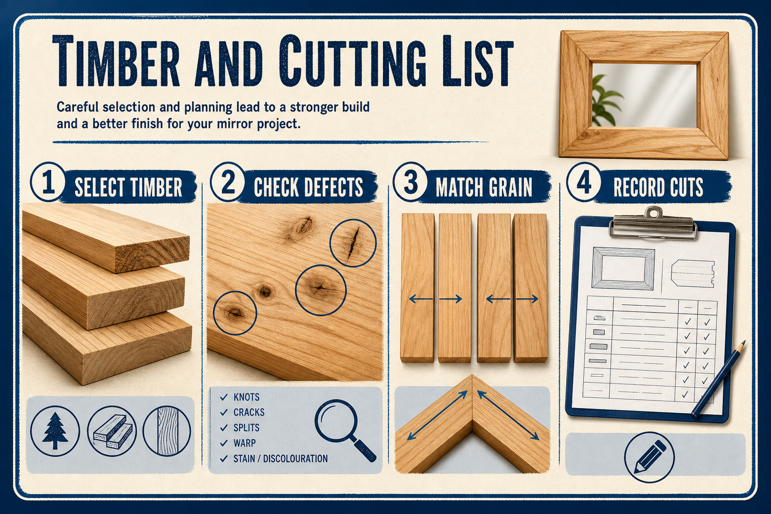
MIRROR
module–02 · 1/8
Grain, defects, seasoning, cost, sustainability and choosing stable material.
module–02 guided learning
Read the theory. Check your understanding. Save useful evidence.
Notes:
Introduce the module purpose and connect it to the current project stage.
[Sources]
- Authorised local course theory: mirror_theory_timber.html

Slide 2
MIRROR
module–02 · 2/8
What you will learn
Use the module in order. Each idea supports the checks and written evidence that follow.
1
What To Look For
2
Select timber before you mark it
3
Timber Choice For The Mirror
Notes:
Preview the learning sequence without giving check answers.
[Sources]
- Authorised local course theory: mirror_theory_timber.html

Slide 3
MIRROR
module–02 · 3/8
What To Look For
Main idea
Grain, knots, moisture and defects all affect how it cuts, joins and finishes.
Check 2
Choosing timber is about stability, appearance, cost and waste.
Check 3
Softwoods such as pine are commonly used in school projects because they are affordable, easy to machine and suitable for practising skills.
Return to the module page for the full explanation, visual and section video.
Notes:
Teach the source-grounded theory for What To Look For.
[Sources]
- Authorised local course theory: mirror_theory_timber.html

Slide 4
MIRROR
module–02 · 4/8
Select timber before you mark it
Main idea
Softwoods such as pine are commonly used in school projects because they are affordable, easy to machine and suitable for practising skills.
Check 2
Hardwoods can be stronger or more decorative, but they can cost more and be harder on tools.
Check 3
Good timber selection reduces warping, weak joints and wasted material.
Return to the module page for the full explanation, visual and section video.
Notes:
Teach the source-grounded theory for Select timber before you mark it.
[Sources]
- Authorised local course theory: mirror_theory_timber.html

Slide 5
MIRROR
module–02 · 5/8
Timber Choice For The Mirror
Main idea
For a mirror frame, the best board is not simply the cheapest or the prettiest.
Check 2
It needs to be straight, stable and long enough for the required component, with sound timber where joints, rebates and screw holes will be made.
Check 3
Lay the board on a flat surface and sight along its length.
Return to the module page for the full explanation, visual and section video.
Notes:
Teach the source-grounded theory for Timber Choice For The Mirror.
[Sources]
- Authorised local course theory: mirror_theory_timber.html

Slide 6
MIRROR
module–02 · 6/8
Pause and check your understanding
What is the controlling idea?
What To Look For
Which check would prevent a mistake?
Select timber before you mark it
What evidence would show your decision?
Timber Choice For The Mirror
Notes:
Use these prompts for retrieval before students open the interactive checks.
[Sources]
- Authorised local course theory: mirror_theory_timber.html

Slide 7
MIRROR
module–02 · 7/8
Build a stronger written response
Read
Underline the command word and the project detail.
Select
Return to the exact theory section and choose relevant evidence.
Explain
Connect the decision, reason and likely result.
Check
Make sure the response answers the question and stays source-accurate.
Notes:
Model the response process without supplying an answer to a live student question.
[Sources]
- Authorised local course theory: mirror_theory_timber.html

Slide 8
MIRROR
module–02 · 8/8
Exit ticket
Before you finish this module, answer these in your own words:
1. One idea I can now explain: What To Look For
2. One practical check I must remember before the next stage
3. One piece of evidence I should save or improve
Return to the module page to complete the checks, written response and folio evidence.
Notes:
Students complete the exit ticket, then return to the website to save evidence.
[Sources]
- Authorised local course theory: mirror_theory_timber.html

