Slide 1
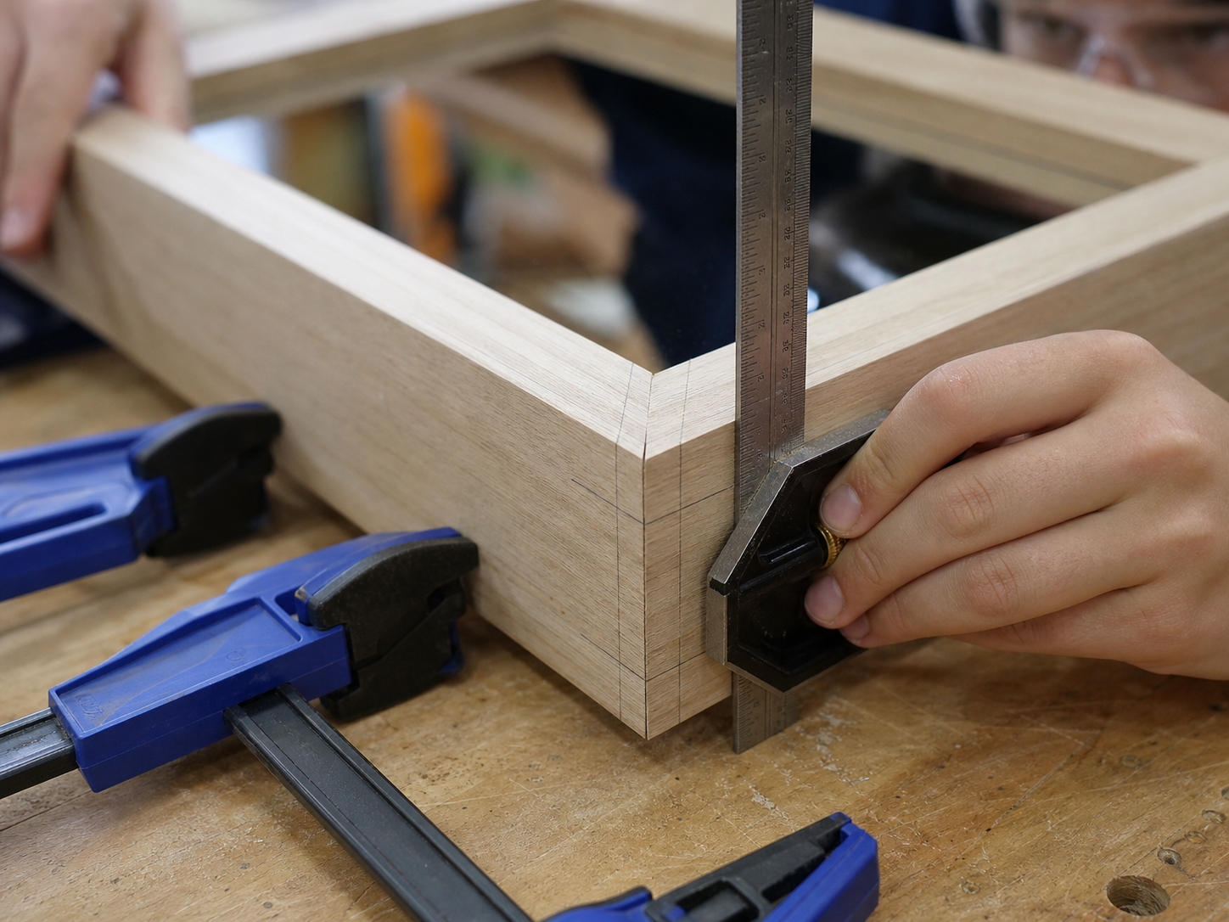
MIRROR
module–03 · 1/8
Datum edges, square lines, cutting allowances and checking before cutting.
module–03 guided learning
Read the theory. Check your understanding. Save useful evidence.
Notes:
Introduce the module purpose and connect it to the current project stage.
[Sources]
- Authorised local course theory: mirror_theory_marking.html

Slide 2
MIRROR
module–03 · 2/8
What you will learn
Use the module in order. Each idea supports the checks and written evidence that follow.
1
Accurate Marking Routine
2
Workshop Rule
3
Use the right marking tool
Notes:
Preview the learning sequence without giving check answers.
[Sources]
- Authorised local course theory: mirror_theory_marking.html

Slide 3
MIRROR
module–03 · 3/8
Accurate Marking Routine
Main idea
Accurate marking is where quality starts.
Check 2
A clean cut cannot fix a careless mark.
Check 3
Measure from a consistent edge and check before cutting.
Return to the module page for the full explanation, visual and section video.
Notes:
Teach the source-grounded theory for Accurate Marking Routine.
[Sources]
- Authorised local course theory: mirror_theory_marking.html

Slide 4
MIRROR
module–03 · 4/8
Workshop Rule
Main idea
Use a datum edge, try square and sharp pencil or marking knife.
Check 2
Mark waste sides clearly so you cut on the correct side of the line.
Check 3
The mirror frame depends on matching lengths and square corners.
Return to the module page for the full explanation, visual and section video.
Notes:
Teach the source-grounded theory for Workshop Rule.
[Sources]
- Authorised local course theory: mirror_theory_marking.html

Slide 5
MIRROR
module–03 · 5/8
Use the right marking tool
Main idea
If the measurement is important, check it twice.
Check 2
If the timber is expensive, check it three times and breathe like a normal human before cutting.
Check 3
Use a steel rule for accurate short measurements, a tape for longer stock, and a try square or combination square for lines at 90 degrees to the datum edge.
Return to the module page for the full explanation, visual and section video.
Notes:
Teach the source-grounded theory for Use the right marking tool.
[Sources]
- Authorised local course theory: mirror_theory_marking.html

Slide 6
MIRROR
module–03 · 6/8
Pause and check your understanding
What is the controlling idea?
Accurate Marking Routine
Which check would prevent a mistake?
Workshop Rule
What evidence would show your decision?
Use the right marking tool
Notes:
Use these prompts for retrieval before students open the interactive checks.
[Sources]
- Authorised local course theory: mirror_theory_marking.html

Slide 7
MIRROR
module–03 · 7/8
Build a stronger written response
Read
Underline the command word and the project detail.
Select
Return to the exact theory section and choose relevant evidence.
Explain
Connect the decision, reason and likely result.
Check
Make sure the response answers the question and stays source-accurate.
Notes:
Model the response process without supplying an answer to a live student question.
[Sources]
- Authorised local course theory: mirror_theory_marking.html

Slide 8
MIRROR
module–03 · 8/8
Exit ticket
Before you finish this module, answer these in your own words:
1. One idea I can now explain: Accurate Marking Routine
2. One practical check I must remember before the next stage
3. One piece of evidence I should save or improve
Return to the module page to complete the checks, written response and folio evidence.
Notes:
Students complete the exit ticket, then return to the website to save evidence.
[Sources]
- Authorised local course theory: mirror_theory_marking.html

