Slide 1
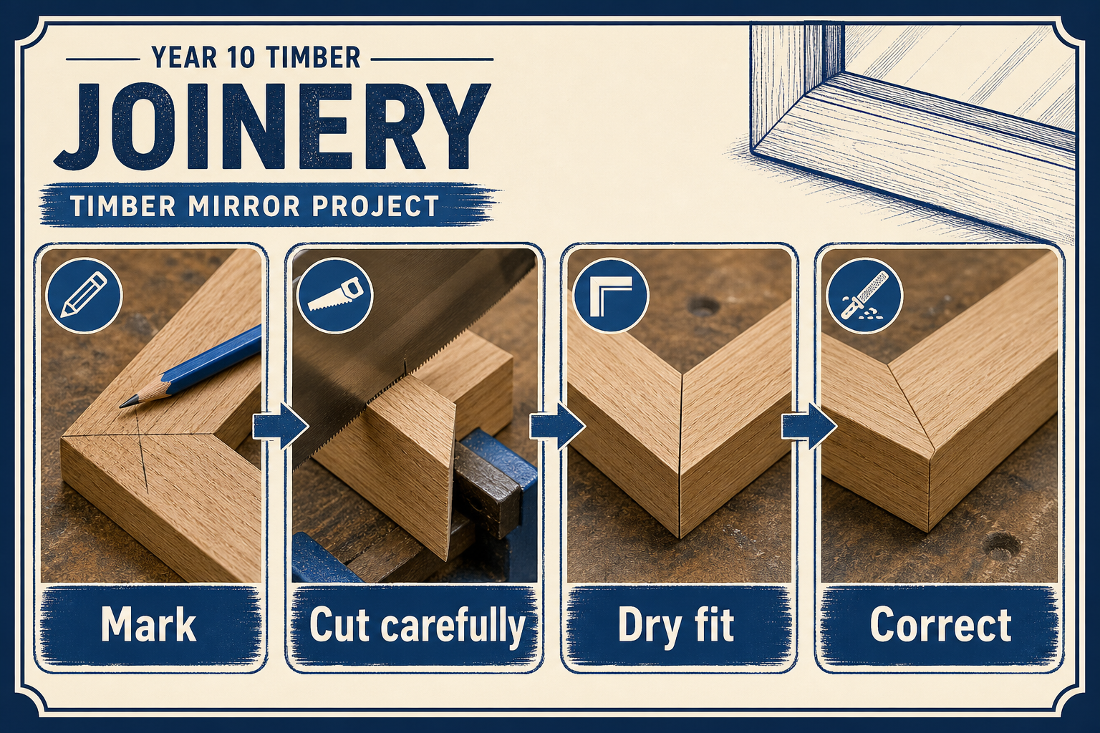
MIRROR
module–04 · 1/8
How timber parts become a strong, square mirror frame.
module–04 guided learning
Read the theory. Check your understanding. Save useful evidence.
Notes:
Introduce the module purpose and connect it to the current project stage.
[Sources]
- Authorised local course theory: mirror_theory_joinery.html

Slide 2
MIRROR
module–04 · 2/8
What you will learn
Use the module in order. Each idea supports the checks and written evidence that follow.
1
Dowel Joint
2
Biscuit Joint
3
Mortise and Tenon
Notes:
Preview the learning sequence without giving check answers.
[Sources]
- Authorised local course theory: mirror_theory_joinery.html

Slide 3
MIRROR
module–04 · 3/8
Dowel Joint
Main idea
How timber parts become a strong, square mirror frame.
Check 2
Joinery is how separate timber pieces become a strong frame.
Check 3
If joints are inaccurate, the mirror may twist, show gaps or fail when handled.
Return to the module page for the full explanation, visual and section video.
Notes:
Teach the source-grounded theory for Dowel Joint.
[Sources]
- Authorised local course theory: mirror_theory_joinery.html

Slide 4
MIRROR
module–04 · 4/8
Biscuit Joint
Main idea
If joints are inaccurate, the mirror may twist, show gaps or fail when handled.
Check 2
Dowels are useful when holes are drilled accurately.
Check 3
Poor alignment causes gaps or twisted frames.
Return to the module page for the full explanation, visual and section video.
Notes:
Teach the source-grounded theory for Biscuit Joint.
[Sources]
- Authorised local course theory: mirror_theory_joinery.html

Slide 5
MIRROR
module–04 · 5/8
Mortise and Tenon
Main idea
Biscuit joints are quicker but not usually as strong as a well-made mortise and tenon.
Check 2
A tenon fits into a matching mortise to create a strong frame joint.
Check 3
The shoulders should close neatly, the tenon should fit firmly, and the joint must be tested before glue.
Return to the module page for the full explanation, visual and section video.
Notes:
Teach the source-grounded theory for Mortise and Tenon.
[Sources]
- Authorised local course theory: mirror_theory_joinery.html

Slide 6
MIRROR
module–04 · 6/8
Pause and check your understanding
What is the controlling idea?
Dowel Joint
Which check would prevent a mistake?
Biscuit Joint
What evidence would show your decision?
Mortise and Tenon
Notes:
Use these prompts for retrieval before students open the interactive checks.
[Sources]
- Authorised local course theory: mirror_theory_joinery.html

Slide 7
MIRROR
module–04 · 7/8
Build a stronger written response
Read
Underline the command word and the project detail.
Select
Return to the exact theory section and choose relevant evidence.
Explain
Connect the decision, reason and likely result.
Check
Make sure the response answers the question and stays source-accurate.
Notes:
Model the response process without supplying an answer to a live student question.
[Sources]
- Authorised local course theory: mirror_theory_joinery.html

Slide 8
MIRROR
module–04 · 8/8
Exit ticket
Before you finish this module, answer these in your own words:
1. One idea I can now explain: Dowel Joint
2. One practical check I must remember before the next stage
3. One piece of evidence I should save or improve
Return to the module page to complete the checks, written response and folio evidence.
Notes:
Students complete the exit ticket, then return to the website to save evidence.
[Sources]
- Authorised local course theory: mirror_theory_joinery.html

