Slide 1
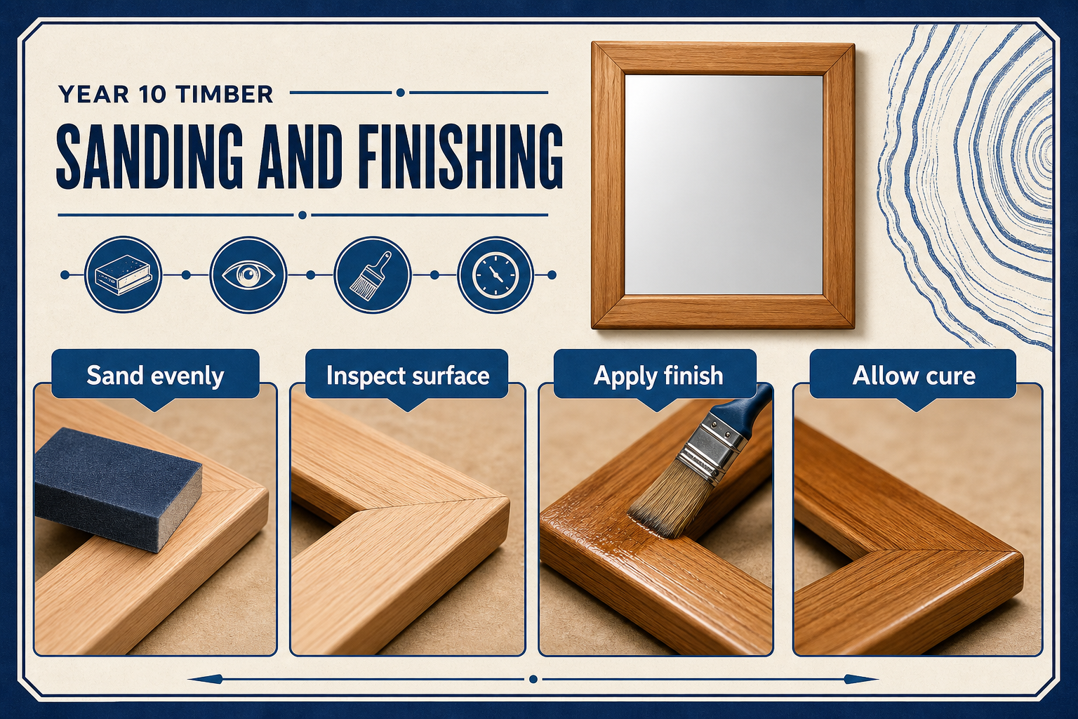
MIRROR
module–06 · 1/8
Surface preparation, finish choice, safe application and cleanup.
module–06 guided learning
Read the theory. Check your understanding. Save useful evidence.
Notes:
Introduce the module purpose and connect it to the current project stage.
[Sources]
- Authorised local course theory: mirror_theory_finishing.html

Slide 2
MIRROR
module–06 · 2/8
What you will learn
Use the module in order. Each idea supports the checks and written evidence that follow.
1
Finishing Routine
2
Chemical Safety
3
Finish Types
Notes:
Preview the learning sequence without giving check answers.
[Sources]
- Authorised local course theory: mirror_theory_finishing.html

Slide 3
MIRROR
module–06 · 3/8
Finishing Routine
Main idea
Surface preparation, finish choice, safe application and cleanup.
Check 2
Finishing protects the timber and improves the appearance.
Check 3
It only works well if the surface is prepared properly.
Return to the module page for the full explanation, visual and section video.
Notes:
Teach the source-grounded theory for Finishing Routine.
[Sources]
- Authorised local course theory: mirror_theory_finishing.html

Slide 4
MIRROR
module–06 · 4/8
Chemical Safety
Main idea
Sanding removes machining marks and prepares the surface.
Check 2
Work through the grit sequence rather than jumping straight to fine paper.
Check 3
Dust must be removed before applying finish.
Return to the module page for the full explanation, visual and section video.
Notes:
Teach the source-grounded theory for Chemical Safety.
[Sources]
- Authorised local course theory: mirror_theory_finishing.html

Slide 5
MIRROR
module–06 · 5/8
Finish Types
Main idea
Wood finishes can be flammable or harmful if used badly.
Check 2
Read the label, use ventilation, wear required PPE, and follow MSDS instructions for storage, spills and disposal.
Check 3
It will not hide poor preparation; it usually highlights it.
Return to the module page for the full explanation, visual and section video.
Notes:
Teach the source-grounded theory for Finish Types.
[Sources]
- Authorised local course theory: mirror_theory_finishing.html

Slide 6
MIRROR
module–06 · 6/8
Pause and check your understanding
What is the controlling idea?
Finishing Routine
Which check would prevent a mistake?
Chemical Safety
What evidence would show your decision?
Finish Types
Notes:
Use these prompts for retrieval before students open the interactive checks.
[Sources]
- Authorised local course theory: mirror_theory_finishing.html

Slide 7
MIRROR
module–06 · 7/8
Build a stronger written response
Read
Underline the command word and the project detail.
Select
Return to the exact theory section and choose relevant evidence.
Explain
Connect the decision, reason and likely result.
Check
Make sure the response answers the question and stays source-accurate.
Notes:
Model the response process without supplying an answer to a live student question.
[Sources]
- Authorised local course theory: mirror_theory_finishing.html

Slide 8
MIRROR
module–06 · 8/8
Exit ticket
Before you finish this module, answer these in your own words:
1. One idea I can now explain: Finishing Routine
2. One practical check I must remember before the next stage
3. One piece of evidence I should save or improve
Return to the module page to complete the checks, written response and folio evidence.
Notes:
Students complete the exit ticket, then return to the website to save evidence.
[Sources]
- Authorised local course theory: mirror_theory_finishing.html

