Slide 1
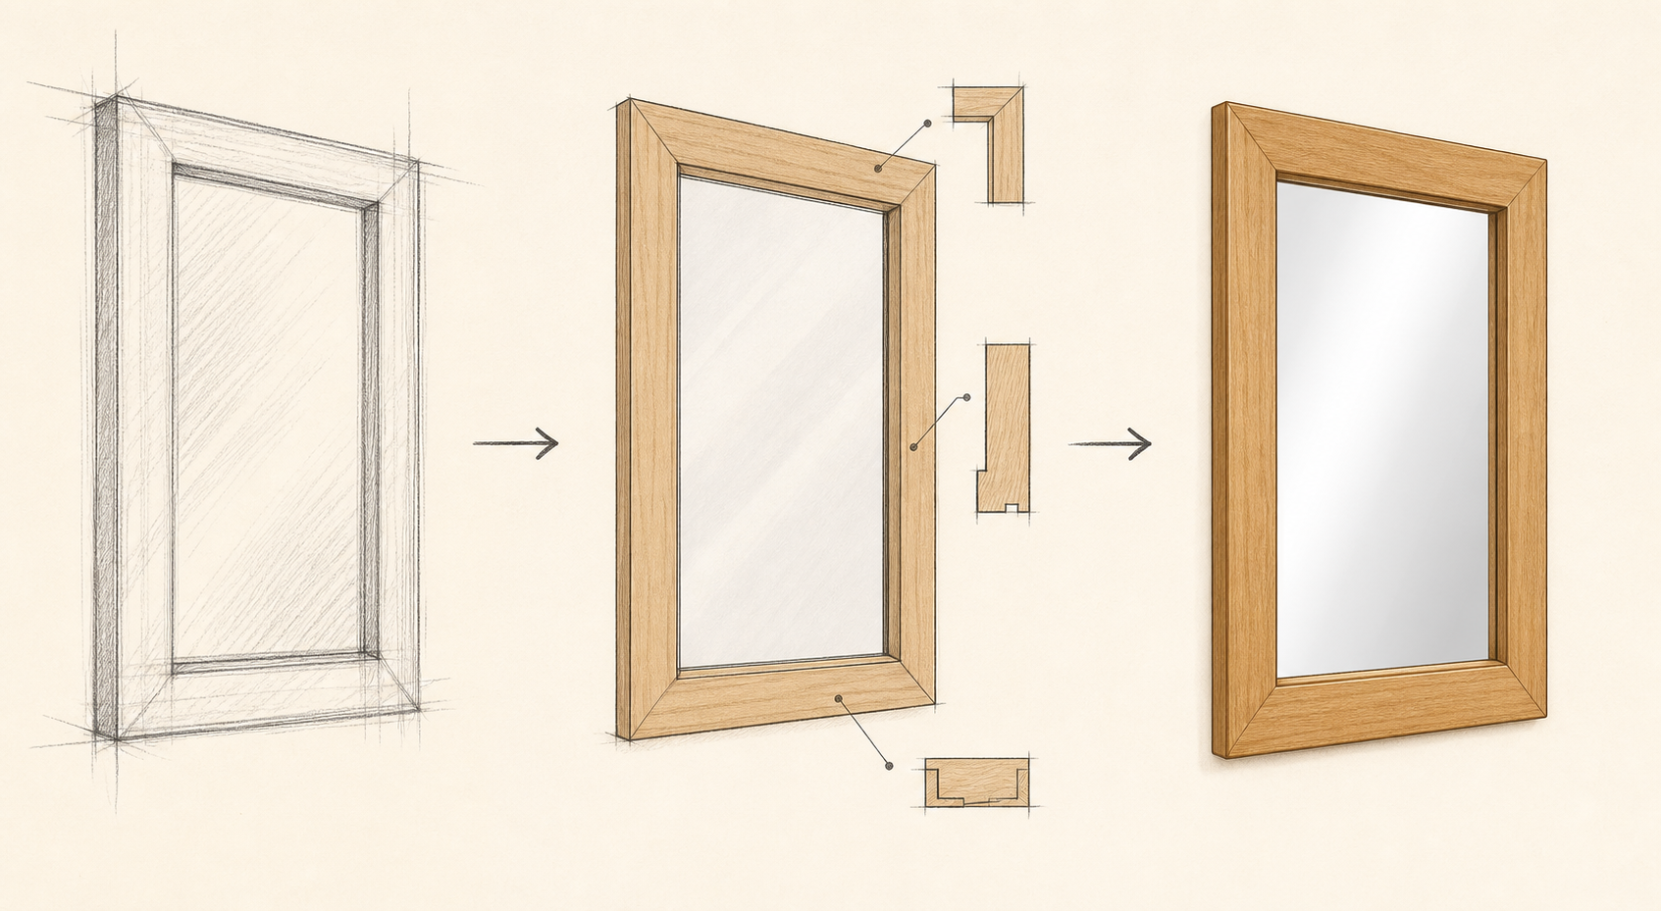
MIRROR
module–07 · 1/8
Briefs, constraints, sketches, user needs and project decisions.
module–07 guided learning
Read the theory. Check your understanding. Save useful evidence.
Notes:
Introduce the module purpose and connect it to the current project stage.
[Sources]
- Authorised local course theory: mirror_theory_design.html

Slide 2
MIRROR
module–07 · 2/8
What you will learn
Use the module in order. Each idea supports the checks and written evidence that follow.
1
Design Evidence
2
From Brief To Final Design
3
Show how your idea improves
Notes:
Preview the learning sequence without giving check answers.
[Sources]
- Authorised local course theory: mirror_theory_design.html

Slide 3
MIRROR
module–07 · 3/8
Design Evidence
Main idea
Briefs, constraints, sketches, user needs and project decisions.
Check 2
A design is more than a nice sketch.
Check 3
It explains what the project is for, who it is for and how it will be made.
Return to the module page for the full explanation, visual and section video.
Notes:
Teach the source-grounded theory for Design Evidence.
[Sources]
- Authorised local course theory: mirror_theory_design.html

Slide 4
MIRROR
module–07 · 4/8
From Brief To Final Design
Main idea
Design choices should be explained, not just decorated.
Check 2
A strong mirror design considers size, timber choice, edge profile, joint method, finish, hanging method, available tools and the target user.
Check 3
The portfolio needs to show thinking, not just a finished object.
Return to the module page for the full explanation, visual and section video.
Notes:
Teach the source-grounded theory for From Brief To Final Design.
[Sources]
- Authorised local course theory: mirror_theory_design.html

Slide 5
MIRROR
module–07 · 5/8
Show how your idea improves
Main idea
The portfolio needs to show thinking, not just a finished object.
Check 2
Good design notes explain why choices were made and how problems changed the plan.
Check 3
The design process starts with a brief, then moves through sketches, material choices, construction decisions and changes made during production.
Return to the module page for the full explanation, visual and section video.
Notes:
Teach the source-grounded theory for Show how your idea improves.
[Sources]
- Authorised local course theory: mirror_theory_design.html

Slide 6
MIRROR
module–07 · 6/8
Pause and check your understanding
What is the controlling idea?
Design Evidence
Which check would prevent a mistake?
From Brief To Final Design
What evidence would show your decision?
Show how your idea improves
Notes:
Use these prompts for retrieval before students open the interactive checks.
[Sources]
- Authorised local course theory: mirror_theory_design.html

Slide 7
MIRROR
module–07 · 7/8
Build a stronger written response
Read
Underline the command word and the project detail.
Select
Return to the exact theory section and choose relevant evidence.
Explain
Connect the decision, reason and likely result.
Check
Make sure the response answers the question and stays source-accurate.
Notes:
Model the response process without supplying an answer to a live student question.
[Sources]
- Authorised local course theory: mirror_theory_design.html

Slide 8
MIRROR
module–07 · 8/8
Exit ticket
Before you finish this module, answer these in your own words:
1. One idea I can now explain: Design Evidence
2. One practical check I must remember before the next stage
3. One piece of evidence I should save or improve
Return to the module page to complete the checks, written response and folio evidence.
Notes:
Students complete the exit ticket, then return to the website to save evidence.
[Sources]
- Authorised local course theory: mirror_theory_design.html

