Slide 1
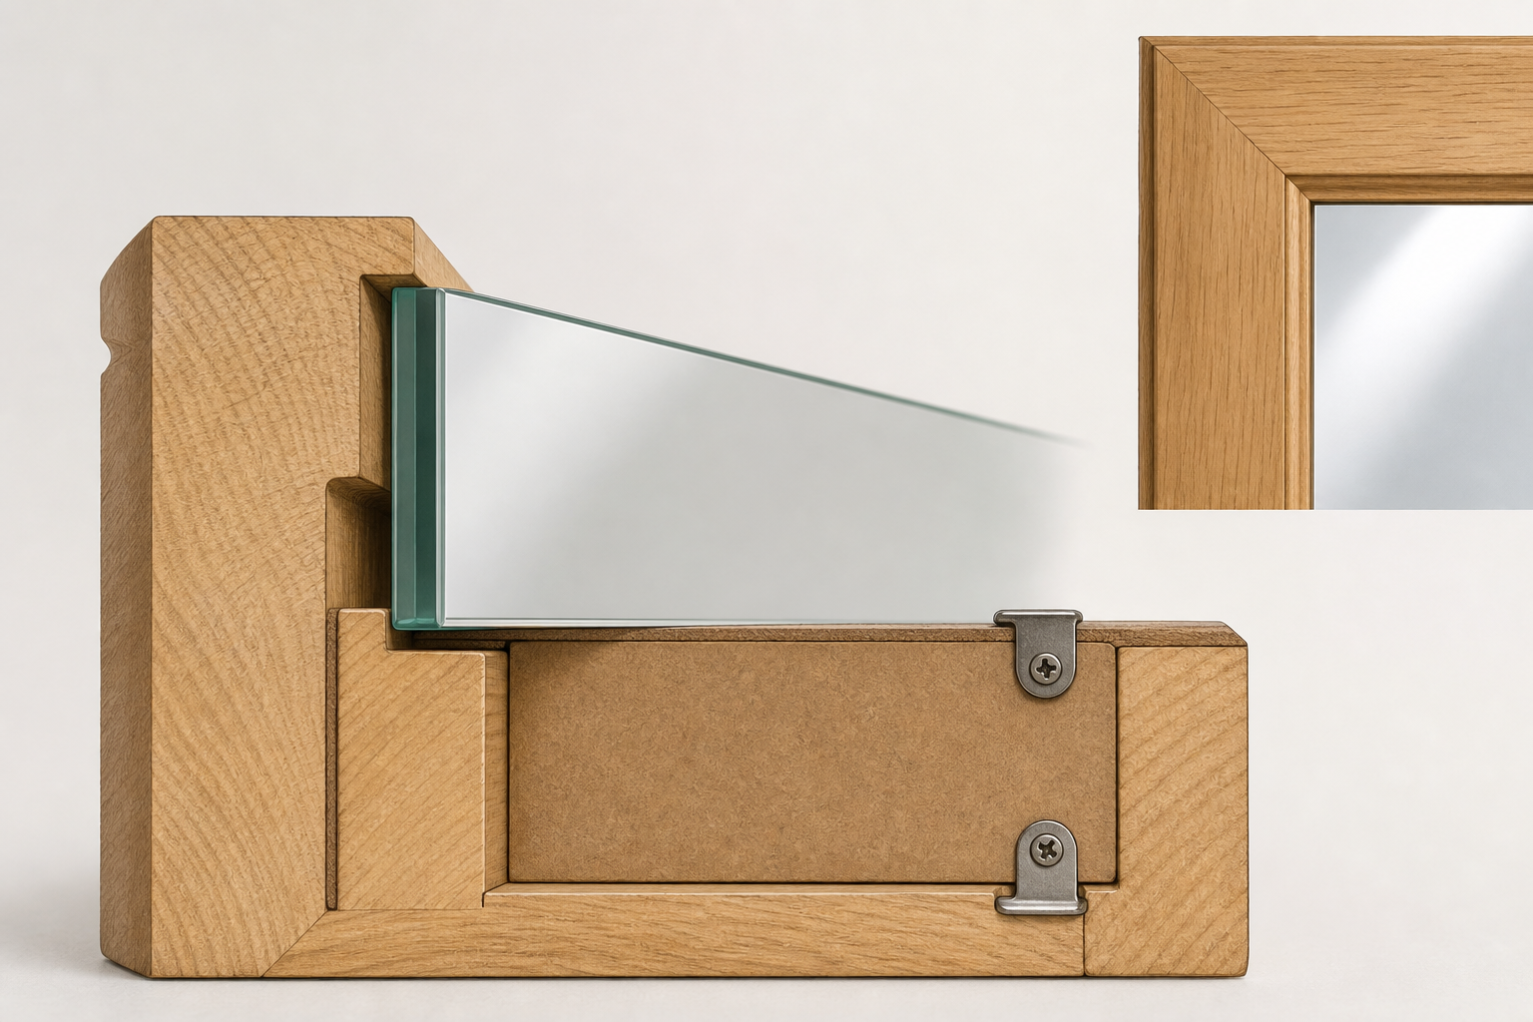
MIRROR
module–08 · 1/8
Safe fitting, rebates, backing, hanging and final checks.
module–08 guided learning
Read the theory. Check your understanding. Save useful evidence.
Notes:
Introduce the module purpose and connect it to the current project stage.
[Sources]
- Authorised local course theory: mirror_theory_fitting.html

Slide 2
MIRROR
module–08 · 2/8
What you will learn
Use the module in order. Each idea supports the checks and written evidence that follow.
1
Safe Fitting Points
2
Fitting Sequence
3
Prepare the fitting area first
Notes:
Preview the learning sequence without giving check answers.
[Sources]
- Authorised local course theory: mirror_theory_fitting.html

Slide 3
MIRROR
module–08 · 3/8
Safe Fitting Points
Main idea
Safe fitting, rebates, backing, hanging and final checks.
Check 2
The mirror needs to be fitted safely and held securely without damaging the frame or glass.
Check 3
Glass and mirror fitting require support, protection and supervision.
Return to the module page for the full explanation, visual and section video.
Notes:
Teach the source-grounded theory for Safe Fitting Points.
[Sources]
- Authorised local course theory: mirror_theory_fitting.html

Slide 4
MIRROR
module–08 · 4/8
Fitting Sequence
Main idea
Glass and mirror fitting require support, protection and supervision.
Check 2
The frame may use a rebate to support the mirror.
Check 3
A backing board, clips, points or beading can hold the mirror in place depending on the design and teacher instructions.
Return to the module page for the full explanation, visual and section video.
Notes:
Teach the source-grounded theory for Fitting Sequence.
[Sources]
- Authorised local course theory: mirror_theory_fitting.html

Slide 5
MIRROR
module–08 · 5/8
Prepare the fitting area first
Main idea
The mirror must be held securely without pressure points that could chip the glass or loosen over time.
Check 2
Mirror fitting happens after the frame has been assembled, finished and checked.
Check 3
The frame should not be forced around the mirror.
Return to the module page for the full explanation, visual and section video.
Notes:
Teach the source-grounded theory for Prepare the fitting area first.
[Sources]
- Authorised local course theory: mirror_theory_fitting.html

Slide 6
MIRROR
module–08 · 6/8
Pause and check your understanding
What is the controlling idea?
Safe Fitting Points
Which check would prevent a mistake?
Fitting Sequence
What evidence would show your decision?
Prepare the fitting area first
Notes:
Use these prompts for retrieval before students open the interactive checks.
[Sources]
- Authorised local course theory: mirror_theory_fitting.html

Slide 7
MIRROR
module–08 · 7/8
Build a stronger written response
Read
Underline the command word and the project detail.
Select
Return to the exact theory section and choose relevant evidence.
Explain
Connect the decision, reason and likely result.
Check
Make sure the response answers the question and stays source-accurate.
Notes:
Model the response process without supplying an answer to a live student question.
[Sources]
- Authorised local course theory: mirror_theory_fitting.html

Slide 8
MIRROR
module–08 · 8/8
Exit ticket
Before you finish this module, answer these in your own words:
1. One idea I can now explain: Safe Fitting Points
2. One practical check I must remember before the next stage
3. One piece of evidence I should save or improve
Return to the module page to complete the checks, written response and folio evidence.
Notes:
Students complete the exit ticket, then return to the website to save evidence.
[Sources]
- Authorised local course theory: mirror_theory_fitting.html

