Slide 1
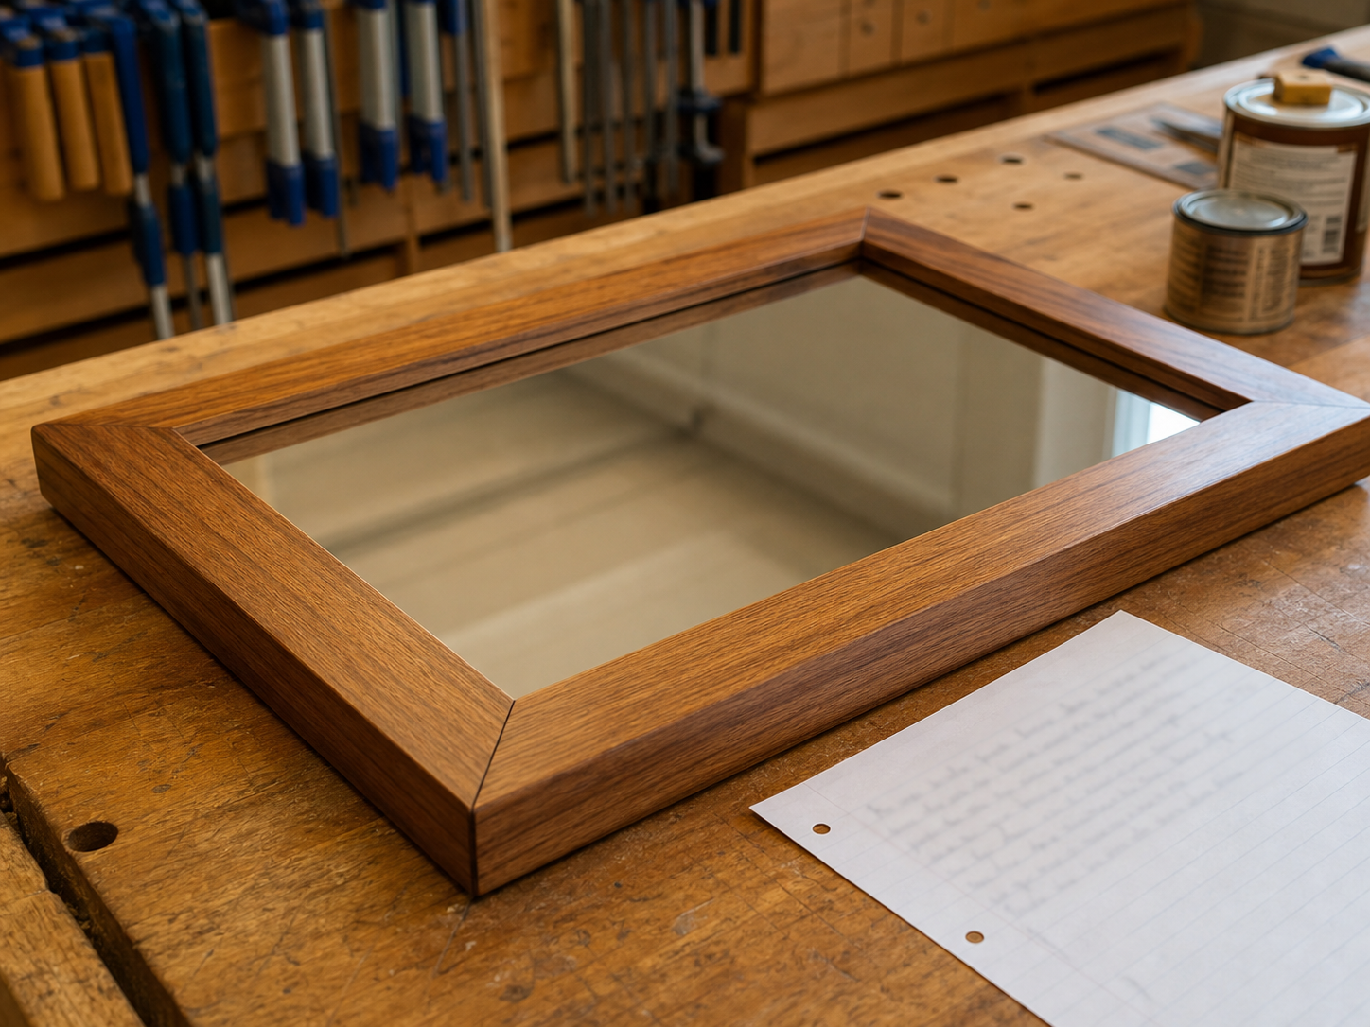
MIRROR
module–09 · 1/8
Judge strengths, weaknesses and improvements using evidence.
module–09 guided learning
Read the theory. Check your understanding. Save useful evidence.
Notes:
Introduce the module purpose and connect it to the current project stage.
[Sources]
- Authorised local course theory: mirror_theory_evaluation.html

Slide 2
MIRROR
module–09 · 2/8
What you will learn
Use the module in order. Each idea supports the checks and written evidence that follow.
1
Evaluation Prompts
2
Strong Portfolio Thinking
3
Evaluate What Can Be Seen
Notes:
Preview the learning sequence without giving check answers.
[Sources]
- Authorised local course theory: mirror_theory_evaluation.html

Slide 3
MIRROR
module–09 · 3/8
Evaluation Prompts
Main idea
Judge strengths, weaknesses and improvements using evidence.
Check 2
It means judging the finished project honestly and using evidence.
Check 3
Good evaluation names strengths, weaknesses and improvements.
Return to the module page for the full explanation, visual and section video.
Notes:
Teach the source-grounded theory for Evaluation Prompts.
[Sources]
- Authorised local course theory: mirror_theory_evaluation.html

Slide 4
MIRROR
module–09 · 4/8
Strong Portfolio Thinking
Main idea
Good evaluation names strengths, weaknesses and improvements.
Check 2
A useful evaluation does not just say the project is good.
Check 3
It explains how well the mirror meets the design brief, how accurate the construction is, what problems were solved and what would be improved next time.
Return to the module page for the full explanation, visual and section video.
Notes:
Teach the source-grounded theory for Strong Portfolio Thinking.
[Sources]
- Authorised local course theory: mirror_theory_evaluation.html

Slide 5
MIRROR
module–09 · 5/8
Evaluate What Can Be Seen
Main idea
Evaluation turns the project into evidence of learning.
Check 2
It shows what you noticed, fixed and would improve next time.
Check 3
Use photos and short captions as evidence.
Return to the module page for the full explanation, visual and section video.
Notes:
Teach the source-grounded theory for Evaluate What Can Be Seen.
[Sources]
- Authorised local course theory: mirror_theory_evaluation.html

Slide 6
MIRROR
module–09 · 6/8
Pause and check your understanding
What is the controlling idea?
Evaluation Prompts
Which check would prevent a mistake?
Strong Portfolio Thinking
What evidence would show your decision?
Evaluate What Can Be Seen
Notes:
Use these prompts for retrieval before students open the interactive checks.
[Sources]
- Authorised local course theory: mirror_theory_evaluation.html

Slide 7
MIRROR
module–09 · 7/8
Build a stronger written response
Read
Underline the command word and the project detail.
Select
Return to the exact theory section and choose relevant evidence.
Explain
Connect the decision, reason and likely result.
Check
Make sure the response answers the question and stays source-accurate.
Notes:
Model the response process without supplying an answer to a live student question.
[Sources]
- Authorised local course theory: mirror_theory_evaluation.html

Slide 8
MIRROR
module–09 · 8/8
Exit ticket
Before you finish this module, answer these in your own words:
1. One idea I can now explain: Evaluation Prompts
2. One practical check I must remember before the next stage
3. One piece of evidence I should save or improve
Return to the module page to complete the checks, written response and folio evidence.
Notes:
Students complete the exit ticket, then return to the website to save evidence.
[Sources]
- Authorised local course theory: mirror_theory_evaluation.html

