Slide 1

Today’s Modern Art: The Emergence of Technology and Art at Boise State
Dr. Steve Cutchin
Associate Professor
Department of Computer Science
Boise State University

Slide 2
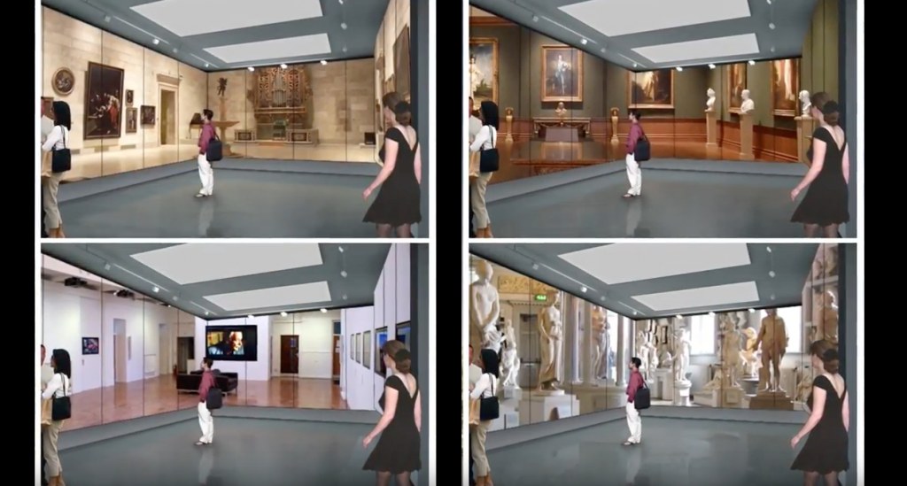
Original Concept
Notes:
Bring the opportunity for the general community, especially children, to see places that it would be very difficult for them to see in person.
Wanted them to have an exposure to a world of quality art beyond their neighborhood.

Slide 3
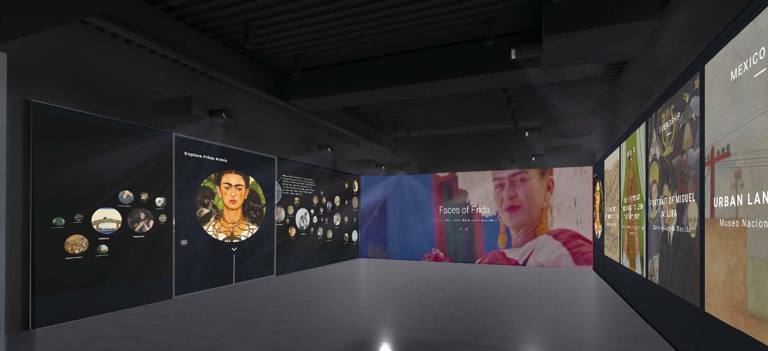
Expected Installation
Notes:
Current installation: an active touch screen environment that supports many sized groups to explore, interact, and share a variety of quality art experiences from theater and music to the visual arts.

Slide 4
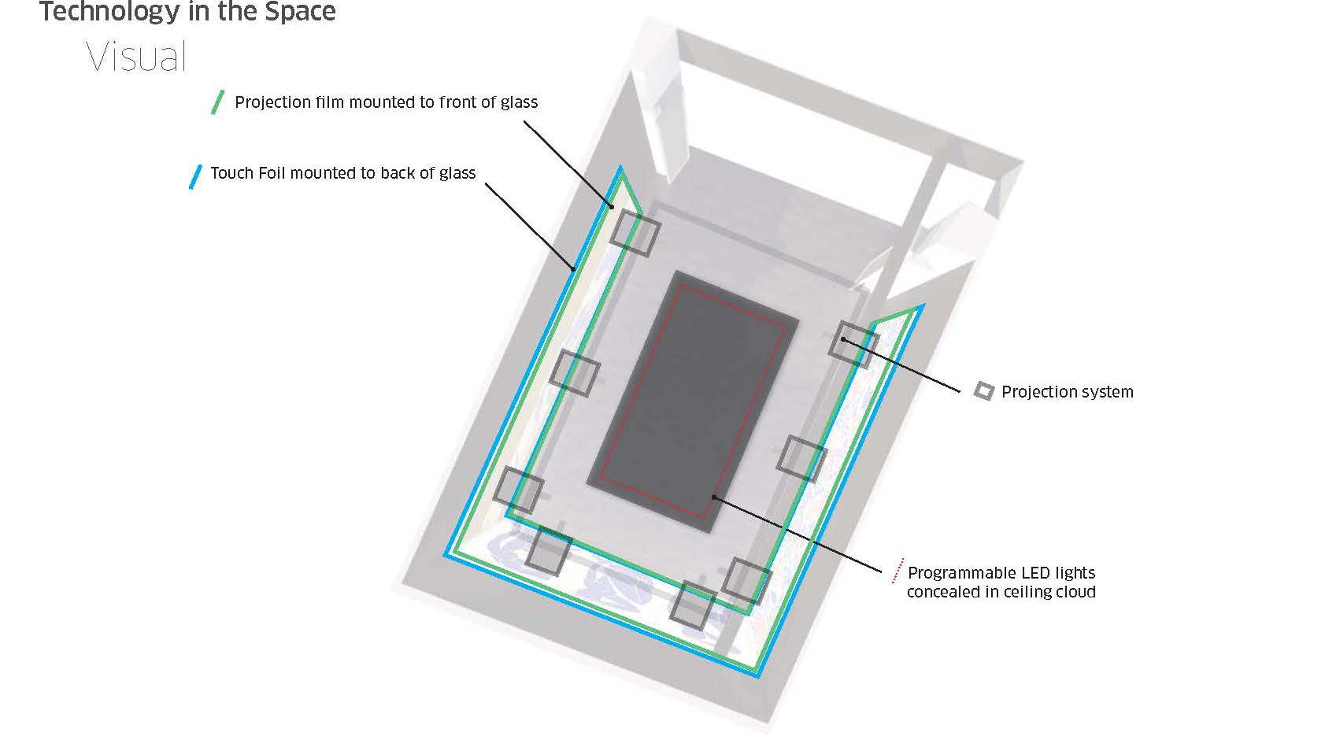

Slide 5
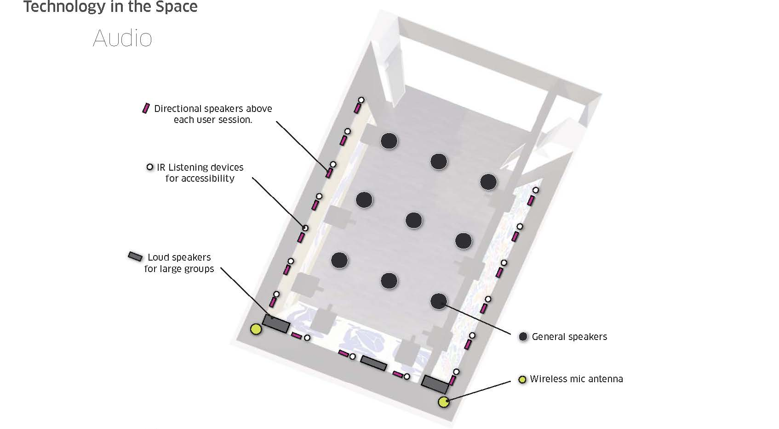

Slide 6
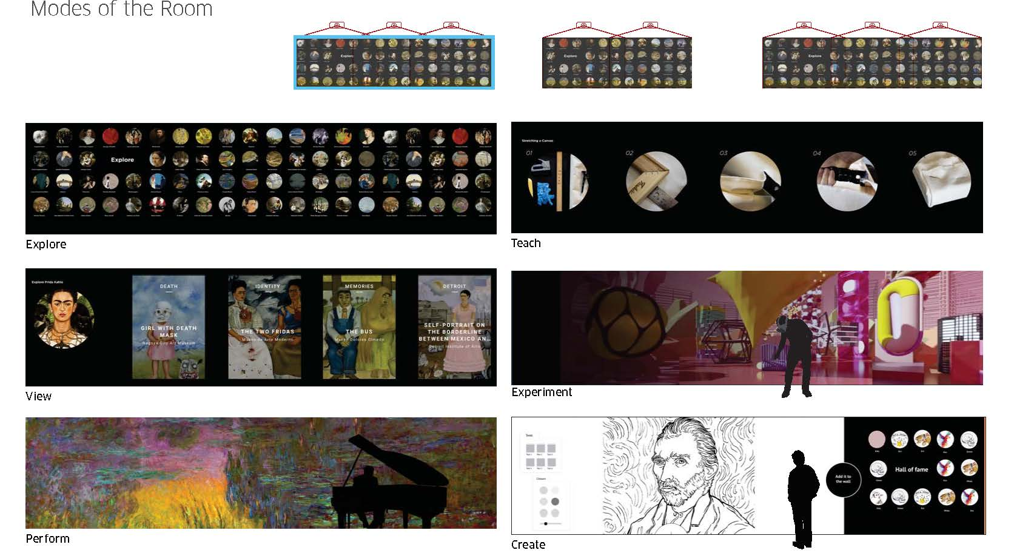
Notes:
Review and critique works
Collect and create a history of students works -> all kinds.
Performances, Interactive experiments, single user, multi-user, groups.
Review
Collaborative performances across the network between remote locations potentially.

Slide 7
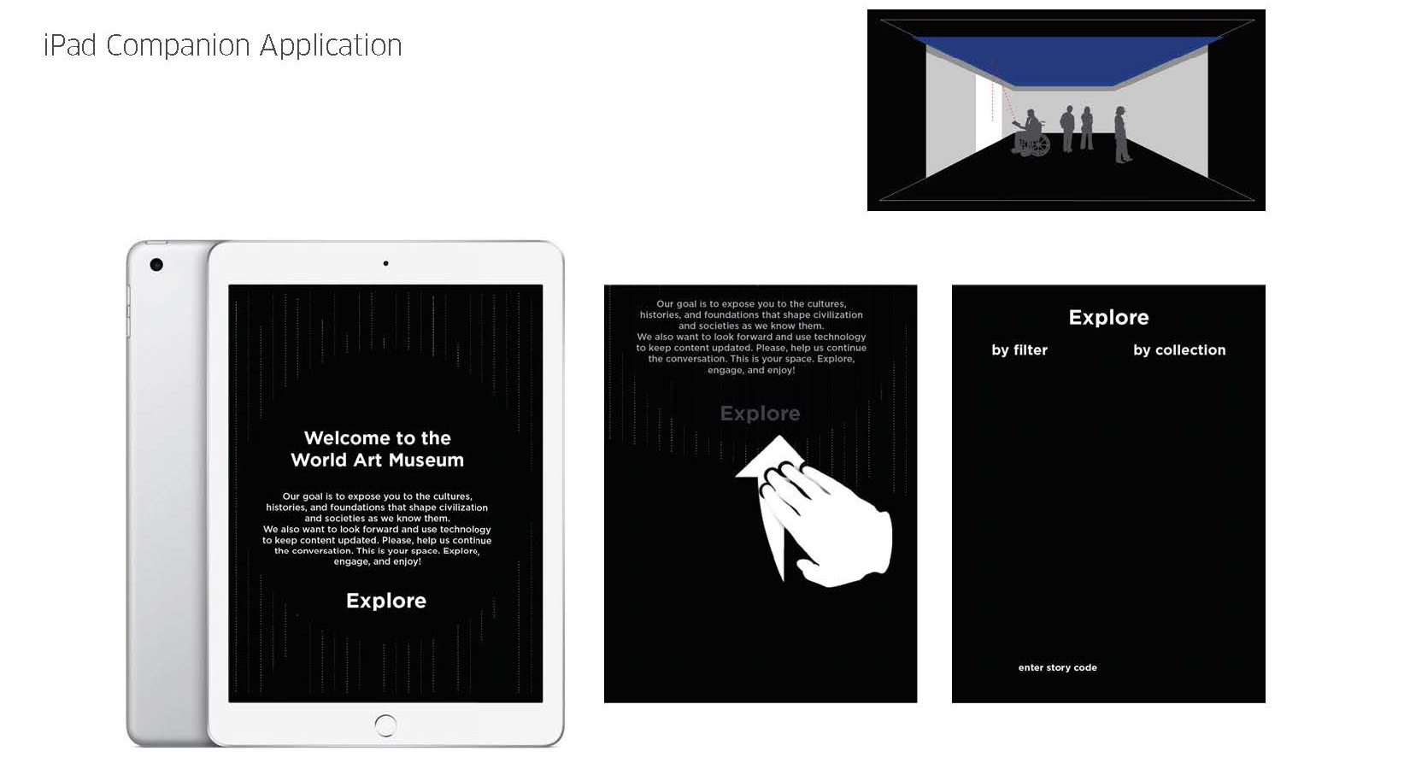

Slide 8
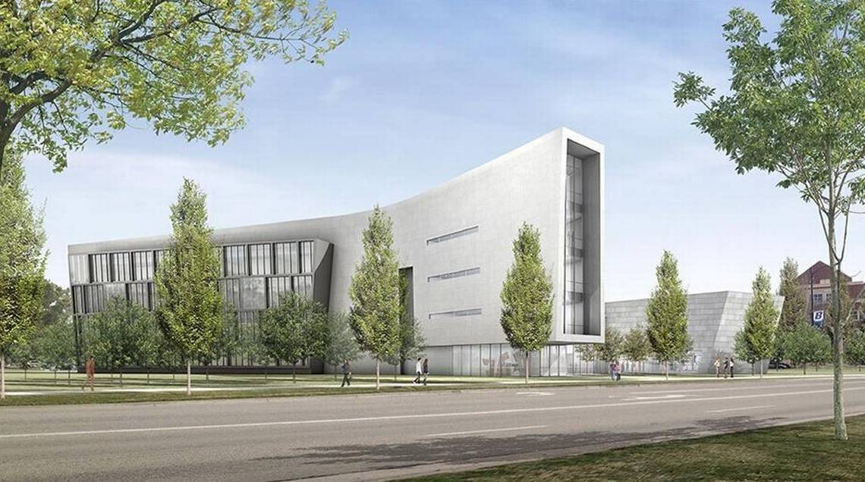
School Of Arts

Slide 9
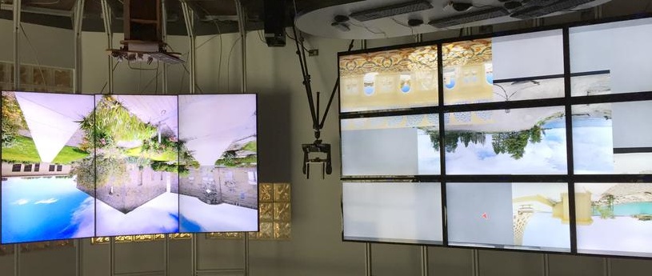
Department of Computer Science

Slide 10
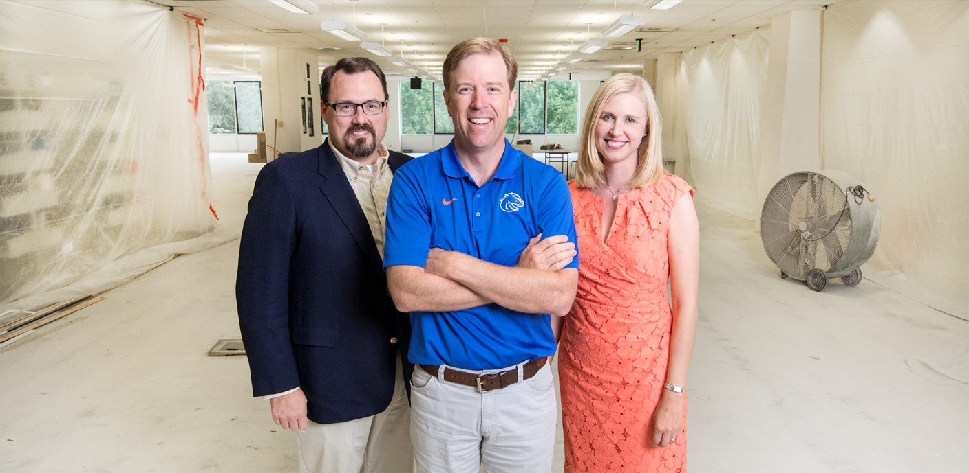
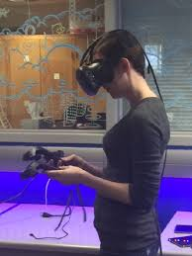
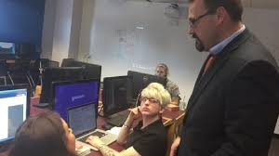
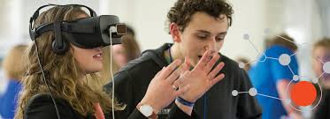
Games Internet Mobile Media

Slide 11
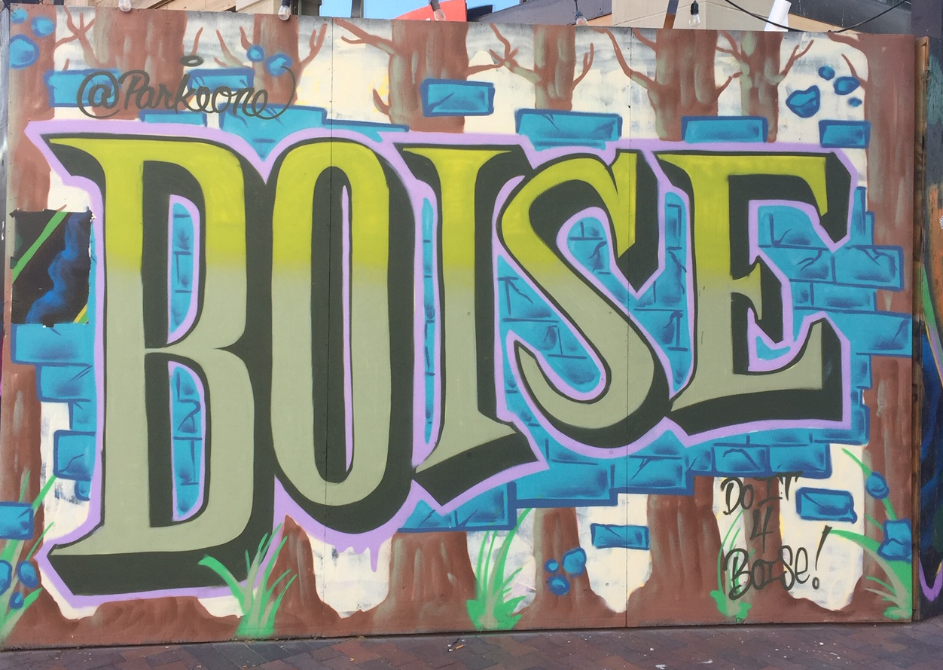
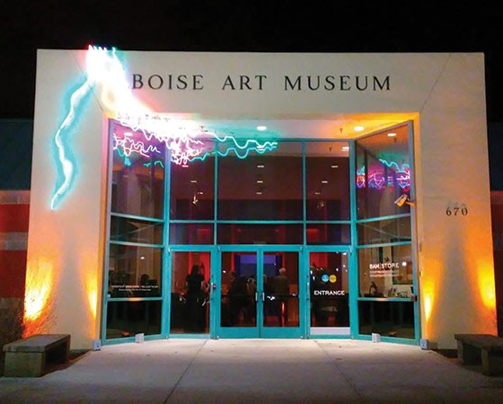

Community Partners

Slide 12
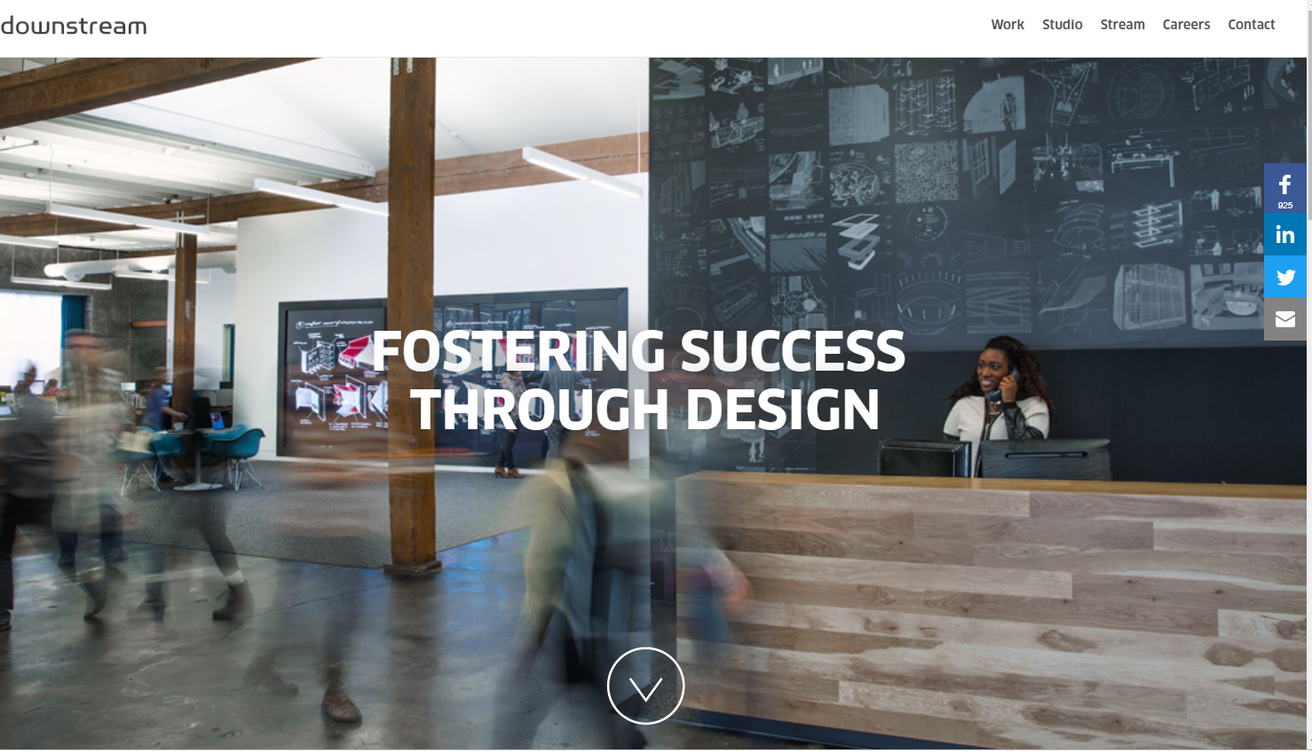

Slide 13
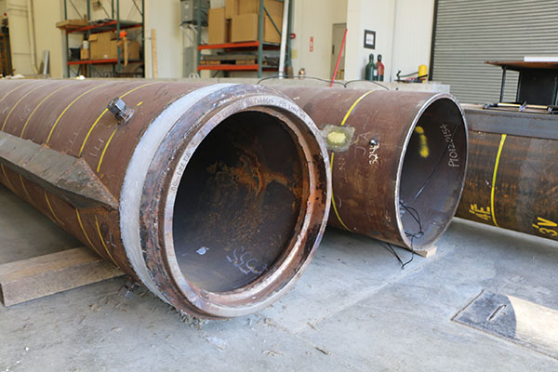
Open Pipe

Slide 14
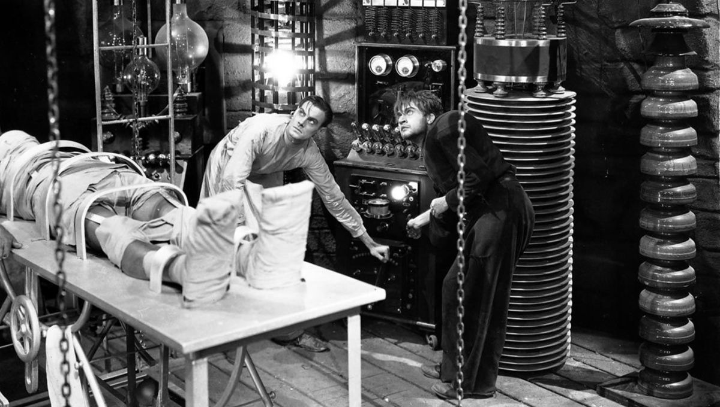

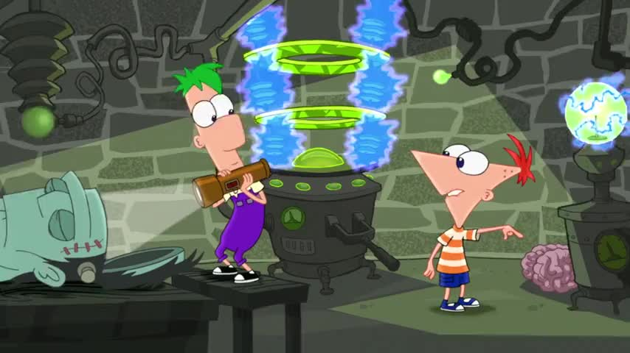
Our Laboratory and Staff working on OpenPipe

Slide 15
OpenPipe: A Federated Production Pipeline
OpenPipe is an open source content management and production solution that supports the delivery of high-resolution content to remote endpoints on-demand. The OpenPipe solution supports both content management and content production using Amazon Web Services and enables distributed human in-the loop content production across multiple locations and sites with integrated time and cost tracking built into the open source solution.
OpenPipe is in development.

Slide 16
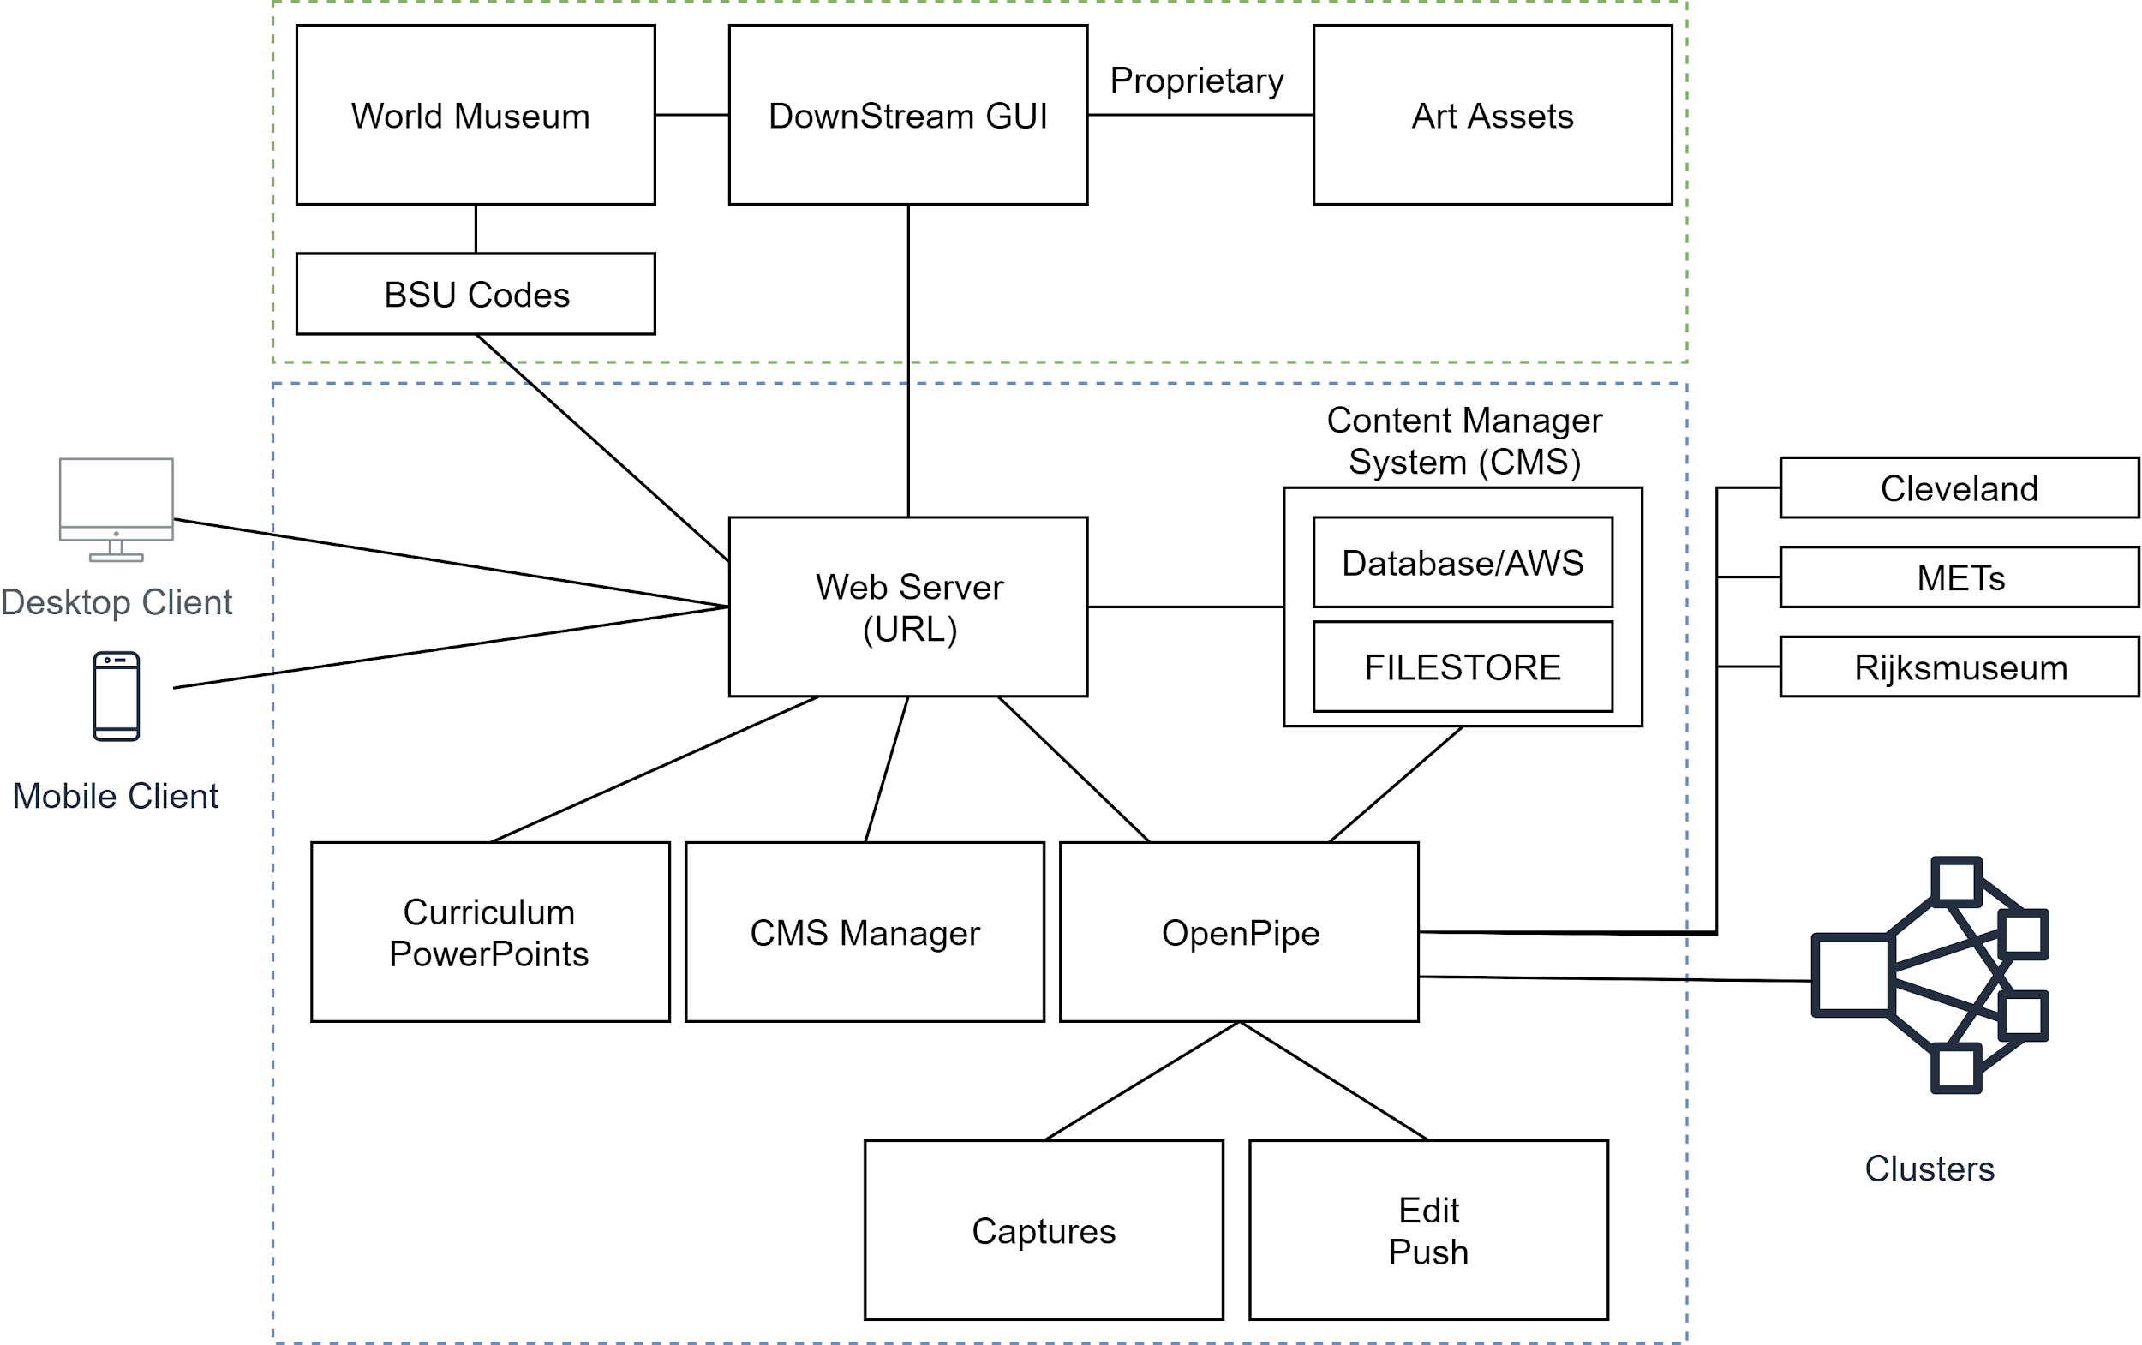
Architecture Overview

Slide 17
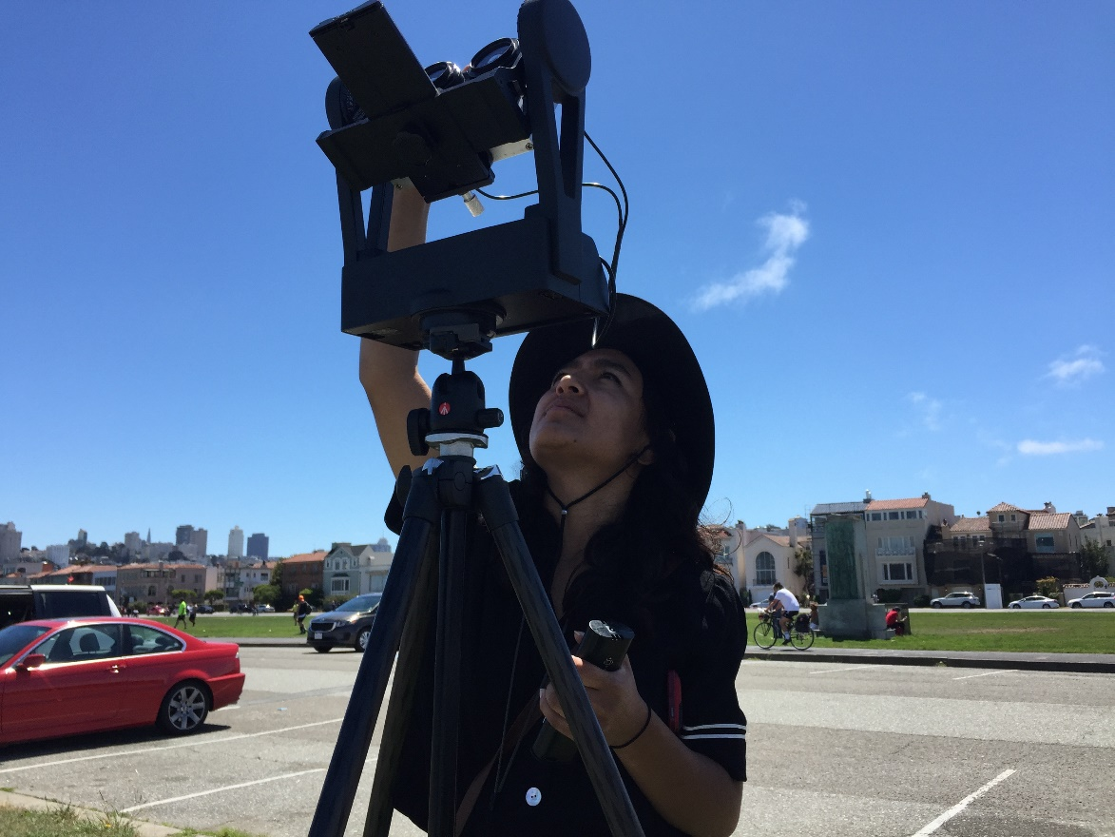
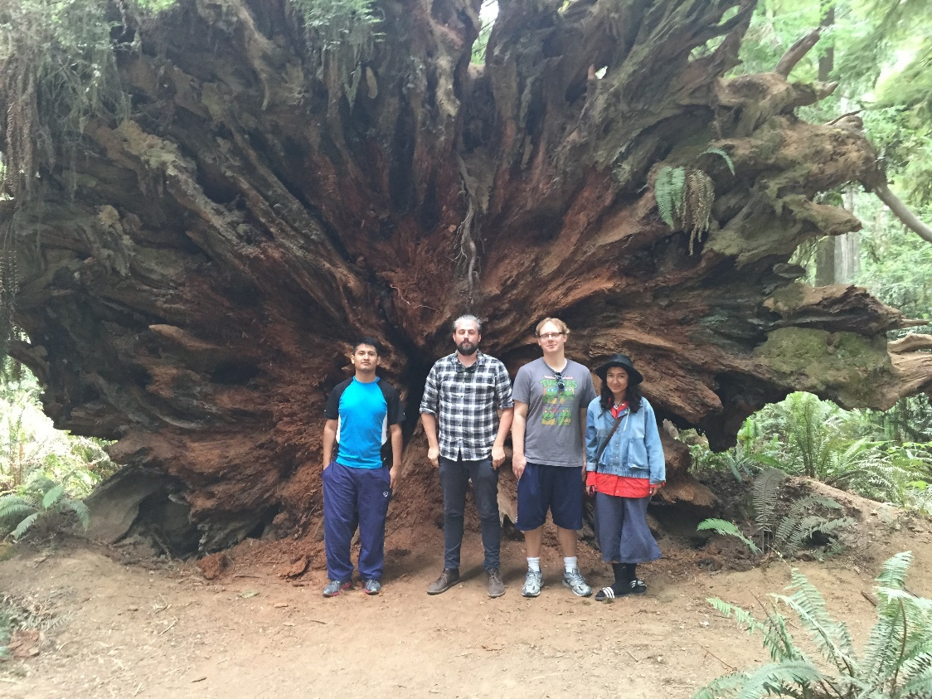
VR Digital Capture
Notes:
16K 128 Megapixel Per Eye with web based streaming solutions to powerwalls and head mounted cisplays.

Slide 18
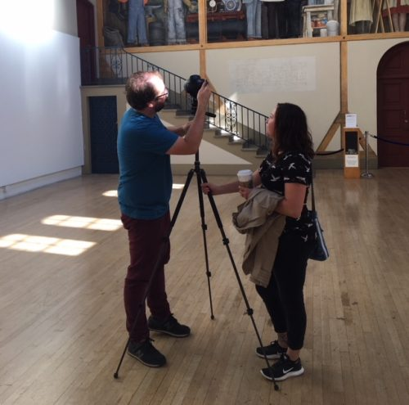
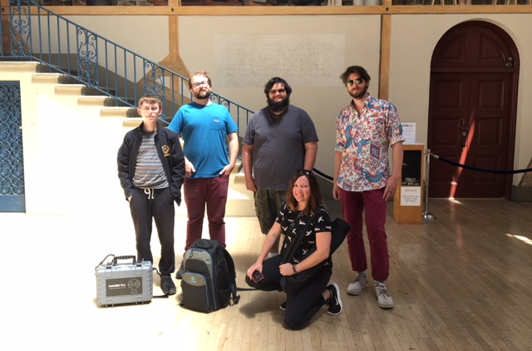
Variety of Media Capture Types

Slide 19
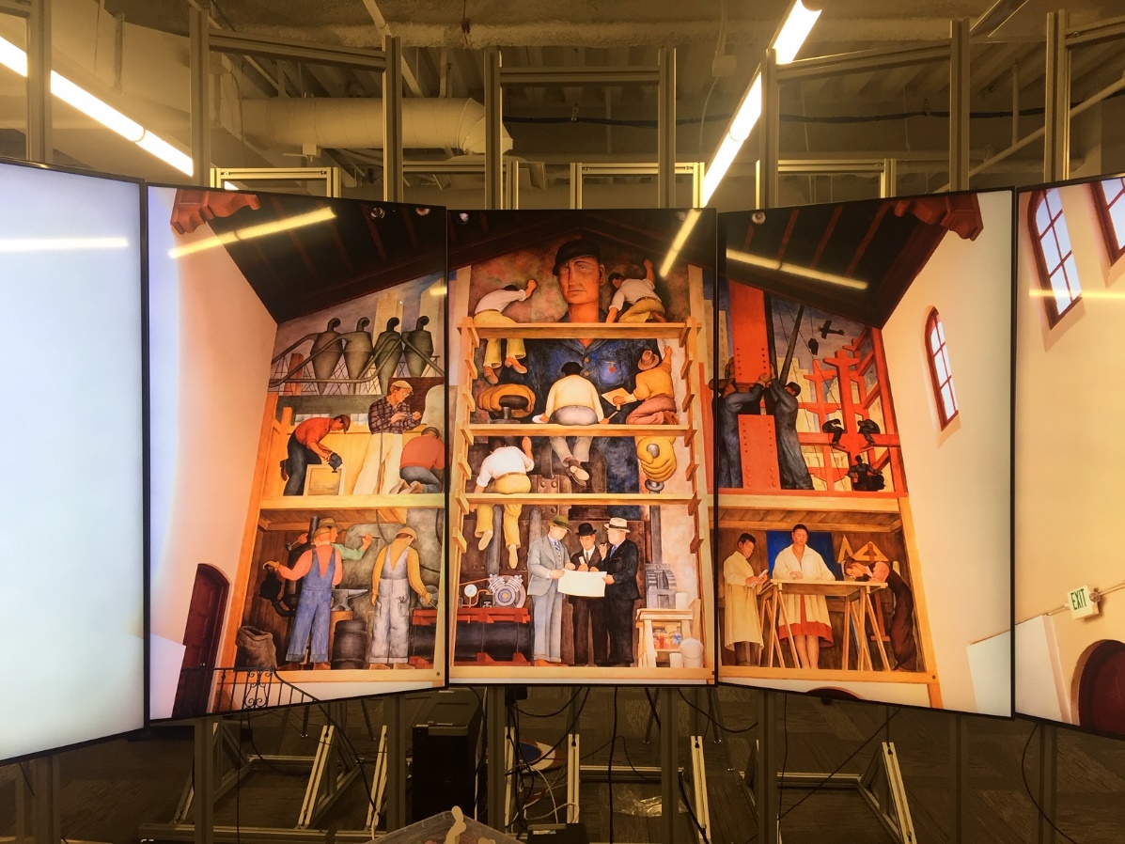
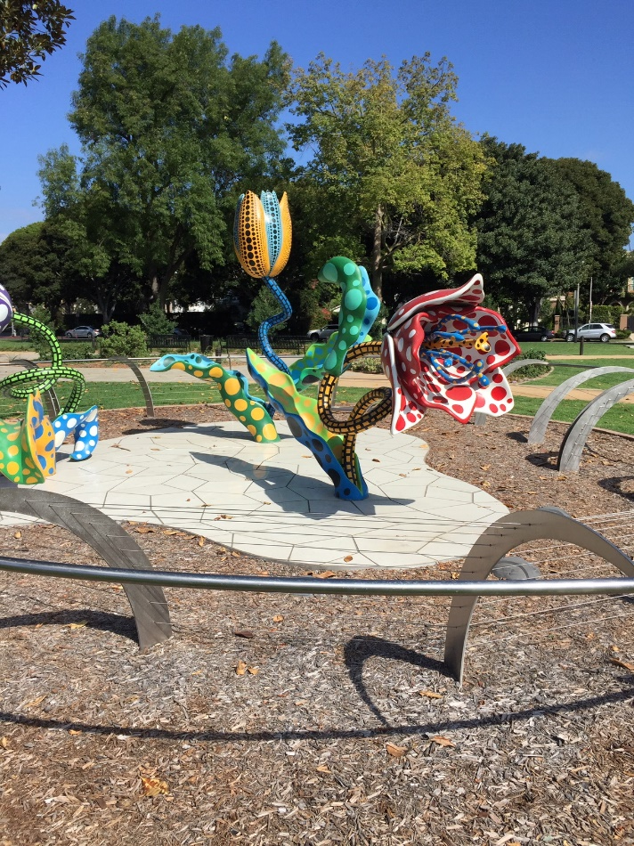
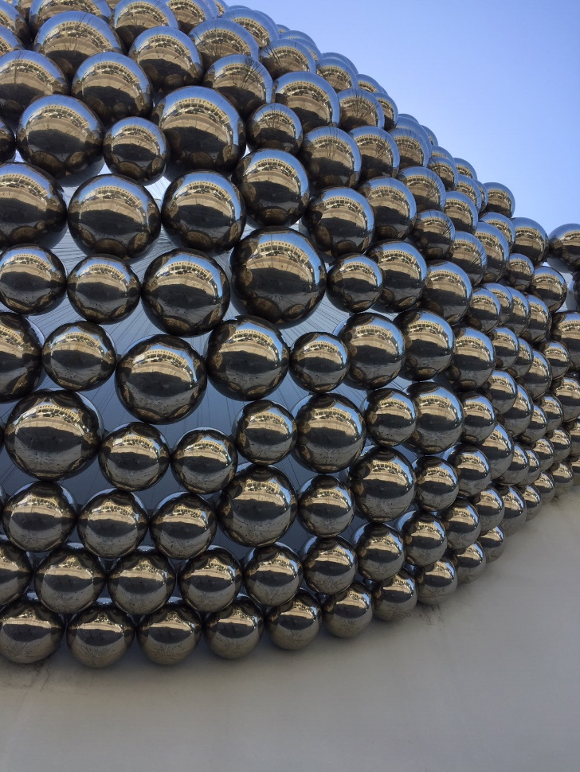
Art Captures

Slide 20
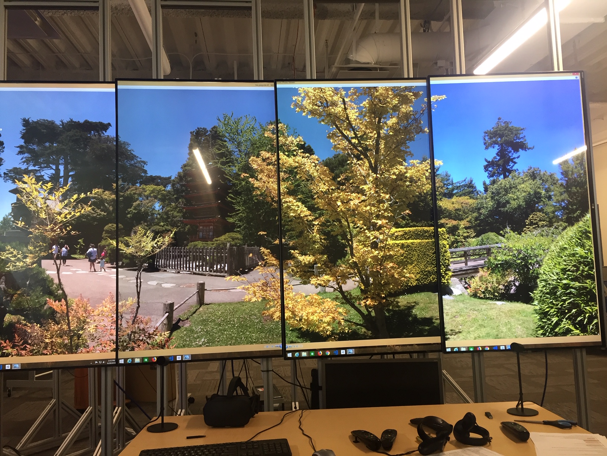
Notes:
http://cs.boisestate.edu/~scutchin/wmuseum

Slide 21
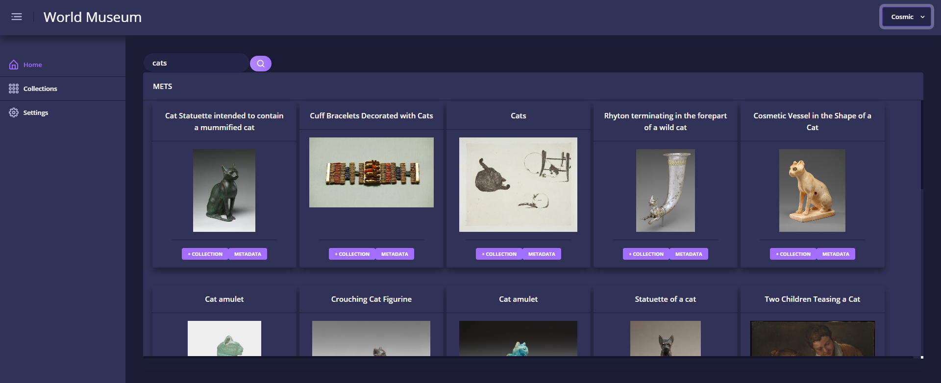
Curator’s Interface

Slide 22
Requirements –
Need to classify 100s of sets of 136 panoramic stereo image pairs automatically.
Need to stitch, tile, and generate multiple 16k+ resolution image sets.
Need to launch OpenCV Image analysis jobs with measured and tracked results automatically for 100s of jobs.
Need to easily ingest large image capture sets, register, and easily tag with trip details for all images.
Need to let human operators edit image sets asynchronously intermixed with automated computation and do so remotely.
Need to share any tracked digital asset to Laptop, Desktop, CAVE, or Phone.
Need to update digital content on all devices at any time.

Slide 23
Requirements –
Need to support Curators in classifying digital art collections.
Need to support Search across multiple Open Art Museums and Databases.
Need to support adding in free-form MetaData by curators and programs.
Need to provide external API access to remote User Interface systems.
Need to support full Federated Database solutions.
Need to support search by text and by image.
Need to provide explorer views for rapid image search and exploration.
Need to provide simple mechanism for generating different interaction layouts and interfaces.

Slide 24
Requirements –
All digital content should be available via URI to any device.
All digital content should be human readable including exchange files, configuration files, and URI results, except true media files.
All assets can have any number of tags.
All values associated with keys are first order lists.
Should be 2 hours work to add in any new database with an accessible endpoint.
System should be open, extensible, efficient, scalable, and documented.
System should integrate into other systems with modest effort.
System should cleanly separate interfaces from code.
We have a budget of $15,000, 4 undergrads and 2 grad students.

Slide 25
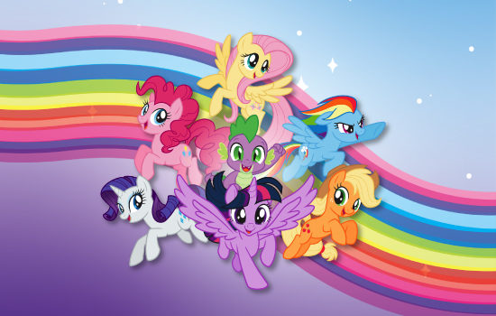
Requirements – and lots of Ponies!

Slide 26
Overview

Slide 27
Current Software Stack
D3 – Data Driven Documents for layouts and interfacing.
Angular – for web interface development
Python – for all Web Server, Compute, and Glue code for the system.
Javascript – for end user web pages.
SQLAlchemy – for ORM access to the database.
SQL – for ease of using already existing large scale database solutions.
AWS RDS, EC2, S3 – highly scalable..
Snakemake – launching compute jobs across campus clusters.
Apache Webserver – open source and available for our federated front end.
Campus R2 cluster and 25TB of storage as well.

Slide 28
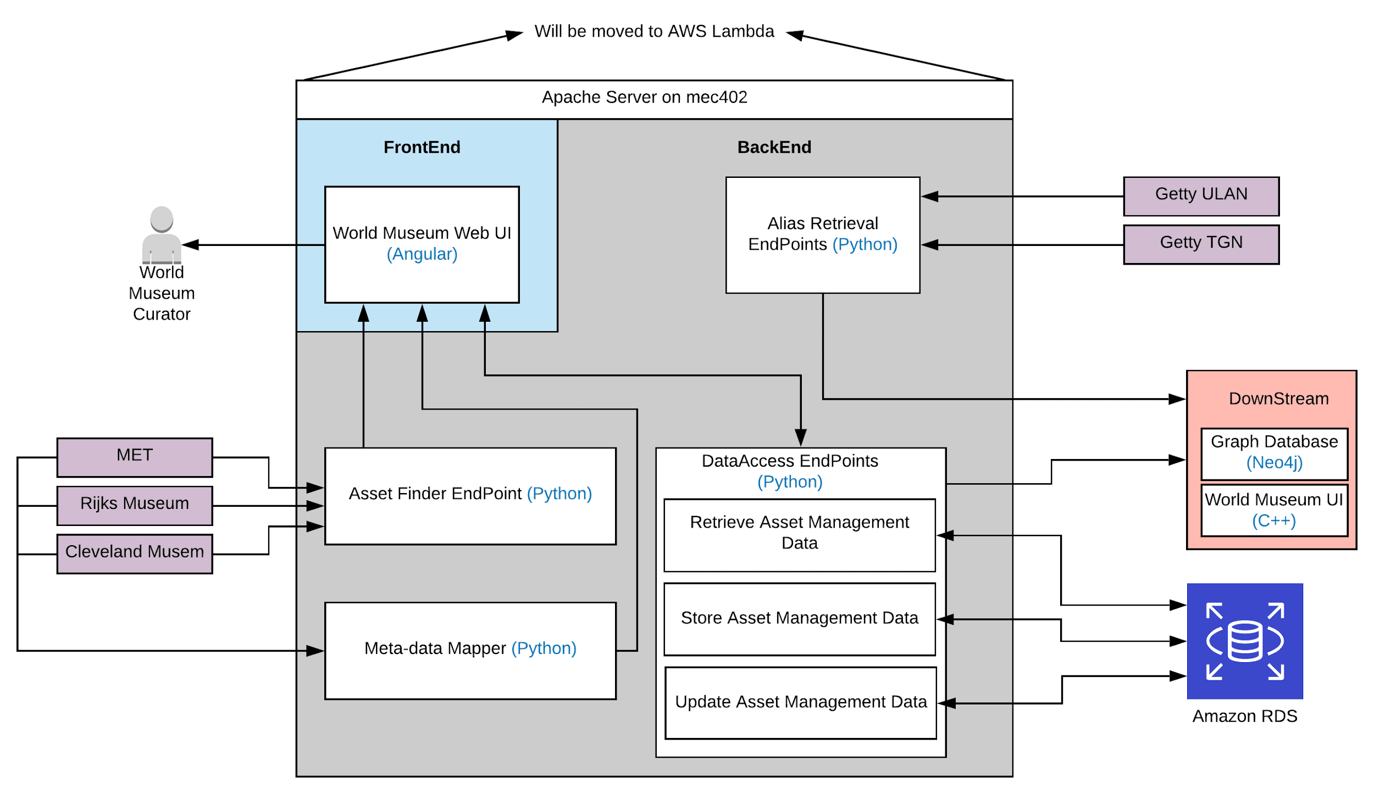
OpenPipe Architecture

Slide 29
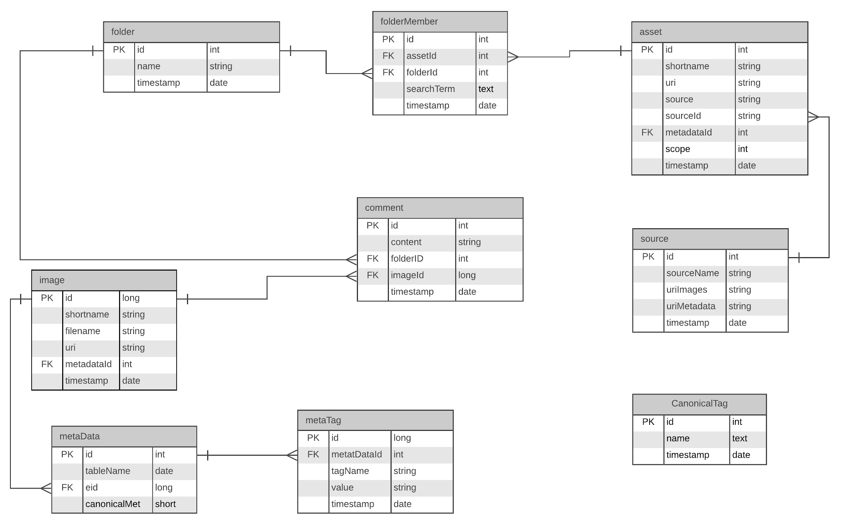
Asset Management Entity- Relation Diagram

Slide 30
Dataset Size = modest but not small
1 Panoramic Image collection = 1.5 Gigabytes.
Croatia trip generated 300 Gigabytes of raw data.
We have 11 trips worth of data for 3.3 Terabytes of past data.
One class of 15 students would generate 4.5 Terabytes.
This falls into the ‘medium scale’ dataset size.

Slide 31
Solution Scale and Scope
A core design choice was to focus on designing a solution that can rapidly scale to support many users and operators working both locally and remotely with large data sets quickly and easily.
Example 1: content collection team in Croatia uploads the days capture for operators on campus to process over night so they can review the next day.
Example 2: A new collection of 300 16K panoramas have been stitched and tiled and are ready to be shared with all end users.
Example 3: A class of 20 art students have been tasked to search and compare various art collections at different online museum collections prepare portfolios to present and discuss as a class assignment.

Slide 32
Design Philosophy
All systems components are designed to be loosely coupled.
All system components connect via URI whenever possible.
HTTP is the primary protocol for exchange on the system.
JSON files are used to exchange all command and control data.
All media is accessible via a URI reference.
Apps use URIs for configuration files.
Compute is offloaded from users to servers whenever possible.
Federate resources whenever possible:
  Ex: Cleveland Museum of Art provides online collections of Art.
  Ex: Getty provides services that maintain canonical lists of Artists.

Slide 33
How Do We Handle Federation?
OpenPipe Asset List
External Museum X
Asset | Museum X | Asset ID
List Assets Endpoint
Asset | Museum X | Asset ID
Search Assets Endpoint
Asset | Internal | Asset ID
Get Asset Endpoint
Python for Museum X
Get Asset Metadata Endpoint
List Assets
Search Assets
Get Asset
Get Metadata
OpenAccess Endpoints
Working on SPARQL Endpoints

Slide 34
How Do We Handle Data Movement?
Ingest Data Into System
For new ingests the system generates a new folder with a unique identifier.
Python script uploads to this folder via available protocols:
  HTTP: if file less than 200 Megabytes.
  sFTP: for many files.
  Globus: for files above 1 TB.
  CP for LAN workstations
Extract Data From the System
We Never Delete Assets
Move data on attached storage with CP.
  EG on an EC2 Node attached to filestore.
Transfer data out using HTTP.
For files larger than 1 TB we can use Globus. That becomes manual.
Checkout is separate action.
We don’t currently support versioning.

Slide 35
How do we compute?
After Data is installed in system the goals is to do all compute on servers.
All compute jobs broken into four stages:
  Compute reservation.
  Data Movement
  Run Compute
  Data retrieval
Use Tools like Snakemake and/or APST.
Human in the Loop?
  Viewed as producing new data every time.
  Extract data sets from system.
  Use an editing tool like PtGui or Photoshop.
  The result is ingested as a new asset into the system.
  Metadata is used to track its production path.

Slide 36
AWS Integration
RDS relational Database for DBMS
S3 for Web Accessible file storage
Lambda for on-demand compute Jobs
EC2 Compute clusters for larger compute tasks.
Why AWS?
  Scales to any demanded size. Basically unlimited resources.
  Teams of thousands of engineers making it better every day.
  Available from anywhere globally with support for automated caching.
  Tracks costs and usage as a built-in.

Slide 37
Curator’s Interface

Slide 38
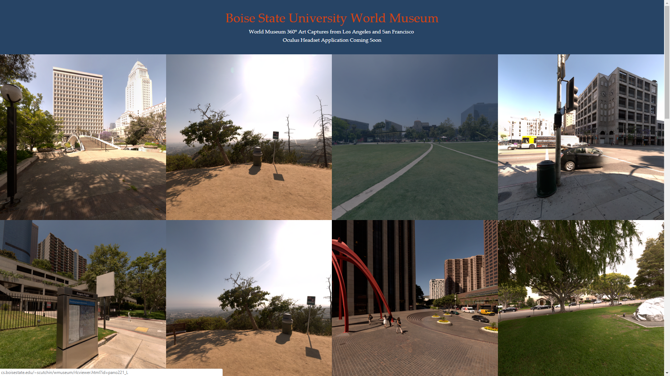
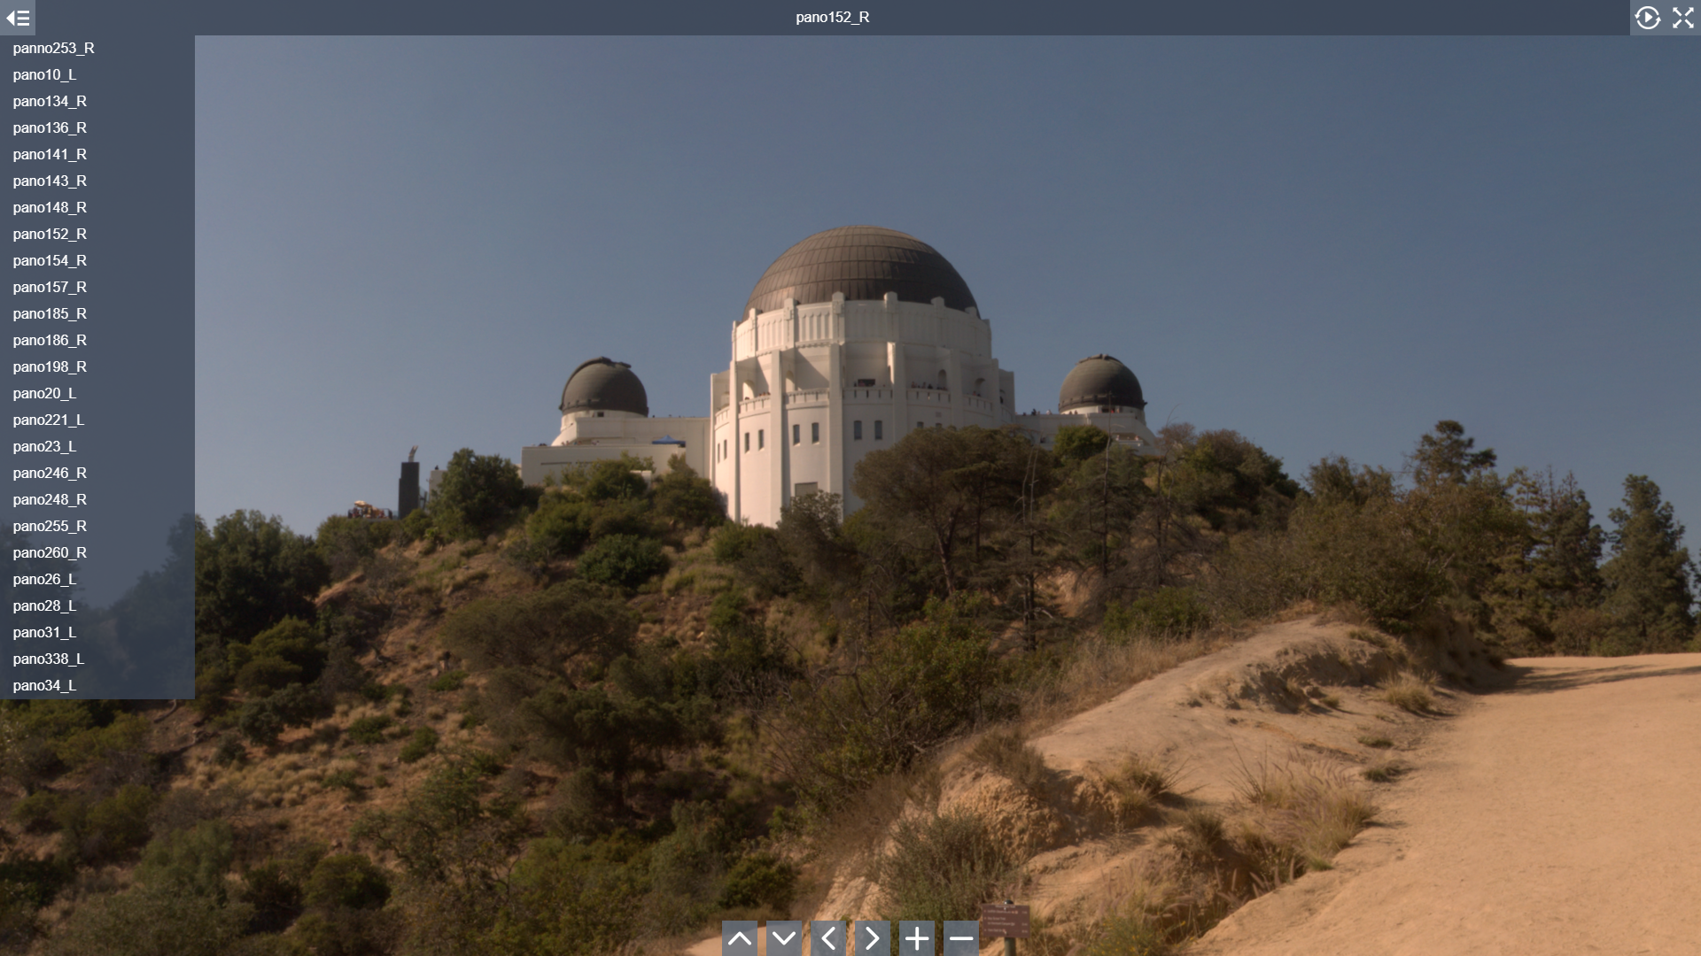
Automated Tiled Panorama Stitching

Slide 39
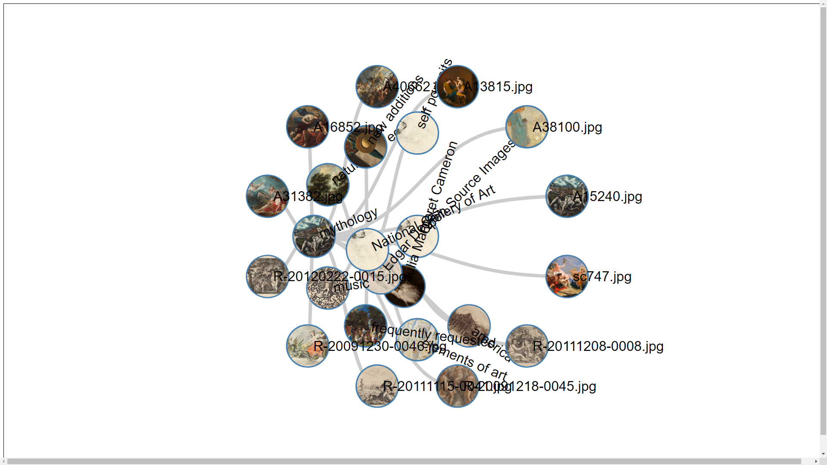
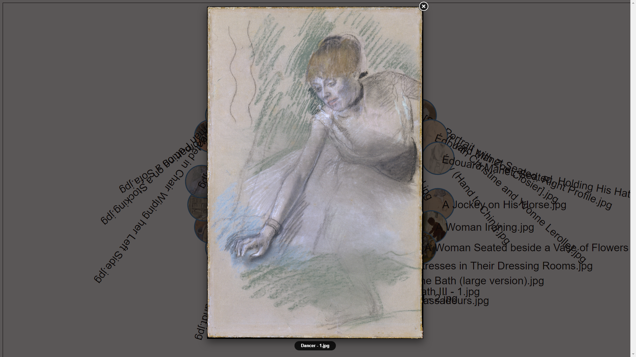
Early D3 UI Interfaces – drawing from OpenPipe.

Slide 40
Questions?

