Slide 1
The Sharing for Variational Autoencoder
April 30, 2018
Analytics

Slide 2
Outline
Introduction to AE (Autoencoder)
The variations of AE
Variational AE
The applications of AE

Slide 3

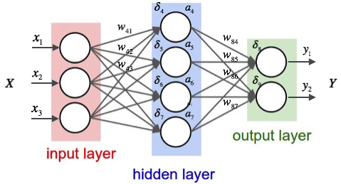
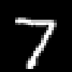
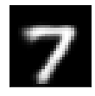
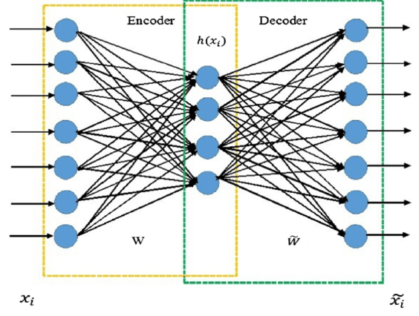


Simple MLP and Simple AE
Prob. for 0
Prob. for 1
Prob. for 2
$$⋮$$
Hidden layers learn the features mapping from inputs to the output results for a set of data
For classification, regression, etc.
Latent layers learn a representation (encoding) for a set of data
For dimension reduction, features extraction, de-nosing, generative model, etc.

Slide 4
The Variations of AE
Simple(one layer) AE
Tow layers AE
AE with De-noising
AE with Convolution

Slide 5

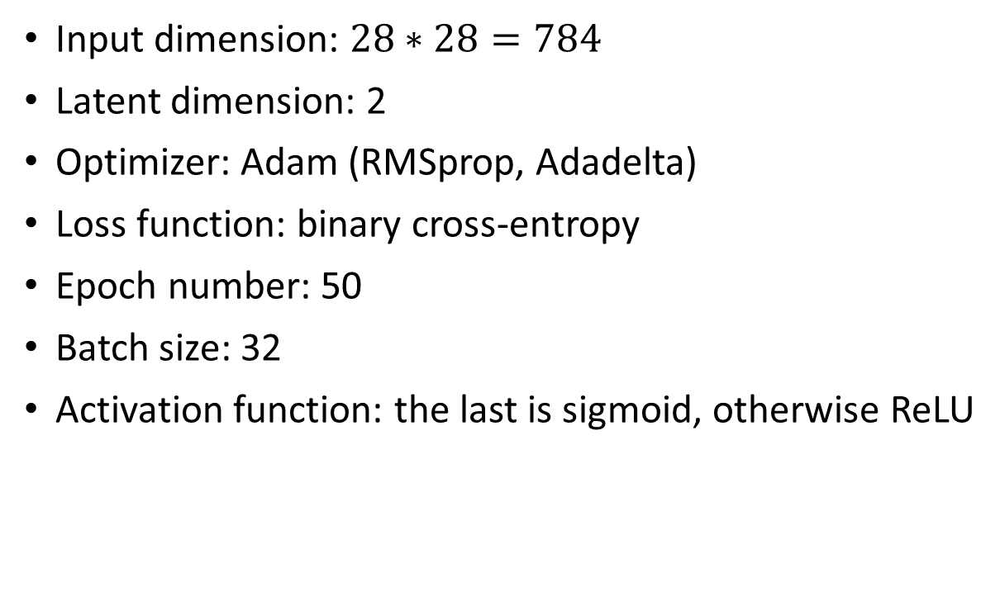

The Example of Simple AE
Input dimension: $28∗28=784$
Latent dimension: 2
Optimizer: Adam (RMSprop, Adadelta)
Loss function: binary cross-entropy
Epoch number: 50
Batch size: 32
Activation function: the last is sigmoid, otherwise ReLU
$$⋮$$
$$⋮$$

Slide 6
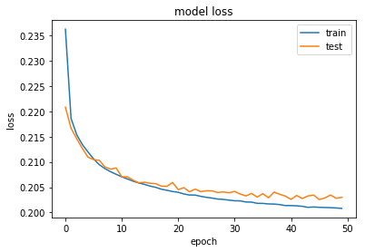
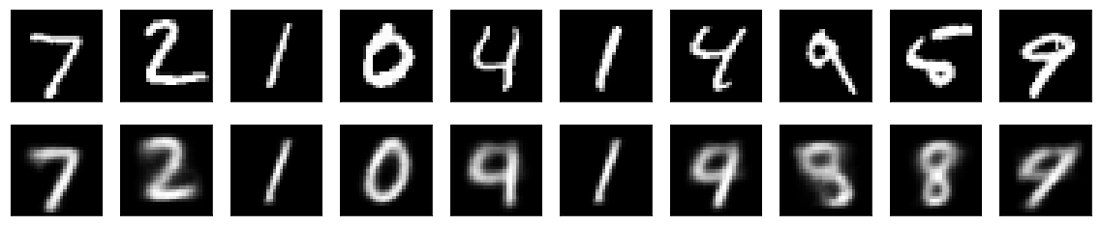
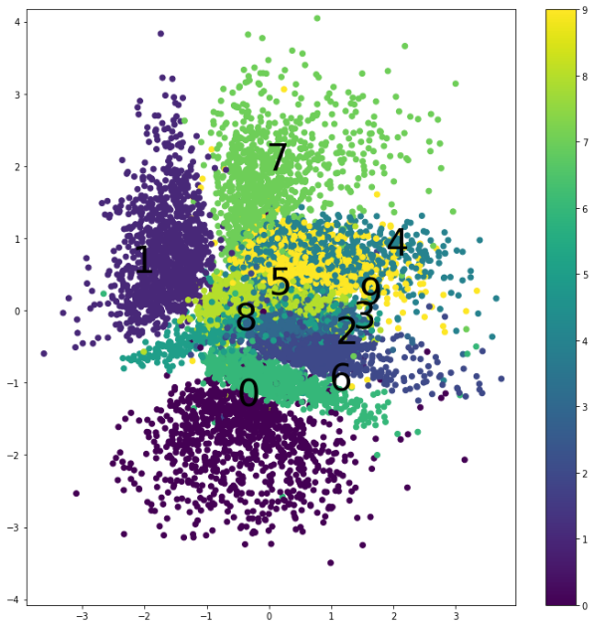
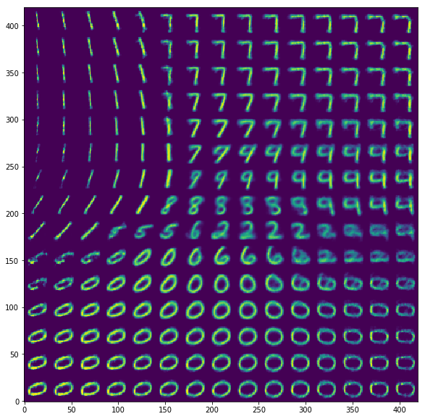



The Aspects and Metrics for the Results
The training progress (learning curve)
The comparison between the original and decoded images
$$⋮$$
$$⋮$$
The decoded images based on the encoded scatter
The scatter of encoded representations
Silhouette score:
-1 for incorrect
1 for highly dense
a: The mean distance between a sample and all other points in the same class.
b: The mean distance between a sample and all other points in the next nearest cluster.

Slide 7
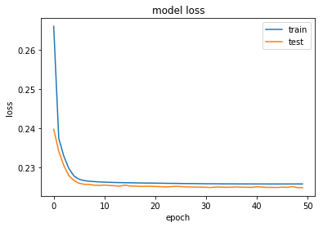
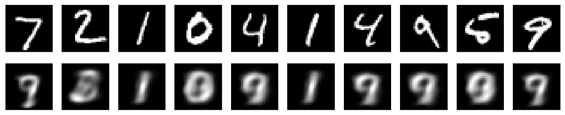
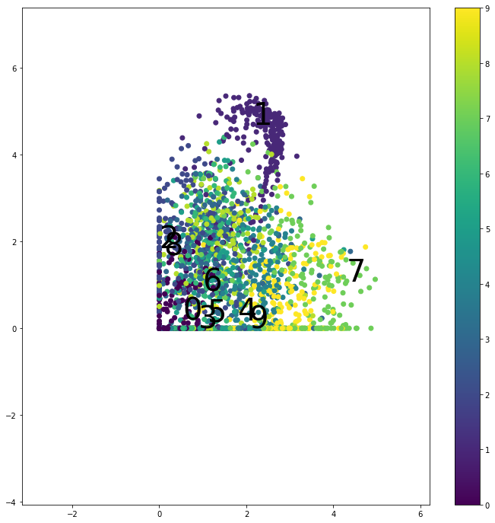
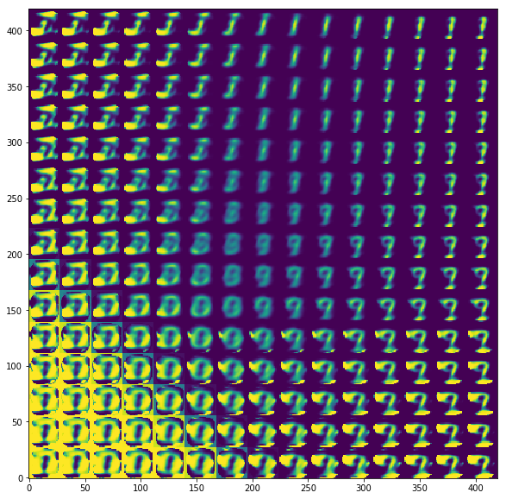


The Results of Simple AE
$$⋮$$
$$⋮$$
Silhouette score: -0.0065
Poor capacity
The latent is less meaningful

Slide 8


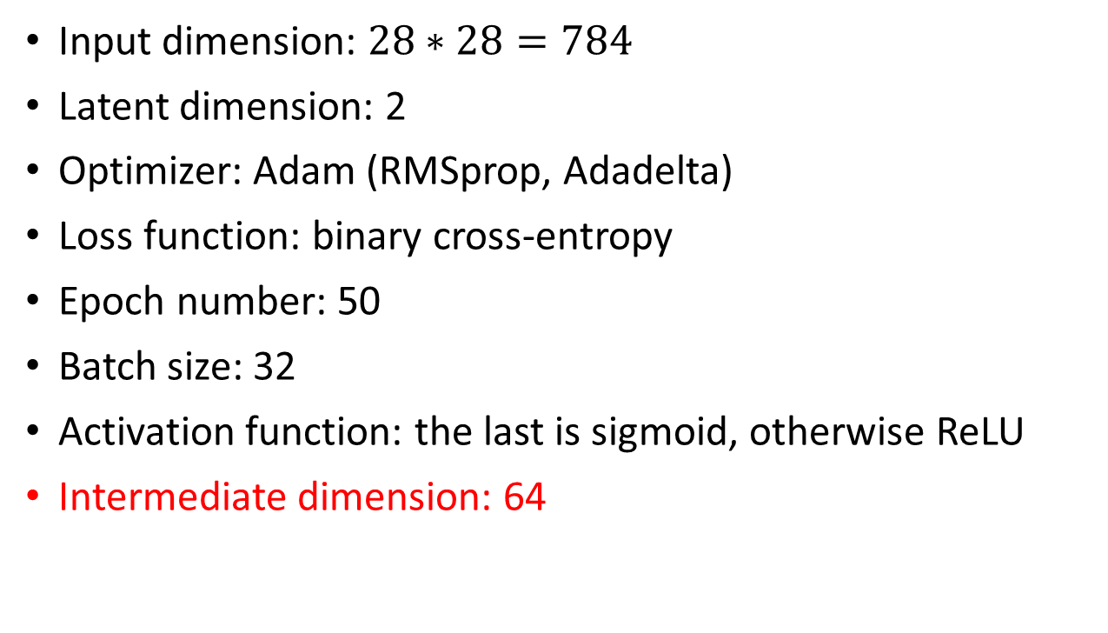
The Example of Two Layers AE
Input dimension: $28∗28=784$
Latent dimension: 2
Optimizer: Adam (RMSprop, Adadelta)
Loss function: binary cross-entropy
Epoch number: 50
Batch size: 32
Activation function: the last is sigmoid, otherwise ReLU
Intermediate dimension: 64
$$⋮$$
$$⋮$$
$$⋮$$
$$⋮$$

Slide 9
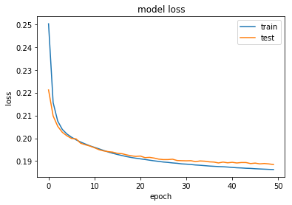
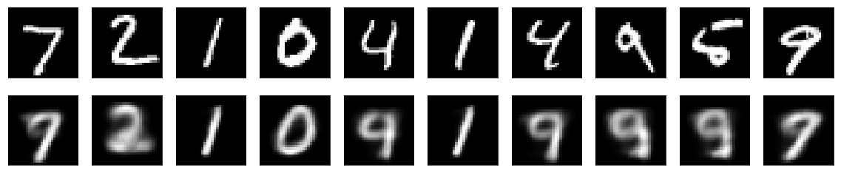
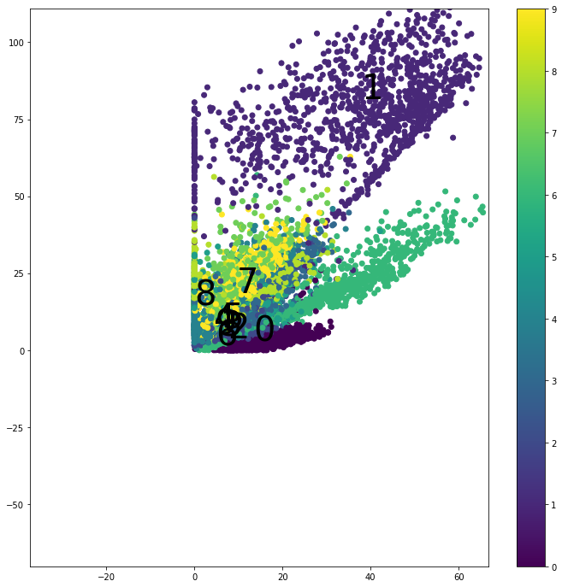


The Results of Two Layers AE
$$⋮$$
$$⋮$$
$$⋮$$
$$⋮$$
Silhouette score: -0.0179
The loss is better than simple Autoencoder
The latent is still less meaningful

Slide 10
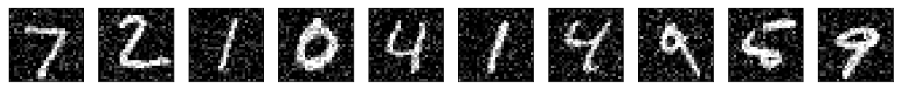

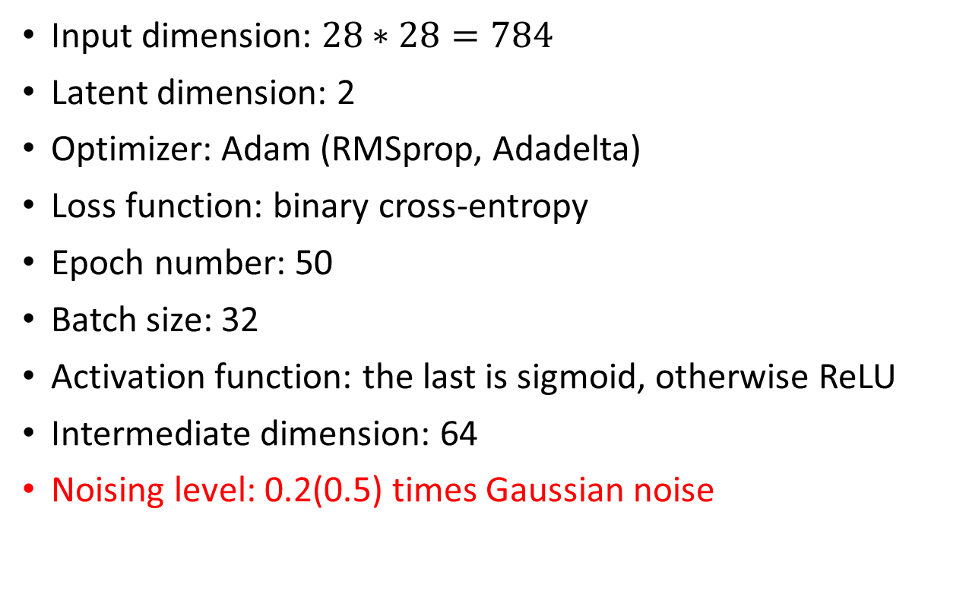

The Example of Two Layers AE with De-noising
Input dimension: $28∗28=784$
Latent dimension: 2
Optimizer: Adam (RMSprop, Adadelta)
Loss function: binary cross-entropy
Epoch number: 50
Batch size: 32
Activation function: the last is sigmoid, otherwise ReLU
Intermediate dimension: 64
Noising level: 0.2(0.5) times Gaussian noise
$$⋮$$
$$⋮$$
$$⋮$$
$$⋮$$

Slide 11
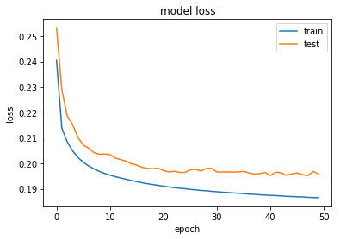
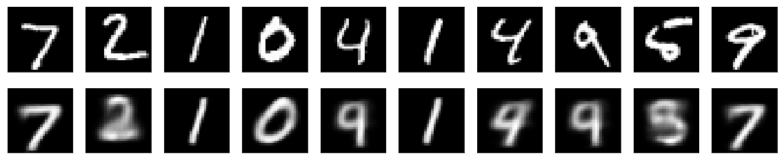
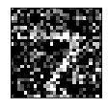
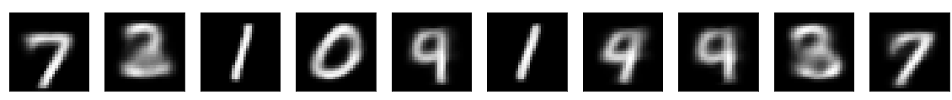
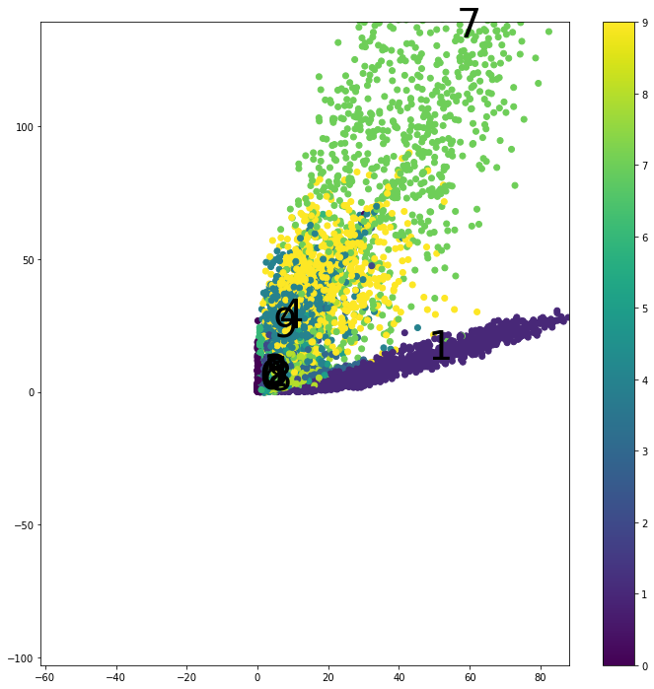
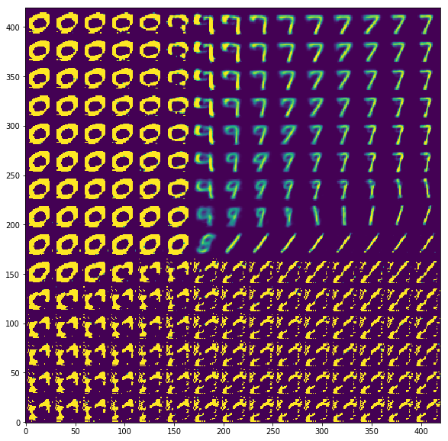
The Results of Two Layers AE with De-noising
Silhouette score: -0.0536
The performance is not improved
The main effect is de-noising

Slide 12


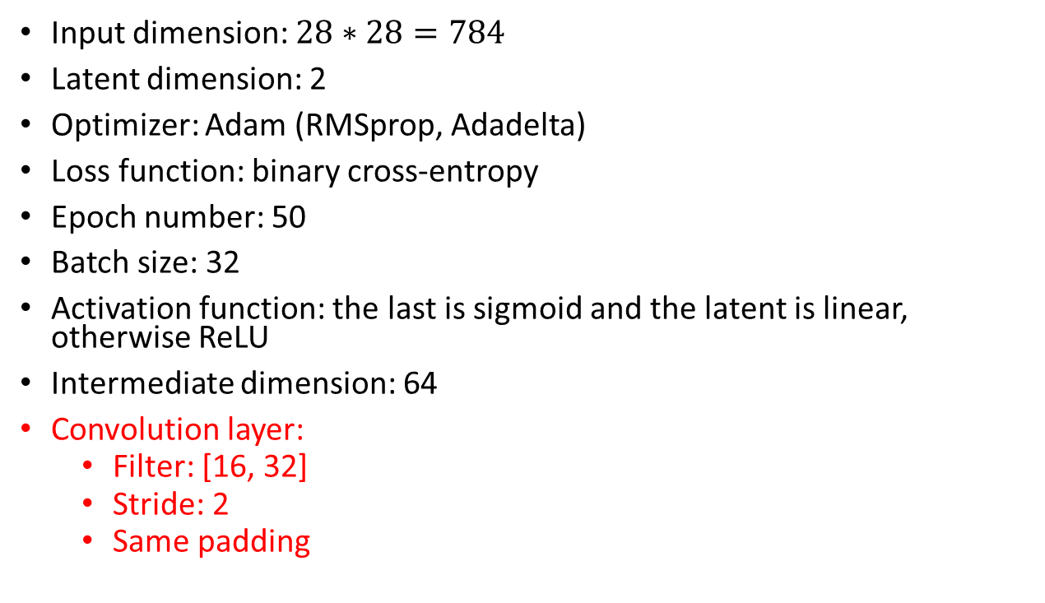




The Example of Two Layers AE with Convolution Layers
Input dimension: $28∗28=784$
Latent dimension: 2
Optimizer: Adam (RMSprop, Adadelta)
Loss function: binary cross-entropy
Epoch number: 50
Batch size: 32
Activation function: the last is sigmoid and the latent is linear, otherwise ReLU
Intermediate dimension: 64
Convolution layer:
Filter: [16, 32]
Stride: 2
Same padding
$$⋰$$
$$⋰$$
$$⋮$$
$$⋰$$
$$⋰$$
$$⋮$$
$$⋮$$
$$⋮$$

Slide 13
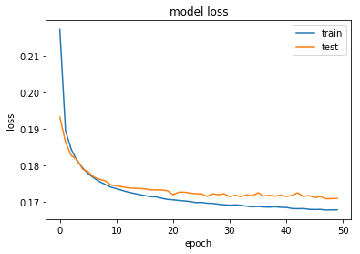
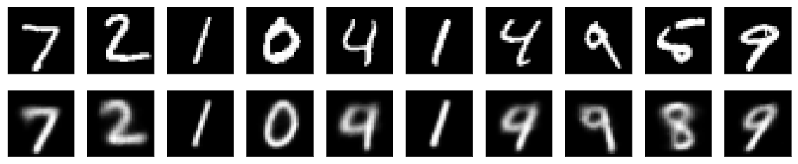
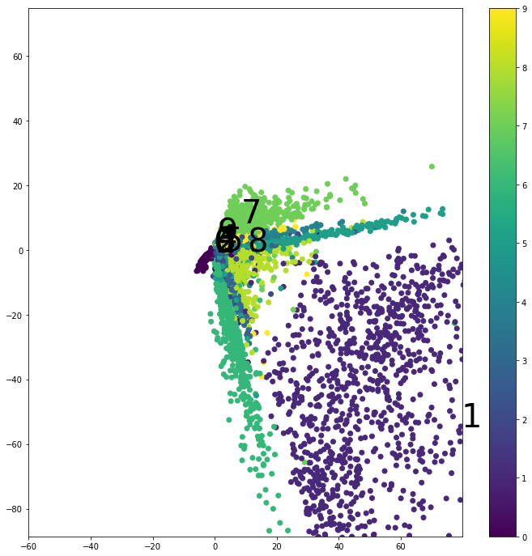
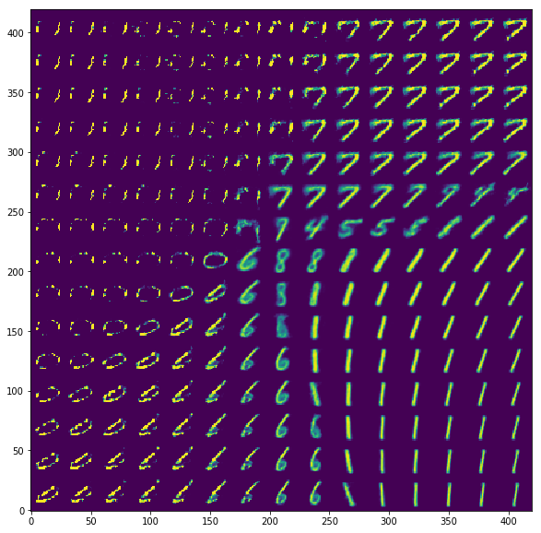


The Results of Two Layers AE with Convolution Layers
$$⋰$$
$$⋰$$
Silhouette score: -0.0383
The loss is better than Two Layers AE
The latent is more meaningful

Slide 14
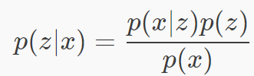


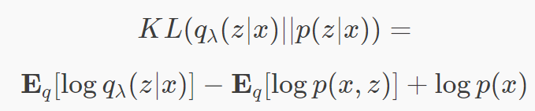




The Variational AE
Apply Bayesian inference
Continuous latent representation
Intractability:
Approximate posterior:
Maximize ELBO:
Loss function :
$$σ$$
Encoder $q_{θ}$
Decoder $p_{φ}$
Evidence Lower Bound:

Slide 15





The Variational AE
Apply Bayesian inference
Continuous latent representation
Intractability:
Approximate posterior:
Maximize ELBO:
Loss function :
$$μ$$
$$⋮$$
$$⋮$$
$$⋮$$
$$⋮$$
$$σ$$
Encoder $q_{θ}$
Decoder $p_{φ}$
Evidence Lower Bound:

Slide 16



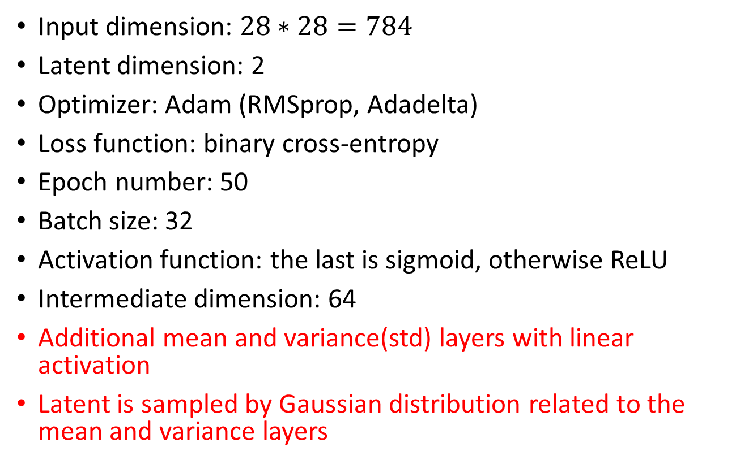



The Example of Variational AE
$$μ$$
Input dimension: $28∗28=784$
Latent dimension: 2
Optimizer: Adam (RMSprop, Adadelta)
Loss function: binary cross-entropy
Epoch number: 50
Batch size: 32
Activation function: the last is sigmoid, otherwise ReLU
Intermediate dimension: 64
Additional mean and variance(std) layers with linear activation
Latent is sampled by Gaussian distribution related to the mean and variance layers
$$⋮$$
$$⋮$$
$$⋮$$
$$⋮$$
$$σ$$
Encoder $q_{θ}$
Decoder $p_{φ}$

Slide 17
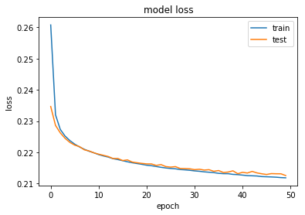
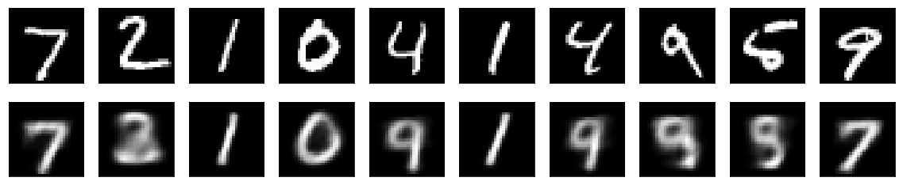
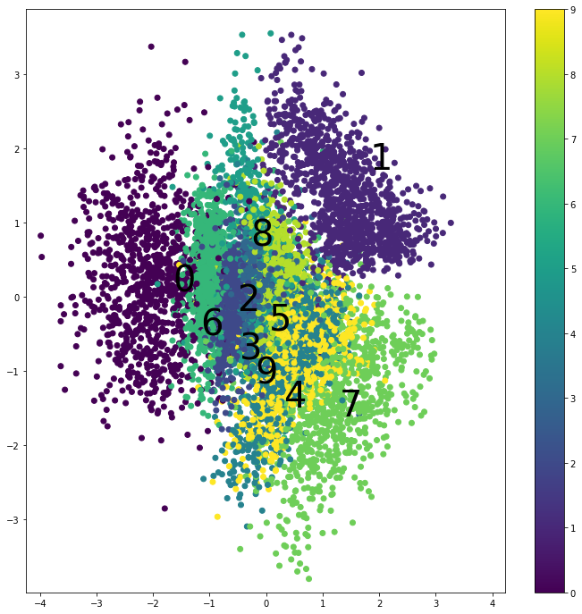
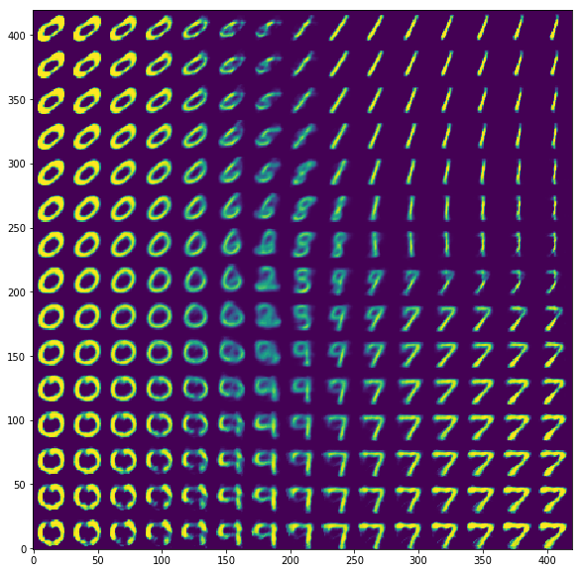
The Results of Variational AE
Silhouette score: 0.0323
The variational AE makes:
the latent more meaningful
continuous distribution
The loss is hard to compare with Two Layers AE

Slide 18
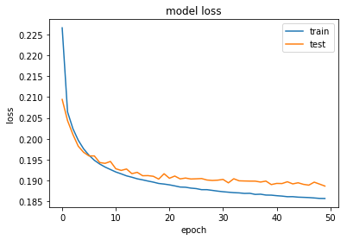
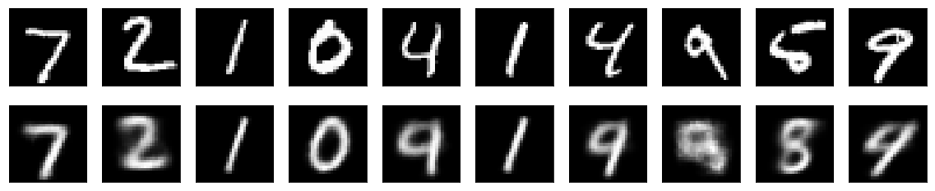
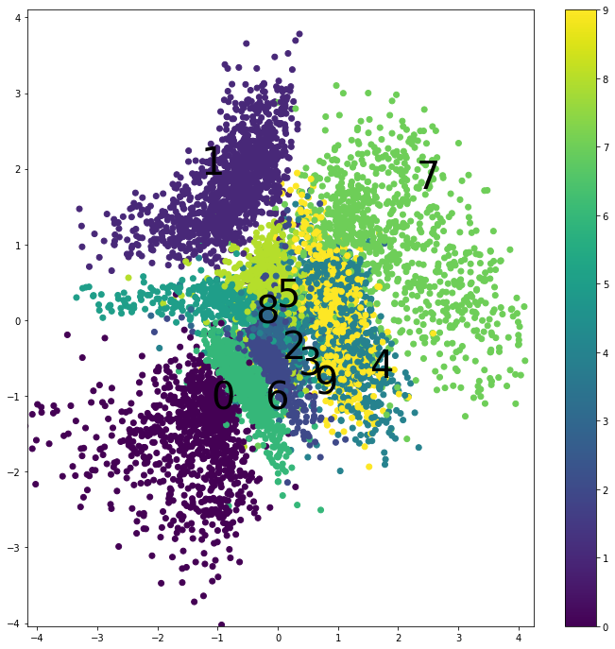
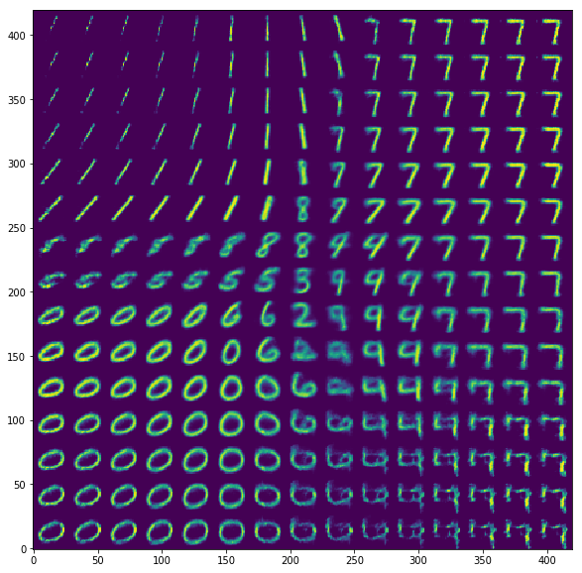
The Results of Variational AE less Regarding KL-Divergence
Silhouette score: 0.0699
The encoded results are more distinct

Slide 19




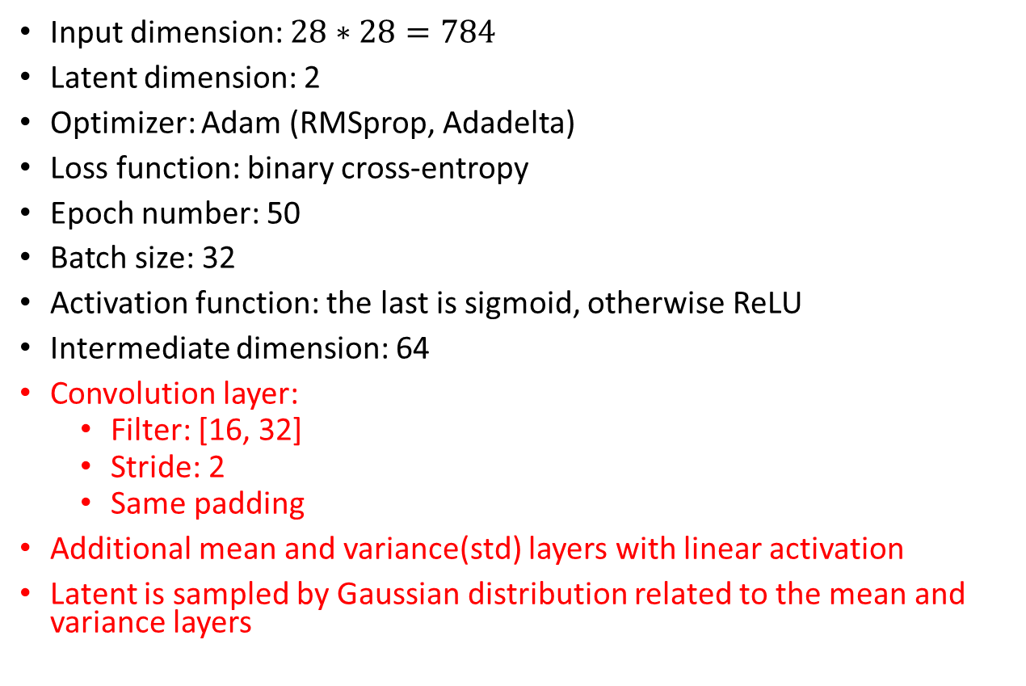




The Example of Variational AE with Convolution Layers
Input dimension: $28∗28=784$
Latent dimension: 2
Optimizer: Adam (RMSprop, Adadelta)
Loss function: binary cross-entropy
Epoch number: 50
Batch size: 32
Activation function: the last is sigmoid, otherwise ReLU
Intermediate dimension: 64
Convolution layer:
Filter: [16, 32]
Stride: 2
Same padding
Additional mean and variance(std) layers with linear activation
Latent is sampled by Gaussian distribution related to the mean and variance layers
$$μ$$
$$⋰$$
$$⋰$$
$$⋰$$
$$⋰$$
$$⋮$$
$$⋮$$
$$⋮$$
$$⋮$$
$$σ$$

Slide 20
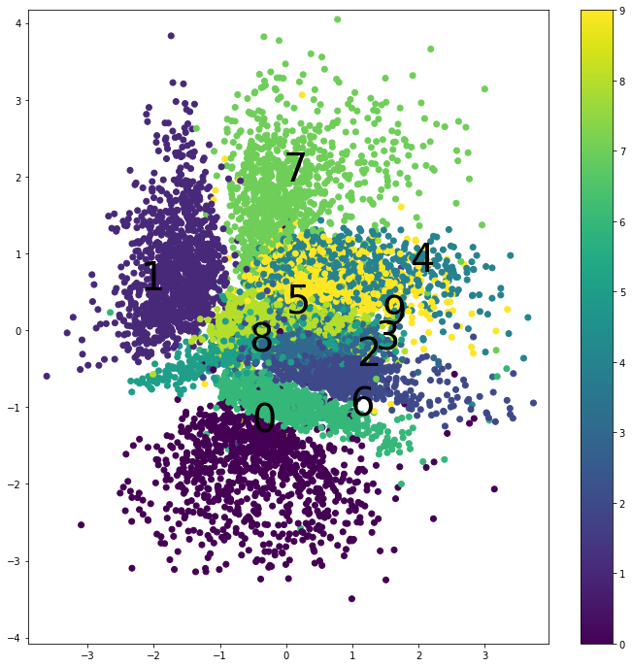


The Results of Variational AE with Convolution Layers
$$⋰$$
$$⋰$$
Silhouette score: 0.0852
Convolution is helpful for:
reducing loss
distinguishing encoded results

Slide 21
The Results of Variational AE with Convolution Layers
$$⋰$$
$$⋰$$
Silhouette score: 0.0996
The encoded results are more distinct

Slide 22
Recap
$$μ$$
AE learn the latent representation (encoding)
Deeper layers are helpful for the training progress
De-noising is mainly useful for coming data with disturbance
Convolution is helpful for:
reducing loss
distinguishing encoded results
The variational AE makes:
the latent more meaningful
continuous distribution
$$⋮$$
$$⋮$$
$$⋮$$
$$⋮$$
$$σ$$
Encoder $q_{θ}$
Decoder $p_{φ}$

Slide 23
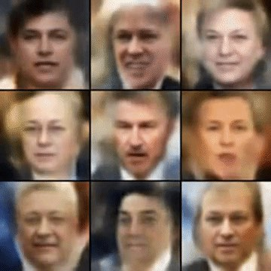
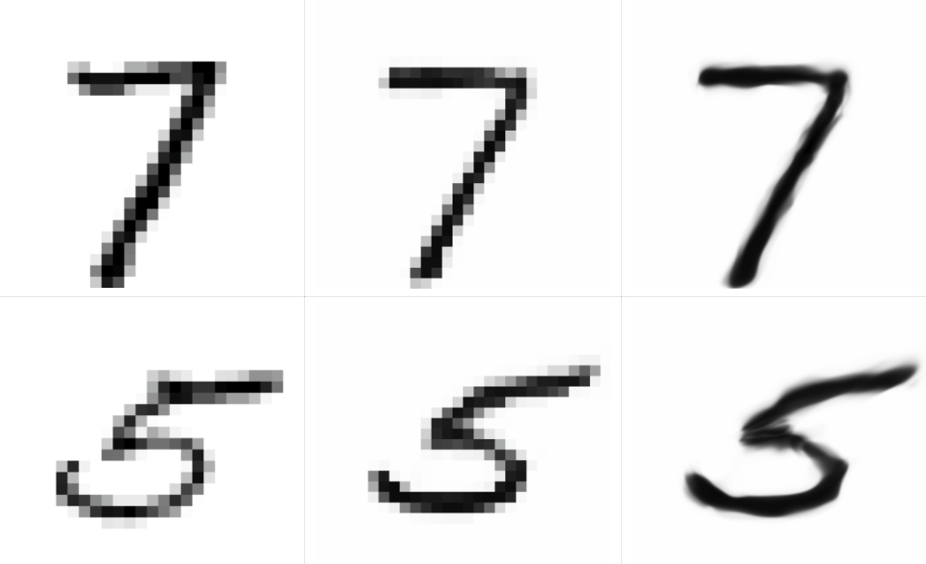
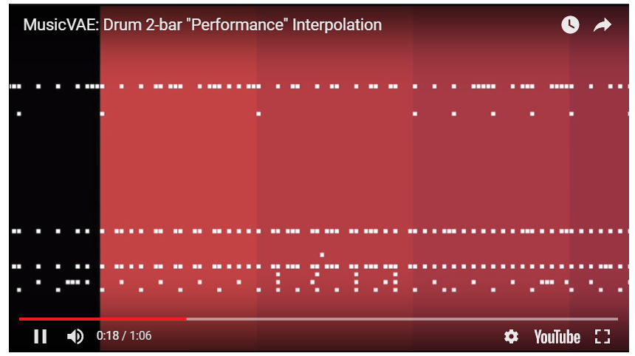
Application of (Variational) AE
Dimension reduction
Features extraction
De-nosing
Generative model:
celebrity faces
high-resolution digital artwork
sequential generator: synthetic text, music

Slide 24
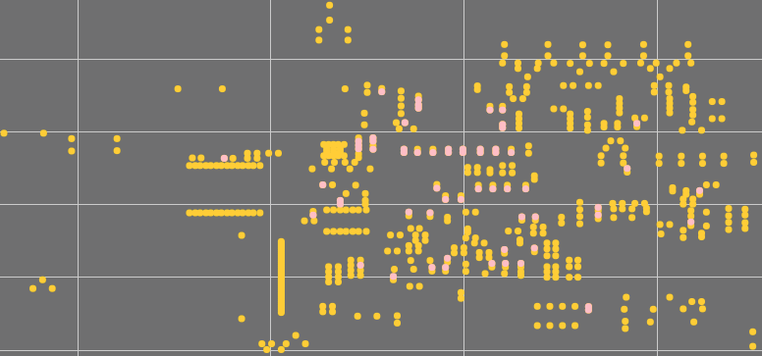
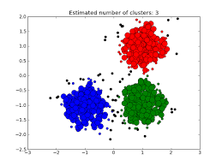
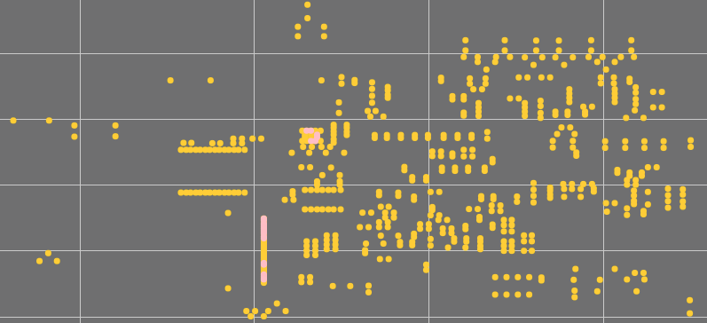





Application for the Data of SPI
PosX(mm) | PosY(mm) | Volume(%) | OffX(mm) | OffY(mm) | Result
35.9 | 62.1 | 134.504 | 0.892 | 0.89 | Good
35.9 | 63.6 | 139.029 | 0.892 | 0.89 | Good
52.4 | 68.7 | 135.867 | 0.892 | 0.89 | Bridging
$$⋮$$ | $$⋮$$ | $$⋮$$ | $$⋮$$ | $$⋮$$ | $$⋮$$
Utilize the information of layout:
By user defined labels
By inspection data
Location
Numerical data for inspection
Labels by rules from the inspection
$$⋰$$
$$⋰$$
$$⋮$$
$$⋮$$

Slide 25
References
https://arxiv.org/pdf/1312.6114.pdf
https://jaan.io/what-is-variational-autoencoder-vae-tutorial/
https://towardsdatascience.com/intuitively-understanding-variational-autoencoders-1bfe67eb5daf
https://blog.keras.io/building-autoencoders-in-keras.html
https://github.com/keras-team/keras/blob/master/examples/variational_autoencoder.py

Slide 26
Thanks for Your Attention

Slide 27
Appendix
The first term of reconstruction error should be calculated through Monte Carlo methods
Suffers from very high variance
A trick that uses a standard normal distribution

