Slide 2
Installation on Ubuntu 18.04 LTM
Environment and package setting
Install anaconda
bash Anaconda-latest-Linux-x86_64.sh
vim .bashrc
export PATH="$HOME/anaconda/bin:$PATH"
source .bashrc
create new environment
conda create -n py36 python=3.6
conda activate py36
Install packages
pip install python-can
(pip install jupyter notebook)

Slide 3
Installation on Ubuntu 18.04 LTM(Cont.)
Install necessary toolkit of linux
install make
sudo apt install make
install gcc
sudo apt-get install gcc
enable pcan in linux

Slide 4
Installation on Ubuntu 18.04 LTM(Cont.)
Install driver peak-linux-driver-8.7.0
cd peak-linux-driver-8.7.0
make clean
make
sudo make install
(modprobe pcan)

Slide 5
Installation on Ubuntu 18.04 LTM(Cont.)
Install library PCAN_Basic_Linux-4.2.0
cd PCAN_Basic_Linux-4.2.0
cd pcanbasic
make clean
make all
sudo make install
(redo the above to ensure the link of libpcanbasic.so)

Slide 7
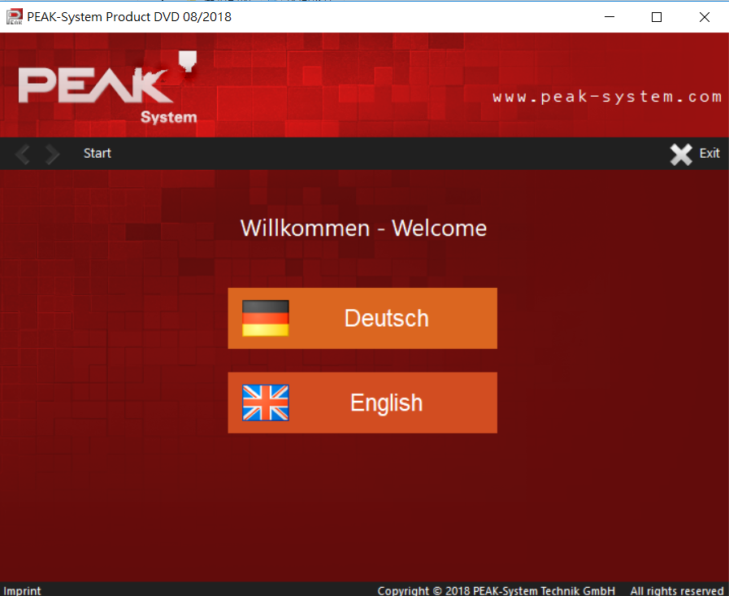
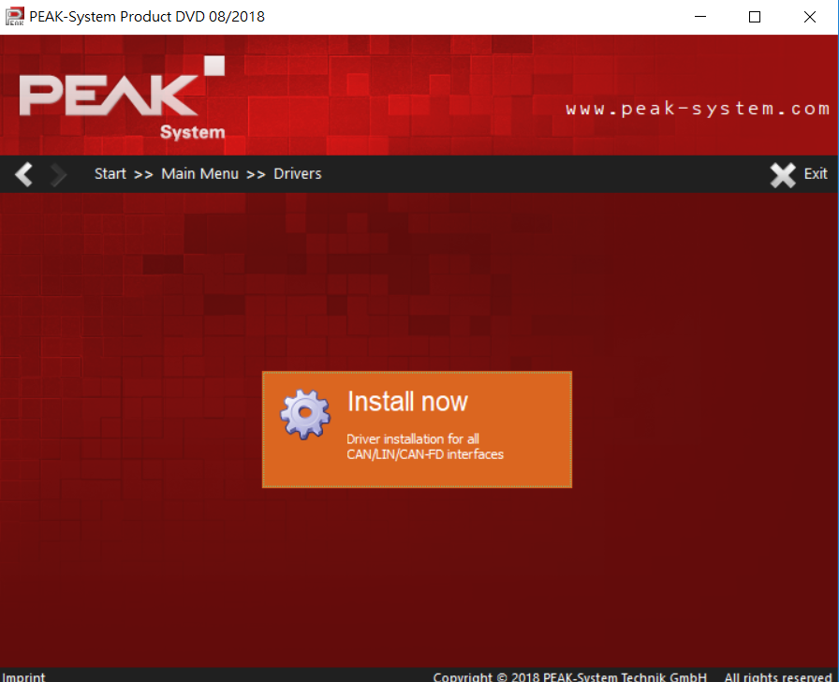
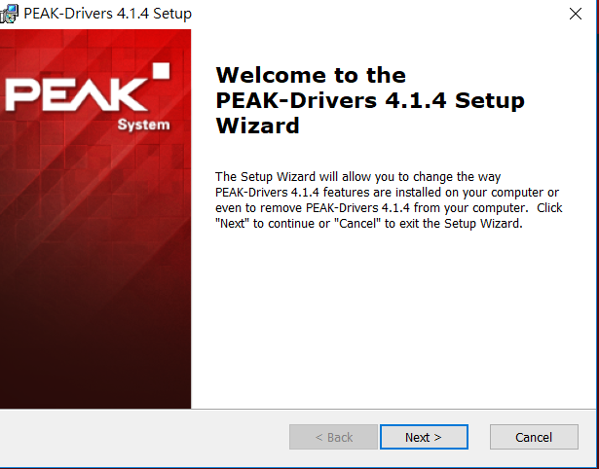
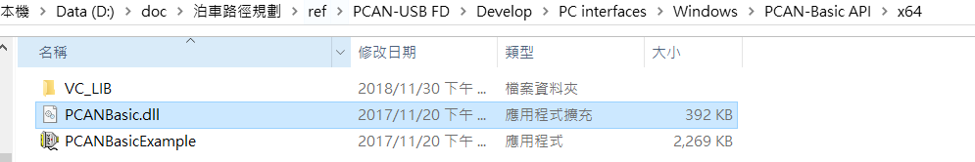
Installation on Win 10
Enter the folder PCAN-USB FD
Click the icon intro
Follow the instruction of installation for driver
After finishing the installation, copy the .dll into your workspace
PCAN-USB FD\Develop\PC interfaces\Windows\PCAN-Basic API\x64\ PCANBasic.dll

