Slide 1
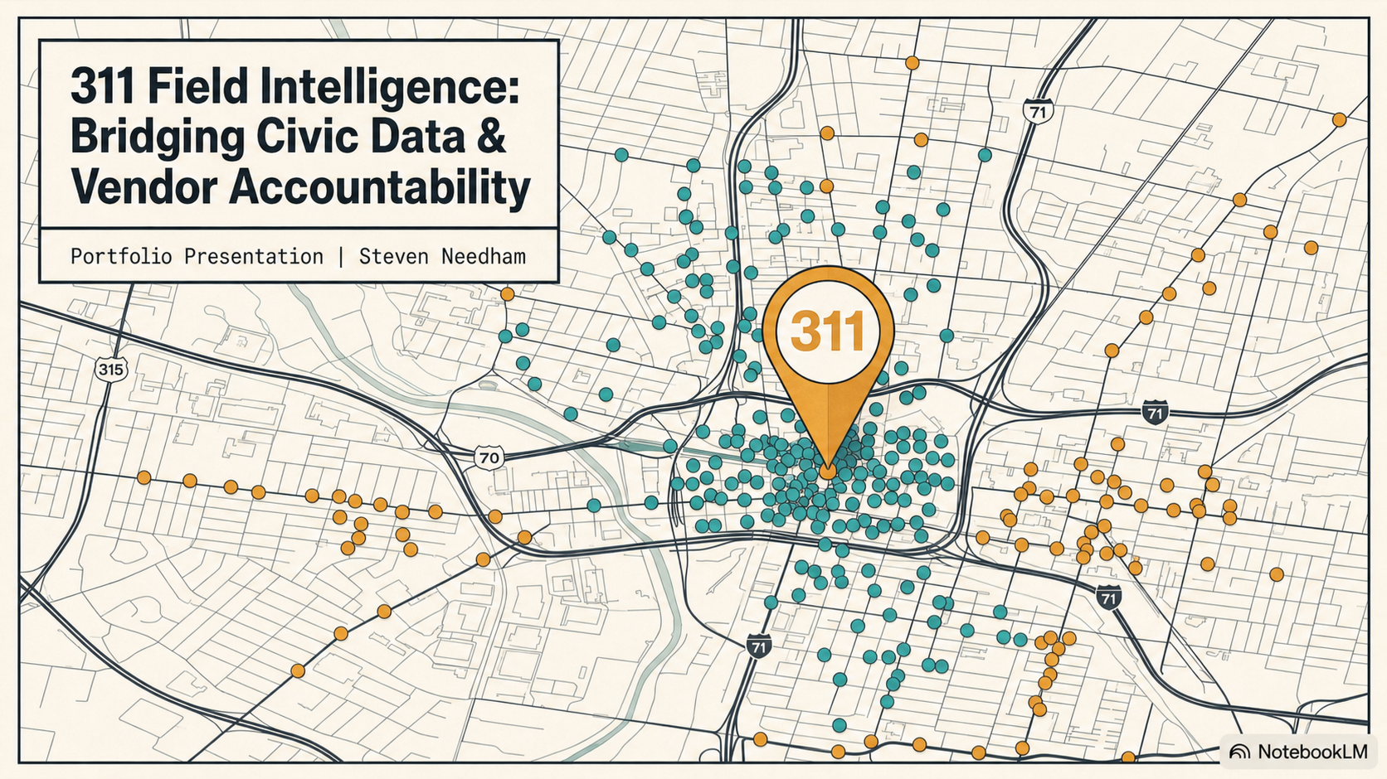
Notes:
[Sources]
Original visual master: Civic_Data_and_Vendor_Accountability.pptx
Design-system palette: tokens/colors.css
Presentation guidance: guidelines/office.md

Slide 2
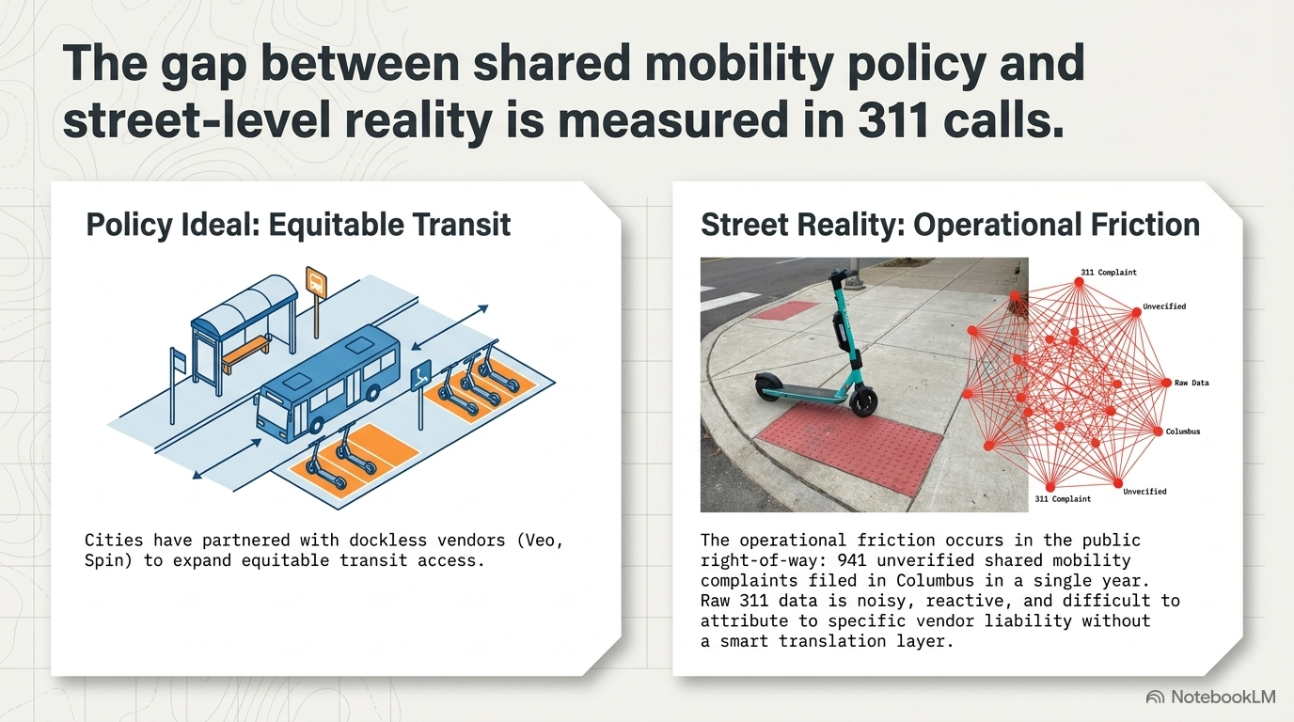
Notes:
[Sources]
Original visual master: Civic_Data_and_Vendor_Accountability.pptx
Design-system palette: tokens/colors.css
Presentation guidance: guidelines/office.md

Slide 3
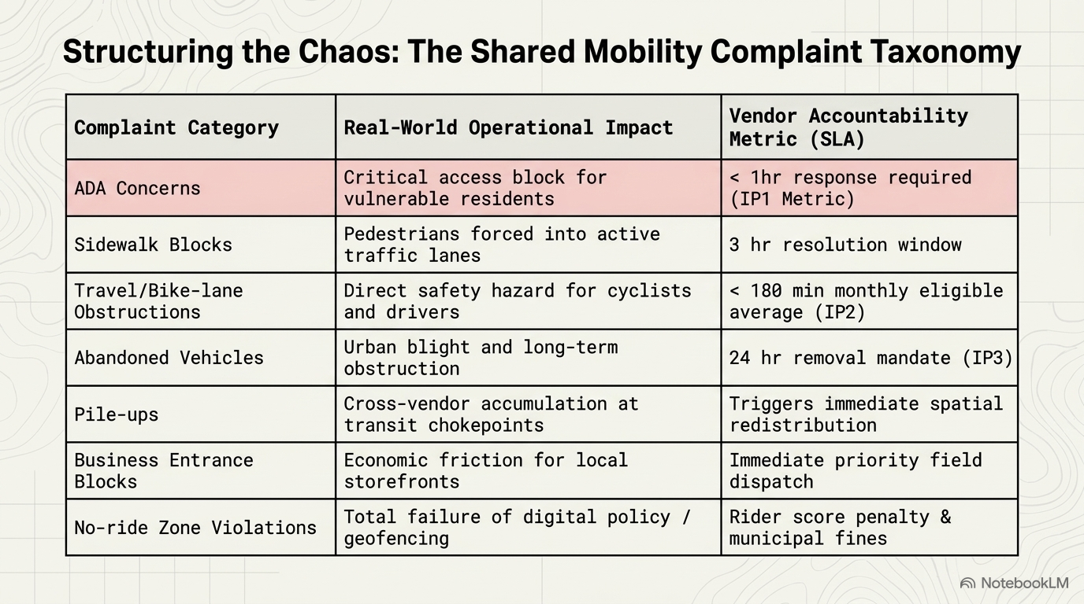
Notes:
[Sources]
Original visual master: Civic_Data_and_Vendor_Accountability.pptx
Design-system palette: tokens/colors.css
Presentation guidance: guidelines/office.md

Slide 4
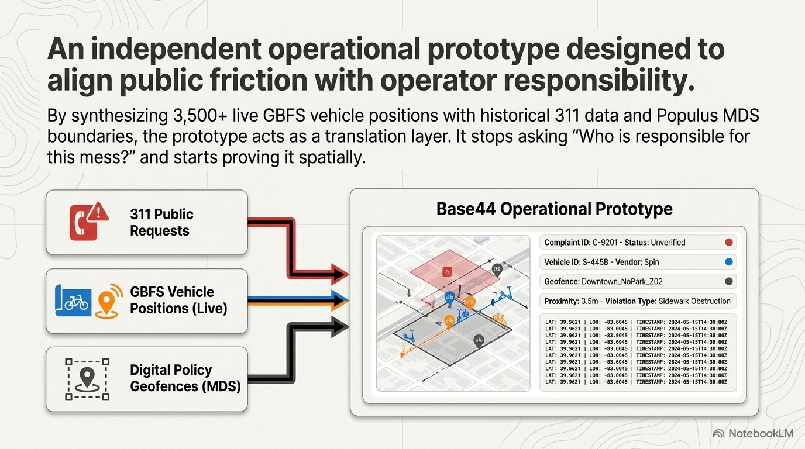
Notes:
[Sources]
Original visual master: Civic_Data_and_Vendor_Accountability.pptx
Design-system palette: tokens/colors.css
Presentation guidance: guidelines/office.md

Slide 5
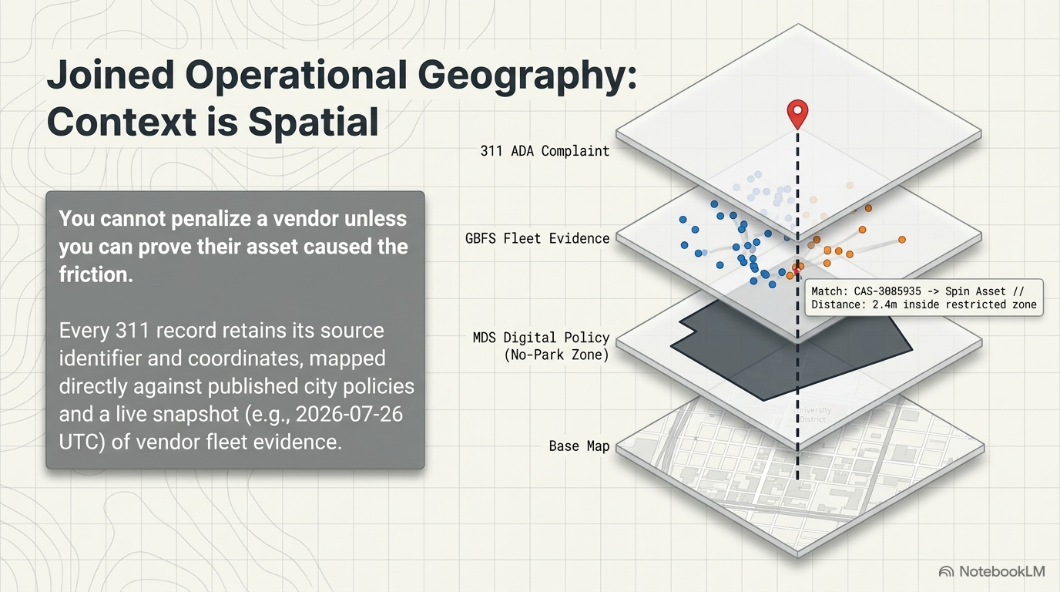
Notes:
[Sources]
Original visual master: Civic_Data_and_Vendor_Accountability.pptx
Design-system palette: tokens/colors.css
Presentation guidance: guidelines/office.md

Slide 6
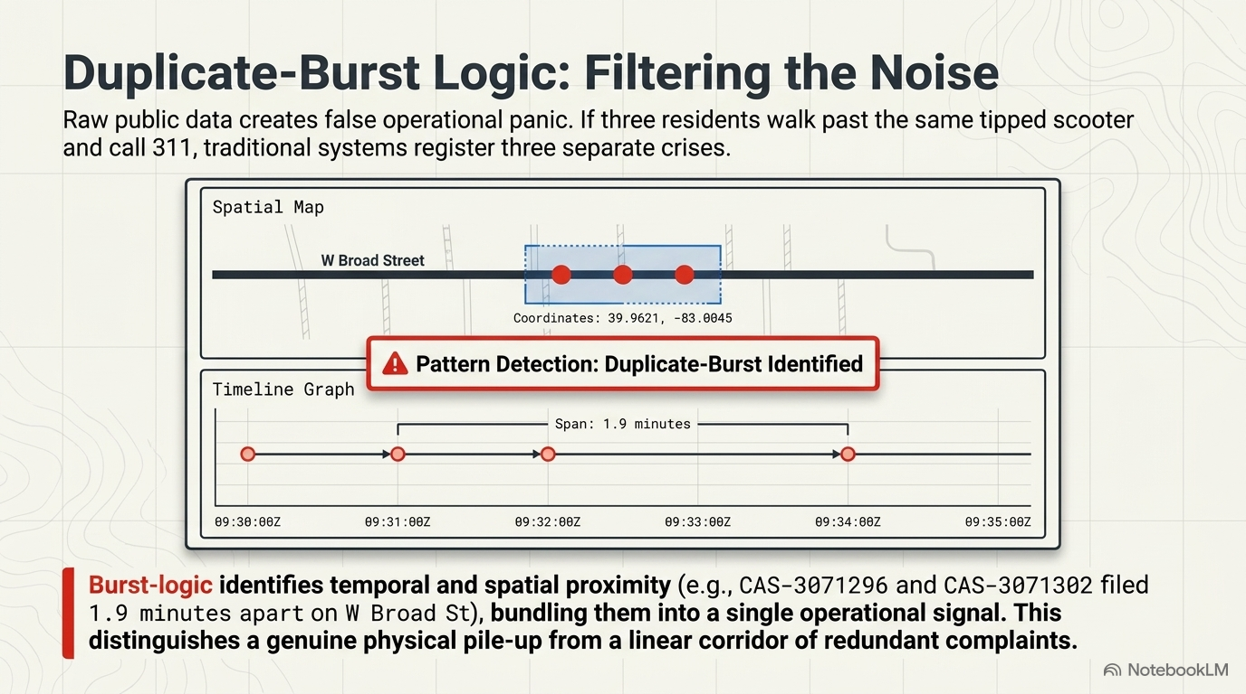
Notes:
[Sources]
Original visual master: Civic_Data_and_Vendor_Accountability.pptx
Design-system palette: tokens/colors.css
Presentation guidance: guidelines/office.md

Slide 7
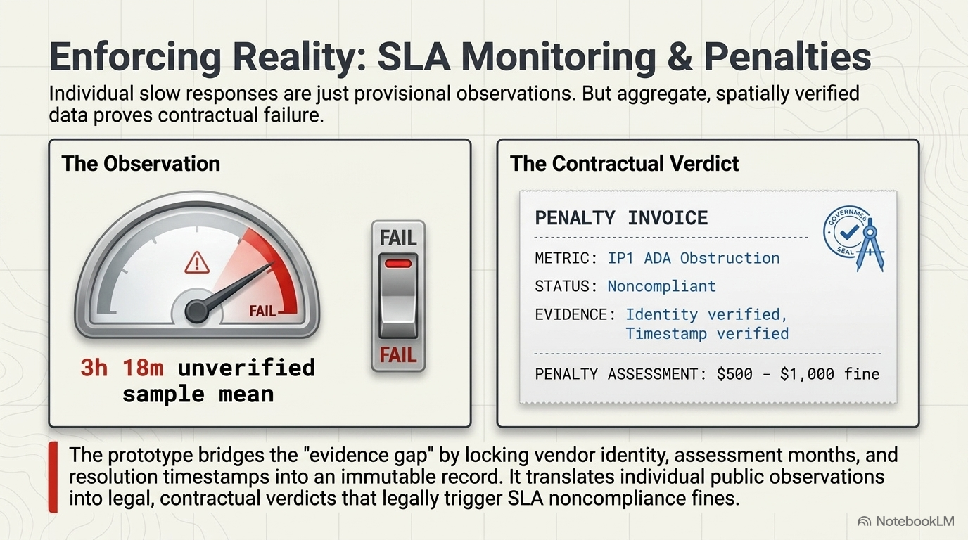
Notes:
[Sources]
Original visual master: Civic_Data_and_Vendor_Accountability.pptx
Design-system palette: tokens/colors.css
Presentation guidance: guidelines/office.md

Slide 8
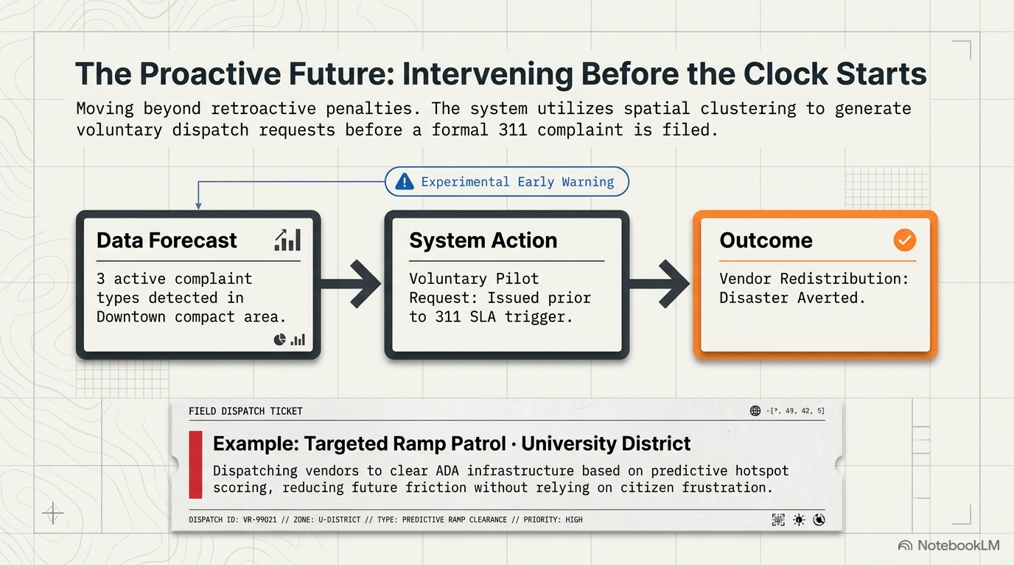
Notes:
[Sources]
Original visual master: Civic_Data_and_Vendor_Accountability.pptx
Design-system palette: tokens/colors.css
Presentation guidance: guidelines/office.md

Slide 9
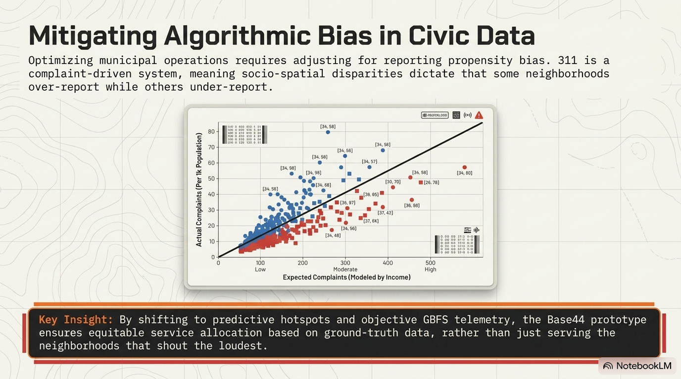
Notes:
[Sources]
Original visual master: Civic_Data_and_Vendor_Accountability.pptx
Design-system palette: tokens/colors.css
Presentation guidance: guidelines/office.md

Slide 10
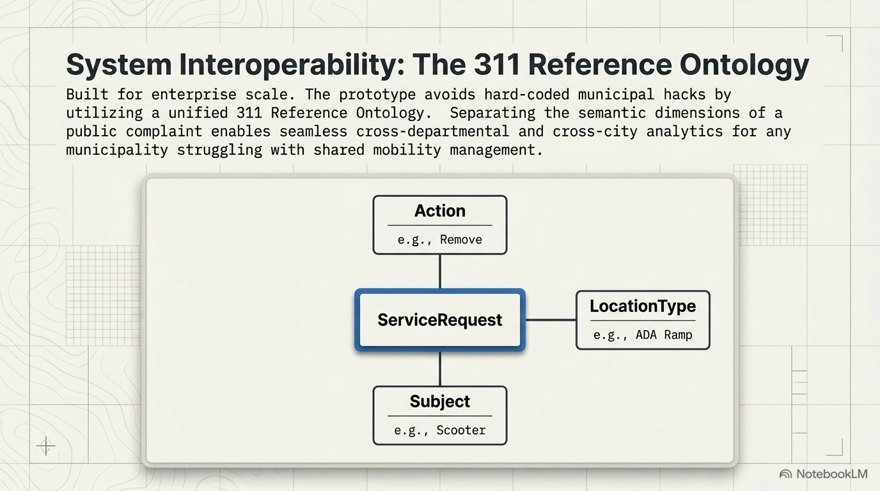
Notes:
[Sources]
Original visual master: Civic_Data_and_Vendor_Accountability.pptx
Design-system palette: tokens/colors.css
Presentation guidance: guidelines/office.md

Slide 11
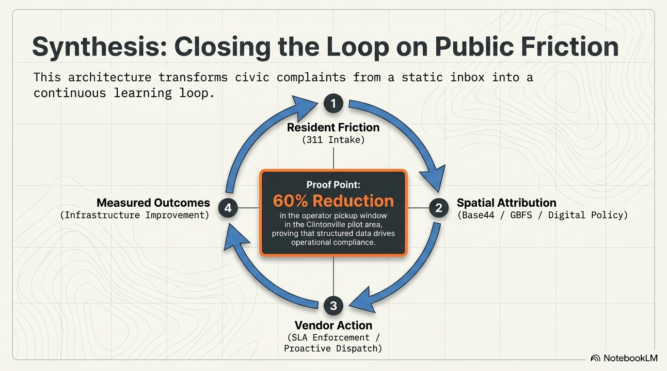
Notes:
[Sources]
Original visual master: Civic_Data_and_Vendor_Accountability.pptx
Design-system palette: tokens/colors.css
Presentation guidance: guidelines/office.md

Slide 12
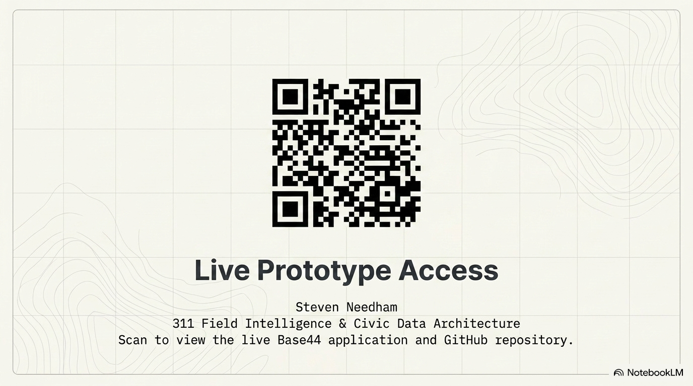
Notes:
[Sources]
Original visual master: Civic_Data_and_Vendor_Accountability.pptx
Design-system palette: tokens/colors.css
Presentation guidance: guidelines/office.md

