Slide 1
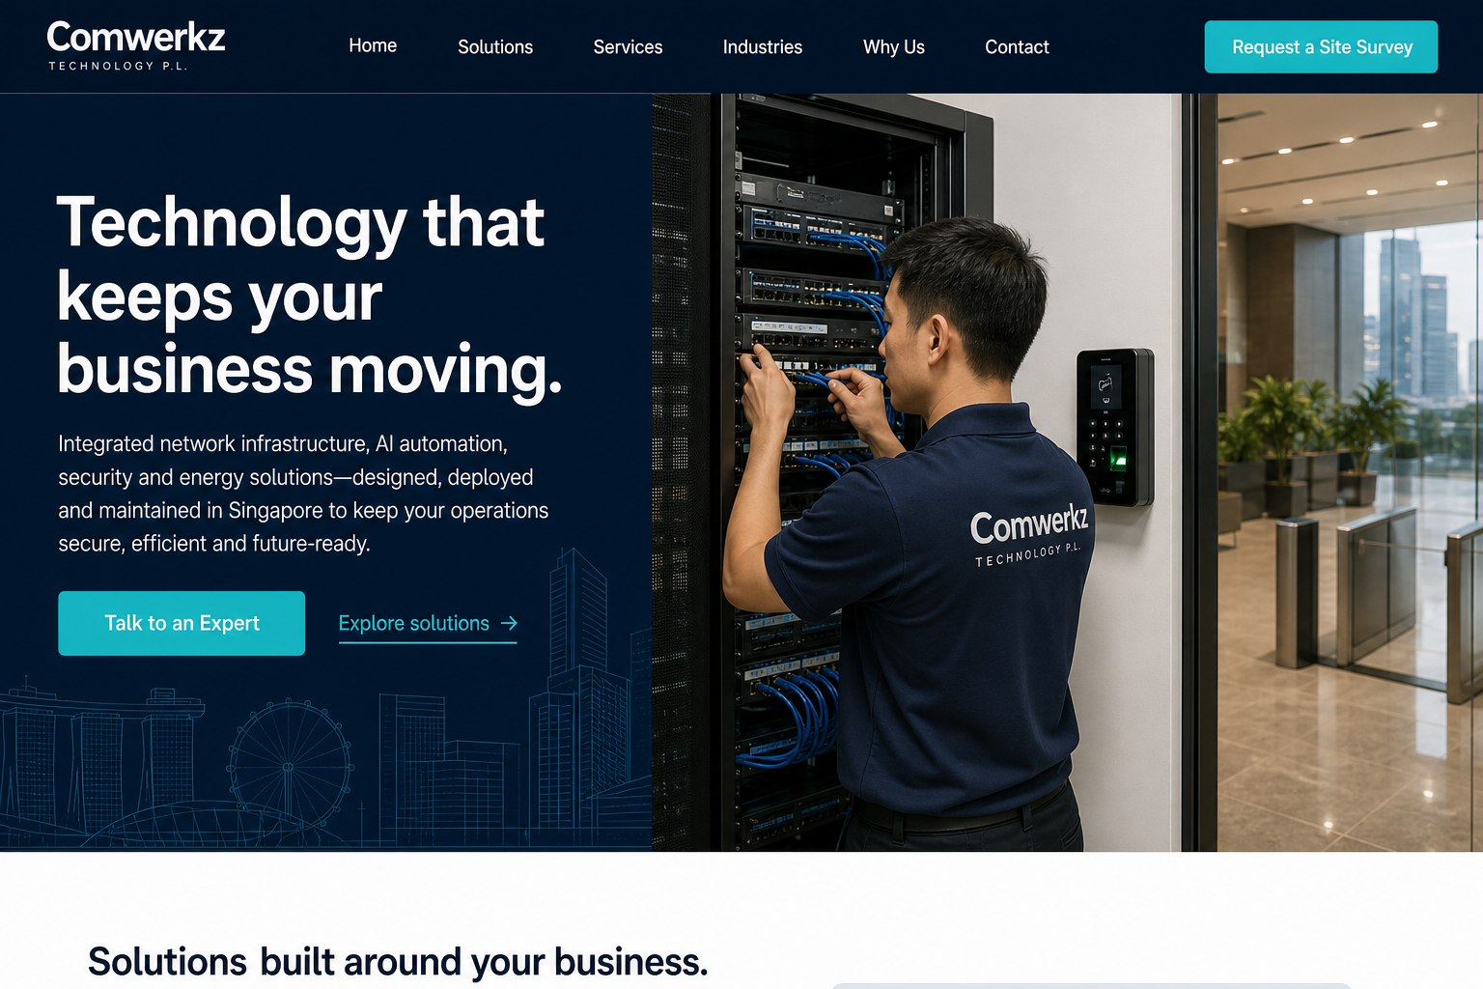
COMWERKZ
TECHNOLOGY P.L.
Website Build
Proposal
A modern, mobile-first digital presence for Singapore’s connected businesses.
INTERNAL LEADERSHIP APPROVAL • JULY 2026
COMWERKZ | WEBSITE BUILD PROPOSAL
01

Slide 2
THE OPPORTUNITY
A clearer website turns a broad capability set into qualified enquiries.
Comwerkz serves multiple property and business environments. The site must help each audience quickly recognise the relevant solution and take the next step.
01
02
03
Clarify the offer
Serve priority buyers
Make contact effortless
Group infrastructure, AI, security, energy and robotics into a simple, credible story.
Speak directly to SMEs, facilities, developers, MCSTs and homeowners.
Guide every visitor to a site survey, phone call, email or preferred message channel.
Priority audiences: SMEs • Commercial buildings • Retail • Factories & warehouses • Hotels & schools • Developers & MCST • Landed homes
COMWERKZ | WEBSITE BUILD PROPOSAL
02

Slide 3
THE PROPOSED EXPERIENCE
One focused page. One clear path to enquiry.
The information architecture moves visitors from relevance to confidence, then puts the right contact action within reach.
01
Lead with the business outcome
Network, automation, security and energy work together to keep operations moving.
02
Show solutions in context
Use direct pathways for the five service pillars and the industries they support.
03
Convert with low-friction actions
Site survey, call, email and message actions remain visible on every device.
COMWERKZ | WEBSITE BUILD PROPOSAL
03

Slide 4
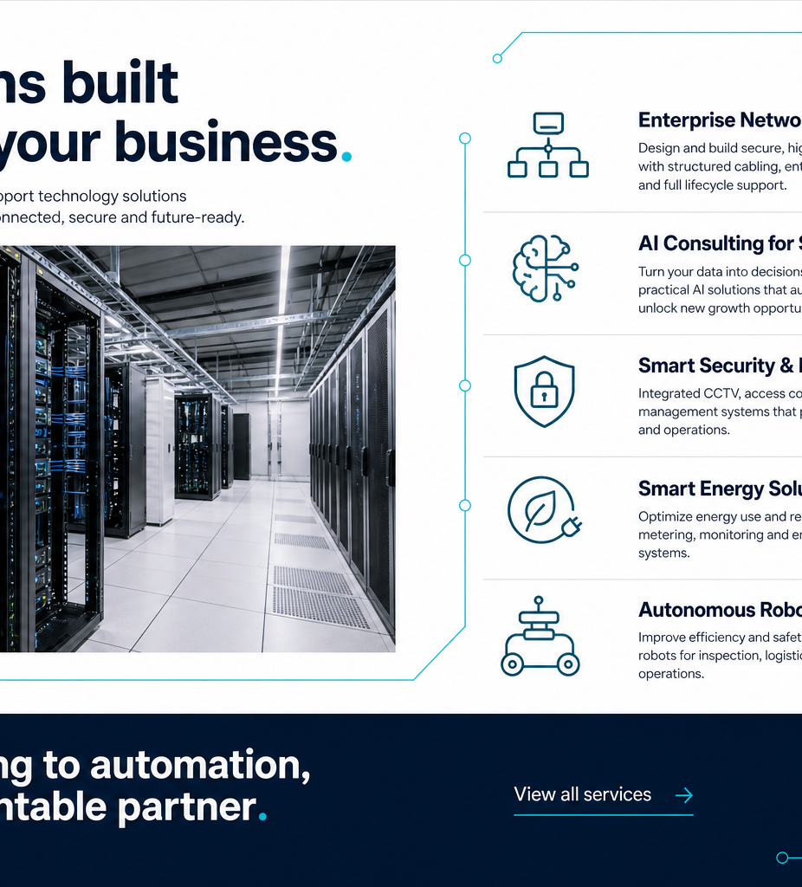
SOLUTIONS CUSTOMERS CAN UNDERSTAND
Five integrated offerings, organised around practical business needs.
The website presents each area without requiring visitors to understand the underlying technology first.
01
Enterprise Network Infrastructure
Cabling, fibre, Wi-Fi, racks and network rollout.
02
AI Consulting for SMEs
Agents, automation, chatbots, RAG and knowledge workflows.
03
Smart Security & Building
Access control, visitor management, CCTV and monitoring.
04
Smart Energy Solutions
EV charging, solar and energy monitoring.
05
Autonomous Robotics
Commercial cleaning and facility automation.
COMWERKZ | WEBSITE BUILD PROPOSAL
04

Slide 5
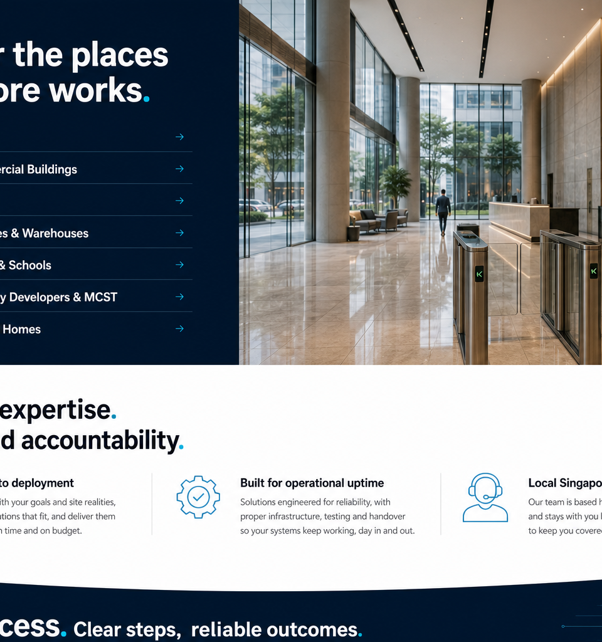
BUILT FOR THE PLACES SINGAPORE WORKS.
Every audience sees a relevant starting point.
The industry section translates Comwerkz’s technical scope into the physical spaces and operating needs customers recognise.
01
SMEs
02
Commercial buildings
03
Retail
04
Factories & warehouses
05
Hotels & schools
06
Property developers & MCST
07
Landed homes
COMWERKZ | WEBSITE BUILD PROPOSAL
05

Slide 6
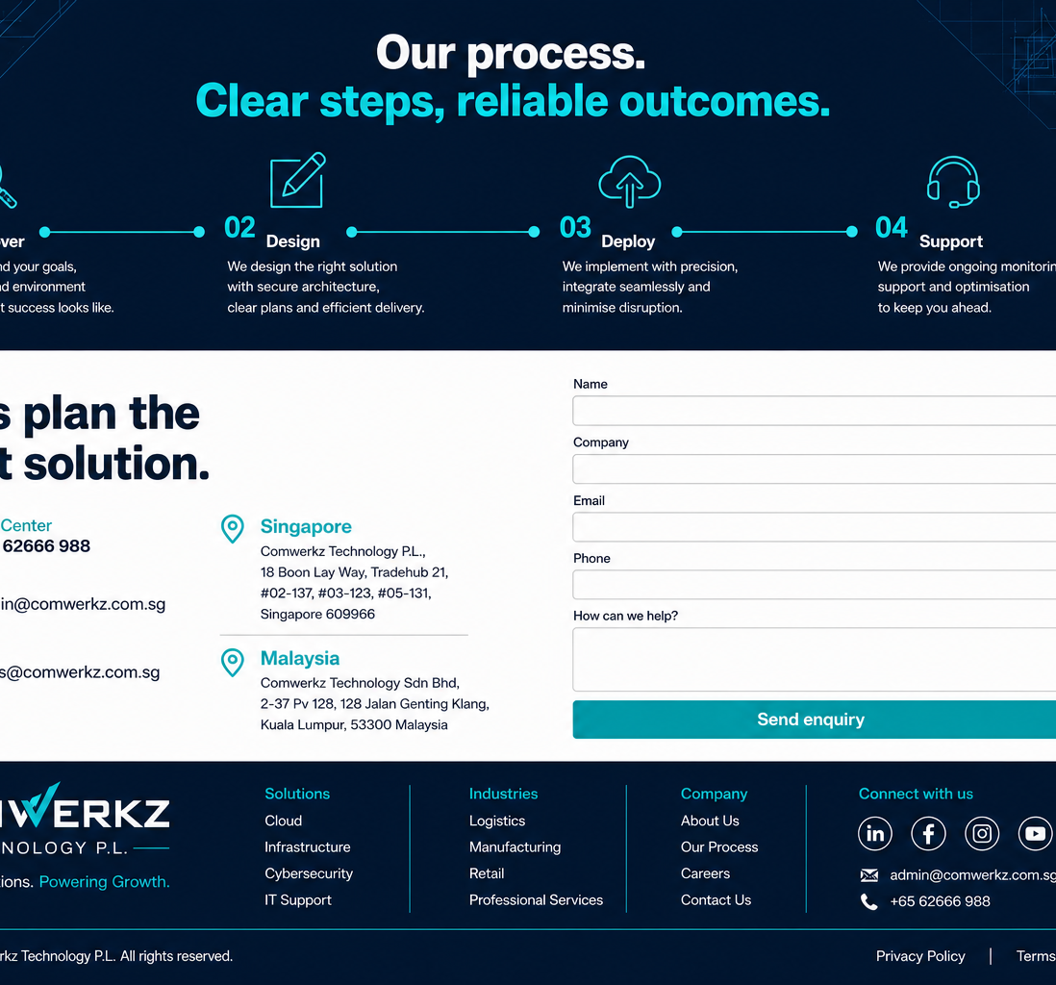
TRUST IS DESIGNED INTO EVERY INTERACTION.
Every next step is easy to complete.
The experience prioritises clear information, accessible interaction and practical communication pathways.
01
Sticky navigation
Straightforward section links, prominent site-survey CTA and a mobile hamburger menu.
02
Enquiry-ready contact
A concise form, phone and email options, plus floating contact actions.
03
Inclusive by default
Large touch targets, responsive layouts, strong contrast and reduced-motion support.
COMWERKZ | WEBSITE BUILD PROPOSAL
06

Slide 7
A PRODUCTION-READY FOUNDATION PROTECTS QUALITY AFTER LAUNCH.
Modern web tooling supports speed, discoverability and safe releases.
The implementation is designed to make future updates routine while preserving performance, accessibility and search readiness.
Build
Experience
Growth
Delivery
Next.js
React
TypeScript
Tailwind CSS
Framer Motion
Responsive design
SEO-ready metadata
Analytics integration
Optimised images
GitHub workflow
Vercel previews
Approved production release
Quality gates
Linting • Unit tests • Build validation • Security scanning • Performance, accessibility and SEO checks
COMWERKZ | WEBSITE BUILD PROPOSAL
07

Slide 8
DELIVERY AND APPROVAL
Approve the direction, then build and launch with confidence.
The first decision is to approve this direction and start the build with the required contact-channel details.
01
Confirm
Approve the visual direction, copy priorities and contact destinations.
Approval requested
02
Build
Create reusable Next.js components, responsive layouts and SEO configuration.
Proceed with the website build plan and nominate final WhatsApp, Telegram and social destinations.
03
Validate
Test mobile and desktop behaviour, accessibility, performance and form flow.
04
Launch
Review preview deployment, approve production release and monitor analytics.
CONTACT
Comwerkz Technology P.L.
18 Boon Lay Way, Tradehub 21
#02-137, #03-123, #05-131
Singapore 609966
COMWERKZ | WEBSITE BUILD PROPOSAL
08

