Slide 1
HTML/CSS/JavaScript
Computer science club
By Marco Gao

Slide 2
Languages use to make Website
Html
Css
JavaScript
PHP
Java Web
Oracle
Sql

Slide 3
HTML label
<p>, <div>, <a>, <h1> - <h6>, <span>, <img>, <html>, <body>, <head>, <style>, <form>, <input>, <table>, <tbody>, <thead>, <td>, <tr>, <ul>, <li>, <select>, <option>,<br>, <script>, <meta>, <link>
Block label: <p> <div>, <h1> - <h6>, <html>, <body>, <head>, <table>, <tbody>, <thead>, <tr>, <ul>, <li>,<br>, <form>, <select>, <option>
Inline-block label: <a>, <span>, <img>, <input>, <td>
Other: <style>, <script>, <meta>, <link>

Slide 4
Elements that have end tag
<p>, <div>, <a>, <h1> - <h6>, <span>, <html>, <body>, <head>, <style>, <form>, <table>, <tbody>, <thead>, <td>, <tr>, <ul>, <li>, <select>, <option>, <script>

Slide 5
Elements that have no end tag
<img>, <input>, <br>, <meta>, <link>

Slide 6
P
The <p> tag defines a paragraph.
Browsers automatically add some space (margin) before and after each <p> element.
<p></p>

Slide 7
Div
The <div> tag defines a division or a section in an HTML document.
The <div> element is often used as a container for other HTML elements to style them with CSS or to perform certain tasks with JavaScript.
<div></div>

Slide 8
a
The <a> tag defines a hyperlink, which is used to link from one page to another.
The most important attribute of the <a> element is the href attribute, which indicates the link's destination.
By default, links will appear as follows in all browsers:
An unvisited link is underlined and blue
A visited link is underlined and purple
An active link is underlined and red
<a></a>

Slide 9
H1 – h6
The <h1> to <h6> tags are used to define HTML headings.
<h1> defines the most important heading. <h6> defines the least important heading.
<h1></h1>
<h2></h2>
<h3></h3>
<h4></h4>
<h5></h5>
<h6></h6>

Slide 10
span
The <span> tag is used to group inline-elements in a document.
The <span> tag provides no visual change by itself.
The <span> tag provides a way to add a hook to a part of a text or a part of a document.
<span></span>

Slide 11
img
The <img> tag defines an image in an HTML page.
The <img> tag has two required attributes: src and alt.
The full name of img is image
<img />

Slide 12
html
The <html> tag tells the browser that this is an HTML document.
The <html> tag represents the root of an HTML document.
The <html> tag is the container for all other HTML elements
<html></html>

Slide 13
body
The <body> tag defines the document's body.
The <body> element contains all the contents of an HTML document, such as text, hyperlinks, images, tables, lists, etc.
<body></body>

Slide 14
head
<head></head>
<head> element is a container for all the head elements.
The <head> element can include a title for the document, scripts, styles, meta information, and more.
The following elements can go inside the <head> element:
<title> (this element is required in an HTML document)
<style>
<base>
<link>
<meta>
<script>
<noscript>

Slide 15
style
The <style> tag is used to define style information for an HTML document.
Inside the <style> element you specify how HTML elements should render in a browser.
Each HTML document can contain multiple <style> tags.
<style></style>

Slide 16
form
<form>
The <form> tag is used to create an HTML form for user input.
The <form> element can contain one or more of the following form elements:
<input>
<textarea>
<button>
<select>
<option>
<optgroup>
<fieldset>
<label>
<output>

Slide 17
input
The <input> tag specifies an input field where the user can enter data.
<input> elements are used within a <form> element to declare input controls that allow users to input data.
An input field can vary in many ways, depending on the type attribute.
Propertied: placeholder, type, value
Value of type: text, number, checkbox, button, submit, password, radio
<input />

Slide 18
table
The <table> tag defines an HTML table.
An HTML table consists of the <table> element and one or more <tr>, <th>, and <td> elements.
<table></table>

Slide 19
thead
The <thead> tag is used to group header content in an HTML table.
The <thead> element is used in conjunction with the <tbody> and <tfoot> elements to specify each part of a table (header, body, footer).
Browsers can use these elements to enable scrolling of the table body independently of the header and footer. Also, when printing a large table that spans multiple pages, these elements can enable the table header and footer to be printed at the top and bottom of each page.
The <thead> tag must be used in the following context: As a child of a <table> element, after any <caption>, and <colgroup> elements, and before any <tbody>, <tfoot>, and <tr> elements.
<thead></thead>

Slide 20
tbody
The <tbody> tag is used to group the body content in an HTML table.
The <tbody> element is used in conjunction with the <thead> and <tfoot> elements to specify each part of a table (body, header, footer).
Browsers can use these elements to enable scrolling of the table body independently of the header and footer. Also, when printing a large table that spans multiple pages, these elements can enable the table header and footer to be printed at the top and bottom of each page.
The <tbody> tag must be used in the following context: As a child of a <table> element, after any <caption>, <colgroup>, and <thead> elements.
<tbody></tbody>

Slide 21
tr
The <tr> tag defines a row in an HTML table.
<tr></tr>

Slide 22
td
The <td> tag defines a standard cell in an HTML table.
The text in <td> elements are regular and left-aligned by default.
<td></td>

Slide 23
ul
The <ul> tag defines an unordered (bulleted) list.
Use the <ul> tag together with the <li> tag to create unordered lists.
<ul></ul>

Slide 24
li
The <li> tag defines a list item.
The <li> tag is used in ordered lists(<ol>), unordered lists (<ul>), and in menu lists (<menu>).
<li></li>

Slide 25
select
The <select> element is used to create a drop-down list.
The <option> tags inside the <select> element define the available options in the list.
<select></select>

Slide 26
option
The <option> tag defines an option in a select list.
<option> elements go inside a <select> or <datalist> element.
<option></option>

Slide 27
br
The <br> tag inserts a single line break.
<br />

Slide 28
script
The <script> tag is used to define a client-side script (JavaScript).
The <script> element either contains scripting statements, or it points to an external script file through the src attribute.
Common uses for JavaScript are image manipulation, form validation, and dynamic changes of content.
<script></script>

Slide 29
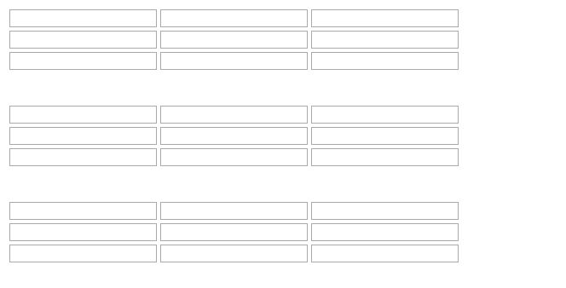
How to write it
Form + div + table *3
Table 1: input type: text
Table 2: input type: number
Table 3: input type: password
Td’s Class: row + row number, line + line number, table + table number
For example: class="line1 row1 table1"
Id: English letter in order, the last one is aa.
notice: English character only

