Slide 1
A Sample Relational Database
NAME E# BIRTH GRADE SALARY
A 121 1958.2.12 2 80
A 132 1961.6.17 3 70
B 101 1973.2.28 4 70
C 106 1961.5.10 2 80
E# BOOK DATE
132 a 99.7.13
121 b 99.8.26
E# ILLNS DATE
101 cold 99.6.20
121 flu 99.5.16
E# ADDR BIRTH
101 aaa 1963.2.28
121 bbb 1948.2.12
106 ccc 1951.5.10
132 ddd 1951.6.17
Notes:
5
6

Slide 2
Some Typical Queries
Some typical queries
  Give names of all employees born before 1970.1.1.
  Give names and addresses of all employees who took out a book before 1999.8.1.
  Send notices to all employees who had a flu to come for a checkup.
Note that some queries involve a single table, and some involve several tables.
We would like to have a convenient language, as close as possible to a natural language, to express these kinds of queries.
Such languages exist; for instance SQL and QBE.
Notes:
6
7

Slide 3
The Need for Good Design
It is important to come up with correct (or just good) choice of
  Which tables to use?
  What should be their structure?
Some sample problems with our design:
  An item of data should usually appear once only.
    Here we have the birth date appearing twice.
      There is a danger that this will be inconsistent.
    Even more dangerous would be multiple storage of employee's address.
      If the employee moves, the address must be changed everywhere.
Note, however, that from efficiency point of view, it might be useful to replicate information, to speed up the access.
Notes:
7
8

Slide 4
Storage of Constraints
Assume that it is the policy of the enterprise that the salary is determined only by the value of GRADE.
  Thus the fact that the GRADE = 2 implies SALARY = 80 is written twice in the database.
  This is another type of redundancy, which is less obvious at first.
There are additional problems with this design.
  We are unable to store the salary structure for a GRADE that does not currently exist for any employee.
  For example, we cannot store that GRADE = 1 implies SALARY = 90.
Notes:
8
9

Slide 5
Handling Storage of Constraints
This problem can be solved by replacing:
  NAME E# BIRTH GRADE SALARY
  A 121 1948.2.12 2 80
  A 132 1951.6.17 3 70
  B 101 1963.2.28 4 70
  C 106 1951.5.10 2 80
by two tables:
  NAME E# BIRTH GRADE
  A 121 1948.2.12 2
  A 132 1951.6.17 3
  B 101 1963.2.28 4
  C 106 1951.5.10 2
  GRADE SALARY
  2 80
  3 70
  4 70
Design of relational databases deals with such issues.
Notes:
9
10

Slide 6
Different Users Need Different Data
Various user groups may need to look at the data assuming different organization.
For privacy/security reasons we may want to give different users different access privileges to the database. For example:
  The payroll department can see salaries but cannot see diseases.
  The health department can see diseases but cannot see salaries.
Users may prefer to look at different aspects of the information.
  The payroll department may prefer to see the salary in a different currency.
  The health department may prefer to see AGE instead of BIRTH.
Notes:
10
11

Slide 7
Solution: Views
A possible solution: give each user (class of users) privileges to look at a view, that is a small derived database. For example:
The health department may think that there is a table:
E# NAME ADDRSS AGE DISEASE
101 B aaa 25 COLD
121 A bbb 37 FLU
The database should provide such a view, which is computed from the existing tables, without the user knowing other (prohibited for this user) information.
We need to leave flexibility for unanticipated queries
  Some people may want to ask the query:
  “How are salaries and diseases correlated?”
Notes:
11
12

Slide 8
Manipulating Data Through Views
The ideal goal is for the users to manipulate the database by means of views.
Unfortunately, sometimes it impossible or difficult to do so.
  If the user wants to change the age of an employee, how should the change be reflected in the date of birth?
  How to change the sum of salaries, if some view contains this information?
Notes:
12
13

Slide 9
Physical Design
The database system must be organized so that it is able to process queries efficiently. To do that:
  Files must be organized appropriately.
  Indices may be employed
For example, if we frequently want to find the GRADE for various E#, maybe the file should be hashed on this value, allowing direct access.
But, if we want to print the salaries of all the employees born in 1973, maybe the file should be sorted by BIRTH.
What to do in general? Physical design of databases deals with such issues, which are also closely related to the optimization of query processing.
  This will be a significant part of 671.
Notes:
13
14

Slide 10
Recovery
The database must be resilient despite the fact that the system is prone to faults.
Assume one more table, describing the balances of employees' accounts in the credit union.
  E# SAVNGS CHECKNG
  101 40 30
  106 40 20
  121 0 80
  132 10 0
We want to give each employee a bonus of 10 in the savings account.
  To do that, a transaction (execution of user program) will sequentially change the values of SAVINGS.
Notes:
14
15

Slide 11
Example of a Problem
The file describing the table is stored on a disk, values are read into random access memory, modified and written out: if X is a local variable then we have a trace of the desired execution (in shorthand):
X:=SAVINGS[101] Read
X:=X+10 Processing
SAVINGS[101]:=X Write
.
.
.
What if the system crashes in the middle (say, electricity stops)?
We do not know which of the values have been changed, so what to do to recover?
Various techniques exist for managing the execution, so that reliable execution is possible.
Notes:
15
16

Slide 12
Concurrency
There may also be problems because of the concurrent execution of several transactions in a time sharing system.
Assume that we are running a transaction, T1, that should compute and print:
  E# BALANCE (CHECKING)
  101 70
  106 60
  121 80
  132 10
Concurrently E# = 121 wants to move 40 from CHECKING to SAVINGS, using transaction T2.
In a time-sharing system we could have an incorrect execution.
We write CH for CHECKING and SA for SAVINGS.
Notes:
16
17

Slide 13
Execution Trace of Two Transactions
T1 T2
.
.
.
X1:=SA[121] (X1=0) \\ Read Savings
Y1:=CH[121] (Y1=80) \\ Read Checking
Y1:= Y1 - 40 (Y1=40) \\ Subtract 40
CH[121]:=Y1 \\ Write it back
X2:=CH[121] (X2=40) \\ Read Checking
X1:=X1 + X2 (X1=40) \\ Sum
PRINT X1 (X1=40) \\ Total = 40
Y2:=SA[121] (Y2=0) \\ Read Savings
Y2:= Y2 + 40 (Y2=40) \\ Add 40
SA[121]:=Y2 \\ Write it back
.
.
We get incorrect value for E# = 121.
Standard operating system constructs do not help here, but concurrency control mechanisms that solve the problem exist.
Notes:
17
18

Slide 14
Purpose of the ER Model and Basic Concepts
The purpose of the Entity –
  Communication between users and the DBA
  Common, informal, and convenient model for the purpose of modeling the data's structure.
ER diagrams: Visual, pictorial descriptions of the relations between various data items.
There are 3 basic concepts appearing in the original ER model, which has since been extended.
  Entity
  Relationship
  Attribute
Notes:
2
29

Slide 15

Entity
This is a “thing'' that is distinguished from others in our application.
  Example: John.
In fact, it is not necessarily clear what a “distinguishable thing” is
All entities of the same “type'' form an entity set.
  Example: PERSON (actually a set of persons).
    We will frequently use the term “entity'' while actually referring to entity sets.
Pictorially it is denoted by a rectangle with its type written inside.
Notes:
3
30

Slide 16

Relationship
This is a relationship between (or among) entities.
  Example: If we are given entities: PERSON, CITY
  then we could define a relationship LIKES, such that person and city are related if and only the person likes the city.
  Pictorially it is denoted by a diamond with its type written inside.
Notes:
4
31

Slide 17

Attribute
This is a property of a an entity.
  Example: If we are given an entity such as PERSON,
  it could have attributes, name, e# (employee number), age, ssn (social security number), etc.
Pictorially, an attribute is denoted by an ellipse with its type written inside.
Notes:
5
32

Slide 18
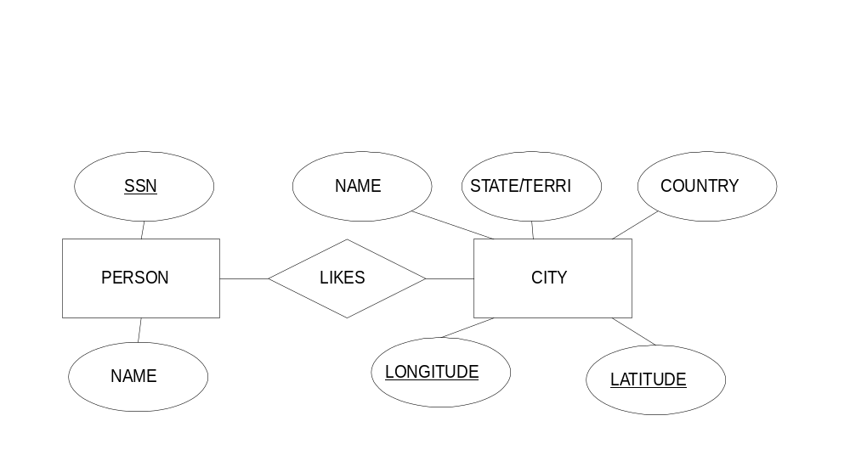
ER Diagrams
To show which entities participate in which relationships, and which attributes participate in which entities, we draw line segments between:
Entities and relationships they participate in.
  Attributes and entities they belong to.
We also underline the elements of some chosen key of each entity.
Notes:
7
34

Slide 19
Binary Relationships and Their Functionality
Consider a relationship R between two entity sets A, B.
A is the set of all living men and B is the set of all living women.
Many to One Relationship: The relationship R is called many to one from A to B if and only if for each element of A there exists at most one element of B related to it.
Example: R is “son of.”
  Each living man has at most one living mother.
One to One Relationship: The relationship R is called one to one between A and B if and only if for each element of A there exists at most one element of B related to it and for each element of B there exists at most one element of A related to it.
Example: R is “(currently married to).”
  Each man has at most one current wife; each woman has at most one current husband.
Many to Many Relationship: The relationship is called many to many between A and B, if it is not many to one from A to B and it is not many to one from B to A.
Example: R is “likes.”
Notes:
8
35

Slide 20
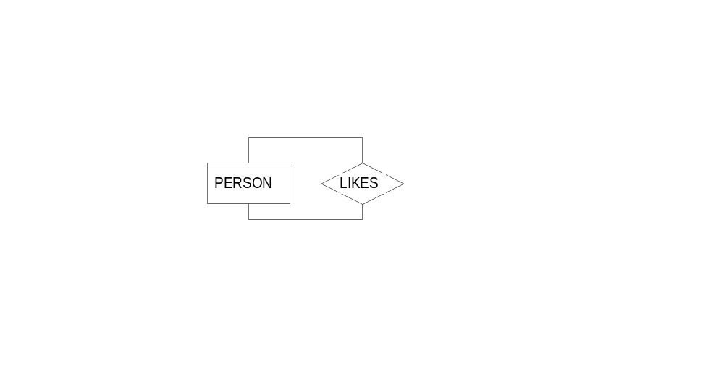
Binary Relationships Involving One Entity Set
Consider the relationship LIKES between PERSONs
  This is a binary relationship between an entity set and itself
  It means that there are pairs of (person,person) such that the first person likes the second person
  It is not necessary, but possible for a person to like himself/herself
Notes:
12
39

Slide 21
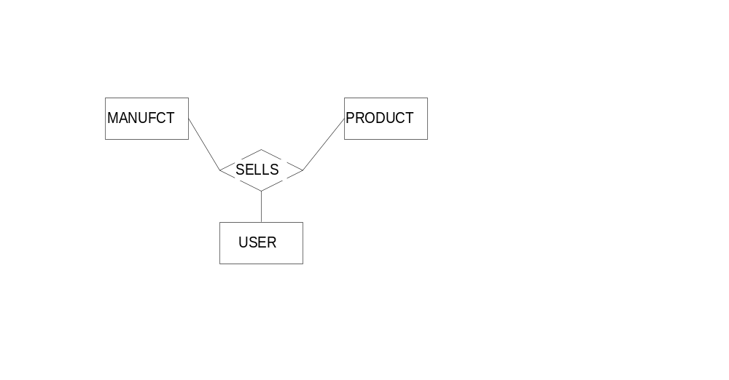
Non-Binary Relationships
Consider a relationship SELLS among MANUFACTURER, PRODUCT, USER.
It lists which manufacturer sells which product to which user.
Note that this relationship could not be expressed by several binary relationships
Notes:
13
40

Slide 22
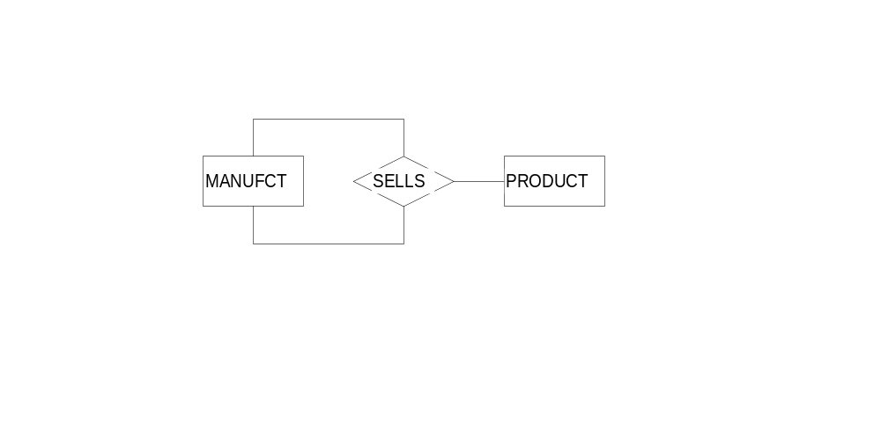
Non-Binary Relationships (Cont.)
Consider a relationship SELLS among MANUFACTURER, PRODUCT, MANUFACTURER:
It list which MANUFACTURER sells which PRODUCT to which MANUFACTURER (heavy industry database)
Notes:
16
43

Slide 23

Relationships Having Attributes
Notes:
18
45

Slide 24
A Small Comprehensive Application
The example will show how to describe an application and also will show how an ER diagram is implemented in the relational model.
The database deals with with the following entities:
  PERSON with attributes SS#, NAME, PHONE.
  OFFICE with attributes ROOM#, SIZE.
  PROFESSOR with attributes SALARY.
  STUDENT.
  COURSE with attributes C#, NAME, YEAR. (Identifies a specific class).
Notes:
26
53

Slide 25
A Small Comprehensive Application (cont.)
The database deals with relationships:
  HAS between PERSON and OFFICE.
  ISA between STUDENT and PERSON.
    Thus student is a weak entity.
  ISA between PROFESSOR and PERSON.
    Thus professor is a weak entity.
  TOOK between STUDENT and COURSE.
    This relationship has attribute GRADE.
  TAUGHT between PROFESSOR and COURSE.
    This relationship has attribute EVALUATION.
  APPROVED among PROFESSOR and TAUGHT.
    The idea is that an assignment of a professor to a course was approved by a professor (probably chair of the department).
Notes:
27
54

Slide 26
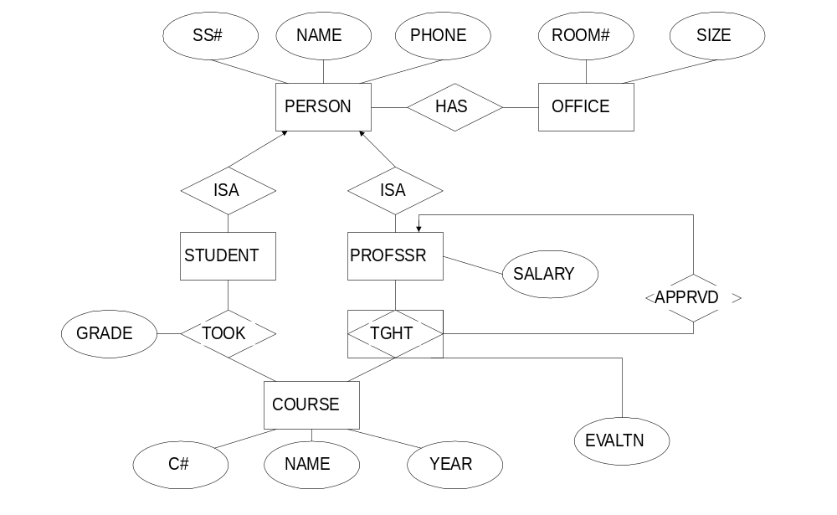
The ER diagram for the application
Notes:
28
55

Slide 27
From an ER Diagram to a Relational Database
From entities to relations
Relations will be specified as R(A1,A2...), where R is the name of the entity, and Ai is an attribute.
  PERSON(SS#, NAME, PHONE).
  OFFICE(ROOM#,SIZE).
  COURSE(C#,NAME,YEAR).
  PROFESSOR(SS#,SALARY).
  STUDENT(SS#).
Notes:
29
56

Slide 28
From Relationships to Relations
The relationships between entity sets give relations whose columns are
  key attributes of the participating entities
  and attributes of the relationship itself.
Thus we have:
  HAS(SS#,ROOM).
  TOOK(STSS#,C#,YEAR,GRADE).
  TAUGHT(PROFSS#,C#,YEAR, EVALUATION).
Each relation corresponding to a relationship has a key which is the concatenation of the keys of the participating entities.
Notes:
32
59

Slide 29
Conclusions
Strengths of the ER model:
  Intuitive.
  Easily convertible into actual database models.
Weaknesses of the ER model:
  It does not deal well with hierarchical structures
Notes:
35
62

Slide 30
Query Languages
Formal Languages
  Relational Algebra
  Relational Calculus
Commercial Languages
  SQL (Structured Query Language)
  QBE (Query By Example)
Notes:
1
65

Slide 31
Relational Algebra Operations
There are several fundamental operations on relations :
  Union
  Intersection
  Difference
  Division
  Projection
  Selection
  Rename
  Cartesian product
  Natural Join
  Theta Join
Notes:
4
67

Slide 32
Relational Algebra Operations
  {SELECT, PROJECT, UNION, DIFFERENCE, CARTESIAN P.} is a complete set (any other relational algebra operations can be expressed as a sequence of operations from this set.)
  Why to define new operations?
    Convenient to use
    Very commonly applied to database applications
  INTERSECTION:
  JOIN: CP followed by a SELECT operation
  NATURAL JOIN: CP preceded by RENAME and followed by SELECT and PROJECT
  DIVISION: Sequence of PROJECT, CP, DIFF
Notes:
4
67

Slide 33
Union (∪ )
If R and S are two relations, then the union of R and S is a relation consisting of all the rows in R and all the rows in S.
  R: A B
  1 10
  2 20
  S: A B
  1 10
  3 20
Thus, the union of R and S, denoted by R ∪ S is:
  A B
  1 10
  2 20
  3 20
Notes:
5
68

Slide 34
Intersection (∩ )
If R and S are two relations, then the intersection of R and S is a relation consisting of all the rows that are both in R and in S.
  R: A B
  1 10
  2 20
  S: A B
  1 10
  3 20
Thus, the intersection of R and S, denoted by R ∩ S is:
  A B
  1 10
Notes:
6
69

Slide 35
Difference ( - )
If R and S are two relations, then the difference of R and S is a relation consisting of all the rows in R that do not appear in S.
  A B
  1 10
  2 20
  A B
  1 10
  3 20
Thus, the difference of R and S, denoted by R - S is:
  A B
  2 20
Notes:
7
70

Slide 36
Projection π
If R is a relation, this operation produces a relation by listing which columns should be kept in the relation.
  A B C D
  1 10 100 1000
  1 20 100 1000
  1 20 200 1000
Then, the projection of R on B, A, D, denoted by π_{B,A,D} (R) is:
  B A D
  10 1 1000
  20 1 1000
Notes:
8
71

Slide 37
Selection (σ )
If R is a relation, this operation produces a relation by specifying a condition under which columns should be kept in the relation.
A B C D
5 5 7 4
5 6 5 7
4 5 4 4
5 5 5 5
4 6 5 3
4 4 3 4
4 4 4 5
4 6 4 6
Then the relation obtained by keeping those rows in which the first column is not greater than the third column and the fourth column values are equal to 4, denoted by: σ_{A ≤ C ∧ D=4} (R) is
A B C D
5 5 7 4
4 5 4 4
Notes:
9
72

Slide 38
Selection (cont.)
In general, the condition can be specified by a Boolean formula with
¬, ∧, and ∨ on atomic conditions, where a condition is:
  a comparison between two column names,
  a comparison between a column name and a constant.
Notes:
10
73

Slide 39
Division ( / )
“Retrieve the names of employees who work on all the projects that ‘John Smith’ works on.”
Used in queries that have a ‘FOR ALL’ requirement.
A row t belongs to R/S if for every tuple s in S there is a tuple r in R such that
  For each common field, the values are the same ( r[S] = s[S] )
  t has [R-S] fields and r[R-S] = t[R-S]

Slide 40
R xid yid S1 yid R/S1 xid
========= ======== ========
x1 y1 y2 x1
x1 y2 x2
x1 y3 S2 yid x3
x1 y4 ======== x4
x2 y1 y2
x2 y2 y4 R/S2 xid
x3 y2 ========
x4 y2 S3 yid x1
x4 y4 ======== x4
y1
y2 R/S3 xid
y4 ========
x1

Slide 41
Rename
This operator is used to rename attributes to remove potential ambiguity.
Ambiguity arises when the same relation appears more than once in a query.
Ambiguity also arises when two different relations in a query have the same field name.

Slide 42
Cartesian Product ( X )
If R and S are two relations, than this operation produces the relation whose rows consist of all the concatenations of the rows of the first relation with all the rows of the second relation.
R: A B
1 10
2 10
2 20
  S: C B D
  40 10 10
  50 20 10
Then the Cartesian product of R and S, denoted by R × S is
A R.B C S.B D
1 10 40 10 10
1 10 50 20 10
2 10 40 10 10
2 10 50 20 10
2 20 40 10 10
2 20 50 20 10
Notes:
11
74

Slide 43
Natural Join
Assume that we have 3 relations
  R(A,B,C), S(B,C,D,E), T(A,C,E,F).
Then the natural join of these 3 relations is:
π_{R.A,R.B, R.C, S.D, S.E, T.F} σR.A = T.A ∧ R.B = S.B ∧ R.C=S.C=T.C ∧ S.E=T.E ( R × S × T ).
  In effect, we glue the tuples together based on equality on equal-named columns and removing duplicate columns.
Notes:
26
89

Slide 44
Theta Join
In a Cartesian product if you can specify any conditions then it is a Theta Join.
Natural Join is when the condition is equals on similar name fields and also when the similar name columns are dropped from the final table.

