Slide 1
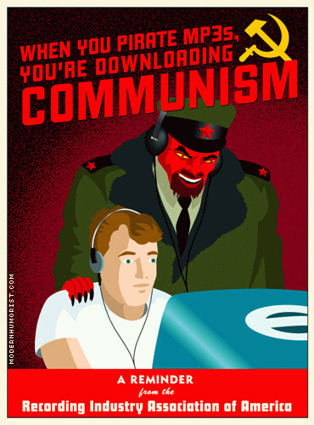
The RIAA’s Sinking Ship.
{It’s time to find a new business model}

Slide 2

RIAA – Who Are They?
Recording Industry Association of America
Trade group that represents hundreds of record labels.
Mission is to foster a business and legal climate that supports it’s members.
Account for ~90% of all legitimate recording produced and sold in U.S.
Source: www.riaa.org

Slide 3


RIAA – Current Business Model.
Vast library of millions of songs.
Sell this library to consumers one album at a time
(usually as CD for approx. $15 each).
Some online music services exist for legally downloading songs (ex. PressPlay, eMusic, & Apple’s iTunes Store).

Slide 4
Why It doesn’t Work.
Consumers don’t want a whole album at a time (approx. $15 each)… often just interested in one or two songs per album.
Can’t “Try-Before-You-Buy”.
Hard to find CDs of small/independent/local artists.
Very difficult to bring your entire collection of CDs everywhere you go, and listen to them anytime you want.
Legally downloaded files often impose use restrictions, cost too much, and are of limited availability (iTunes only has approx. 200k songs… compared to the millions that exist).

Slide 5

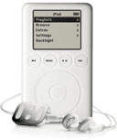


The Free Services.
Napster Revolution – today countless Napster Clones exist, creating file-swapping networks that allow users to trade music, movies, software, etc… (KaZaA currently largest, more than 15 million files traded each month).
mp3, AAC, wma, etc… formats along w/ portable players (Apple’s iPod has 30GB of storage, holding approx. 7,500 songs or 780 albums) allow consumers to bring their entire collection of music w/ them anywhere, and listen to it anytime.
Most important… These are FREE!!!
A few problems:
  Erroneous, incomplete, and poor-quality files are abundant on these free services; also hard to find high bit-rate files.

Slide 6
RIAA’s New Model?
All members of the RIAA develope joint venture to give consumers largest possible selection of music (this also makes an industry standard format easier to push out).
Subscription based fee, w/ option of a per-song fee, for downloading music (This would allow for some type of incentives).
Allow users to store, play, and burn the files they download on as many computers, portable devices, and CDs as they want.
All available files are error-free and of good quality.
Make high-quality files ( > 128Kbps) available if users want them.
Need to offer something that the Free Services don’t.

Slide 7
Sources:
www.apple.com
www.mp3-mac.com/pages/History_of_MP3.html
www.riaa.org
www.openp2p.com
www.kazaa.com
www.zdnet.com

