Slide 1
AI plays AI-generated Pong
Steven Harper

Slide 2
AI plays AI-generated Pong
Create a model which plays Pong, called the agent
Create an image generator model which emulates Pong
Use the generator to create fake images of Pong
Train the agent on that fake version of Pong
See how good it does on real Pong

Slide 3
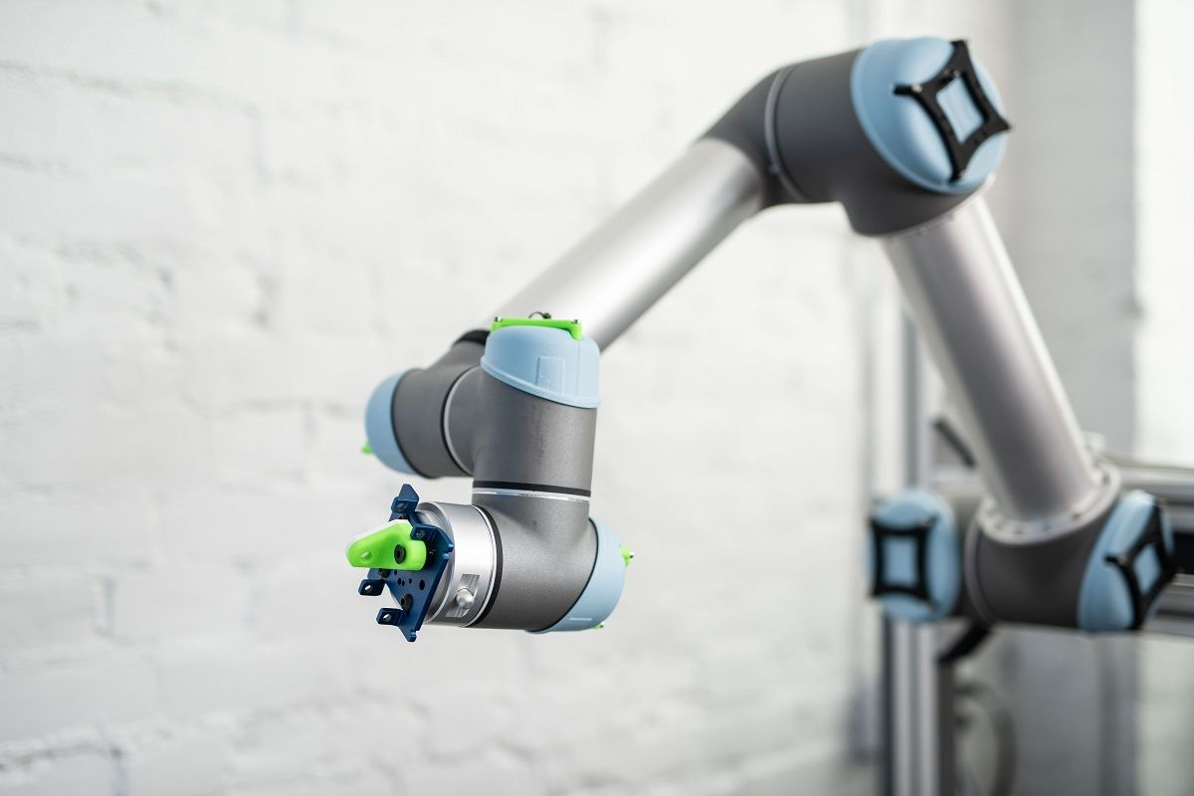
Why?
Training reinforcement learning models in a real environment can be expensive/difficult
Video generation is something that can also be applied to many other ideas.
It’s easy to get lots of data by running a game and saving images.

Slide 4
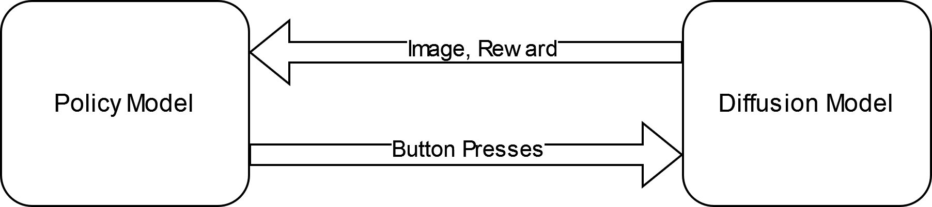
Overall Implementation
The agent model
Input: an Image
Output: a decision for what button to press
The generator model
Input: previous images & the agent’s decision
Output: a new image & rewards for the agent
The generator is trained before the agent

Slide 5
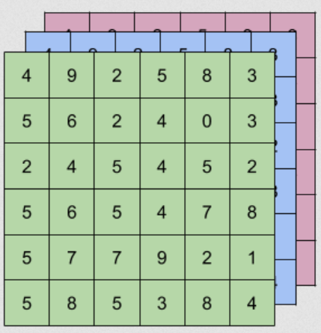
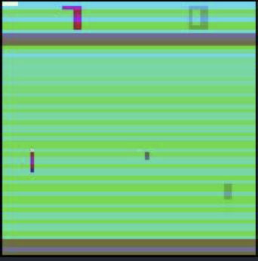
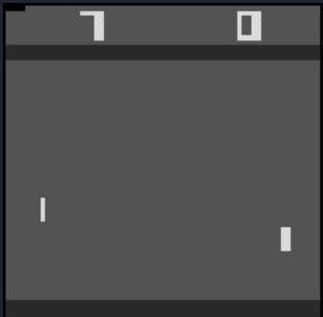
Data Generation
Run OpenAI gym library
Randomly select what actions to do
Save the last two images and decision as a 3 channel tensor (224x224)
Save the resulting image as a ground truth for the generator (64x64)

Slide 6
Architecture

Slide 7
Generator
Max pool
Denoising
Diffusion model
(Unet)
Upscale
Resnet18
(no fc layers)
1 Fully connected layer
Agent Reward
= Frozen
= Unfrozen
= No weights
Done signal

Slide 8
Denoising Diffusion Model

Slide 9
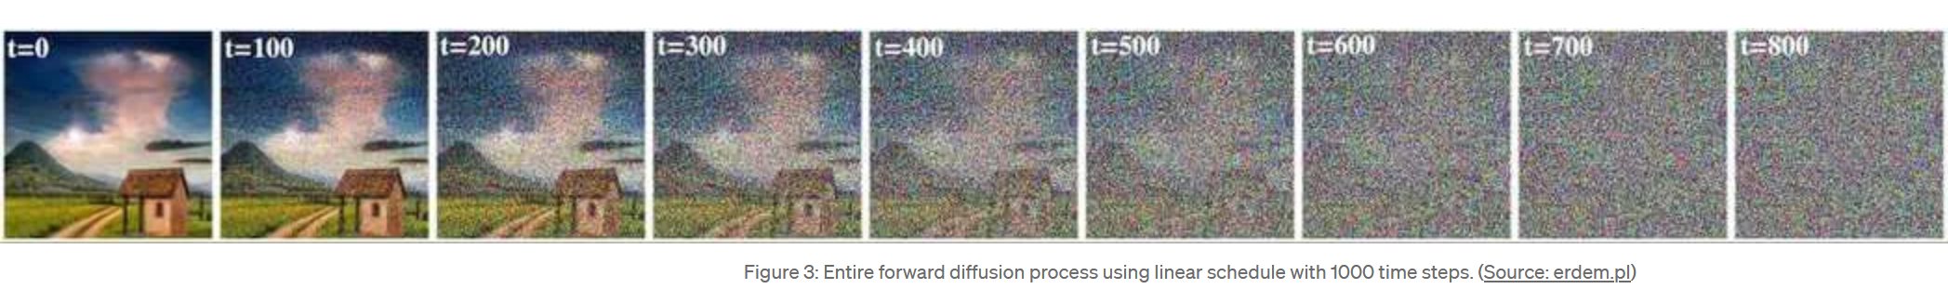
Concept
Generate an image from pure noise + an embedding
Incrementally undo noise
Train the model by trying to undo different levels of noise.
linear schedule

Slide 10
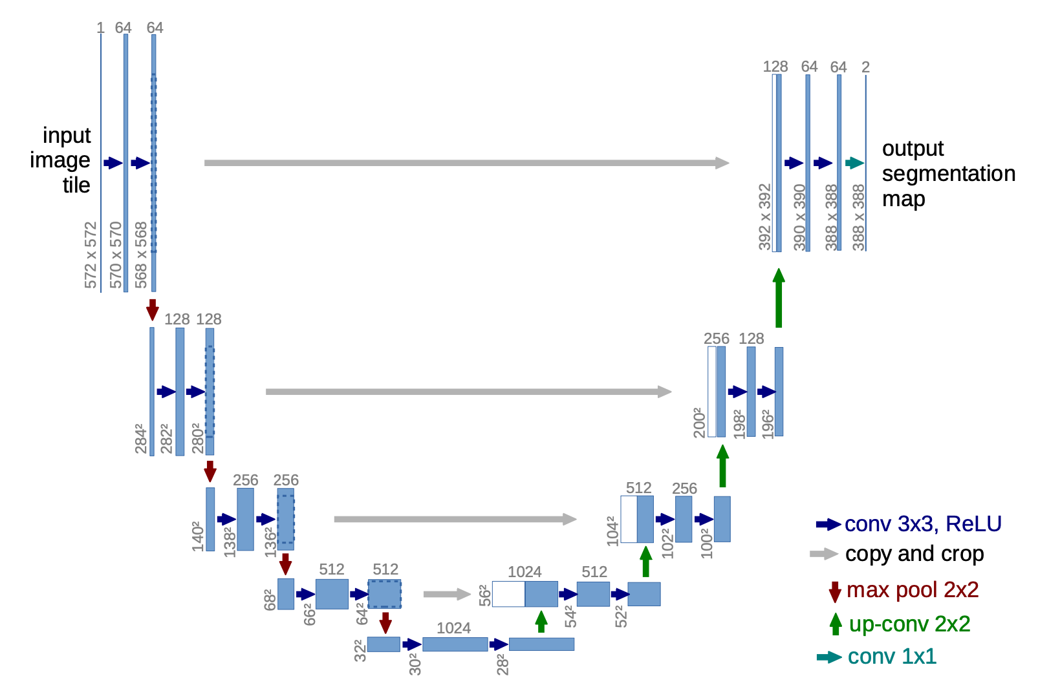
Architecture
Differences not listed here:
Up-conv consists of a direct upscaling of the image followed by many 3x3 convolution layers
A self attention layer is added between each down and each up layer.
Layer dimensions are not accurate for the model I used
Image sizes were 64x64
Output image size matched the input size
Input image
Less
Noised
Image
Image source: https://arxiv.org/abs/1505.04597

Slide 11
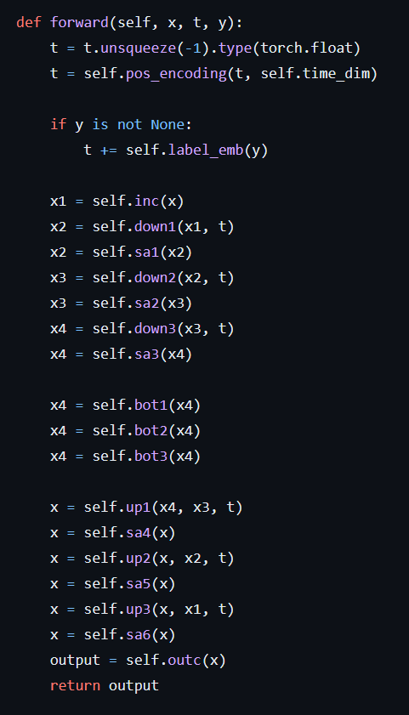
Specifics
Time step and embedding are applied at skip connections.
Time step uses positional encoding
Training vs Eval
At training the model is trying to predict the noise, given a noised image.
At eval the model is iteratively creating an image from noise.

Slide 12


Results
Many errors in training data
Wrong transforms
Conv layers
Learning rate
Still no good results.
With conv
Without conv

Slide 13
Further work
Get better results with generator
Change the generator to use a cosine scheduler
Try using the generator recurrently
Try using an agent
Look into better methods of upscaling diffusion images

Slide 14
Questions

Slide 15
Thank You

Slide 16
Generator Specifics
Resnet 18 takes a 224x224 image, Pong is 210x160
Resnet 18 has no fully connected layers, it outputs a 512 vector, this is reduced to 256 by the max pooling layer.
The output image looks like 64x64 but is upscaled to 224x224

