Slide 2



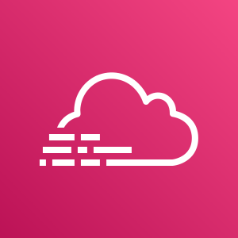

KMS Key
Log Bucket
All Regions
CloudTrail
CloudWatch Logs

