Slide 1

















Step 6
QUALITY
SPEED
COST

Slide 2

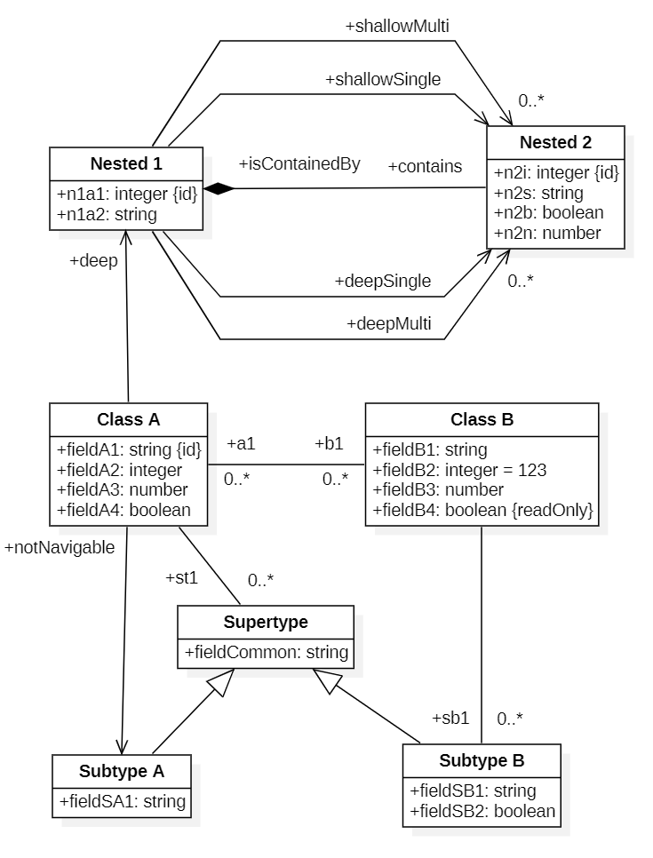
I want an API that integrates our systems …
What business data resources should the API transfer? …
Phases for Efficient API Development
Which API endpoints do we need, which can be removed?
Now to add business logic to the generated code
Project Sponsor
Business Analyst
1
Software Architect
Software Developer
2
3
4
5
API Spec Generator Tool
API Code Generator Tool
Finished API ready for
testing and deployment
Business Domain Model depicting API data resources, fields, and relationships
OpenAPI
Interface Specification
API Implementation Code
API Ideation
API Design
API Implementation

Slide 3
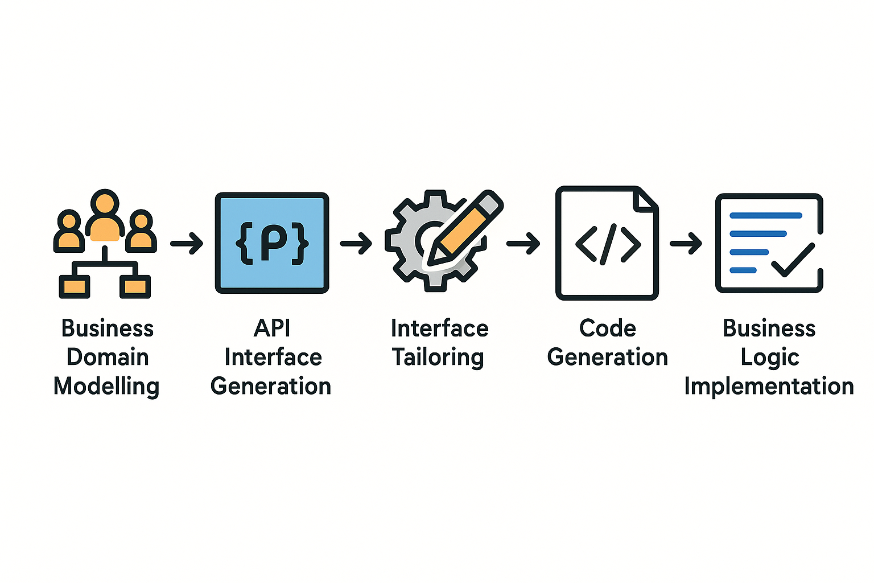
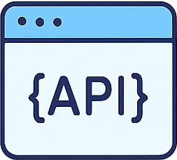


API

