Slide 1
Arduino: Beyond the Basics
Steven J Winter
Principal Engineer
Gracenote

Slide 2
Agenda
Introduction
Our friend, the Arduino
I want to make cheap stuff
Hello world
Blinky lights
Why bother, really?
What about the internet thingie?
I want to be a mad scientist!
Conclusion

Slide 3
Introduction
<add stuff about me>

Slide 4
Our Friend, the Arduino
Your basic Arduino
Like a Ferrari, it’s from Italy
Really, it’s not much of a computer
It does what you tell it to, when you tell it to
Sometimes computers are really busy playing music, videos, checking mail. They do stuff when they get around to it.

Slide 5
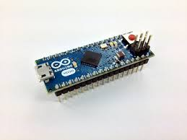
I want to make cheap stuff
$35 for a blinking light, really?
If you don’t need a shield
Arduino Micro: Basically an Arduino but small and cheaper ($20)

Slide 6
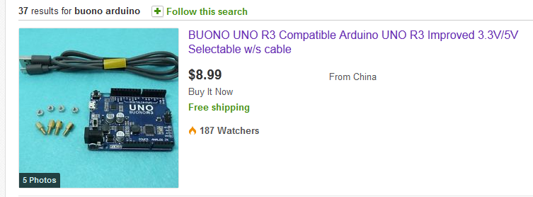
I want to make cheap stuff
I want to make cheap stuff but I need to use a shield.
Can you say “ebay”?
Buono: $9.00 (free shipping from China)

Slide 7
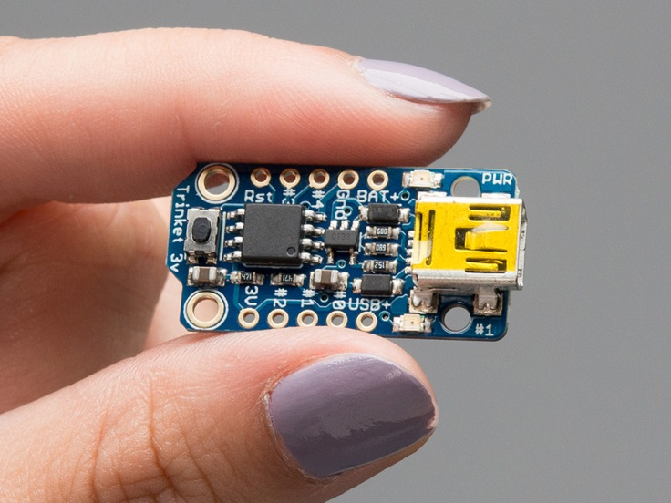
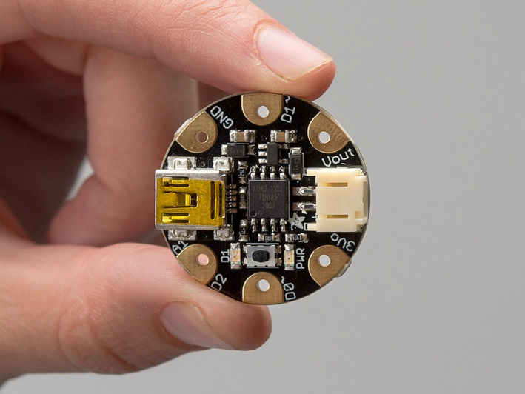
I want to make cheap stuff
No, I want to make really cheap stuff
Adafruit Trinket $7.00
Adafruit Gemma $9.00
Not as powerful/extendable but great for small projects
Trinket
Gemma

Slide 8
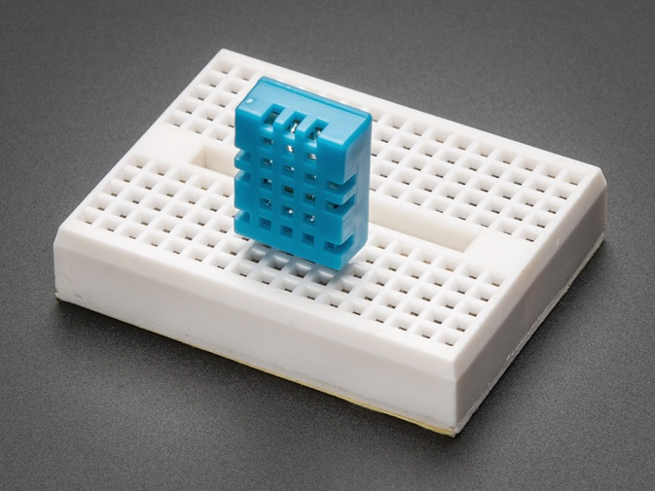
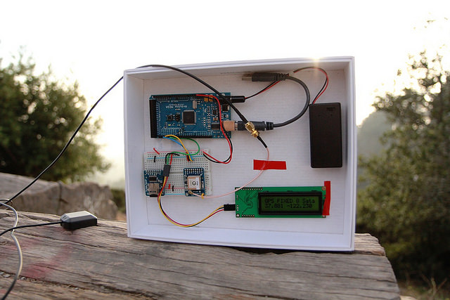
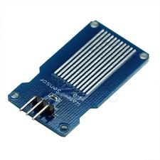
Hello World
Getting interesting data into your Arduino
Accelerometer: Senses motion
Magnetometer: Compass ($10)
Temperature/Humidity ($5)
Moisture/water ($1.25)
GPS ($35)
Temperature/Humidity Sensor
GPS Experiment
Water/Moisture Sensor

Slide 9
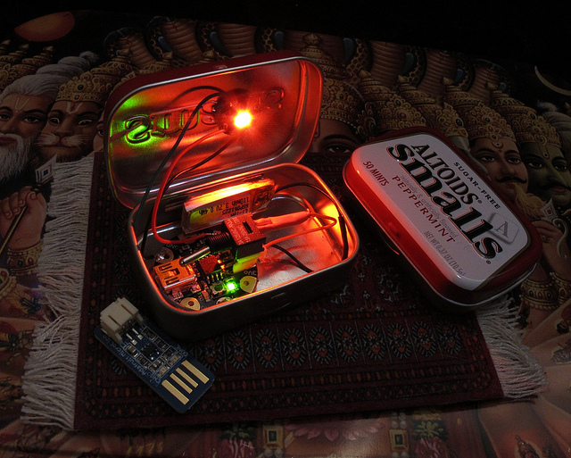
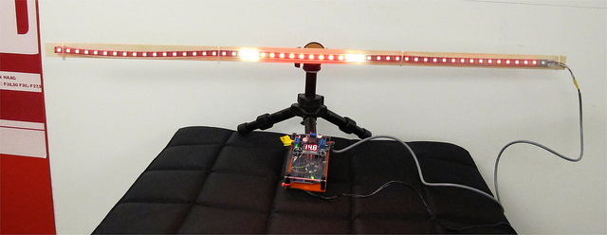
Blinky lights
Single Lights
New ‘neopixel’ technology
Any color you want
Strings of lights
Animated sequences

Slide 10
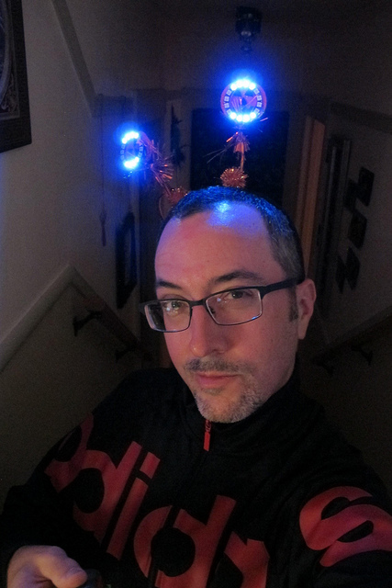
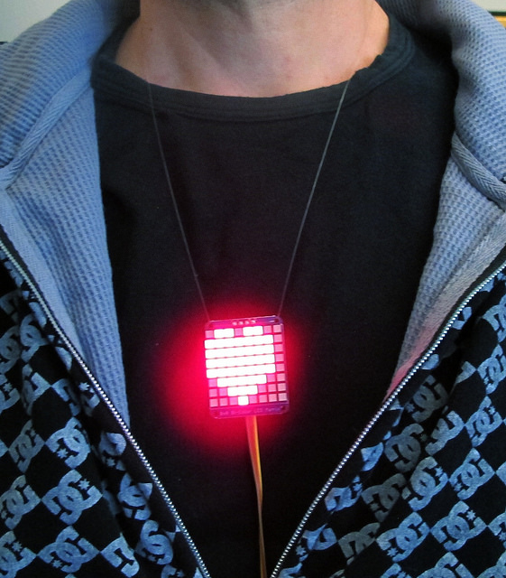
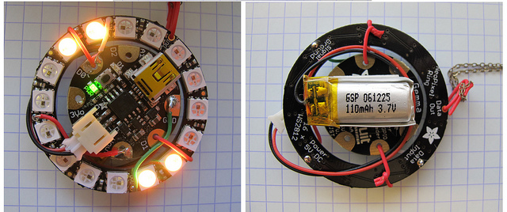
Blinky lights
Wearable? Definitely.

Slide 11
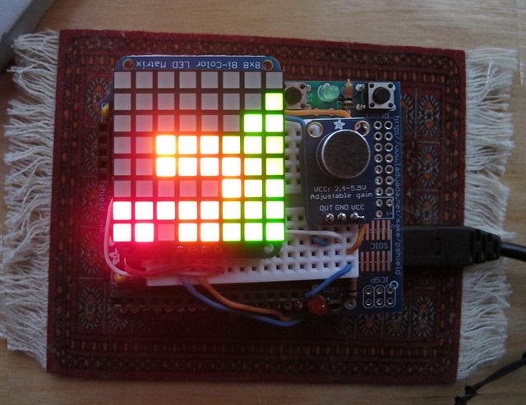
Blinky lights
Grids of pixels

Slide 12
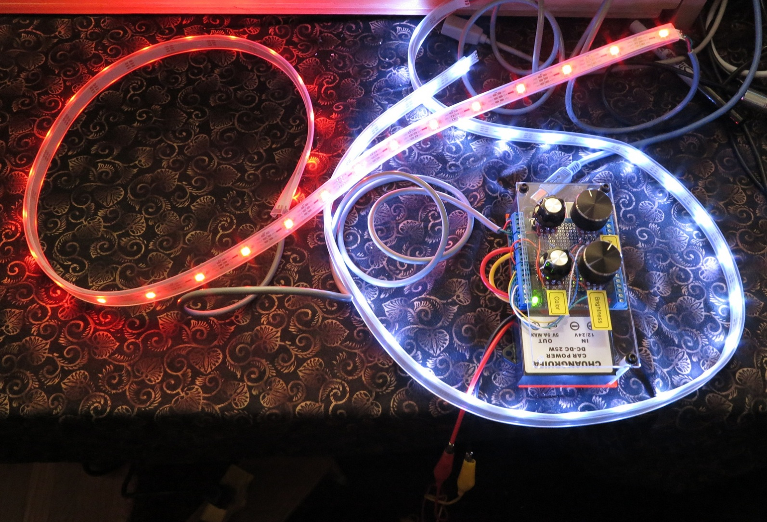
Blinky lights
The solar cabin project
Arduino with colored light strings
Any color, any brightness

Slide 13
Why bother, really?
Is making your own thing better than buying one?
I want to get a job making cool stuff
Where I work: 70 open jobs (August 2014)
Get an arduino to do boring stuff you don’t want to do
Let’s all make a load of $$ on an Arduino idea

Slide 14
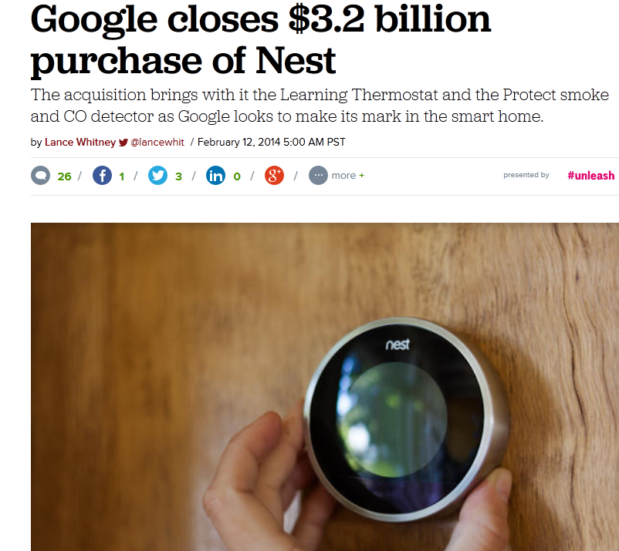
Why bother, really?
Oh really, can I make a load of $$$
Example: Nest Thermostat $3.2 Billion

Slide 15
What about the internet thingie?

Slide 16
I want to be a mad scientist!

Slide 17
Conclusion

