Slide 1
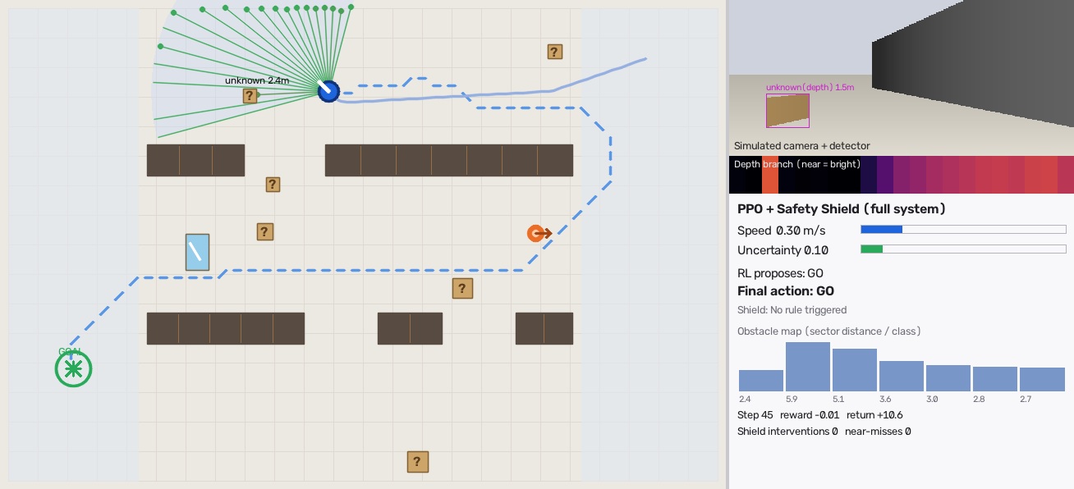
Weekly progress: our robot now drives itself through a warehouse
Group 3 · Camera-Based Obstacle Detection for Autonomous Warehouse Robots
Live demo: python app.py
82%
0%
99.9%
of test runs reach the goal (PPO + shield)
collisions with the safety shield on
of obstacles found by detector + depth
Notes:
This week we moved from perception-only work to a robot that drives itself. We built a simulated warehouse, trained a PPO reinforcement-learning policy for 1.2 million steps, and added the safety shield. The three numbers come from 100 test episodes on warehouse layouts the robot never saw during training. All navigation results are from simulation, not a physical robot.

Slide 2







What we built this week
All four layers of our design now run end to end in a simulated warehouse
Camera
Detector + depth
Fusion
PPO policy
Safety shield
120° view, 6 m range
person, pallet, forklift + any surface
unknown obstacles, uncertainty, tracking
GO · SLOW · STOP · LEFT · RIGHT
hard stop · person · uncertainty
Existing components we reuse
New logic we added
Warehouse simulator (Gymnasium): racks, workers, forklifts, pallets, fallen boxes
PPO trained 1.2 M steps with domain randomisation (layouts, obstacles, sensor noise)
Safety shield with decision log + event-triggered path replanning
Interactive Gradio demo: click to drop obstacles, switch perception modes
Notes:
Blue boxes are components we reuse, orange boxes are our new logic, the same colour code as our design document. In the simulator, the detector branch labels known classes and can miss them, the depth branch sees any surface but has noise, shadow false alarms and fails on shiny stretch wrap, exactly the weaknesses we listed. The policy never sees pixels, only the obstacle map, which is our sim-to-real argument.

Slide 3



The PPO policy learned to reach the goal
Mean episode reward during training (higher = faster, safer trips)
Phase 1 (0–0.6 M)
Learned to stop safely, but got stuck behind pallets on its path
Phase 2 (0.6–1.2 M)
Replans around obstacles it sees; goal reached in 82% of test runs
Bug found and fixed
Robot 'farmed' reward by driving in circles; we fixed the reward
Notes:
The reward goes up as the robot learns. In phase 1 it learned that stopping is safe, but it stayed stuck when a pallet was on its planned path. We added event-triggered replanning, which is what real warehouse robots do with their costmap. We also found reward hacking: the robot drove in circles to collect progress reward when the path changed. We now measure progress on the fixed map distance and retrained from the phase-1 checkpoint. Training takes about 30 minutes on 4 CPU cores.

Slide 4
RL + safety shield beats the rule-based baseline
100 test runs per controller on unseen warehouse layouts (simulation)
0%
collisions with PPO + shield
8%
collisions with PPO alone: the shield is needed
38 s
average time to goal (PPO + shield)
Notes:
Green is reaching the goal, red is a collision, grey is running out of time. The rule-based baseline is our 'stop if closer than 1 m' controller. PPO alone is faster but still collides sometimes; with the safety shield on top it never collided in the test runs. Remaining failures are time-outs, where the robot waits or hesitates, which is the safe failure mode.

Slide 5
Depth fusion finds what the detector misses
Confusion matrix: true obstacle (rows) vs what our perception reported (columns), % of frames
Detector only (existing method)
Our fusion (detector + depth)
True \ Predicted | person | pallet | forklift | unknown | missed
person | 92% | · | · | · | 8%
pallet | · | 92% | · | · | 8%
forklift | · | · | 91% | · | 9%
fallen box | · | · | · | · | 100%
True \ Predicted | person | pallet | forklift | unknown | missed
person | 89% | · | · | 11% | ·
pallet | · | 90% | · | 10% | ·
forklift | · | · | 88% | 12% | ·
fallen box | · | · | · | 100% | ·
99.9%
73.2%
obstacle recall, fusion
detector only
Unknown fallen boxes: 0% → 100% found
Notes:
Each row is a true obstacle type, each column is what our perception said, counted per frame in simulation. The detector alone never reports the fallen boxes because they are not a trained class, so 100% of them are missed, and it misses about 10% of people and pallets. With depth fusion, almost nothing is missed: a person the detector missed still appears as an 'unknown obstacle', so the robot still avoids it. The bar chart is our ablation study: with detector only, the robot crashes into what it cannot see. Note: the detector here is simulated with 80-97% recall; our real YOLO11n baseline on LOCO is mAP@50 31.7%, which we are still improving.

Slide 6
Shiny wrap raises uncertainty, so the robot slows
Uncertainty score when a pallet is within 3 m in front of the robot (share of frames)
Next week
Add the COCO person class and retrain YOLO11n (mAP@50 now 31.7%)
Run Depth Anything V2 on our hard-case videos and measure distance error
Train 3 random seeds and report mean ± spread
Reduce time-outs: train with the shield in the loop
Webcam-on-a-trolley demo with live boxes, depth and actions
3% → 87%
100%
0.21 ms
slow-down triggered: normal → shiny pallets
worker-steps-out tests where the shield stopped in time
policy + shield decision time per frame on a CPU
Notes:
Our uncertainty-aware slowdown: on shiny stretch-wrapped pallets the depth reading jumps between frames and disagrees with the detector box, so the score shifts right and the robot slows down far more often, while normal pallets rarely trigger it. In scripted tests where a worker suddenly steps out about one metre ahead, the shield stopped the robot every time. Next week we connect the real models: YOLO with the person class, Depth Anything on our hard-case footage, and three seeds for robustness.

