Slide 1
Quantum vs classical local algorithms for local maxcut
Alex Kolla, Adam Bouland (Stanford), Charles Carlson, Steven Kordonowy

Slide 2
Quantum Supremacy
Challenge: computational task such that
Classically intractable
Experimentally feasible
Quantumly tractable
Verifiable (classically)
Sampling: quantum, probabilistic systems
Boson Sampling (Aaronson and Arkhipov ‘13, Boixo et al ‘19)
Random Circuit Sampling (Bouland et al ‘19)
Sampling from shallow-depth QAOA circuit classically hard (Farhi, Harrow ’19)

Slide 3

Quantum Supremacy
$\#P$
Given $f\left(x\right)={\left\{0,1\right\}}^{n} →\{0,1\}$, compute $\sum_{x}{f(x)}$
$Gap−P$
Given $f\left(x\right)={\left\{0,1\right\}}^{n} →\{−1,+1\}$, compute $\sum_{x}{f(x)}$
Approximating $\#P$ is easy
Approximating $Gap−P$ is still hard
Classical ($\#P$) vs quantum ($Gap−P$)

Slide 4

Local Search
Hard problem P on n nodes
Solution $σ∈S$ with value $V\left(σ\right)∈$ℝ
Find $τ∈S$ such that $V\left(τ\right)>V(σ)$ using “local” changes from $σ$
Iterate until no more improving $τ′∈S$ exist
Ex: MaxCut
Notes:
VC: neighboring solution is one that differs in one vertex, build up to maximal solution
Max-Cut : edge or vertex constraints/info
MCMC: Metropolis Hastings
Algorithm:
$$\vec{v}=(v_{1},v_{2}, …, v_{n}) \text{with} v_{i}∈_{u}\{−1,+1\}$$
$$\vec{F}=(v_{1}⋅\sum_{\left\{1j∈E\right\}}{v_{j}}, …,v_{n}⋅\sum_{\left\{nj∈E\right\}}{v_{j}})$$
If $F_{j}≥t$, then flip $v_{j}$

Slide 5

MaxCut
Graph G = (V,E)
Cut: $C⊆V$
Cut value: $f\left(C\right)=\sum_{e_{ij}∈E: i∈C, j ∉C}{1}$
Output: $arg max{\{f\left(C\right) :C⊆V \}}$
NP-hard
Max-k-cut

Slide 6

Local MaxCut
Graph G = (V,E), cut: $C⊆V$, cut value: $f\left(C\right)=\sum_{e_{ij}∈E: i∈C, j ∉C}{1}$
Output: locally maximal cut $C⊆V$
Local: $C^{′}∈nbhd(C)$ if $C^{′}$ differs from $C$ by flipping a single vertex
Maximal: $C$ maximal if $f$ is not increased over $nbhd(C)$
$v_{j}$ is satisfied if most of its neighboring vertices are on the other side of the cut
Notes:
Approximation useless for k=2, random assignment
Will show an example of diff next
*or show empirical evidence

Slide 7
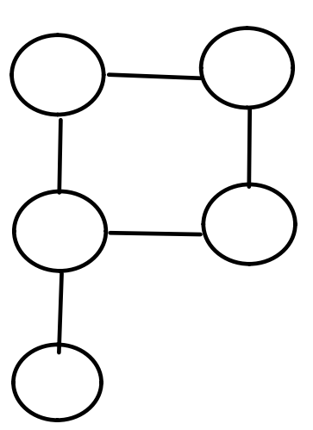
Local Search Example
Notes:
VC: neighboring solution is one that differs in one vertex, build up to maximal solution

Slide 8
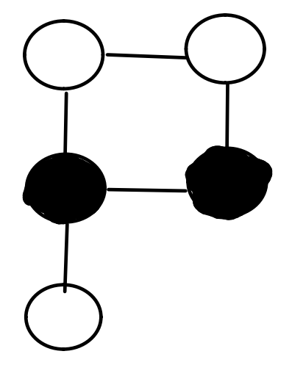
Local Search Example
Notes:
VC: neighboring solution is one that differs in one vertex, build up to maximal solution

Slide 9
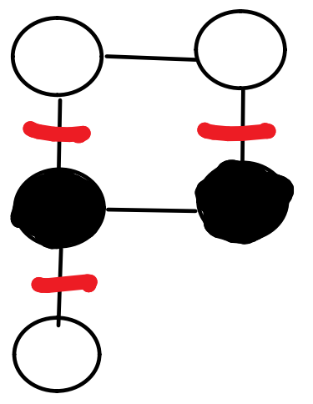
Local Search Example
Notes:
VC: neighboring solution is one that differs in one vertex, build up to maximal solution

Slide 10
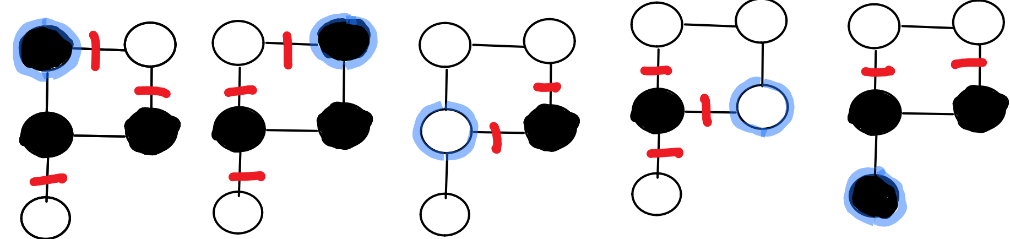
Local Search Example
Notes:
VC: neighboring solution is one that differs in one vertex, build up to maximal solution

Slide 11
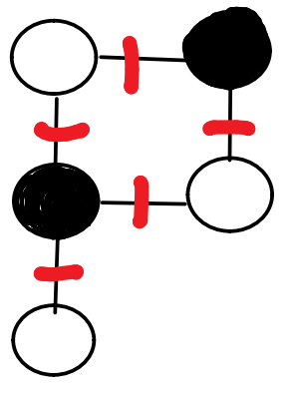
MaxCut vs. Local MaxCut
Notes:
Also, the neighborhood structure is different, which can be s een later

Slide 12

MaxCut vs. Local MaxCut
Hamiltonian is different
For $k∈{\left\{0,1\right\}}^{n}$
$\left\langle k\left|H_{MC}\right|k\right\rangle =\#\{ij∈E:ij cut by k\}$
$\left\langle k\left|H_{LMC}\right|k\right\rangle =\#\{v∈V:v is satisfied cut by k\}$
Notes:
Also, the neighborhood structure is different, which can be s een later

Slide 13
Local Search
Polynomial-time Local Search (PLS)
Ex: Combinatorial problems, Hopfield neural networks, MCMC
Neighborhood structure
Flip
Kernighan-Lin
Allows comparisons against quantum algorithms (Hastings ’19)
Update via local quantum circuit
Classical can beat quantum
Notes:
PLS – captures difficulty in finding locally optimal solution
VC, MC, 3SAT, etc.
MCMC – Metropolis-Hastings
QAOA IS a local algorithm that has quantum degrees of freedom
Done with LS as general framework, now onto specific problem

Slide 14
Local MaxCut
Local max-k-cut is a (1 − 1/k)-approximate max-k-cut
PLS-hard (Schaffer and Yannakakis ’91)
Nash equilibria party affiliation game
Conjecture: Classical FLIP algorithm outperforms QAOA for low circuit depth
Notes:
Approximation useless for k=2, random assignment
Will show an example of diff next
*or show empirical evidence

Slide 15

FLIP Algorithm (Classical)
Alg (p = 1):
Start: $\vec{v}=(v_{1},v_{2}, …, v_{n}) \text{with} v_{i}∈_{r}\{−1,+1\}$
Update: If $v_{j}$ is unhappy, then flip $v_{j}$ with probability 4/5
Expected value converges to n exponentially fast
degree = 2
degree > 3
Update rule modifiable
Force vector? Non-constant probability?
Notes:
Our contribution
R = random, can be uniform or another distribution
Approximation useless for k=2, random assignment
Will show an example of diff next
* can do a lot of different things here

Slide 16

QAOA
Problem Hamiltonian $\hat{C}=\sum_{jk∈E}{\hat{C_{jk}}}$
Mixing Hamiltonian $\hat{B}=\sum_{v∈V}{\hat{B_{v}}}$
Local:
$\left[\hat{C_{jk}},\hat{C_{lm}}\right]=0$ for $jk≠lm$
$\left[\hat{B_{j}},\hat{B_{k}}\right]=0$ for $j≠k$
Hermitian H and angle θ, construct operator $U\left(H,θ\right)=exp⁡(−iθH)$
$\left|γ, β\right\rangle =U\left(B,β_{p}\right)U\left(C,γ_{p}\right)⋯U\left(B,β_{1}\right)U\left(C,γ_{1}\right){\left|+\right\rangle }^{⨂n}$
Goal: $arg max{\{\left\langle γ, β\right|\hat{C}\left|γ, β\right\rangle :γ∈{[0,2π)}^{p}, β∈{[0,π)}^{p}\}}$
Notes:
Does not have to be broken down by edge
Typically C (and Ci) are diagonal in computational basis
Tensor product structure

Slide 17

QAOA
Goal: $arg max{\{\left\langle γ, β\right|\hat{C}\left|γ, β\right\rangle :γ∈{[0,2π)}^{p}, β∈{[0,π)}^{p}\}}$
For subgraphs$G_{i}≤G$, we have
$$\left\langle γ, β\right|\hat{C}\left|γ, β\right\rangle =\sum_{i}{n_{i}\left\langle γ, β\right|\hat{C_{G_{i}}}\left|γ, β\right\rangle }$$
So focus on calculating $\left\langle γ, β\right|\hat{C_{G_{i}}}\left|γ, β\right\rangle$
Notes:
C_Gi is the Hamiltonian restricted to Gi
Calculating expectations = sampling

Slide 18
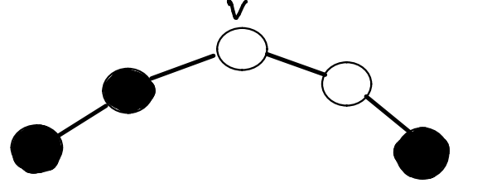

QAOA – Local MaxCut
$\hat{C}$: represents how many satisfied vertices exist per cut
$⟨k\left|\hat{C}\right|k⟩=\#\{v∈V :v satsified for cut k∈2^{n}\}$
$\hat{B_{v}} =σ_{v}^{X}=I_{1}⊗⋯{⊗I}_{v−1}⊗X_{v}⊗I_{v+1}⊗⋯⊗I_{n}$
Local: $\hat{C_{v}}$ represents the number of satisfied vertices near v
$⟨k\left|\hat{C_{v}}\right|k⟩=\#\{v∈nbhd(v):v satsified for cut k∈2^{n}\}$
Notes:
Return to example to show # happy vertices

Slide 19

QAOA – Local MaxCut (Simple Instance)
Graph degree d = 2 , triangle free
One subgraph type $G_{1}$, so:
$$\left\langle γ, β\right|\hat{C}\left|γ, β\right\rangle =\frac{n}{3}\left\langle γ, β\right|\hat{C_{v}}\left|γ, β\right\rangle$$
For p = 1:
$$\left\langle γ, β\right|\hat{C}\left|γ, β\right\rangle =\frac{1}{2^{n}}\sum_{x}{e^{−iγ⟨x\left|\hat{C}\right|x⟩}}{\left|\sum_{y}{e^{−iγ\left\langle y\left|\hat{C}\right|y\right\rangle }}\left\langle x\left|U(\hat{B},β)\right|y\right\rangle \right|}^{2}$$
Notes:
Return to example to show # happy vertices
C diagonal
All easy to compute!
P=1 doable maybe analytically, but gets subsequently messier as p -> infty

Slide 20
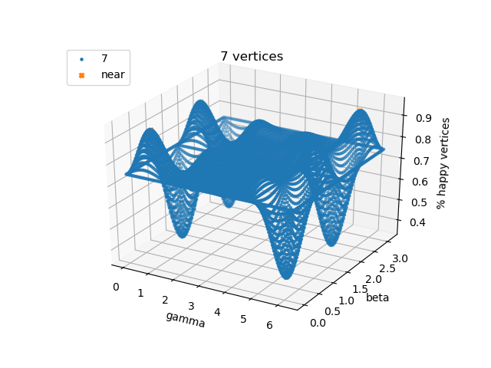
QAOA – Local MaxCut Results (Simple Instance)
Notes:
Return to example to show # happy vertices

Slide 21
QAOA – Local MaxCut Hard(?) Instance
Graph degree d = 3, triangle free
Subgraph types:
Notes:
Return to example to show # happy vertices
C diagonal

Slide 22
Future Work
Analytical solutions for low-depth QAOA for degree = 2 and 3 graphs
Different mixing operators
More exploration on classical FLIP for more complex graph types
Can smooth analysis bridge the gap?

Slide 23
Quantum Supremacy
Approximation algorithms

