Slide 1
Overlapping types of context?

Slide 2
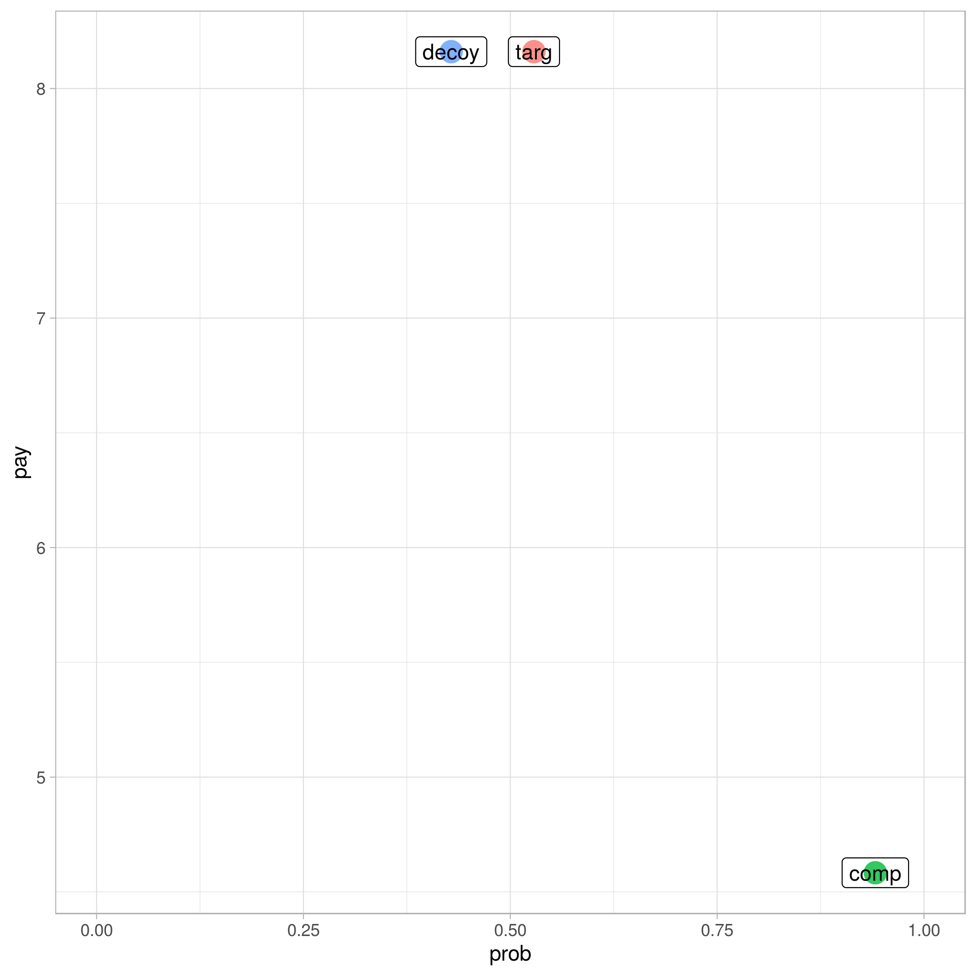

Slide 3
Role in the last trial
Novel / target / competitor / decoy [chosen / not chosen]
Role in the current trial
target / competitor / decoy
[These come in different flavours: Upper-left vs lower-right for targ/comp, left, down, or both for decoys. Also, decoys might vary in proximity]
Item type
lottery ticket (typically low probability & large payouts)
urn (typically high probability low payout)
Choice context
Black-border (urns more likely)
White-border (tickets more likely)

Slide 4
Properties of the immediate choice environment?
eg. multi-alternative decision field theory, leaky competing accumulator, multi-attribute LBA, associative accumulation (reviewed Evans, Holmes, Trueblood 2019)
Properties of the task-context environment?
Decision-by-sampling: people respond to the rank of the choice option in some relevant reference class (tracking environment statistics, potentially at multiple levels?) (Stewart 2009, Ronayne & Brown 2017)
Optimal inference with noisy observations: (Chen, Chang, Howes 2020)
Something other than expectation maximization?
"...all possible choice options and preferences are represented in a shared, continuous, multidimensional space that supports generalization. Decision making is cast as a learning process that seeks to align choices and preferences to maintain coherency." (Hornsby & Love 2020)
Some really exotic sequence effects?
...across two experiments, we observed that mean preference strength oscillated over time and found that eliciting a choice strongly affected the pattern of oscillation. Preferences following choices oscillated between being stronger than those without prior choice (bolstering) and being weaker than those without choice (suppression)
(Kvam, Busemeyer, Pleskac 2020)

Slide 5
Role in the last trial
novel / novel / novel / target / competitor / decoy
Role in the current trial
target / competitor / decoy
Item type
lottery ticket (typically low probability & high payouts)
urn (typically high probability low payout)
Choice context
Black-border (urns more likely)
White-border (tickets more likely)
x6
x3
x2
x2
72

