Slide 1
Decision making with rockets
(and why you might care)

Slide 2


Slide 4


Slide 5
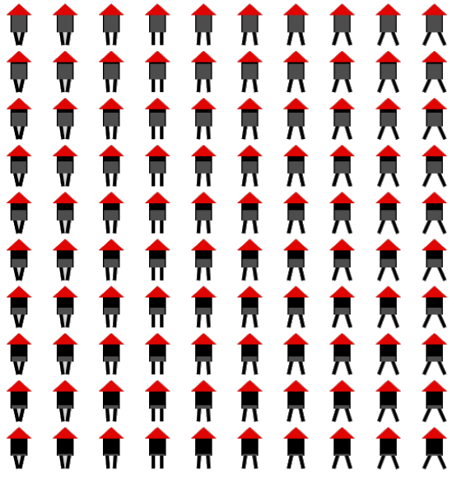

Slide 6
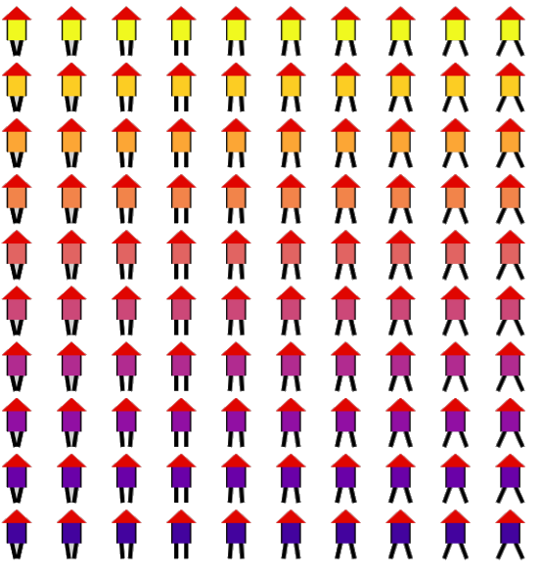

Slide 7


