Slide 1
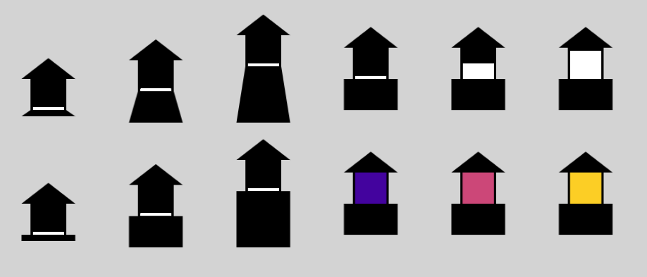
Example ‘launch stage’ variation
Example ‘orbital stage’ variation
←worse better →
←worse better →

