Slide 1
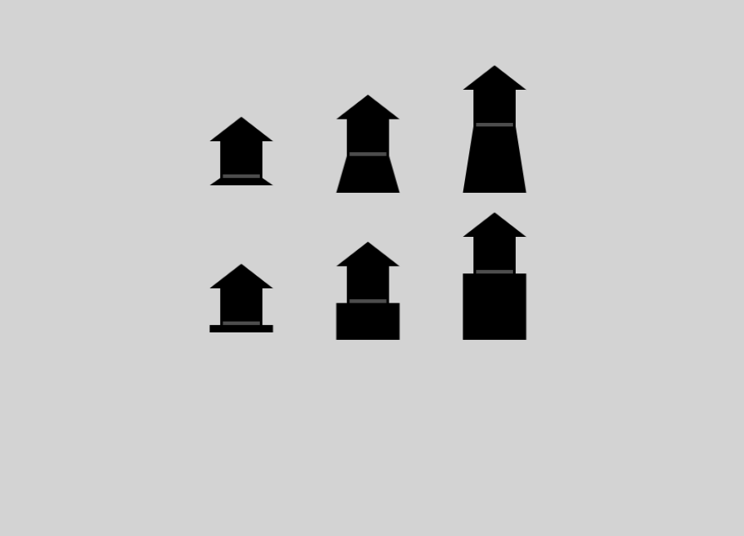
←Worse Better→
Some examples of bad, medium, and good launch stages
in the two different styles, straight-sides and angle-sides

