Slide 1
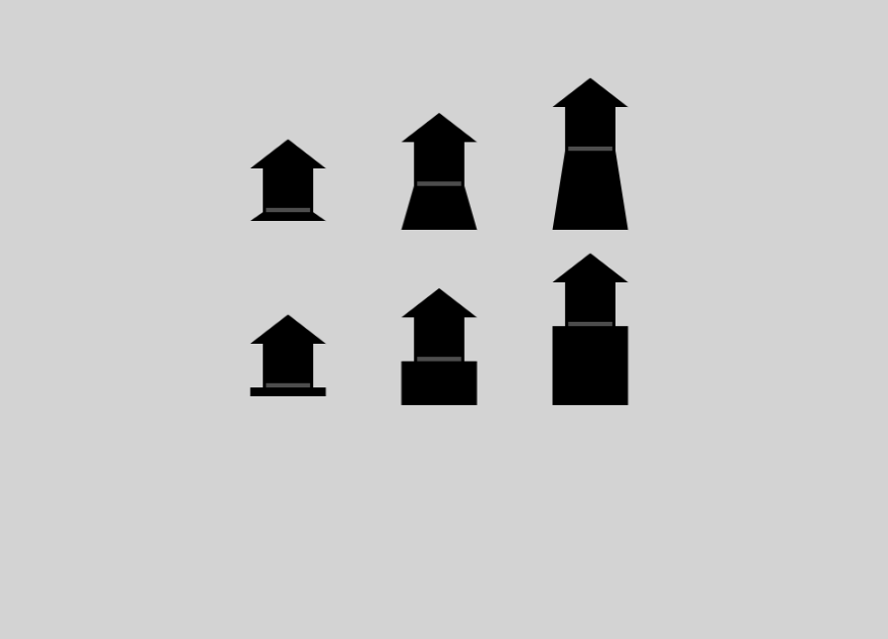
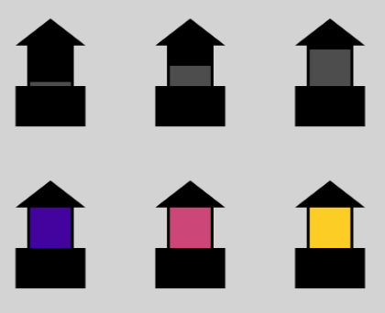
←Worse Better→
Some examples of bad, medium, and good orbital stages
in the two different styles, grey-bar and color-patch

