Slide 1


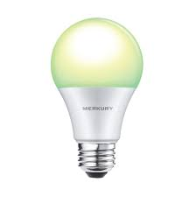
Colorless green ideas 2019
State Trace Analysis
!

Slide 2
Law
Evil
Good
Chaos

Slide 3
Law
John loves Mary
Evil
Good
Chaos

Slide 4
Law
John loves Mary
Evil
Good
Yous are all wrong
Chaos

Slide 5
Law
John loves Mary
Evil
Good
Ideas green furiously
Yous are all wrong
Chaos

Slide 6
Law
Fish fish fish eat eat eat
John loves Mary
Evil
Good
Ideas green furiously
Yous are all wrong
Chaos

Slide 7
Observable
outcome
Acceptability
judgement
Grammaticality
judgement

Slide 8
Sentence properties
Lexical statistics
?
Plausibility
Structural well-formedness
wrt a grammar
?
Memory demands
?
Observable
outcome
Acceptability
judgement
Grammaticality
judgement

Slide 9
Sentence properties
Lexical statistics
?
Plausibility
Structural well-formedness
wrt a grammar
?
Memory demands
?
Perception
&
Judgement
Observable
outcome
Acceptability
judgement
Grammaticality
judgement

Slide 10
Sentence properties
Lexical statistics
?
Plausibility
Structural well-formedness
wrt a grammar
?
Memory demands
?
Perception
&
Judgement
Attention
Coffee
[Formal/folk]
Theory of language
Endorsement
criterion level
Observable
outcome
Acceptability
judgement
Grammaticality
judgement

Slide 11
Sentence properties
Lexical statistics
?
Plausibility
Structural well-formedness
wrt a grammar
?
Memory demands
?
Perception
&
Judgement
Happy
feelings
Endorsement
criterion level
Observable
outcome
Acceptability
judgement
Grammaticality
judgement

Slide 12
Acceptability
Well-formedness
Grammaticality

Slide 13
A short list of things that don’t compel belief in the 2d account

Slide 14
A short list of things that don’t compel belief in the 2d account
There exist sentences that are judged grammatical but not acceptable.

Slide 15
A short list of things that don’t compel belief in the 2d account
There exist sentences that are judged grammatical but not acceptable.
There exist sentences that are judged acceptable but not grammatical.

Slide 16
A short list of things that don’t compel belief in the 2d account
There exist sentences that are judged grammatical but not acceptable.
There exist sentences that are judged acceptable but not grammatical.
Both (1) and (2) at the same time.

Slide 17
A short list of things that don’t compel belief in the 2d account
There exist sentences that are judged grammatical but not acceptable.
There exist sentences that are judged acceptable but not grammatical.
Both (1) and (2) at the same time.
Grammaticality judgments can be shown to contain ‘extra information’ over that contained in acceptability judgments.

Slide 18
Dissociations in 1D

Slide 19
Dissociations in 1D
(non-linear) Mapping 1:
Stimulus →representation

Slide 20
Dissociations in 1D
(non-linear) Mapping 1:
Stimulus →representation
A(x)=Φ(.5,x,0.5)
G(x)=Φ(.5,x,0.1)

Slide 21
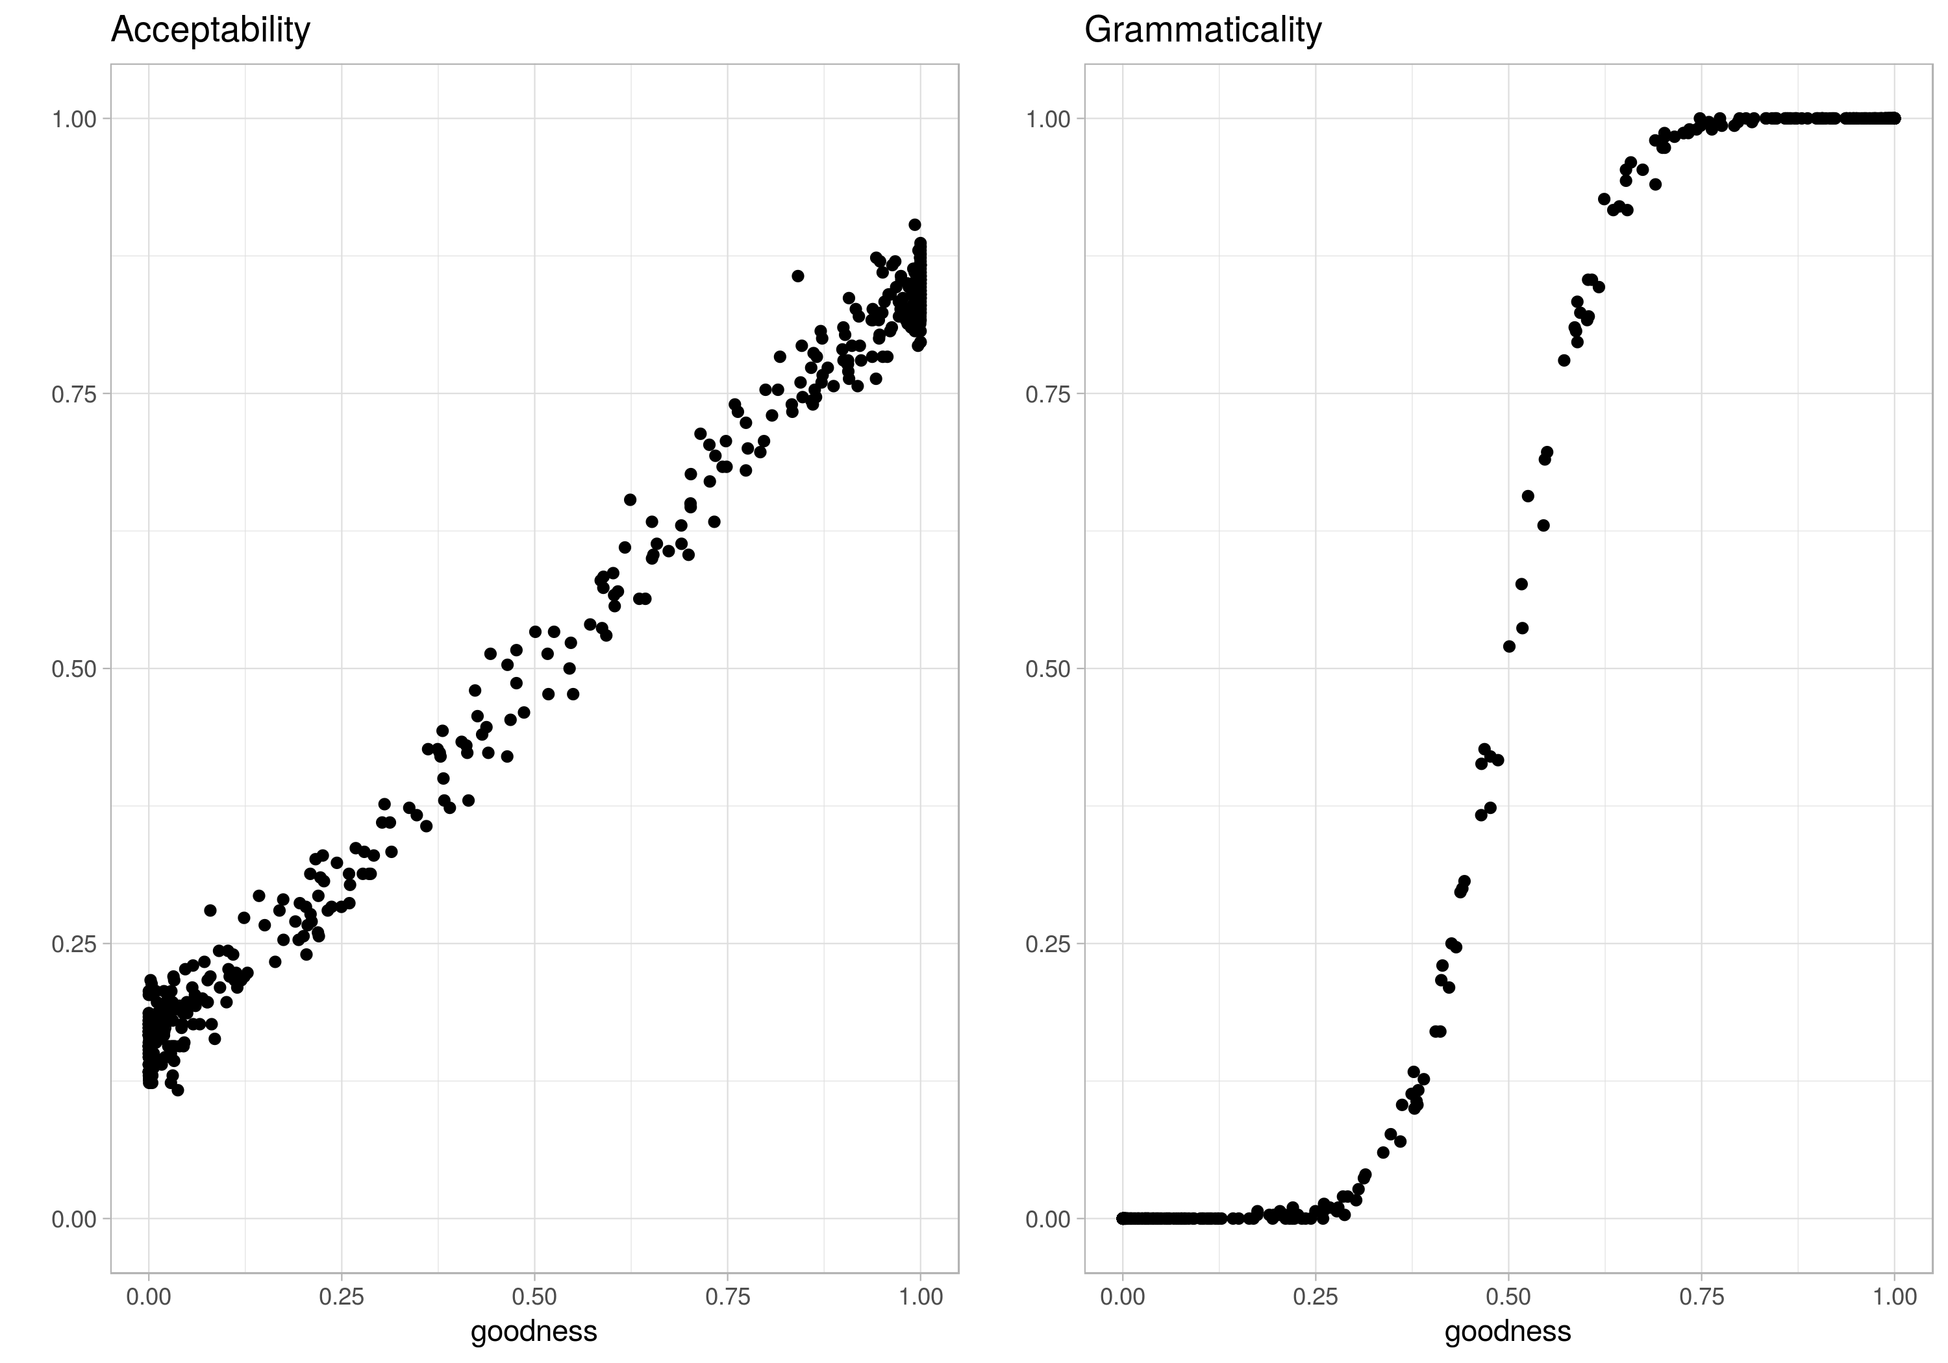
Dissociations in 1D
(non-linear) Mapping 1:
Stimulus →representation
A(x)=Φ(.5,x,0.5)
G(x)=Φ(.5,x,0.1)

Slide 22
Dissociations in 1D
(non-linear) Mapping 1:
Stimulus →representation
A(x)=Φ(.5,x,0.5)
G(x)=Φ(.5,x,0.1)

Slide 23
Dissociations in 1D
(non-linear) Mapping 1:
Stimulus →representation
A(x)=Φ(.5,x,0.5)
G(x)=Φ(.5,x,0.1)
(non-linear) Mapping 2:
Representation → response

Slide 24
Dissociations in 1D
(non-linear) Mapping 1:
Stimulus →representation
A(x)=Φ(.5,x,0.5)
G(x)=Φ(.5,x,0.1)
(non-linear) Mapping 2:
Representation → response
Dichotomize
on median

Slide 25
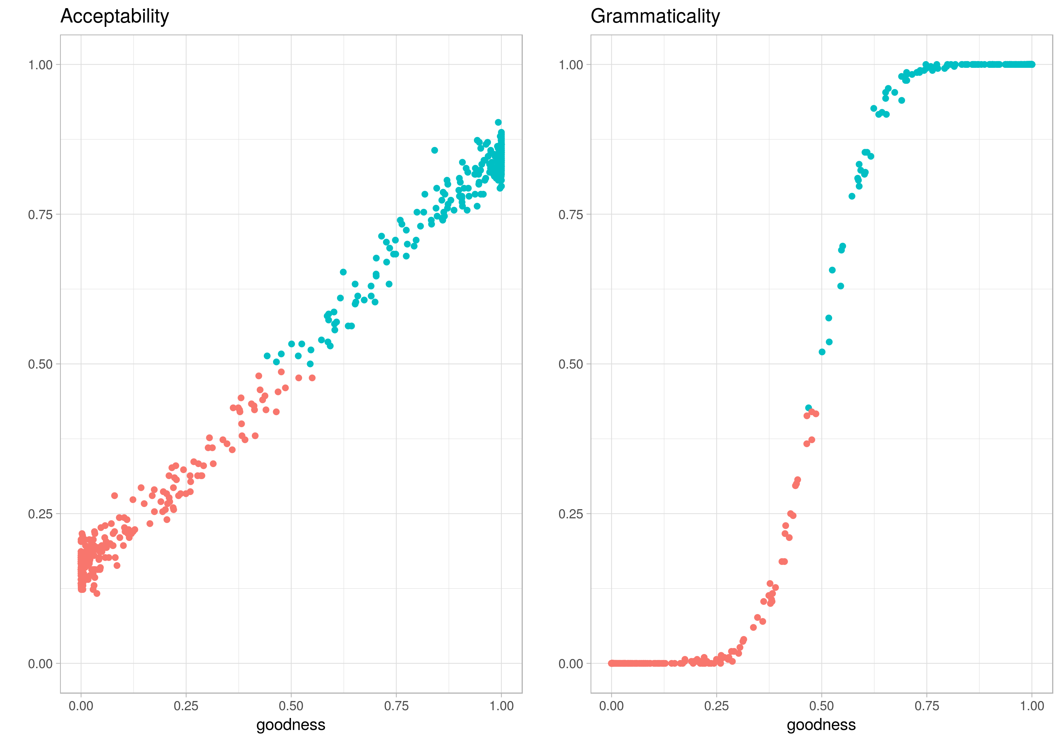
Dissociations in 1D
(non-linear) Mapping 1:
Stimulus →representation
A(x)=Φ(.5,x,0.5)
G(x)=Φ(.5,x,0.1)
(non-linear) Mapping 2:
Representation → response
Dichotomize
on median

Slide 26
Dissociations in 1D
(non-linear) Mapping 1:
Stimulus →representation
A(x)=Φ(.5,x,0.5)
G(x)=Φ(.5,x,0.1)
(non-linear) Mapping 2:
Representation → response
Dichotomize
on median

Slide 27
Dissociations in 1D
(non-linear) Mapping 1:
Stimulus →representation
A(x)=Φ(.5,x,0.5)
G(x)=Φ(.5,x,0.1)
(non-linear) Mapping 2:
Representation → response
Dichotomize
on median
Re-scale if necessary:
units are unconstrained.

Slide 28
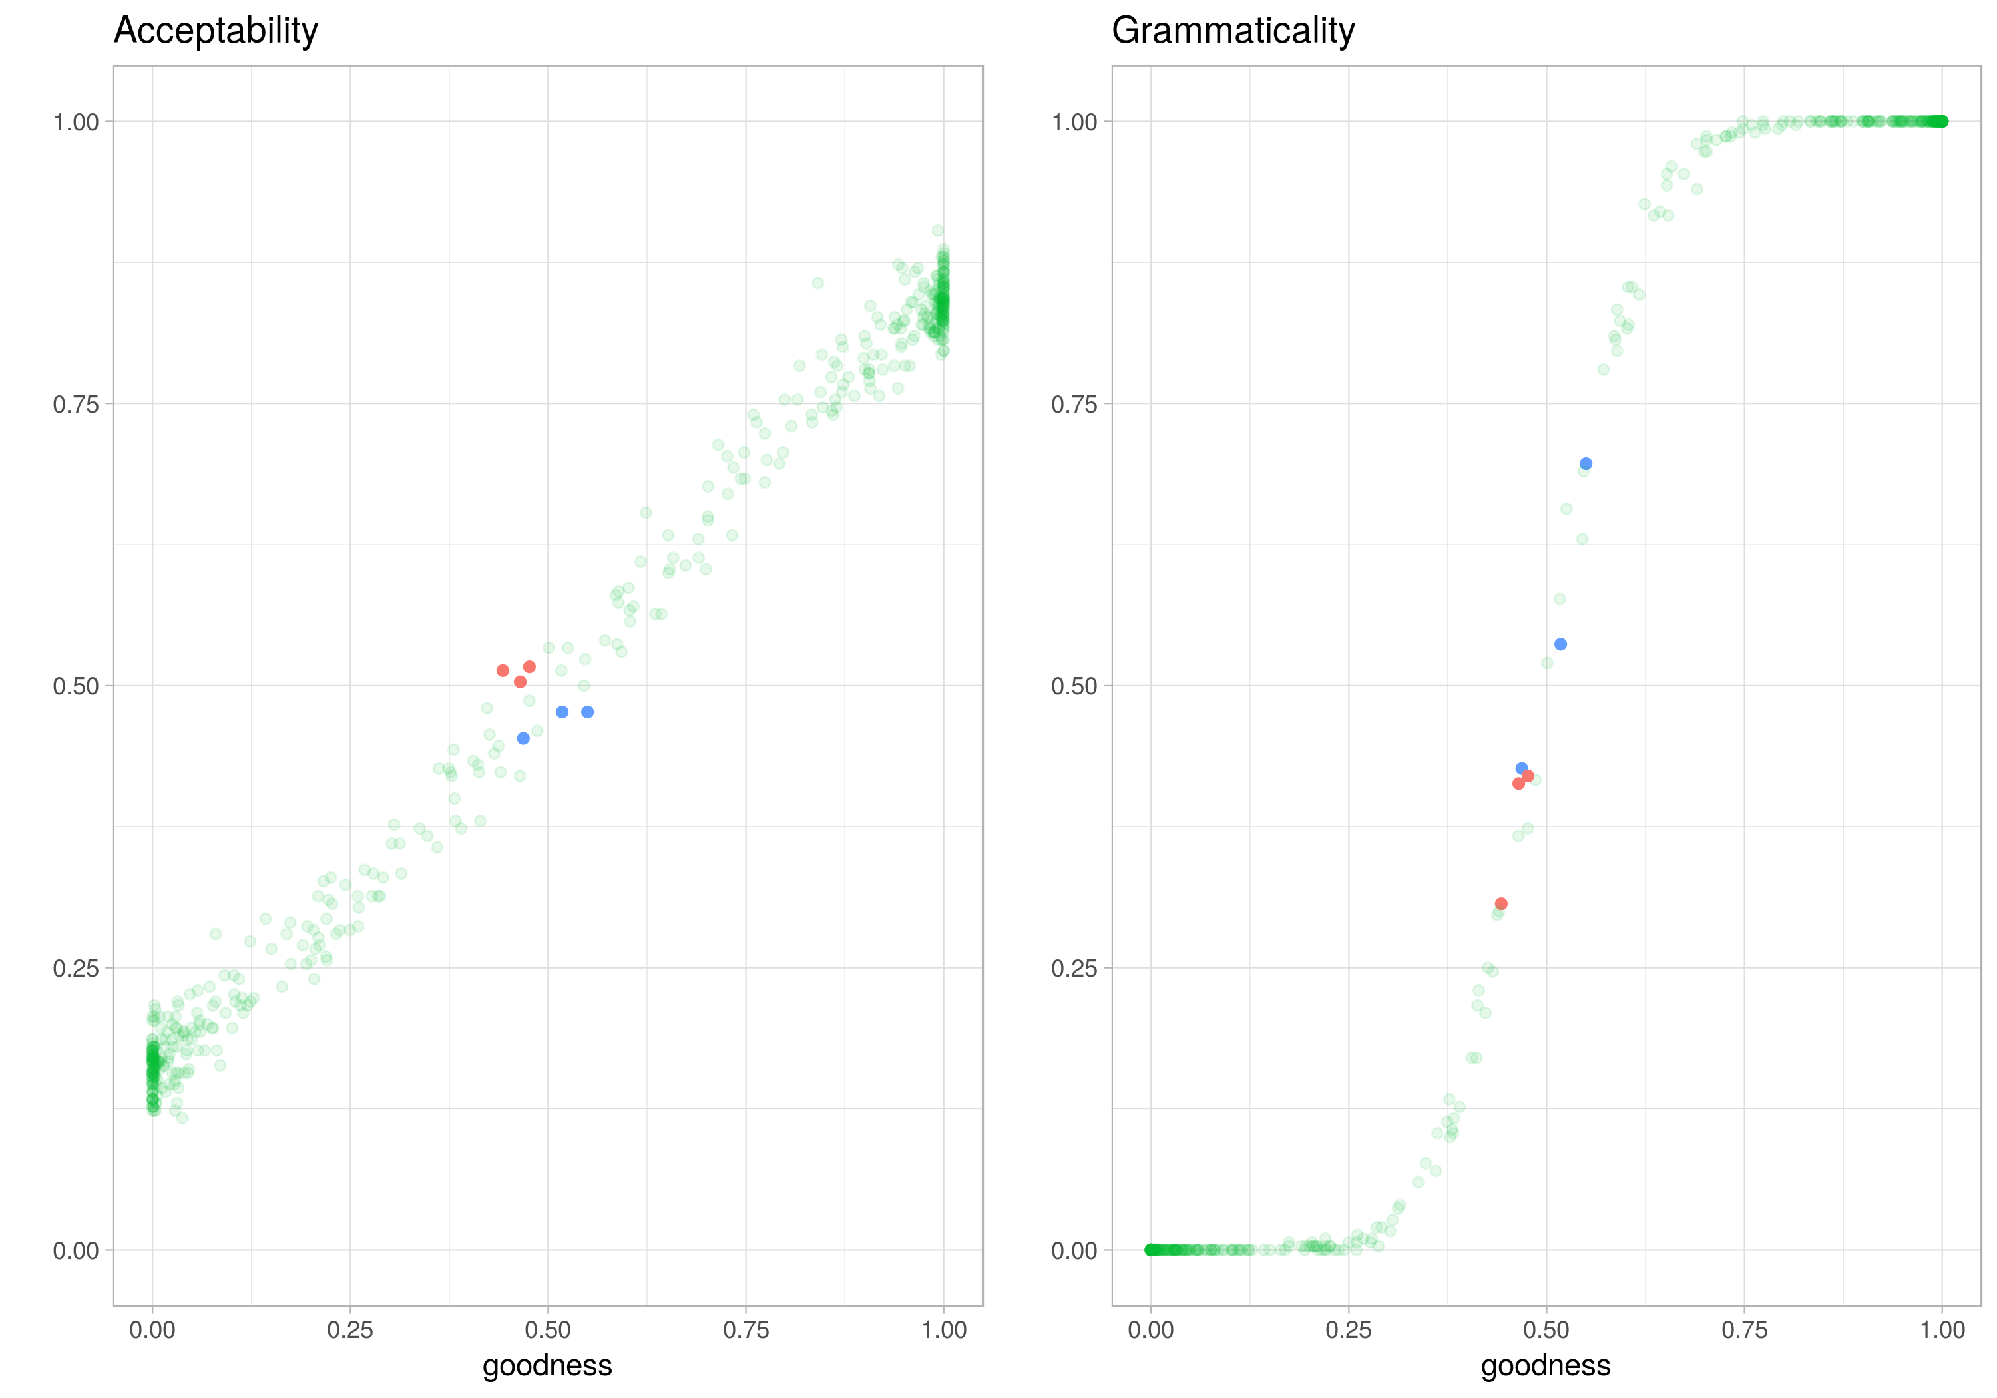
Dissociations in 1D
(non-linear) Mapping 1:
Stimulus →representation
A(x)=Φ(.5,x,0.5)
G(x)=Φ(.5,x,0.1)
(non-linear) Mapping 2:
Representation → response
Dichotomize
on median
Re-scale if necessary:
units are unconstrained.

Slide 29
Dissociations in 1D
(non-linear) Mapping 1:
Stimulus →representation
A(x)=Φ(.5,x,0.5)
G(x)=Φ(.5,x,0.1)
(non-linear) Mapping 2:
Representation → response
Dichotomize
on median
Re-scale if necessary:
units are unconstrained.

Slide 30
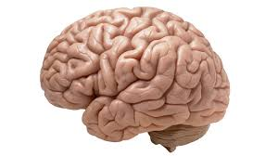

Slide 32


Slide 36
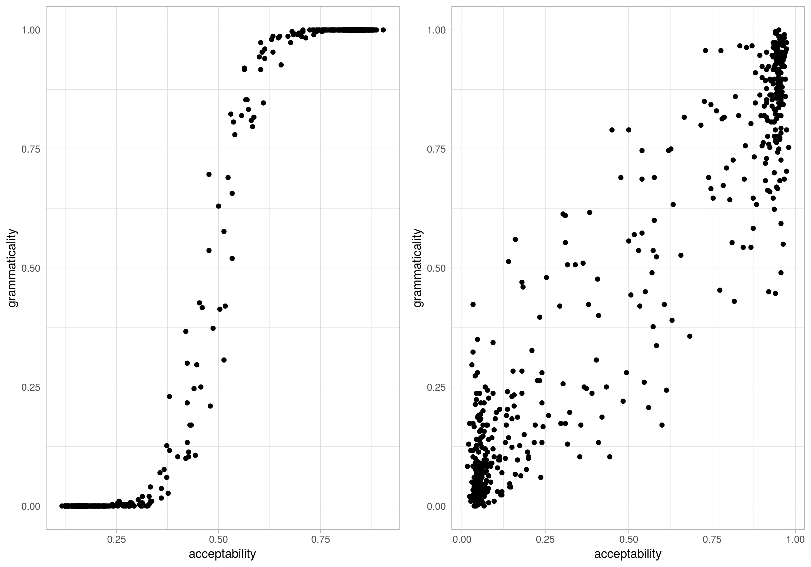

Slide 44
Stimuli

Slide 45
Stimuli
Embedding

Slide 46
Stimuli
Embedding
Agreement attraction

Slide 47
Stimuli
Embedding
Agreement attraction
Comparison illusion

Slide 48
Stimuli
Embedding
Agreement attraction
Comparison illusion
NPI illusion

Slide 49
Stimuli
Embedding
Agreement attraction
Comparison illusion
NPI illusion
LI-author / crowd disagreements

Slide 50
This block of questions asks you to judge how acceptable a sentence is. Here “acceptable” means ‘well-formed’ or ‘natural-sounding’. The sentences here range in acceptability from very good to very poor, please use the rating scale to indicate where each sentence falls in this range.

Slide 51
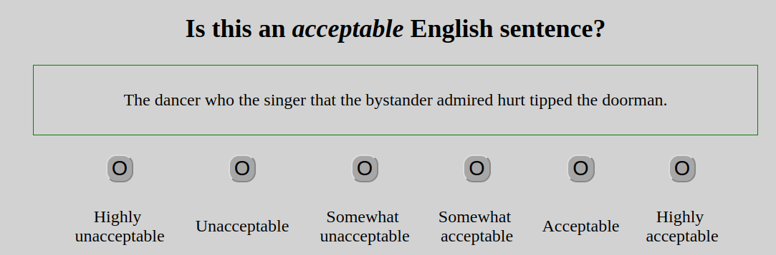

Slide 52
This block of questions asks you to judge if a sentence is grammatical or not. It doesn’t matter if the sentence is ugly or even makes no sense: please answer ‘yes’ if it is a valid construction in English or ‘no’ if it is not.

Slide 53
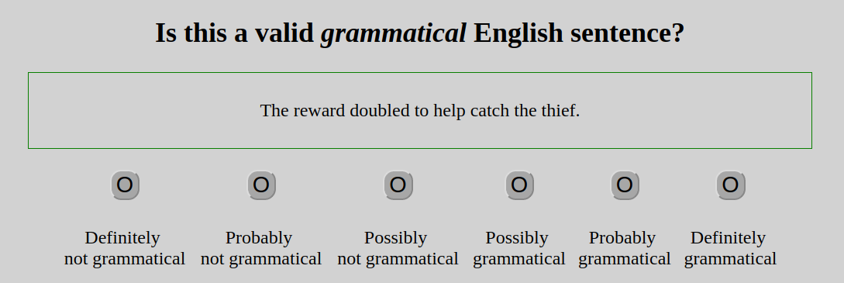

Slide 54
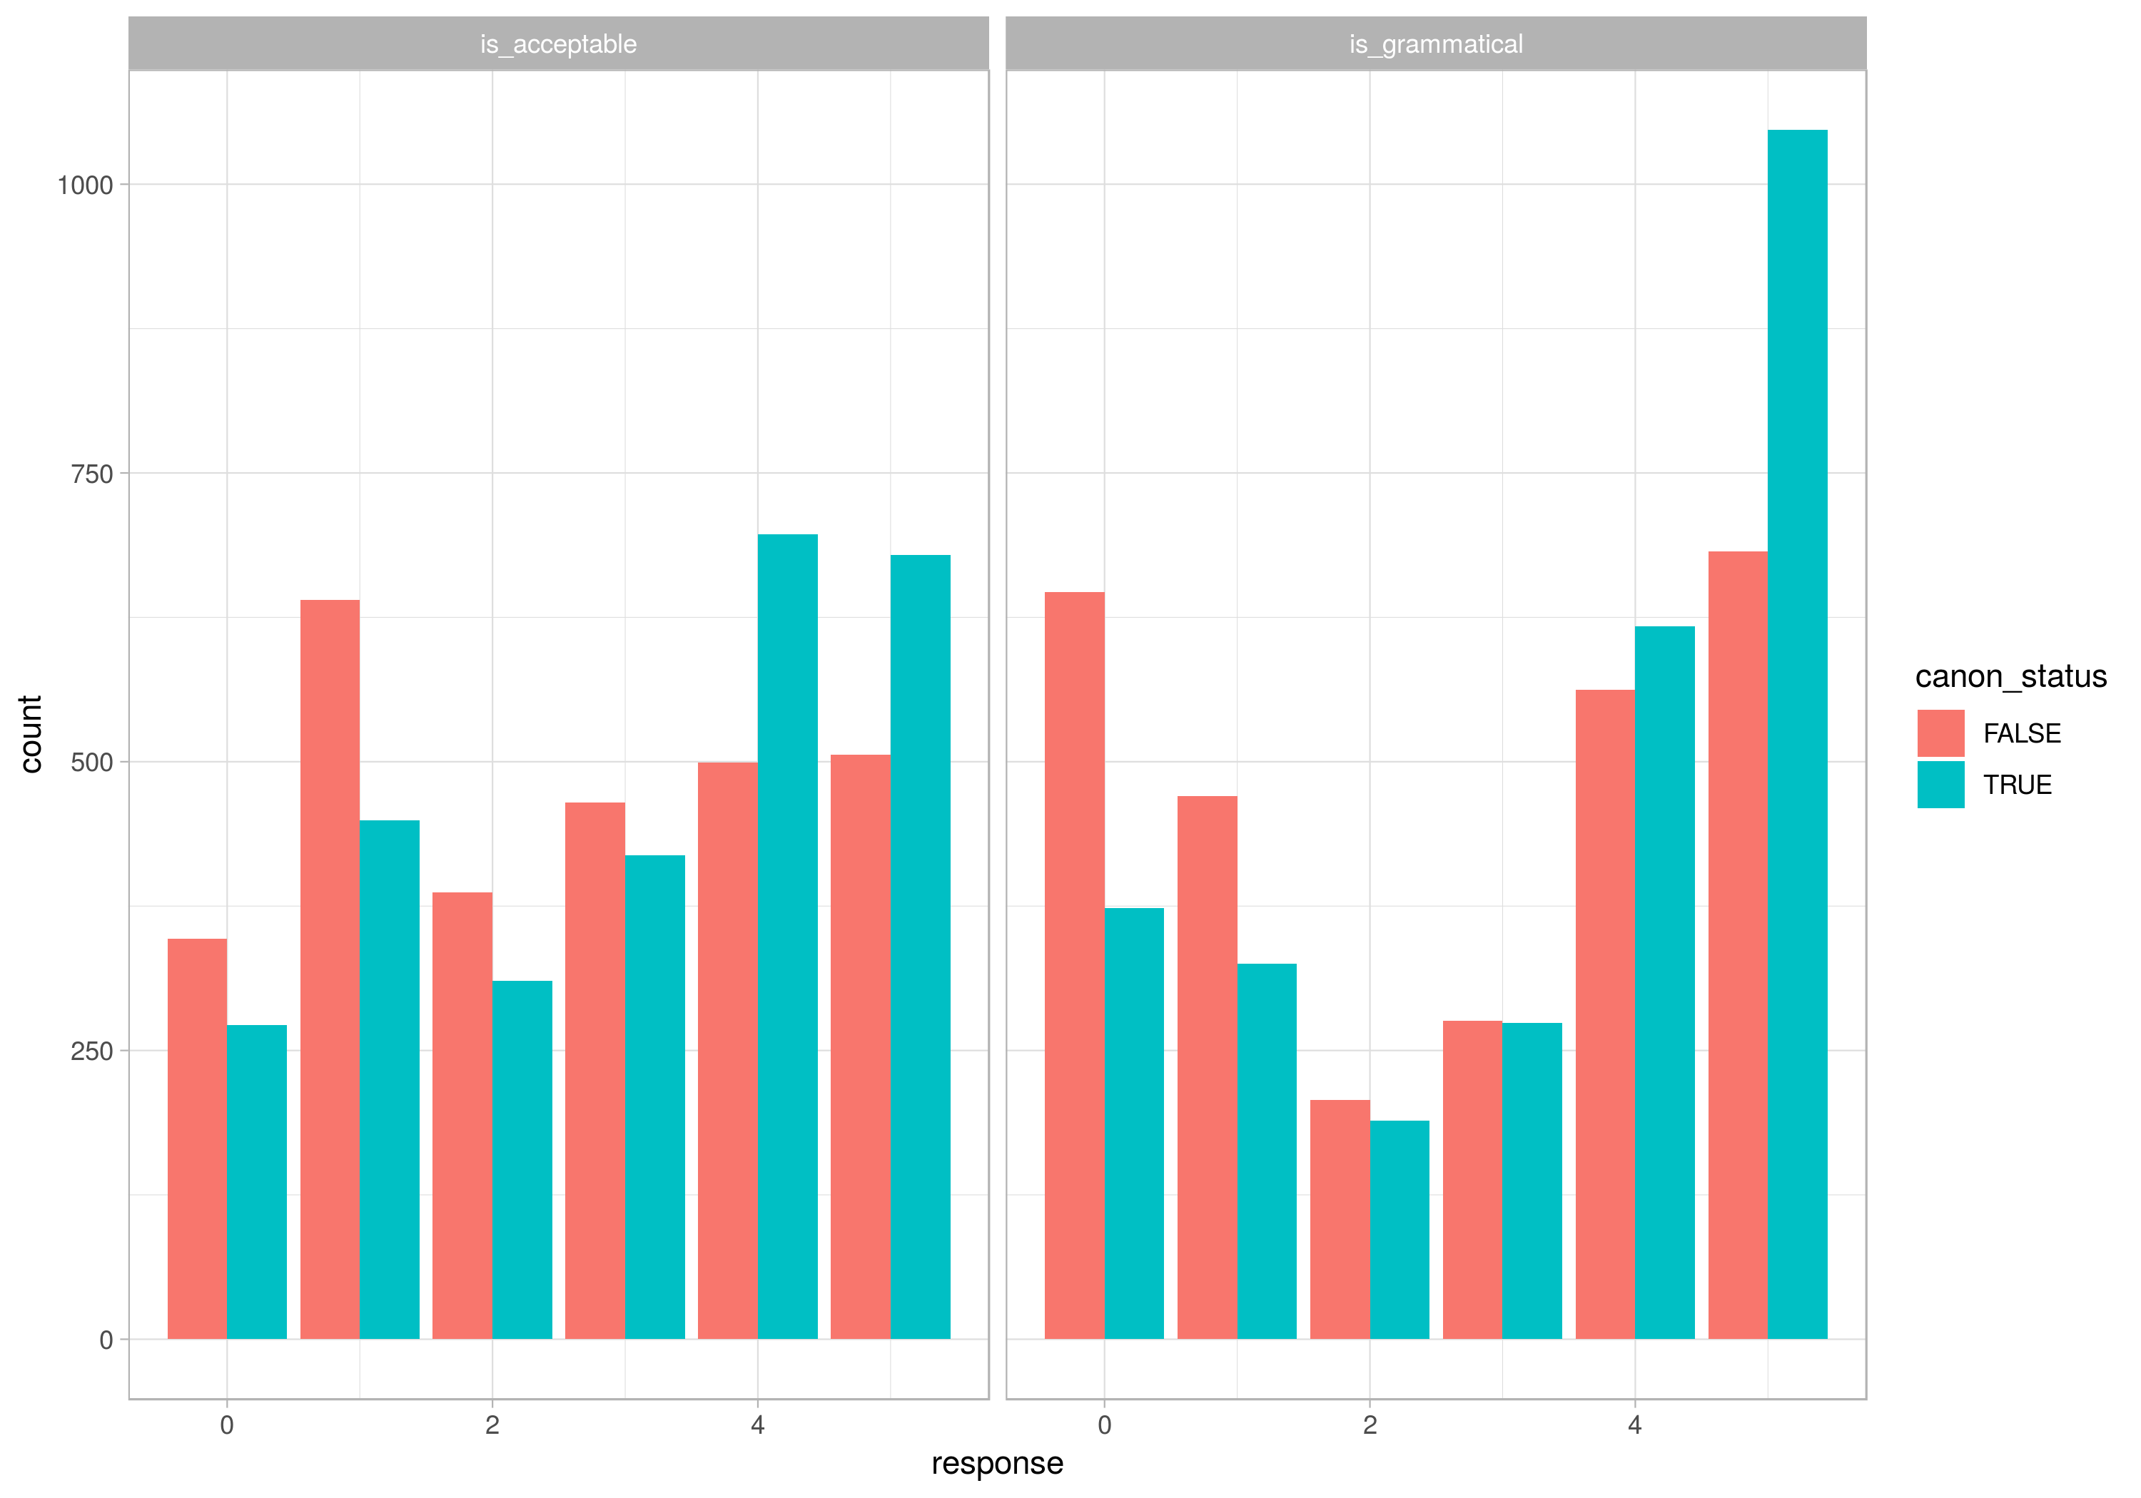

Slide 55
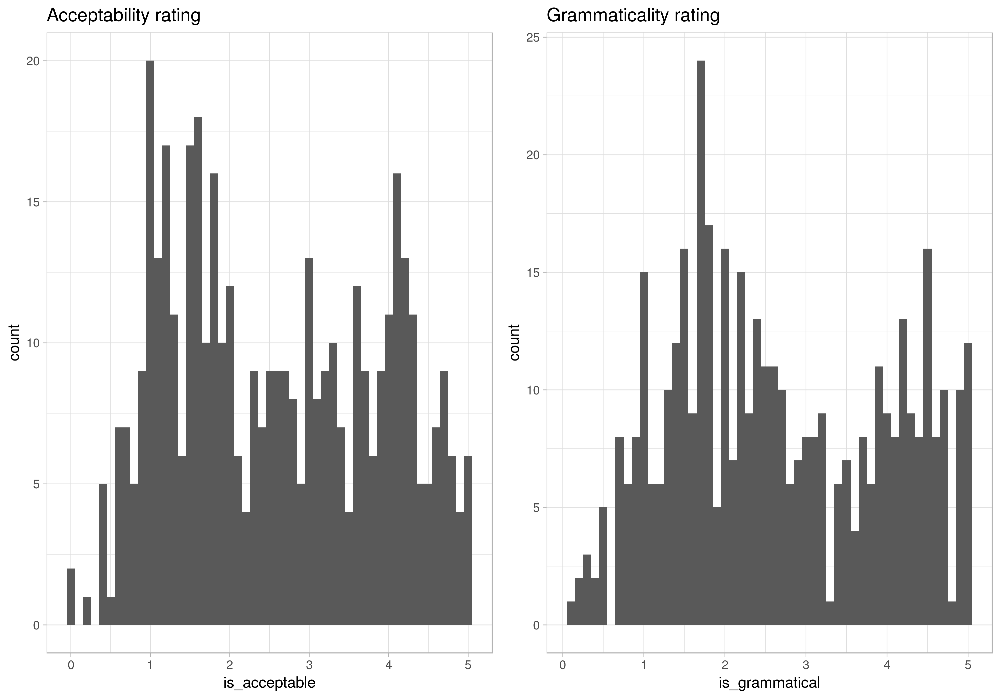

Slide 56
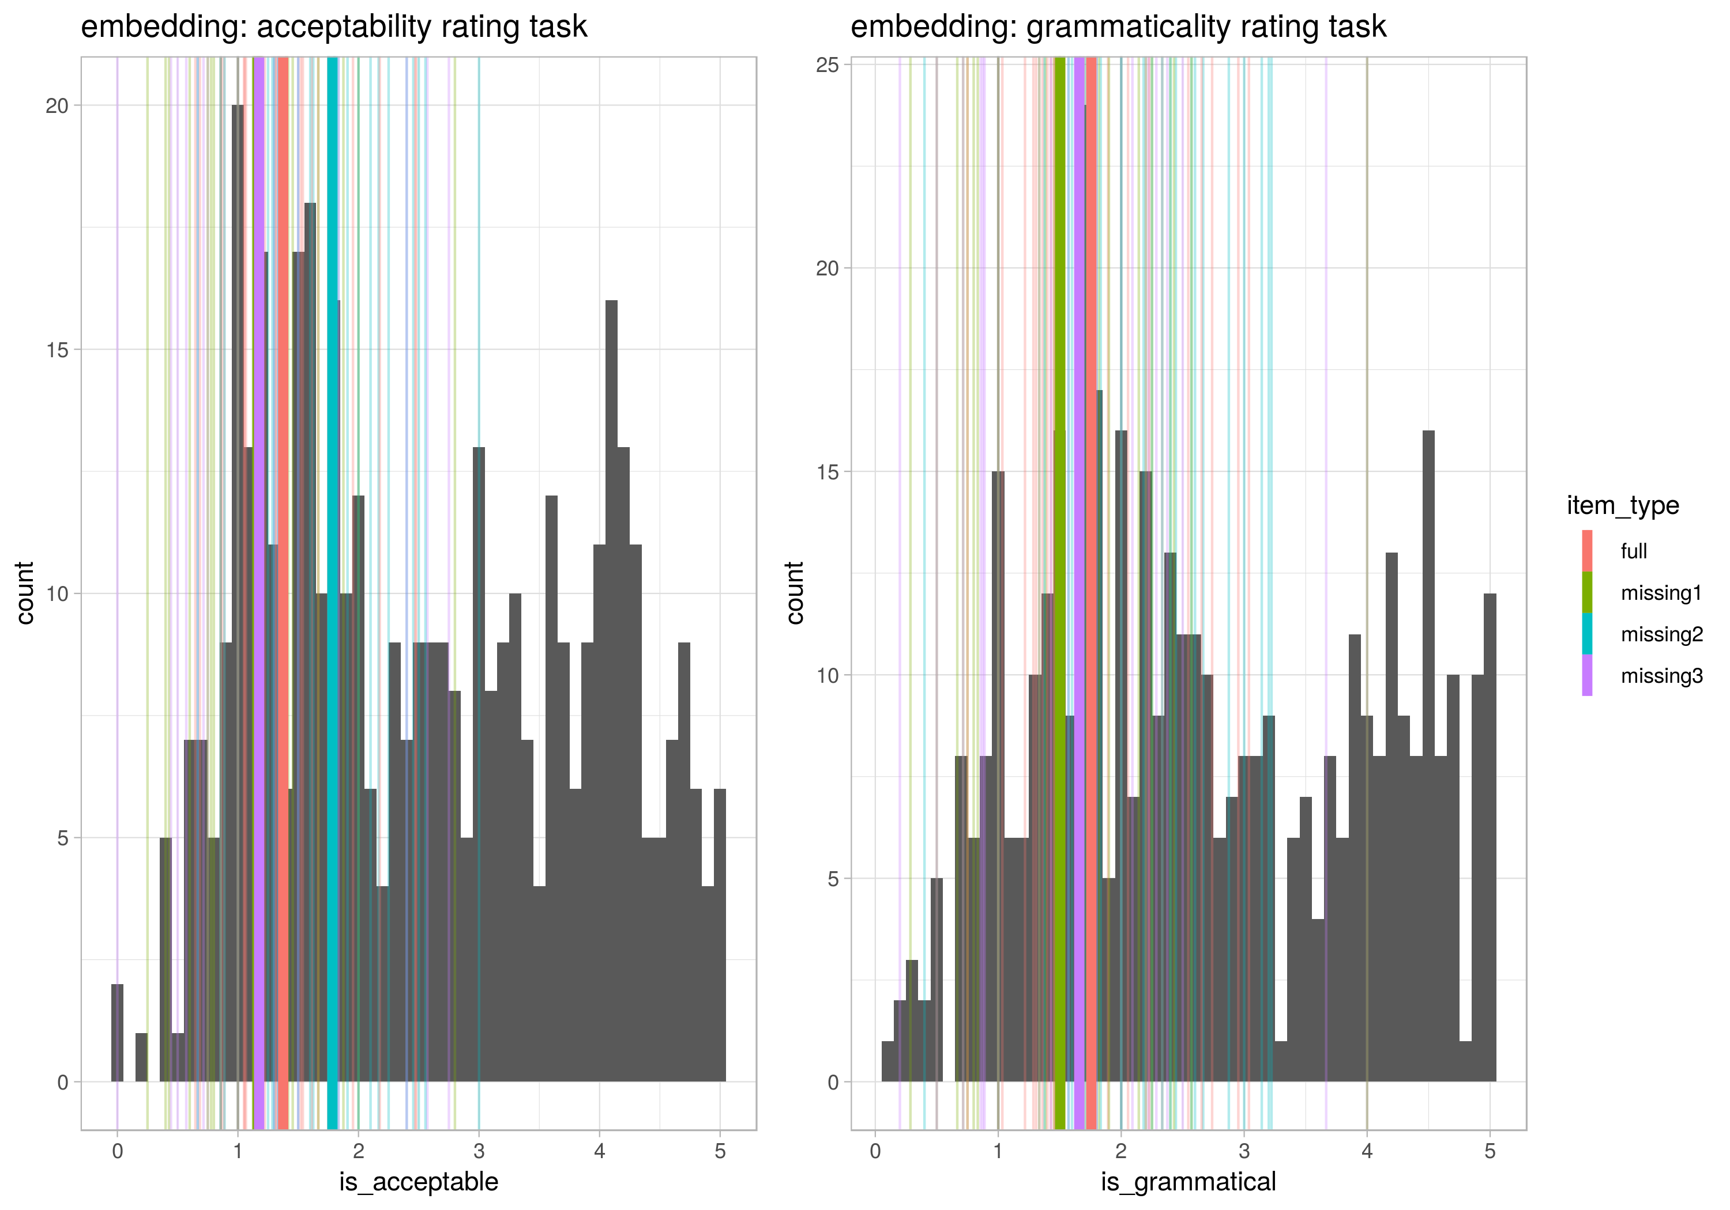
Embedding | Full embedding | The paper the student the catalog confused was studying in the library was missing a page
 | Missing V1 | The paper the student the catalog studying in the library was missing a page
 | Missing V2 | The paper the student the catalog confused was missing a page
 | Missing V3 | The paper the student the catalog confused was studying in the library.

Slide 57
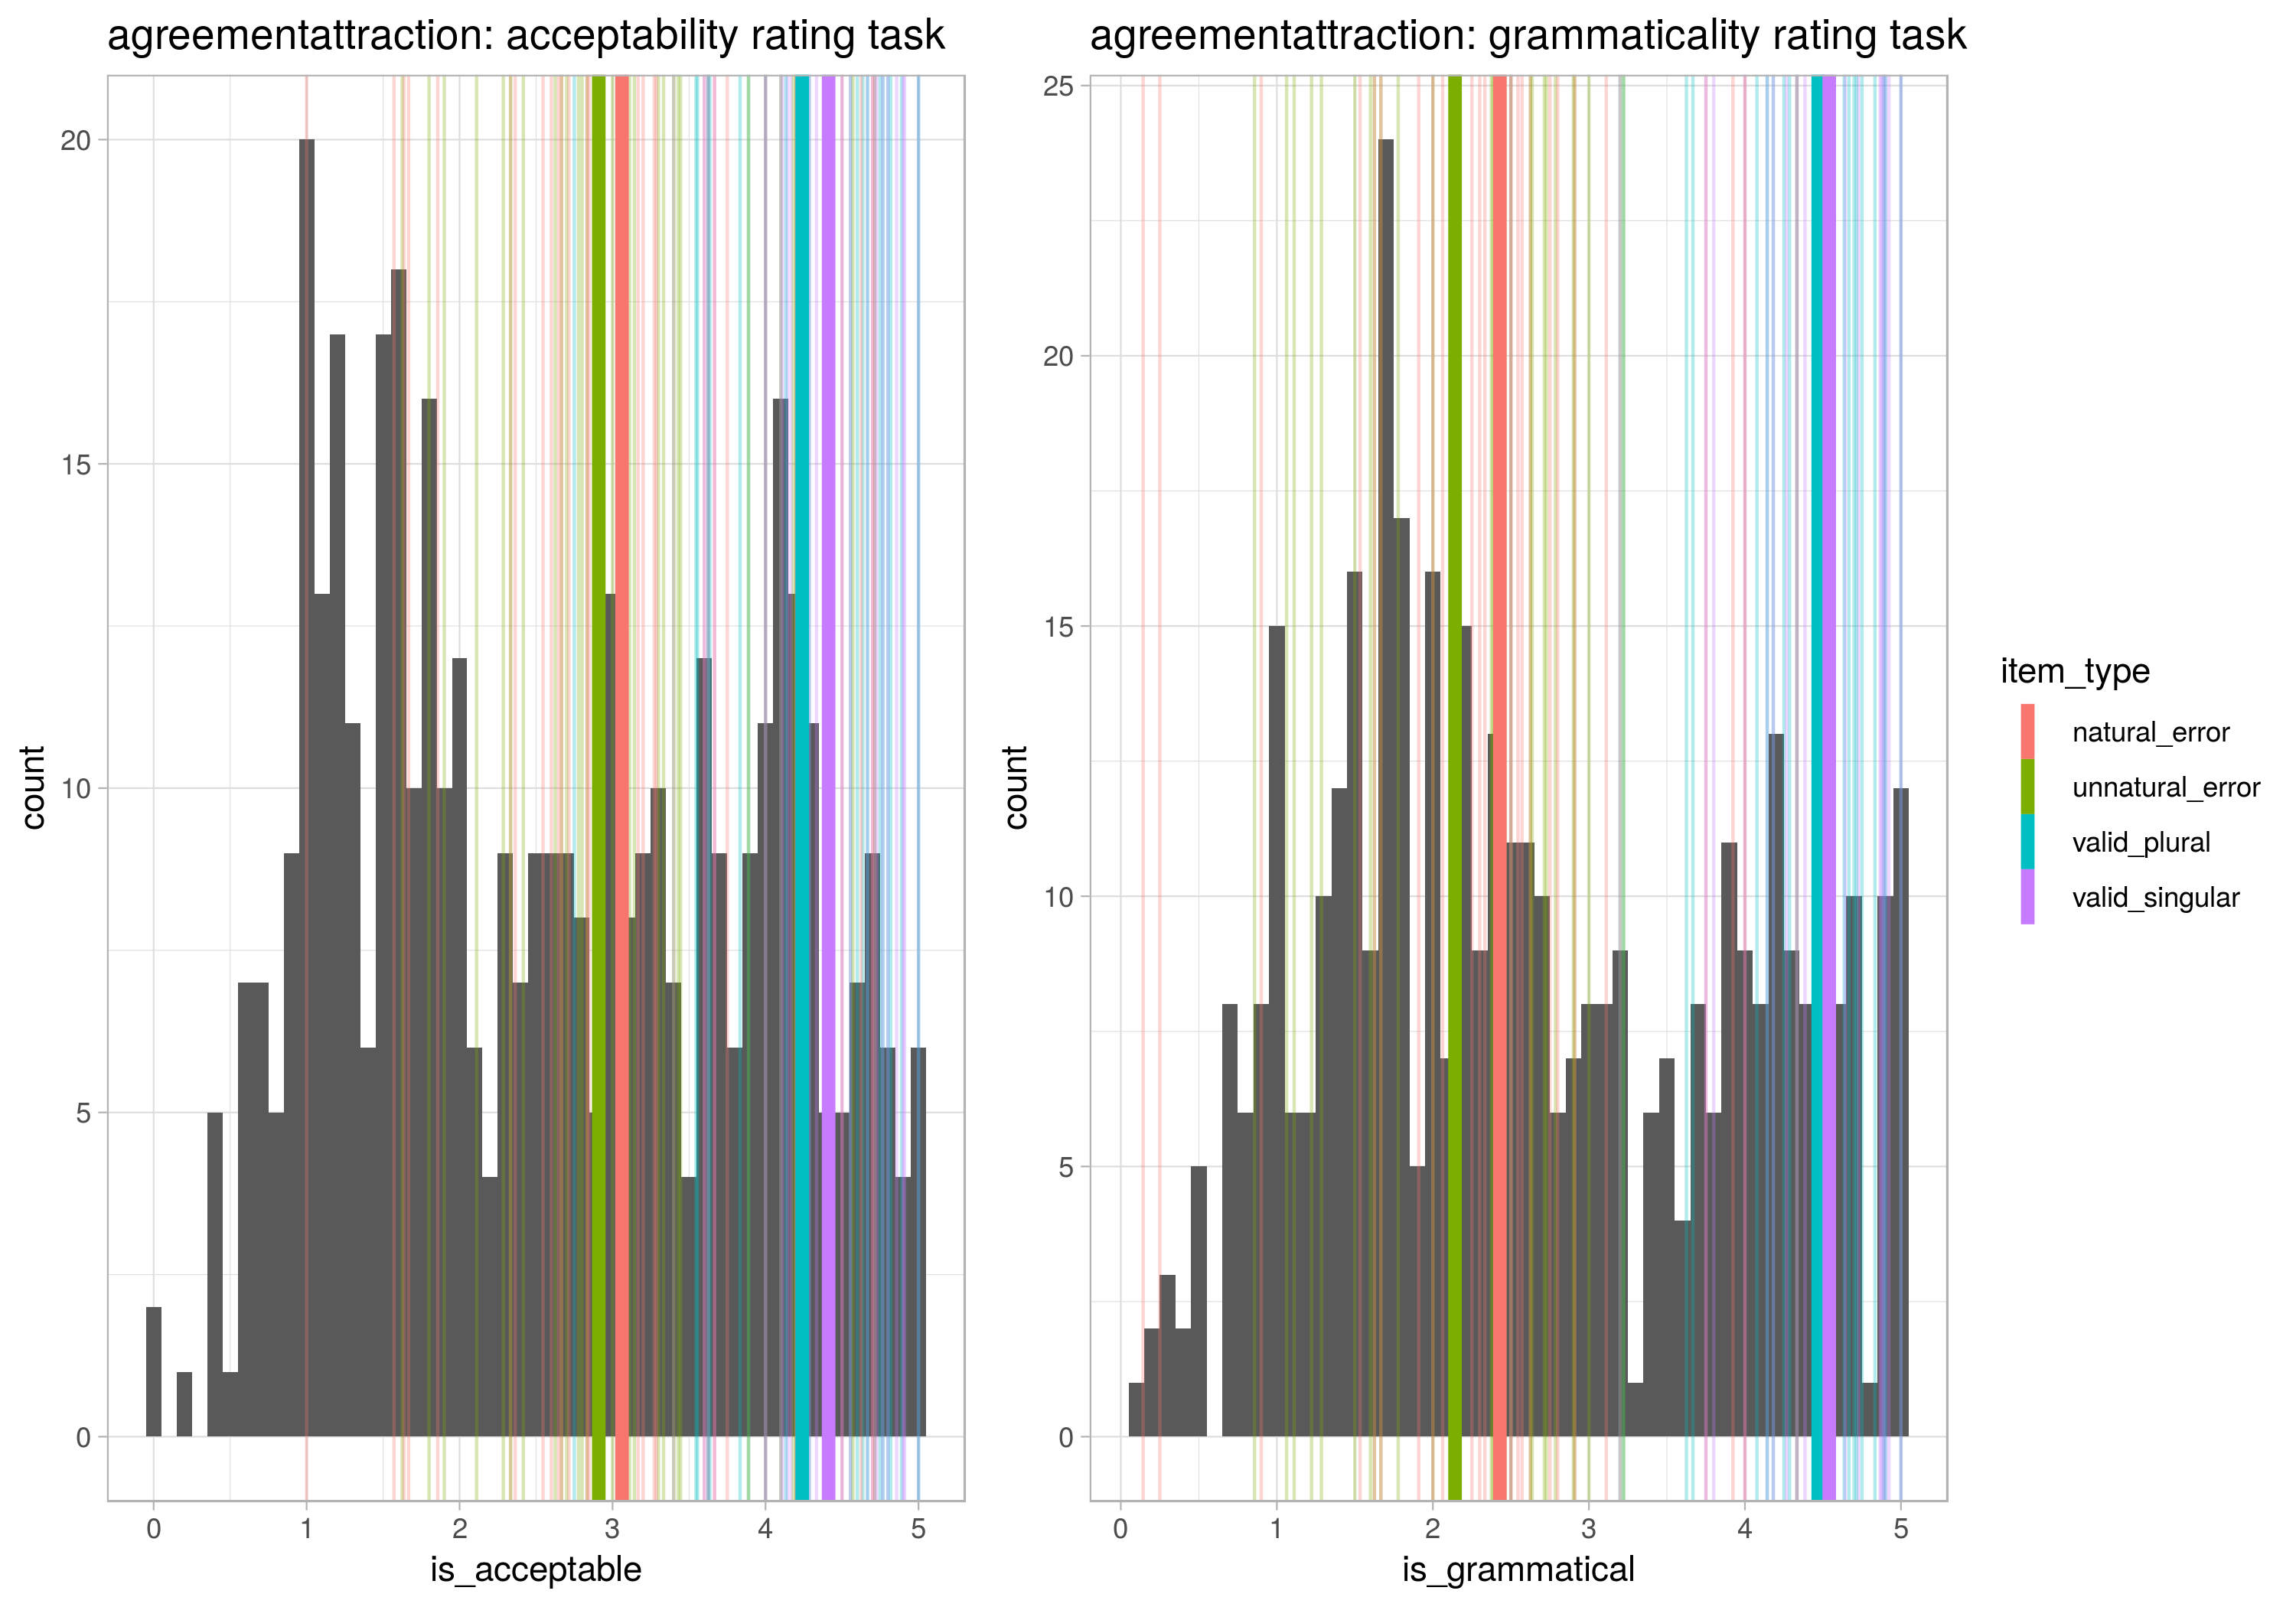
Agreement attraction | Valid Singular | The label on the bottle is quite hard to read
 | Valid Plural | The labels on the bottles are quite hard to read
 | Natural error | The label on the bottles are quite hard to read
 | Unnatural error | The labels on the bottle is quite hard to read

Slide 58
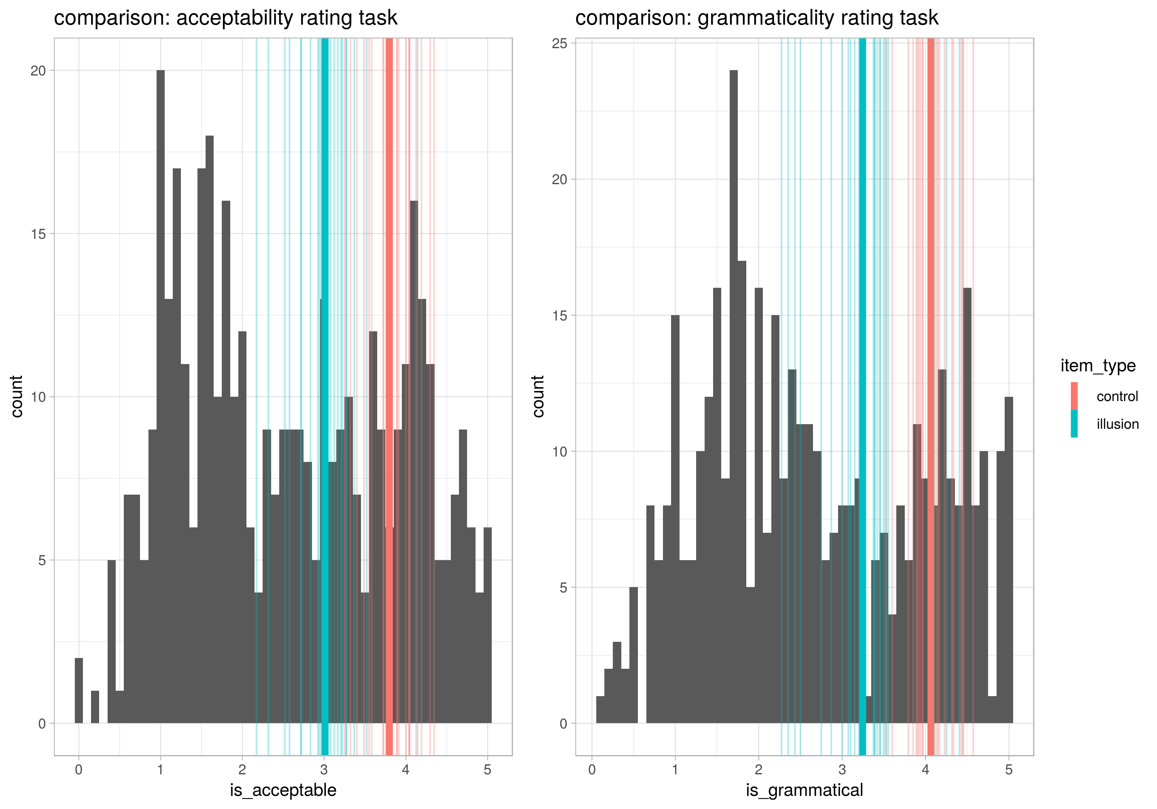
Comparison Illusion | Illusion | At the party more seniors were talking with the professors than the junior was.
 | Control | At the party more seniors were talking with the professors than juniors were.

Slide 59
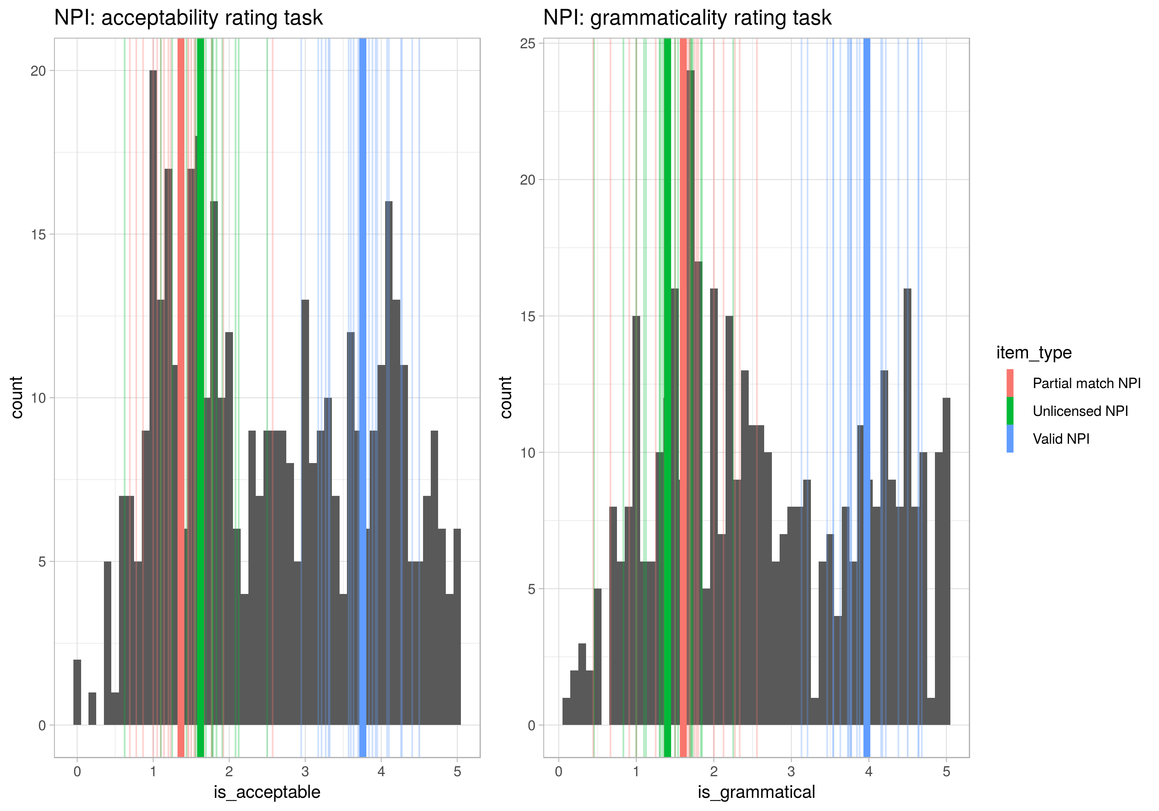
NPI Illusion | Valid | Few gamblers with a system have ever finished ahead.
 | Partial match | A gambler without a system has ever finished ahead.
 | Unlicensed | Most gamblers with a system have ever finished ahead.

Slide 60
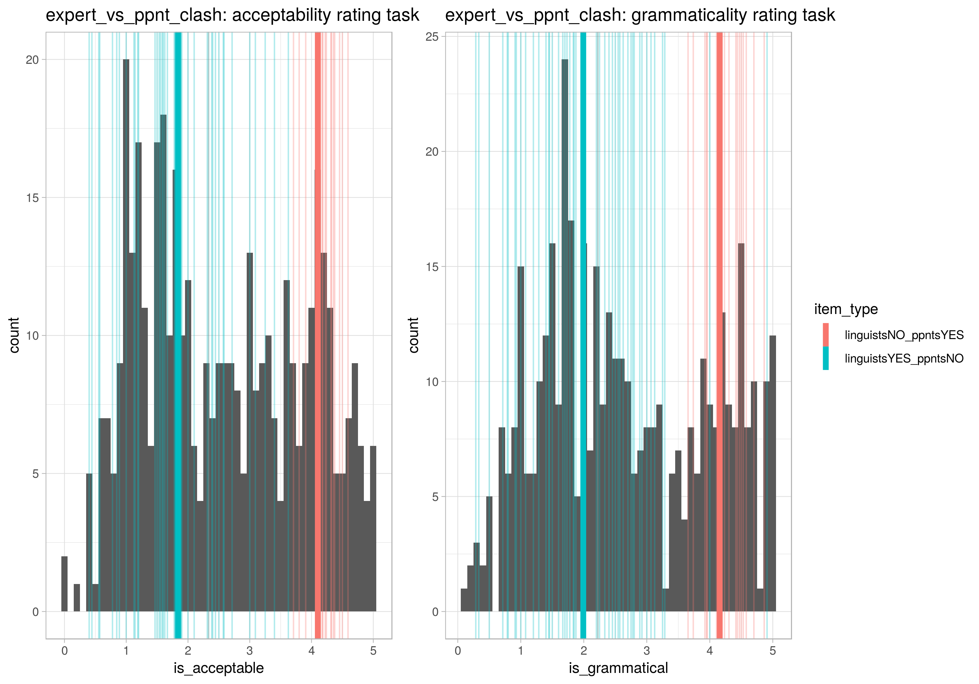
LI vs MTurk | LI-yes, Turk-no | The car was driven while being tired.
 | LI-no, Turk-yes | The game was played shoeless.

Slide 61
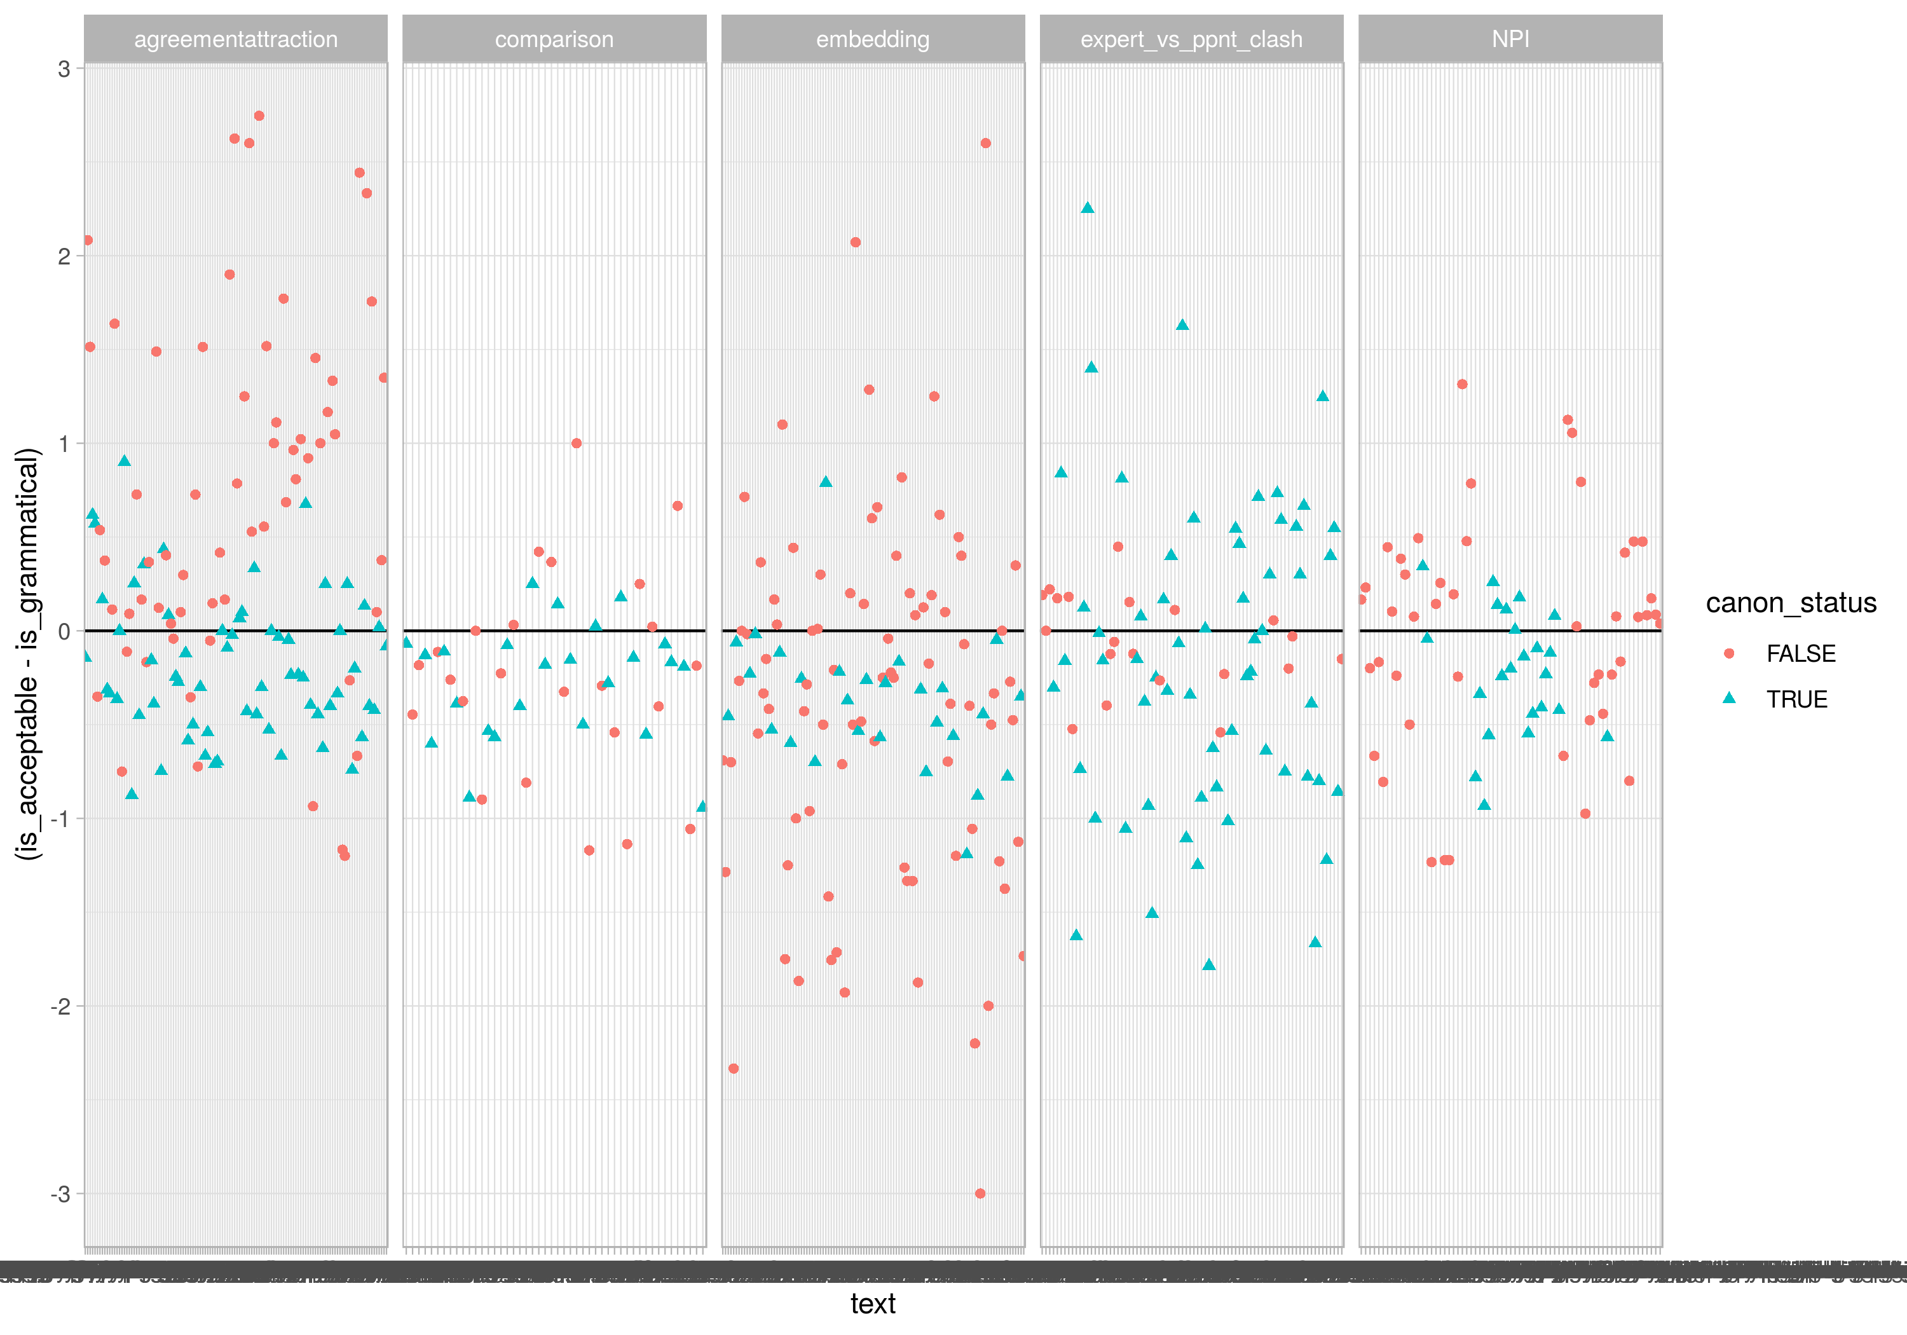

Slide 67
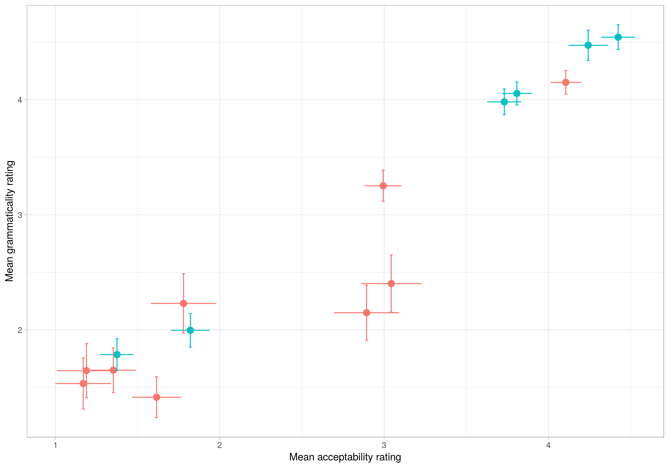

Slide 70
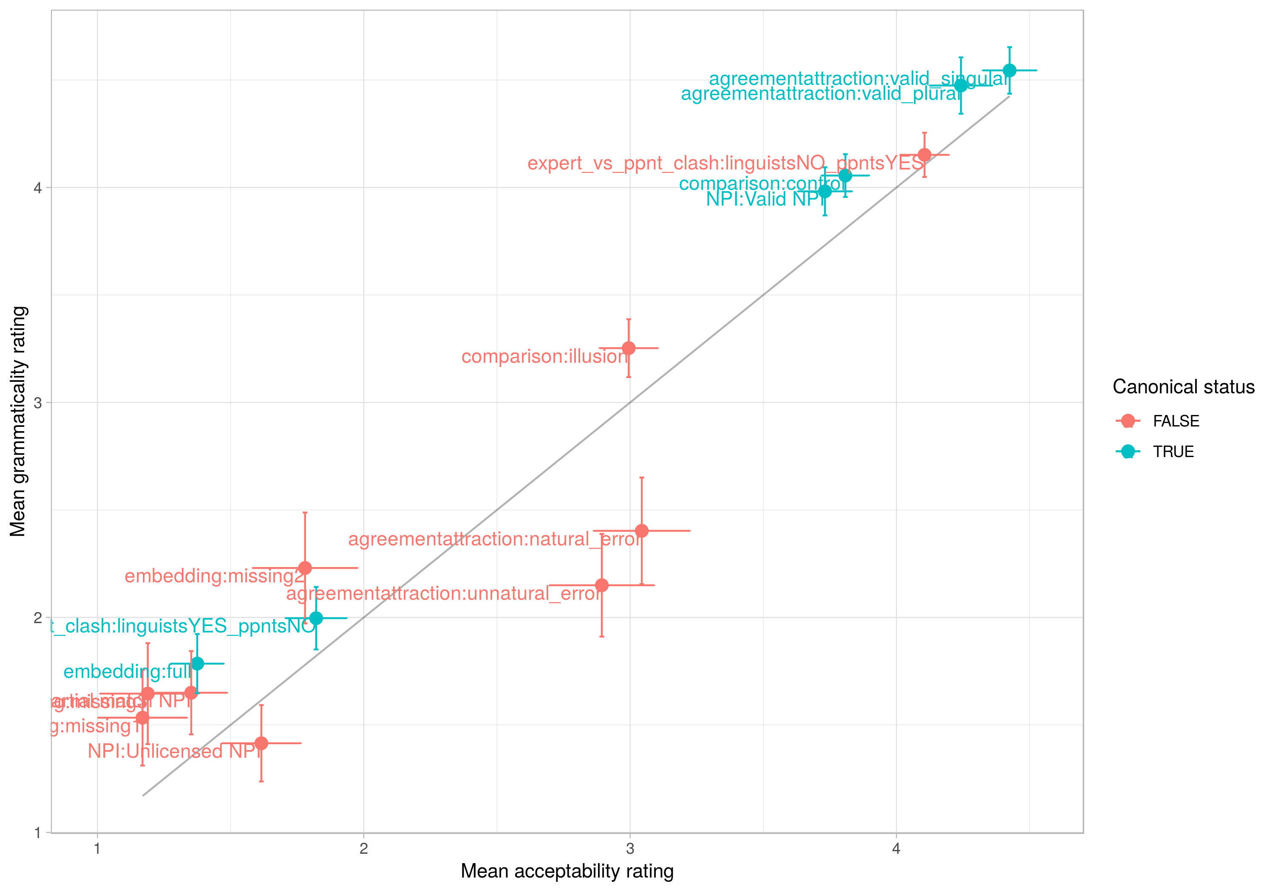

Slide 71
Linguistics
Lau & Lappin (2017). Grammaticality, acceptability, and probability: a probabilistic view of linguistic knowledge. Cognitive Science 41(5), 1202–1241
Sprouse, Yankama, Indurkhya, Fong, & Berwick, (2018). Colorless green ideas do sleep furiously: gradient acceptability and the nature of the grammar. The Linguistic Review 35(3), 575–599.
Lappin & Lau (2018)Gradient Probabilistic Models vs Categorical Grammars: A Reply to Sprouse et al. http://thescienceoflanguage.com/2018/07/22/gradient-probabilistic-models-vs-categorical-grammars-a-reply-to-sprouse-et-al-2018/
State trace analysis (readable)
Newell & Dunn (2008). Dimensions in data: Testing psychological models using state-trace analysis. Trends in cognitive sciences 12(8), 285–290
Stephens, R., Matzke, D., & Hayes, B. (2018). Disappearing dissociations in experimental psychology: Using state-trace analysis to test for multiple processes. Journal of Mathematical Psychology, access at https://osf.io/ah2wb
(this particular) State trace analysis (technical)
Kalish, Dunn, Burdakov, & Sysoev (2016) A statistical test of the equality of latent orders.
Journal of Mathematical Psychology, 70, 1–11

Slide 72
