Slide 1


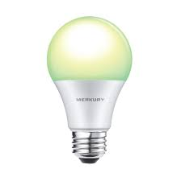
Colorless green ideas 2019
State Trace Analysis
!

Slide 2
Law
Evil
Good
Chaos

Slide 3
Law
John loves Mary
Evil
Good
Chaos

Slide 4
Law
John loves Mary
Evil
Good
Staple my beets!
Chaos

Slide 5
Law
John loves Mary
Evil
Good
Ideas green furiously
Staple my beets!
Chaos

Slide 6
Law
Fish fish fish eat eat eat
John loves Mary
Evil
Good
Ideas green furiously
Staple my beets!
Chaos

Slide 7
Observable
outcome
Acceptability
judgement
Grammaticality
judgement

Slide 8
Sentence properties
Lexical statistics
?
Plausibility
Structural well-formedness
wrt a grammar
?
Memory demands
?
Observable
outcome
Acceptability
judgement
Grammaticality
judgement

Slide 9
Sentence properties
Lexical statistics
?
Plausibility
Structural well-formedness
wrt a grammar
?
Memory demands
?
Perception
&
Judgement
Observable
outcome
Acceptability
judgement
Grammaticality
judgement

Slide 10
Sentence properties
Lexical statistics
?
Plausibility
Structural well-formedness
wrt a grammar
?
Memory demands
?
Perception
&
Judgement
Attention
Coffee
[Formal/folk]
Theory of language
Endorsement
criterion level
Observable
outcome
Acceptability
judgement
Grammaticality
judgement

Slide 11
Sentence properties
Lexical statistics
?
Plausibility
Structural well-formedness
wrt a grammar
?
Memory demands
?
Perception
&
Judgement
Happy
feelings
Endorsement
criterion level
Observable
outcome
Acceptability
judgement
Grammaticality
judgement

Slide 12
Acceptability
Well-formedness
Grammaticality

Slide 13
A short list of things that don’t compel belief in the 2d account

Slide 14
A short list of things that don’t compel belief in the 2d account
There exist sentences that are grammatical but not acceptable.

Slide 15
A short list of things that don’t compel belief in the 2d account
There exist sentences that are grammatical but not acceptable.
There exist sentences that are acceptable but not grammatical.

Slide 16
A short list of things that don’t compel belief in the 2d account
There exist sentences that are grammatical but not acceptable.
There exist sentences that are acceptable but not grammatical.
Both (1) and (2) at the same time.

Slide 17
A short list of things that don’t compel belief in the 2d account
There exist sentences that are grammatical but not acceptable.
There exist sentences that are acceptable but not grammatical.
Both (1) and (2) at the same time.
Grammaticality judgments can be shown to contain ‘extra information’ over that contained in acceptability judgments.

Slide 18
Good enough
Not good
Good

Slide 19
Good enough
Not good
Good

Slide 20
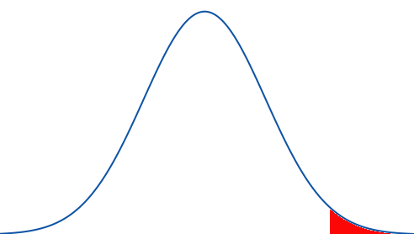
Good enough
Not good
0.1
Good

Slide 21
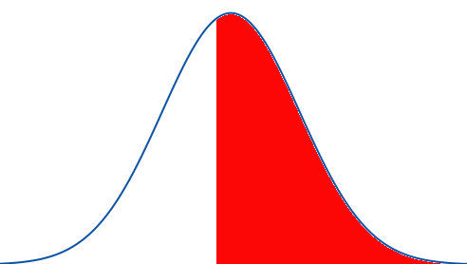
Good enough
Not good
0.1
0.55
Good

Slide 22
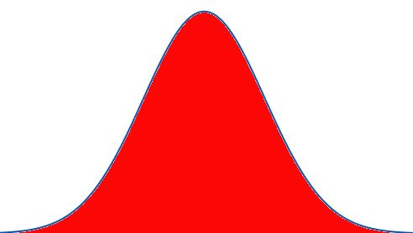
Good enough
Not good
0.1
0.55
1
Good

Slide 23
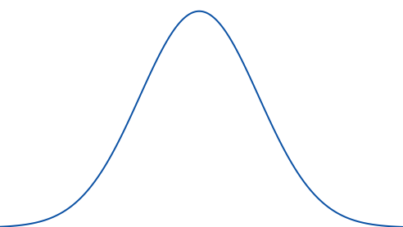
Good enough
Not good
0.1
0.55
1
Good
0

Slide 24
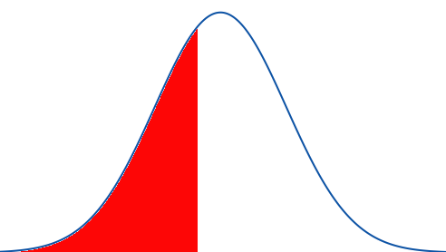
Good enough
Not good
0.1
0.55
1
Good
0
0.48

Slide 25
Good enough
Not good
0.1
0.55
1
Good
0
0.48
1

Slide 26
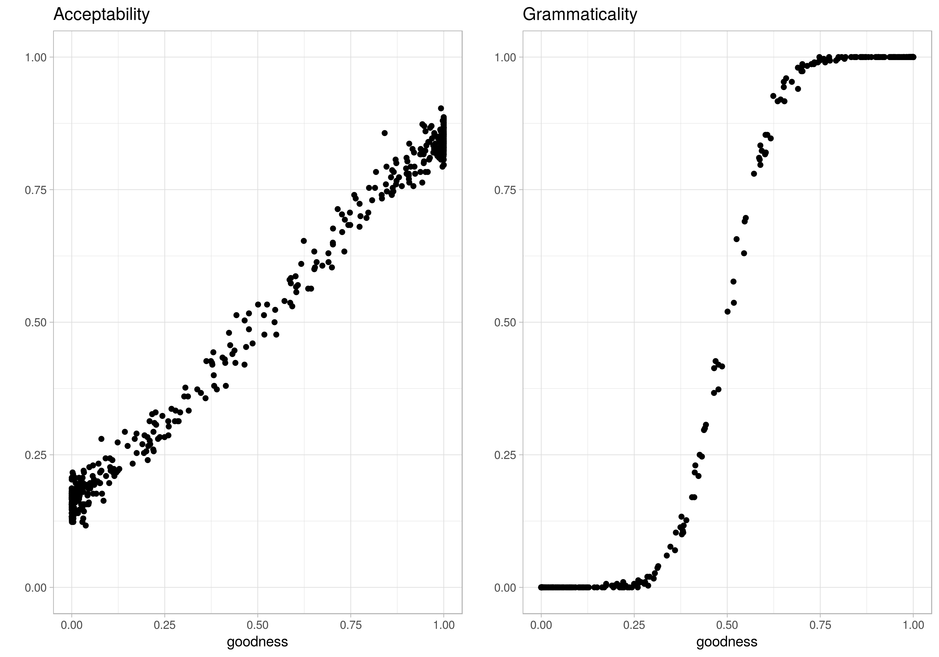

Slide 28
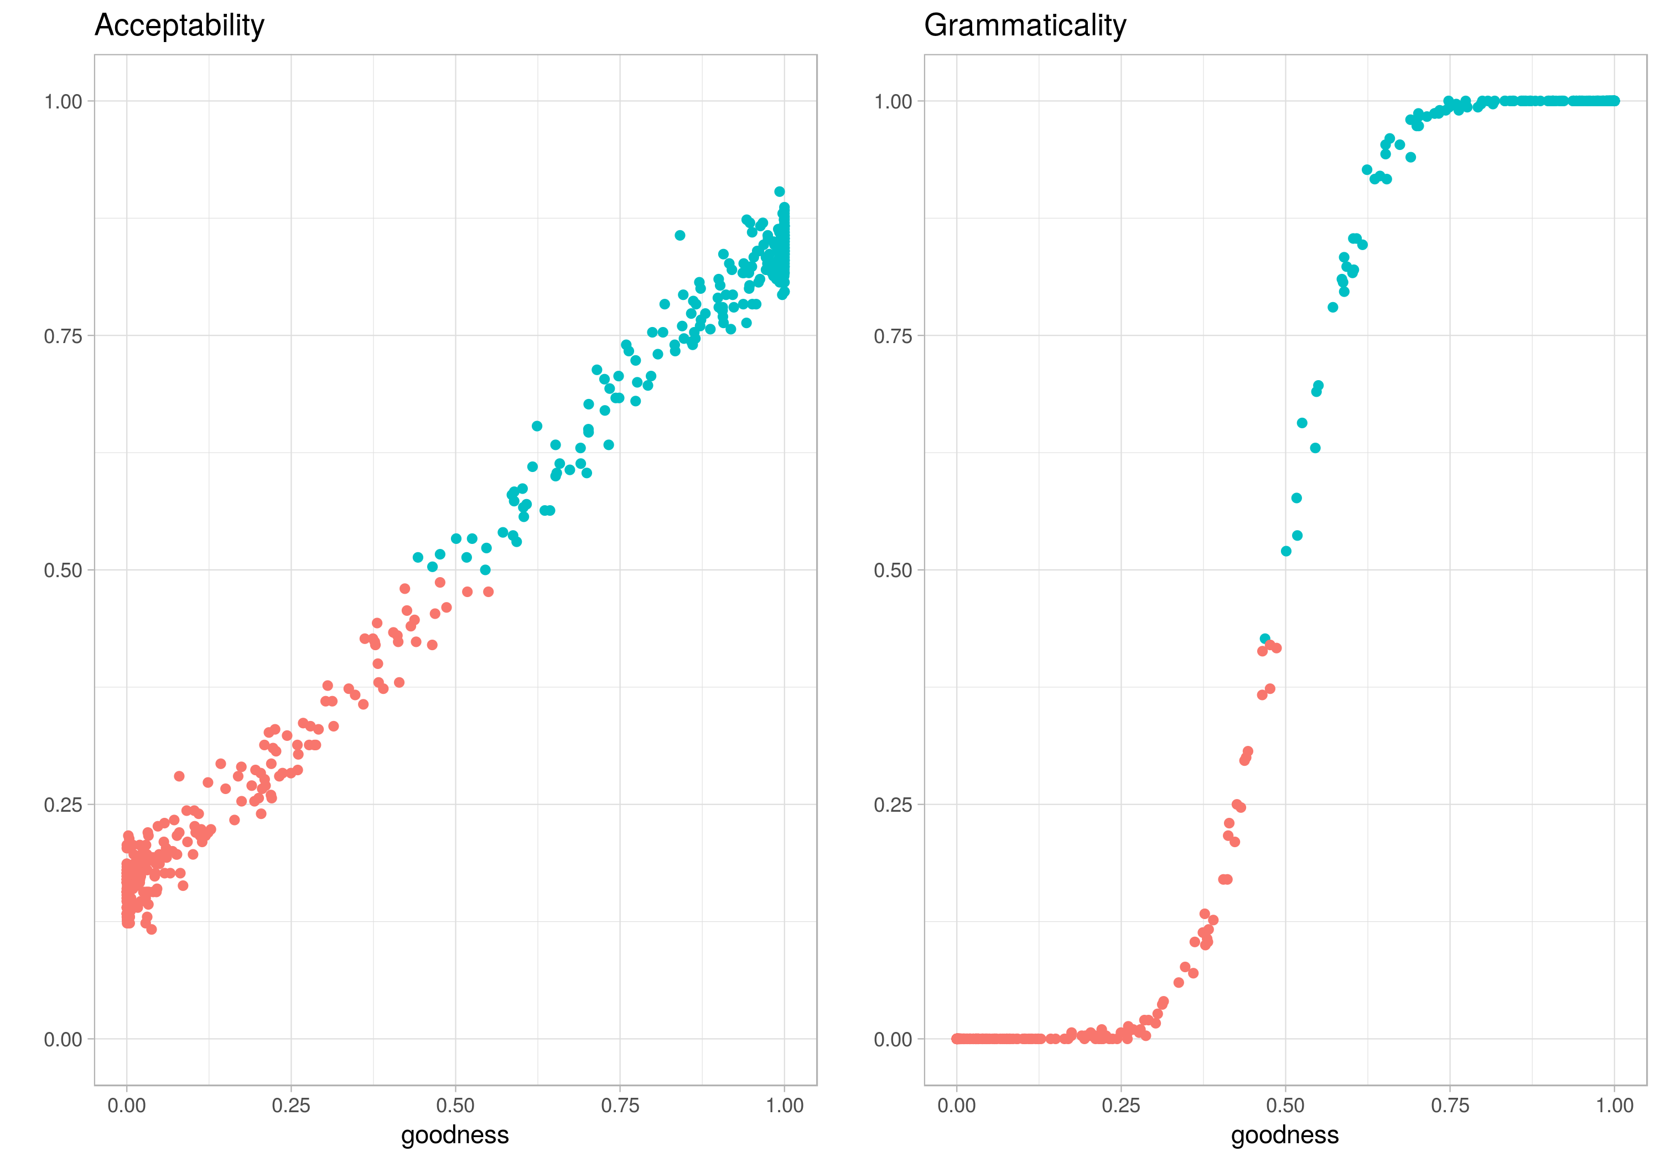

Slide 29
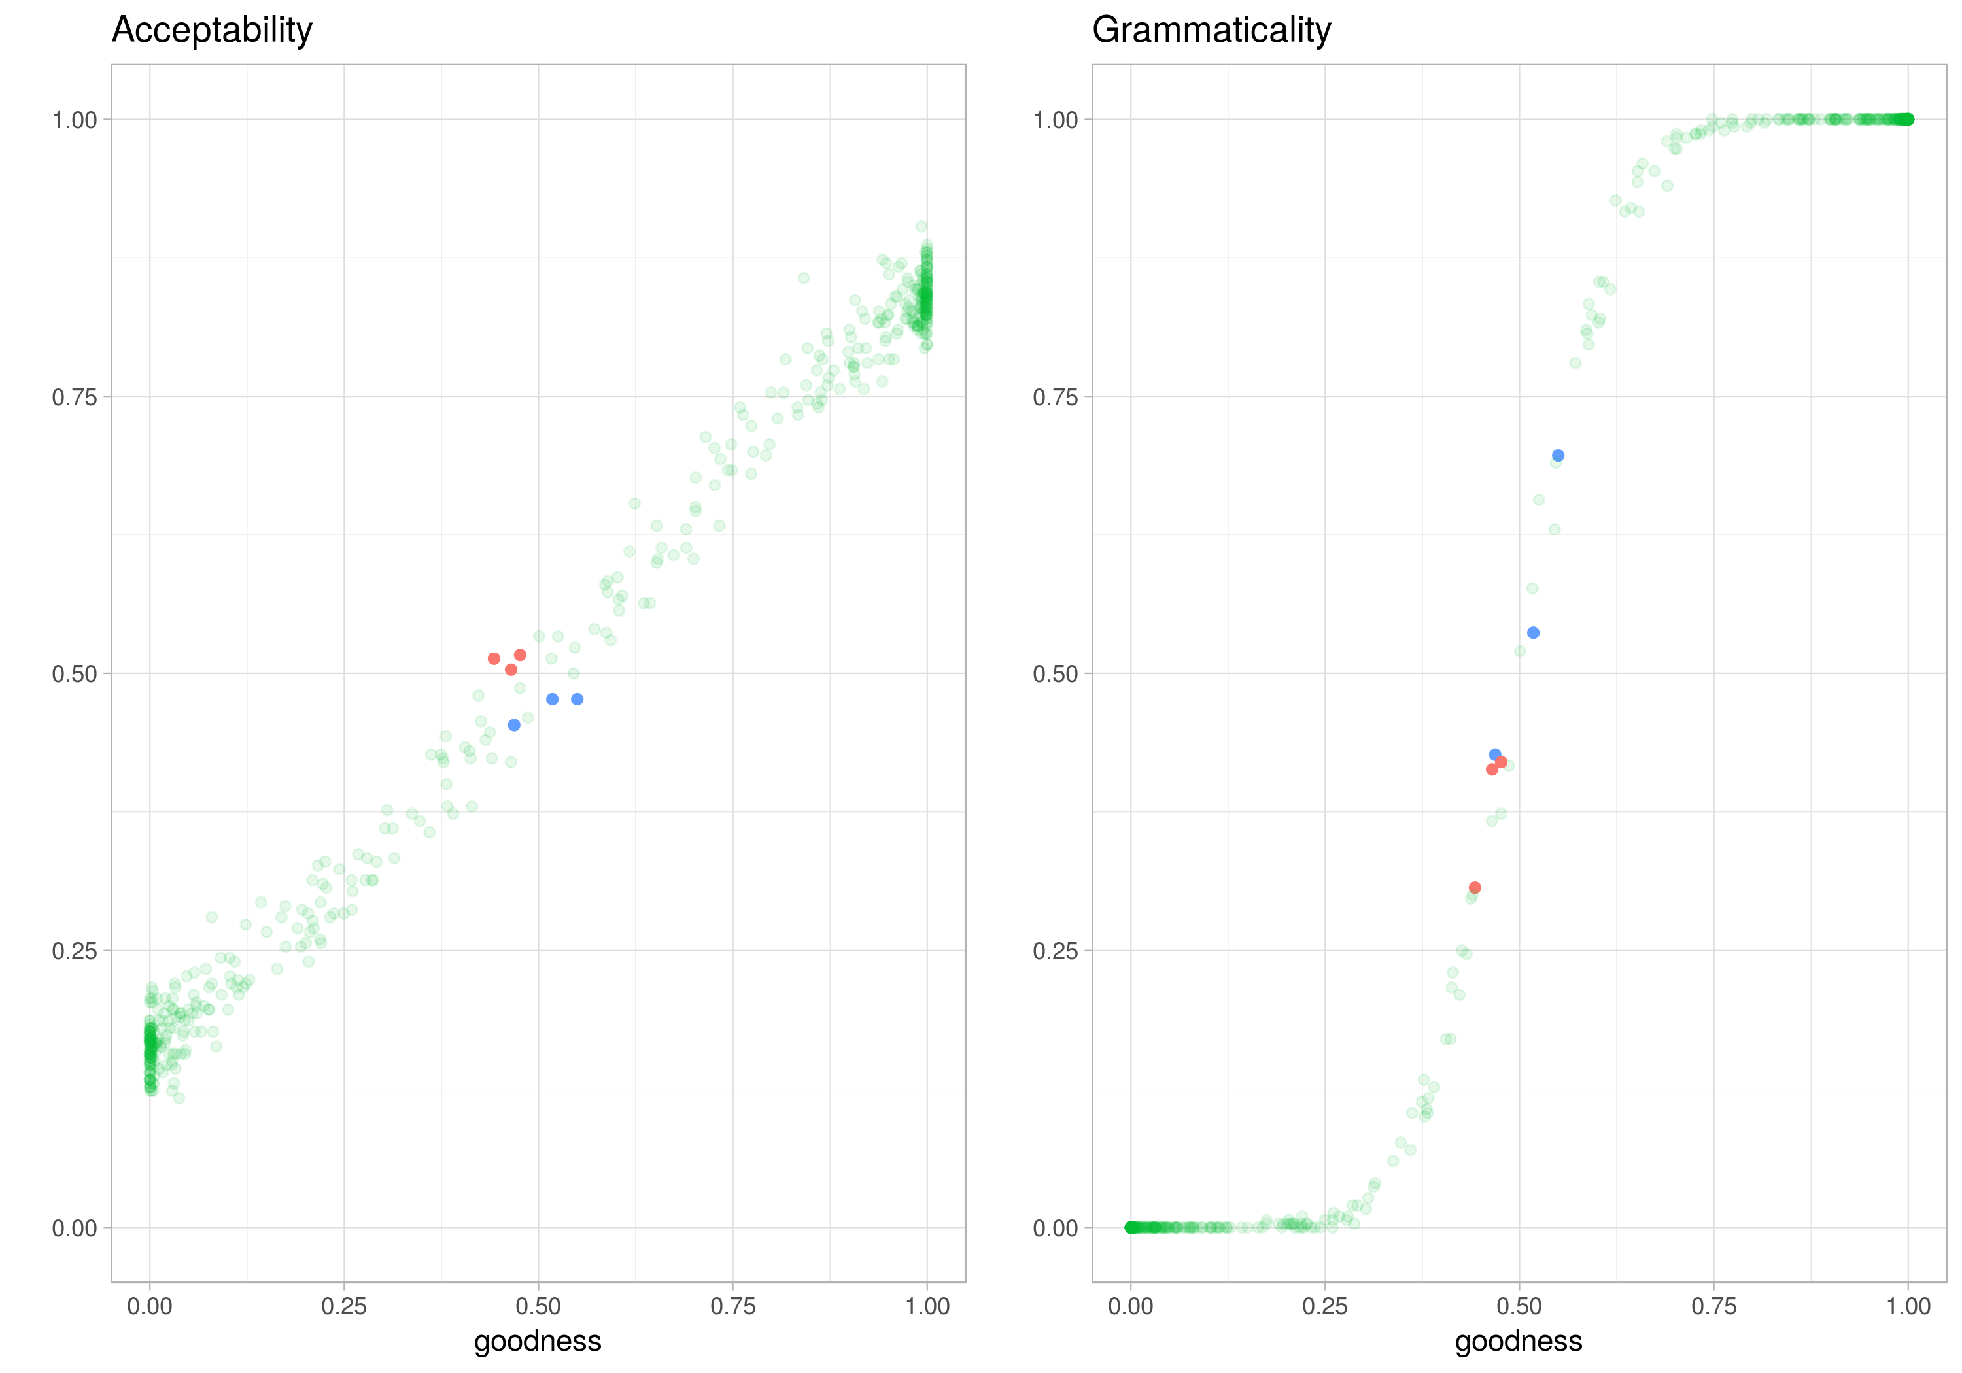

Slide 30
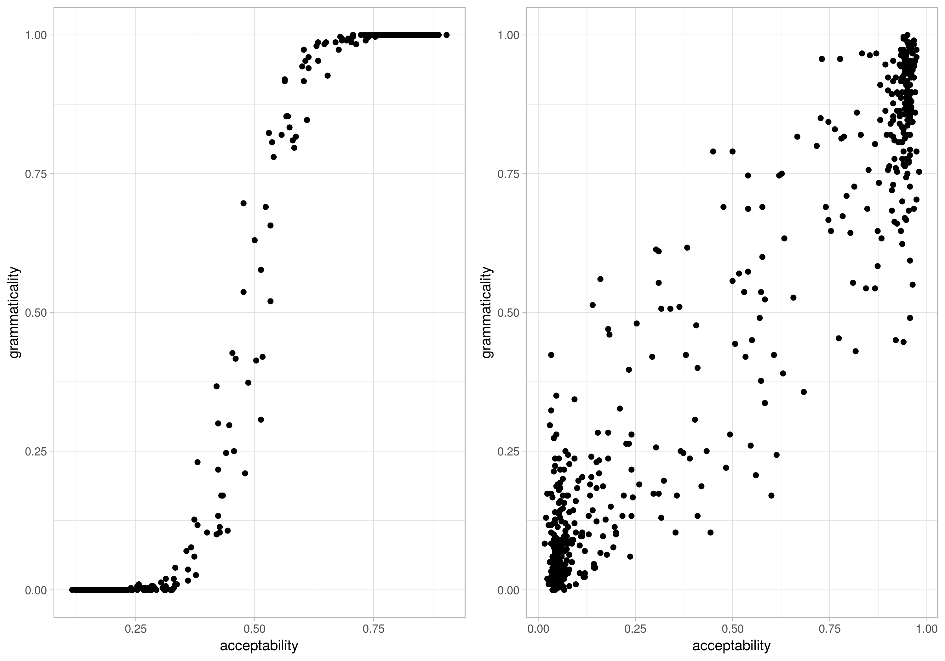

Slide 31
cor(x,y)= 0.92

Slide 32
cor(x,y)= 0.92

Slide 33
cor(x,y)= 0.92

Slide 34
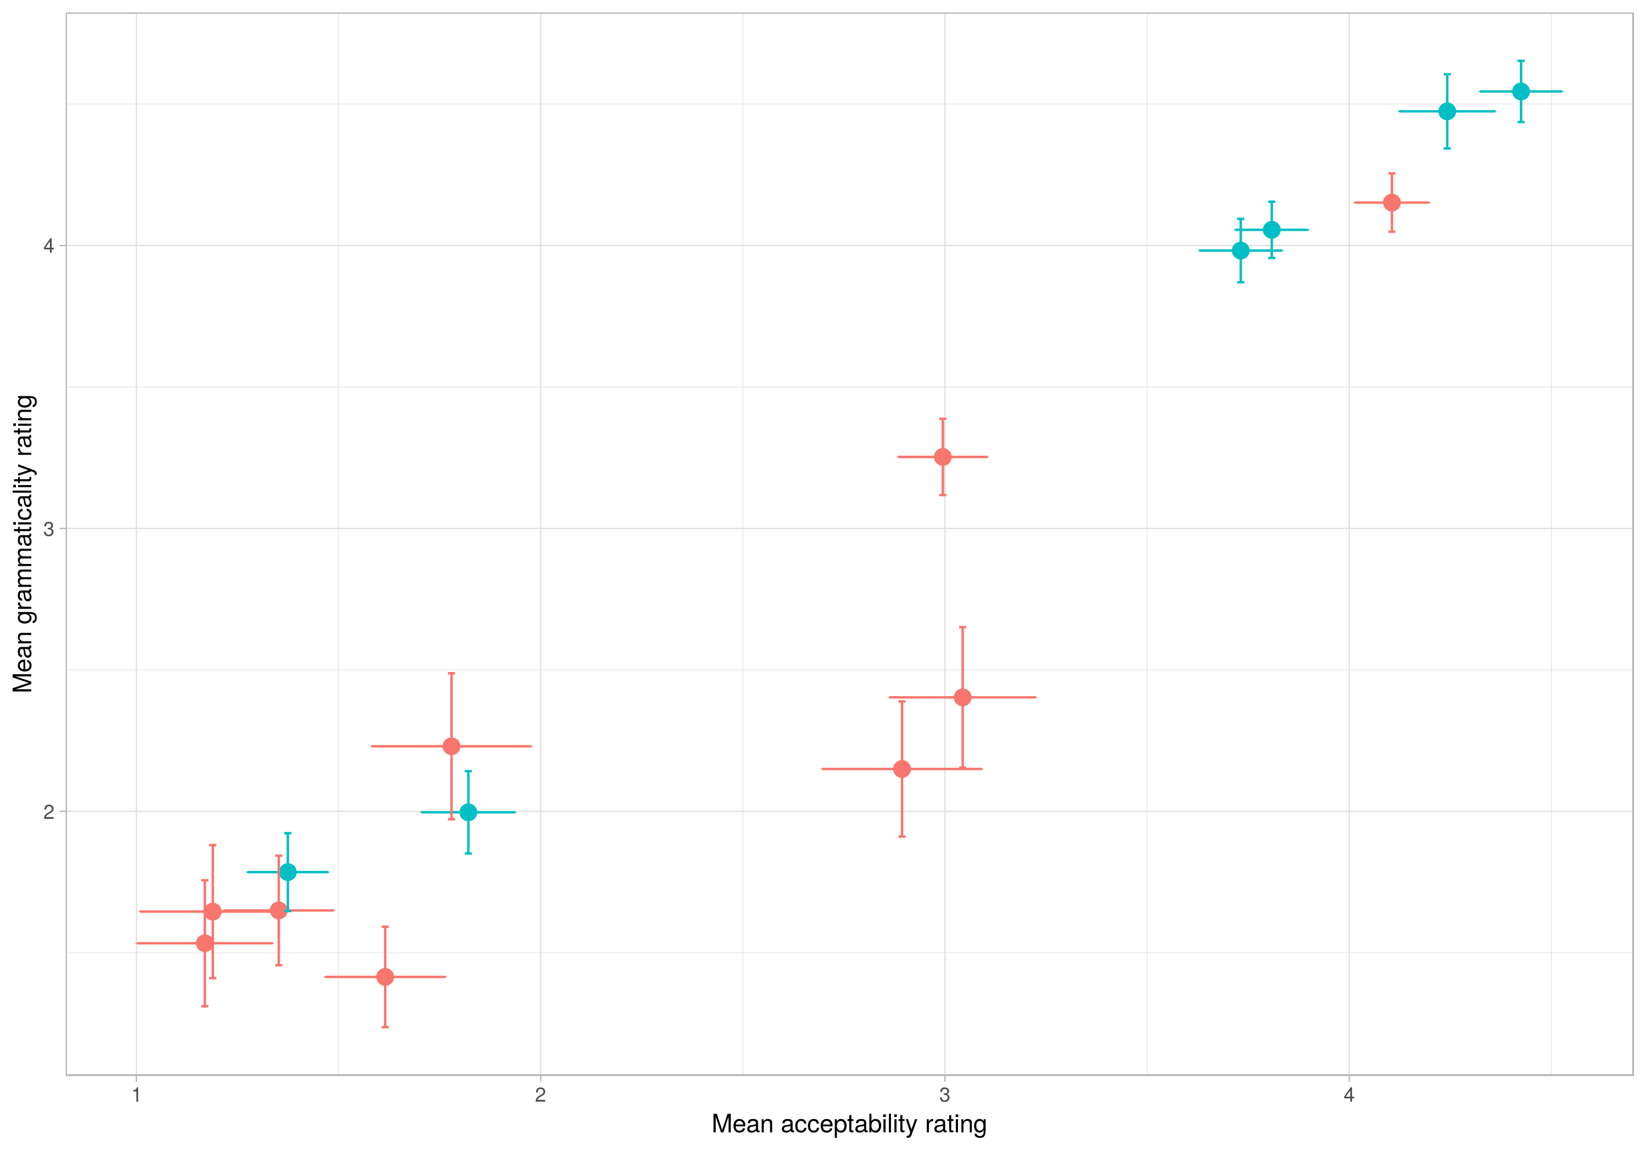

Slide 35
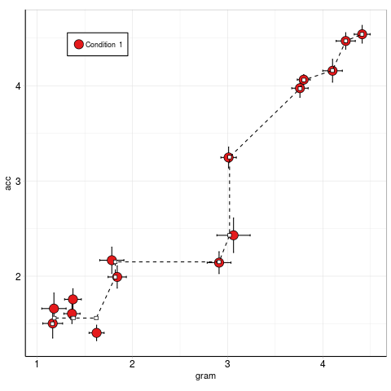
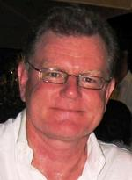
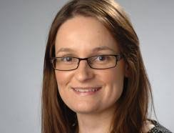

Slide 36
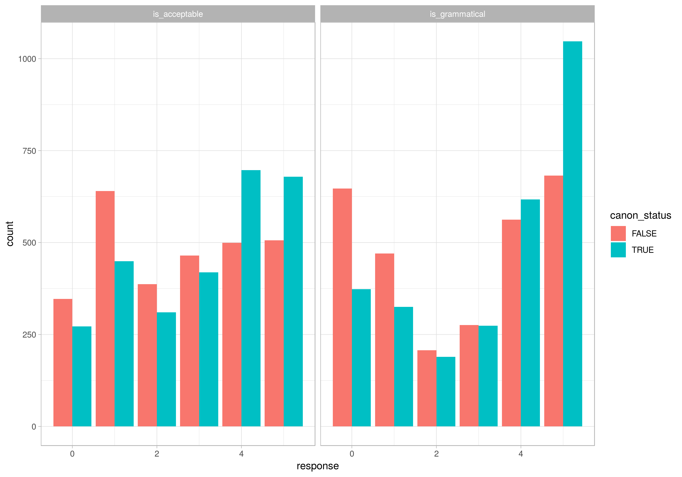

Slide 37
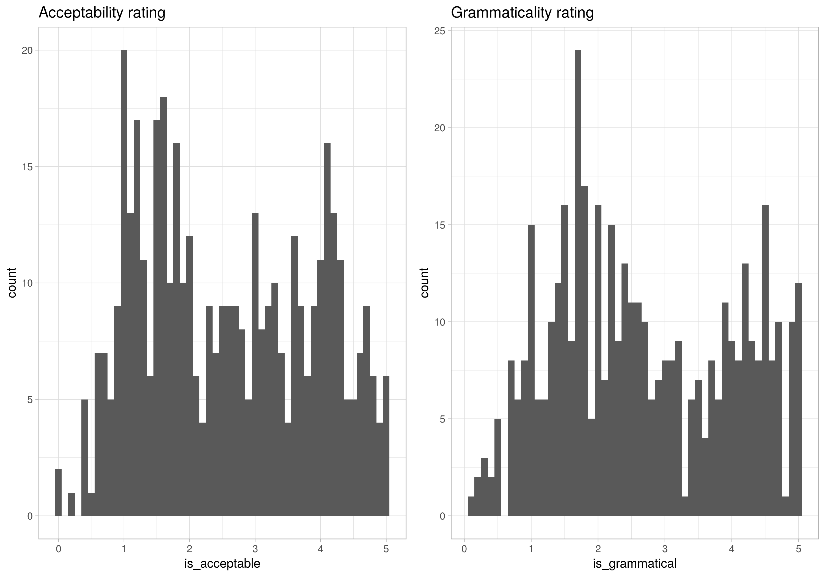

Slide 38
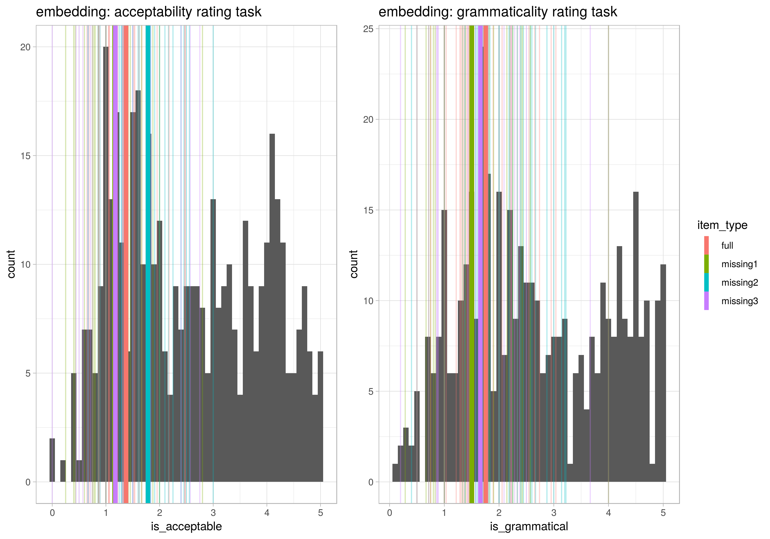
Embedding | Full embedding | The paper the student the catalog confused was studying in the library was missing a page
 | Missing V1 | The paper the student the catalog studying in the library was missing a page
 | Missing V2 | The paper the student the catalog confused was missing a page
 | Missing V3 | The paper the student the catalog confused was studying in the library.

Slide 39
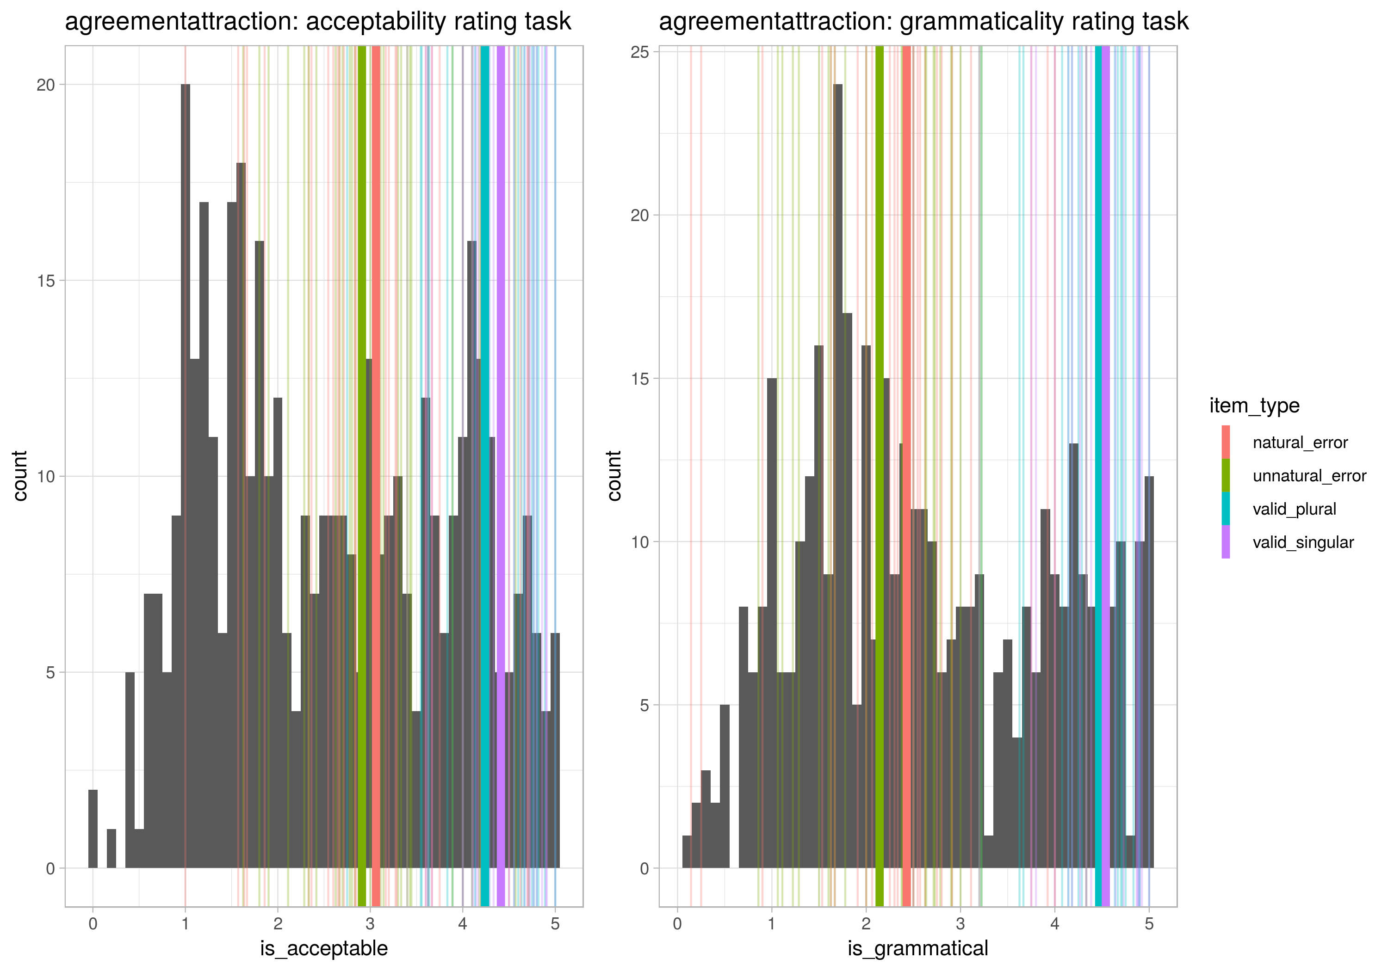
Agreement attraction | Valid Singular | The label on the bottle is quite hard to read
 | Valid Plural | The labels on the bottles are quite hard to read
 | Natural error | The label on the bottles are quite hard to read
 | Unnatural error | The labels on the bottle is quite hard to read

Slide 40
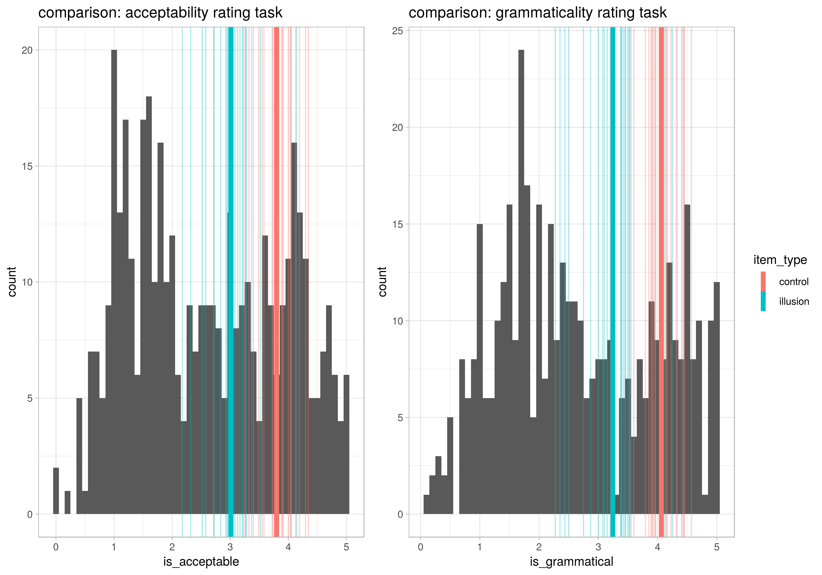
Comparison Illusion | Illusion | At the party more seniors were talking with the professors than the junior was.
 | Control | At the party more seniors were talking with the professors than juniors were.

Slide 41
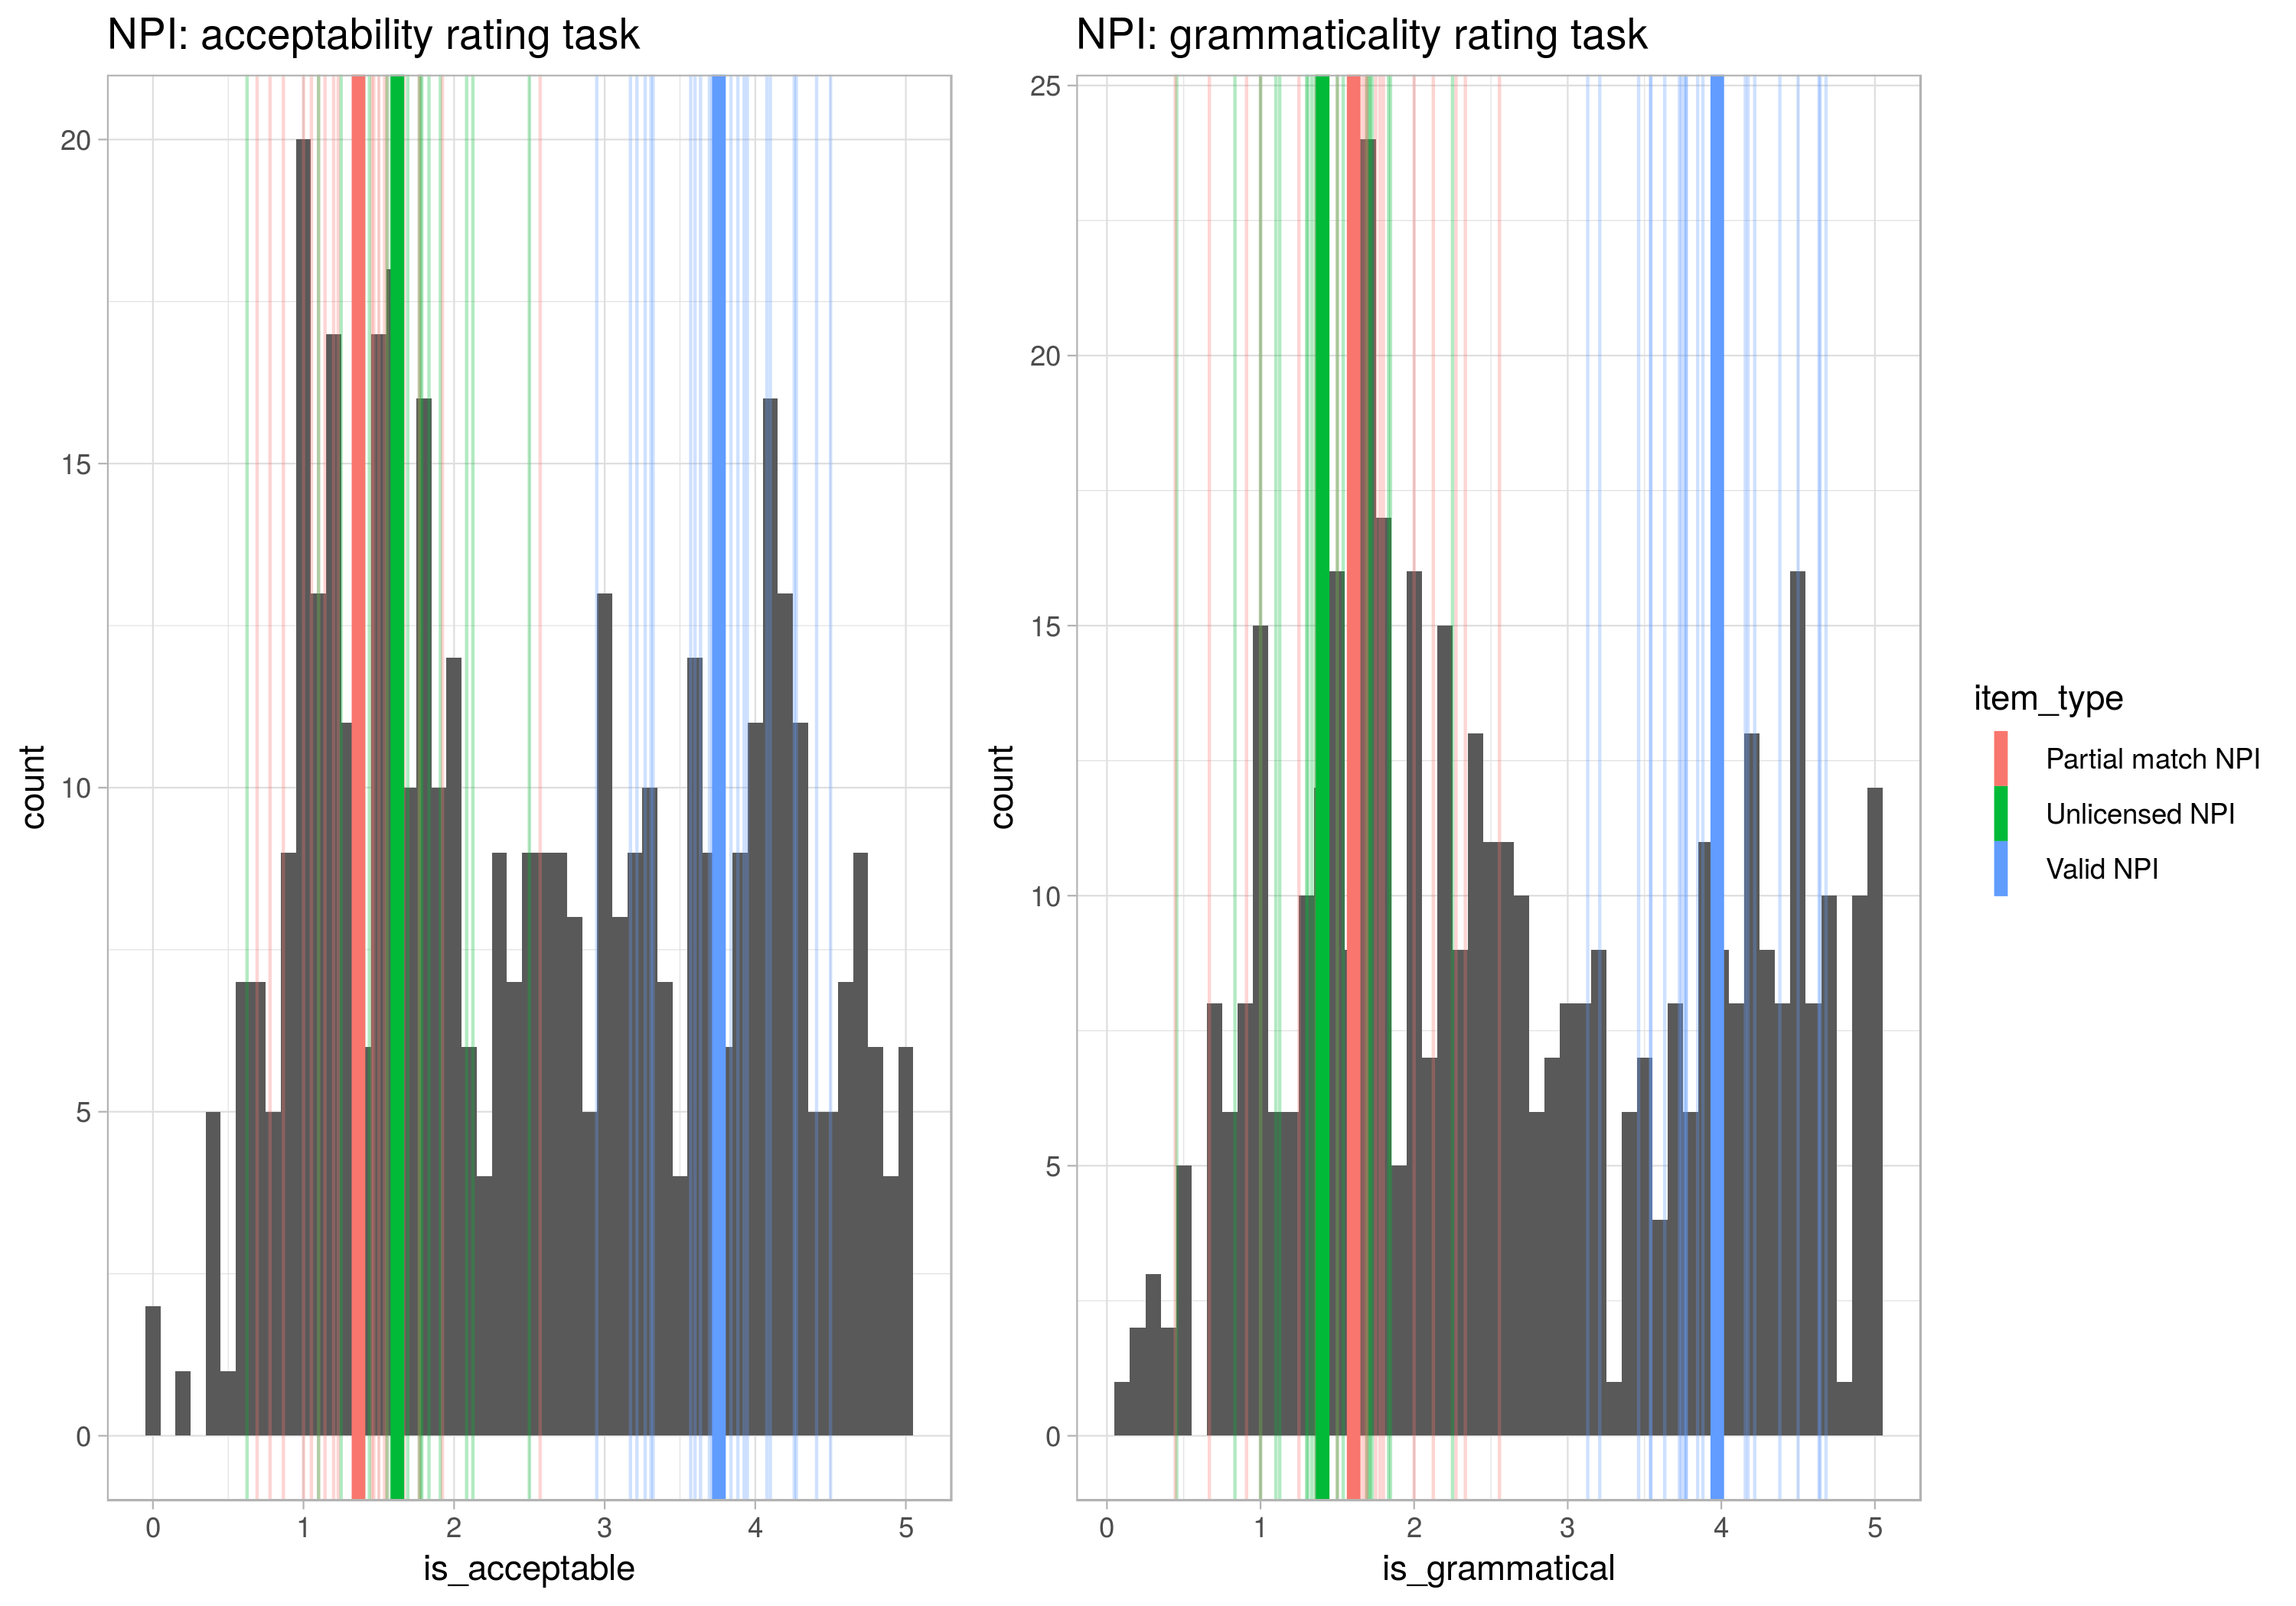
NPI Illusion | Valid | Few gamblers with a system have ever finished ahead.
 | Partial match | A gambler without a system has ever finished ahead.
 | Unlicensed | Most gamblers with a system have ever finished ahead.

Slide 42
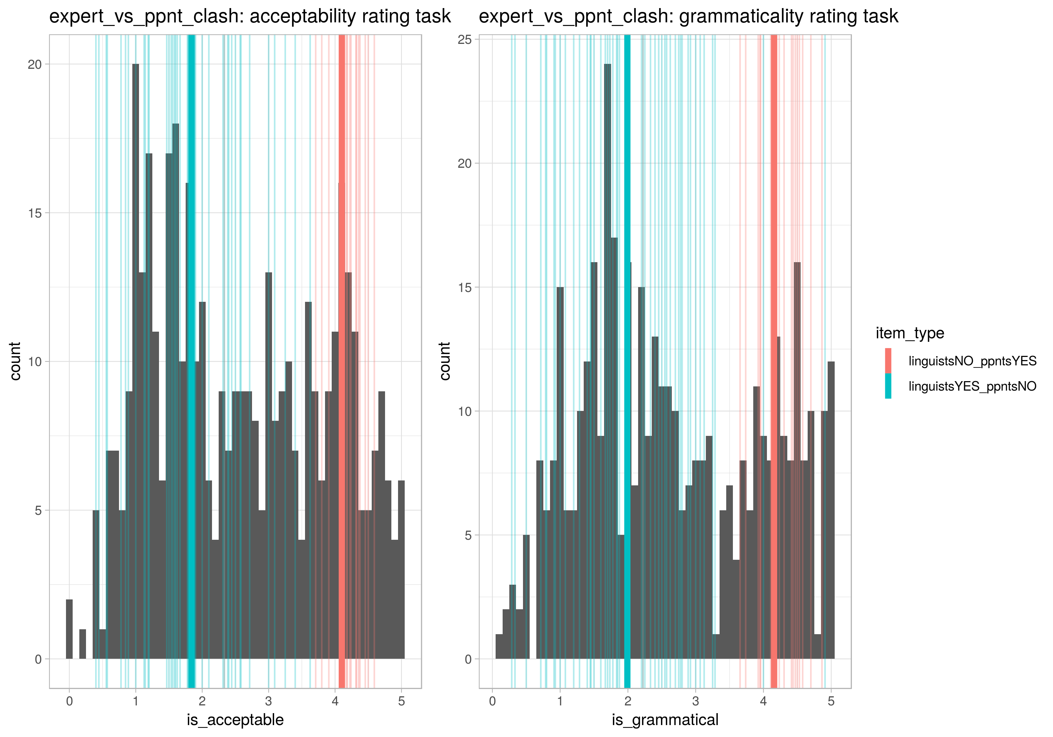
LI vs MTurk | LI-yes, Turk-no | The car was driven while being tired.
 | LI-no, Turk-yes | The game was played shoeless.

Slide 43
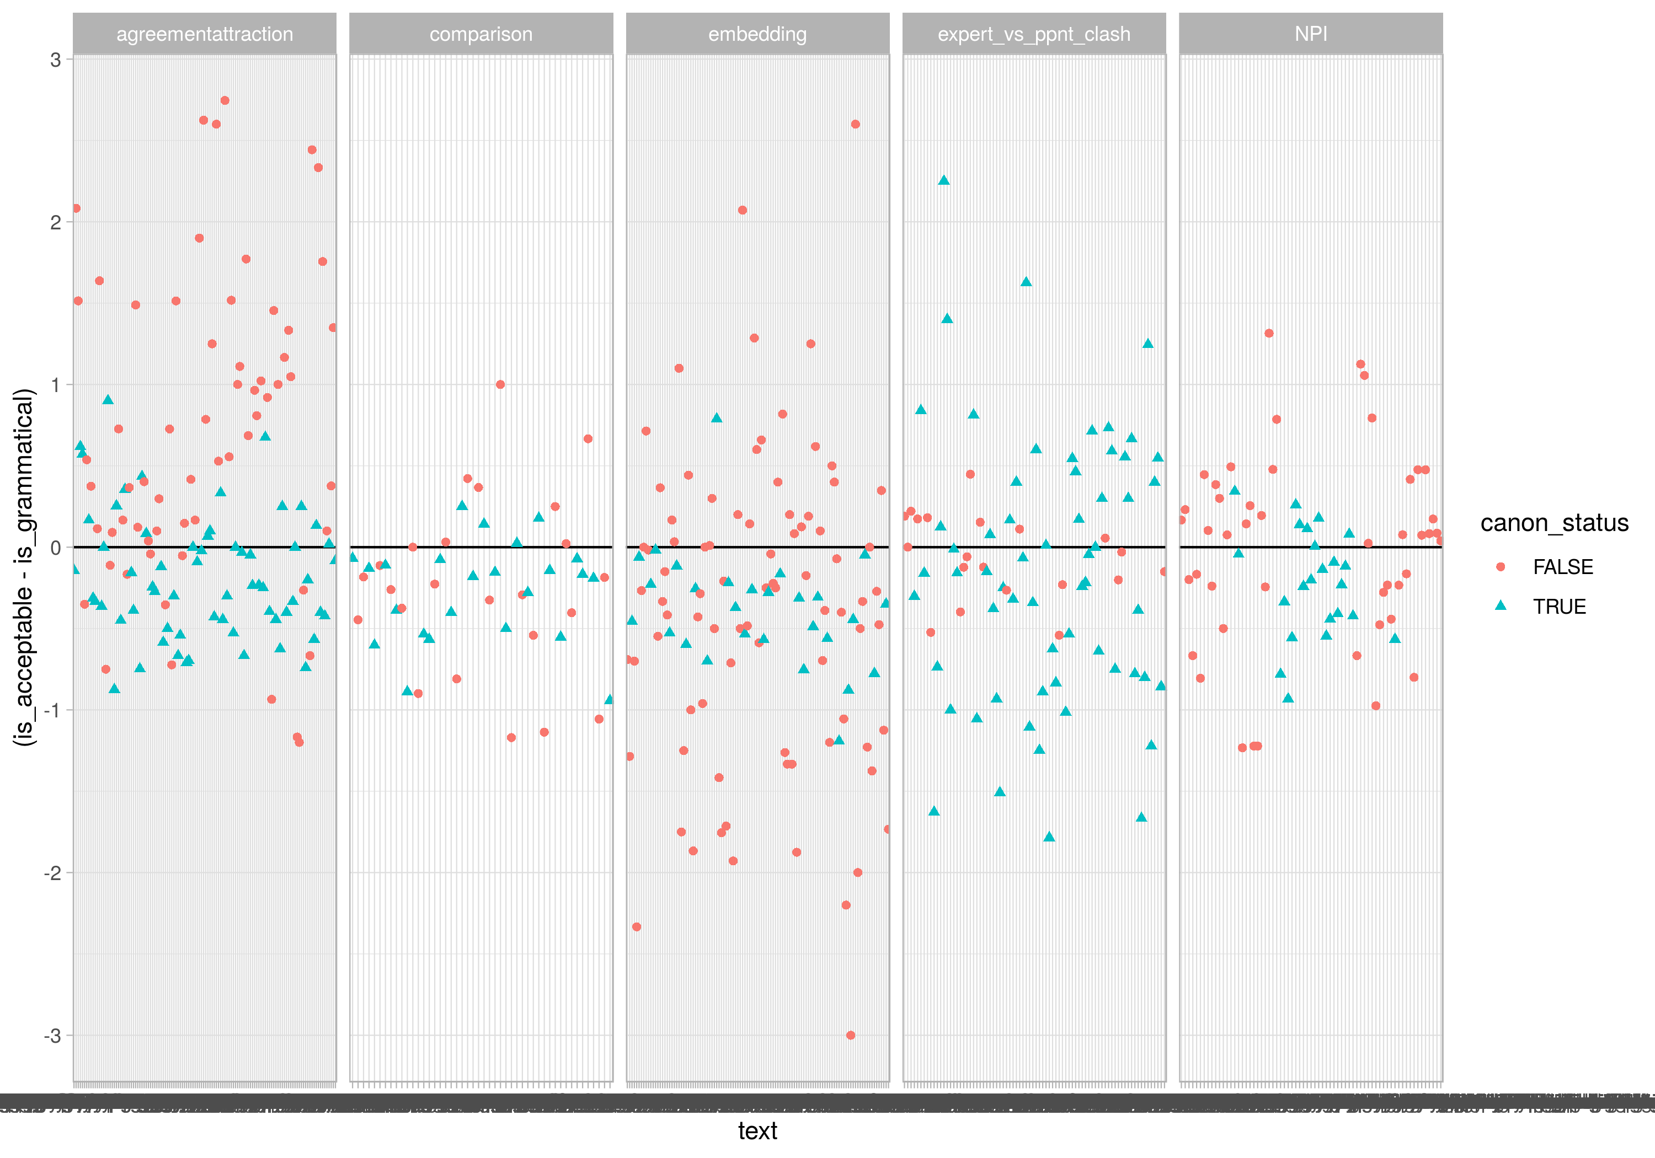

Slide 49
