Slide 1

Managing IP Addresses
A short presentation explaining how to list or delist ip addresses from the approved list

Slide 2
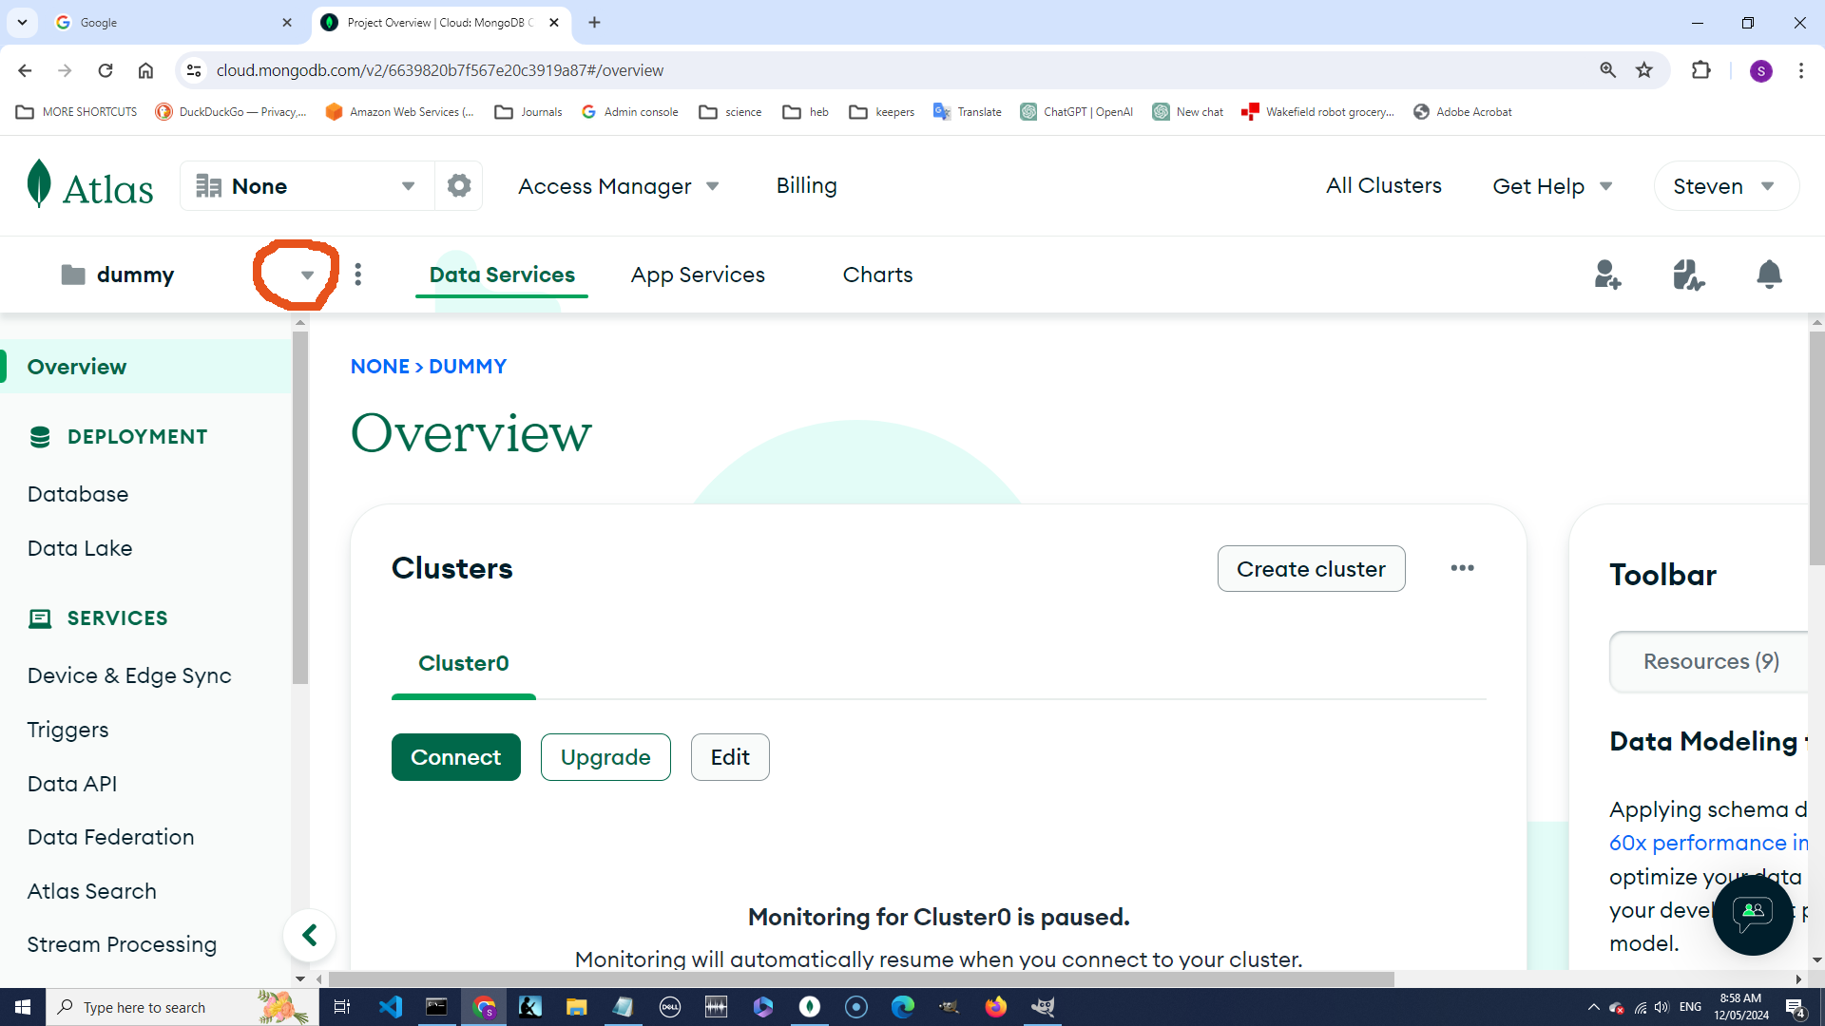

Slide 3
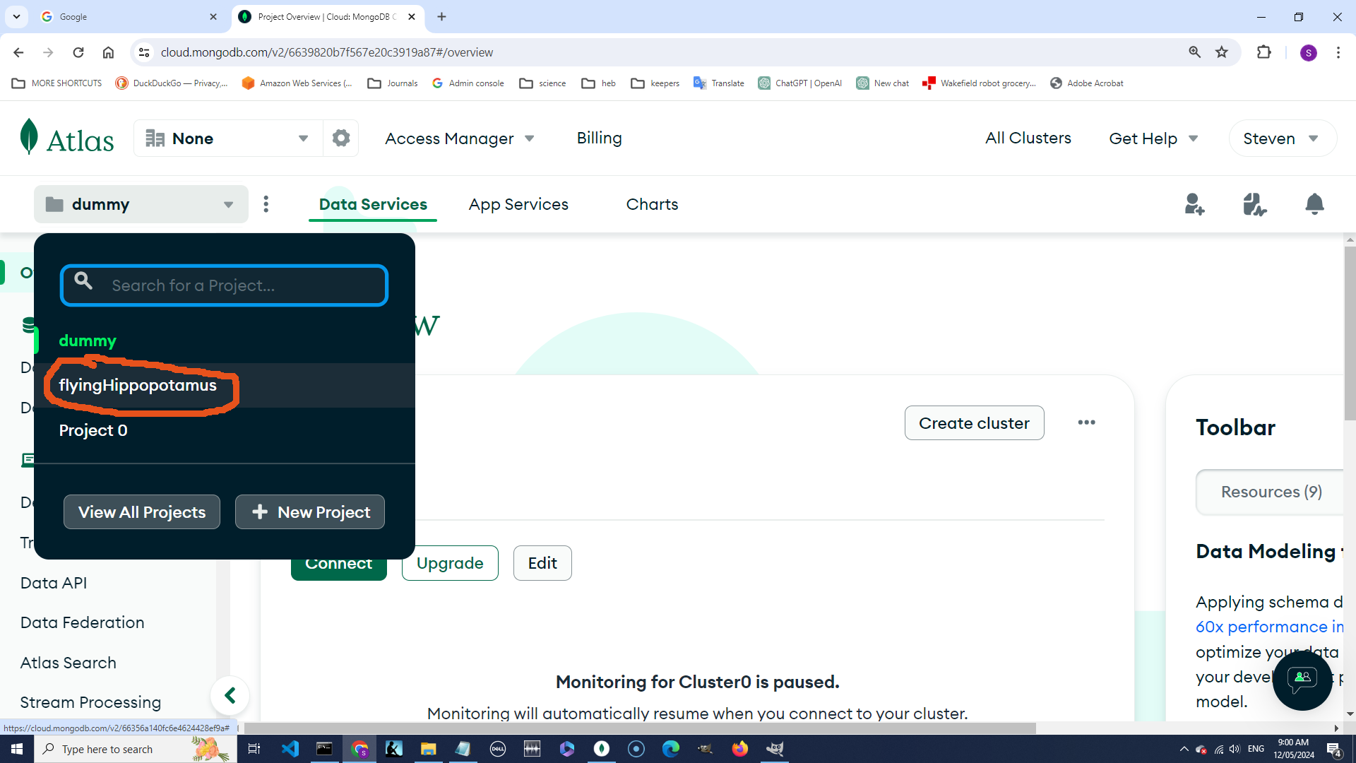

Slide 4
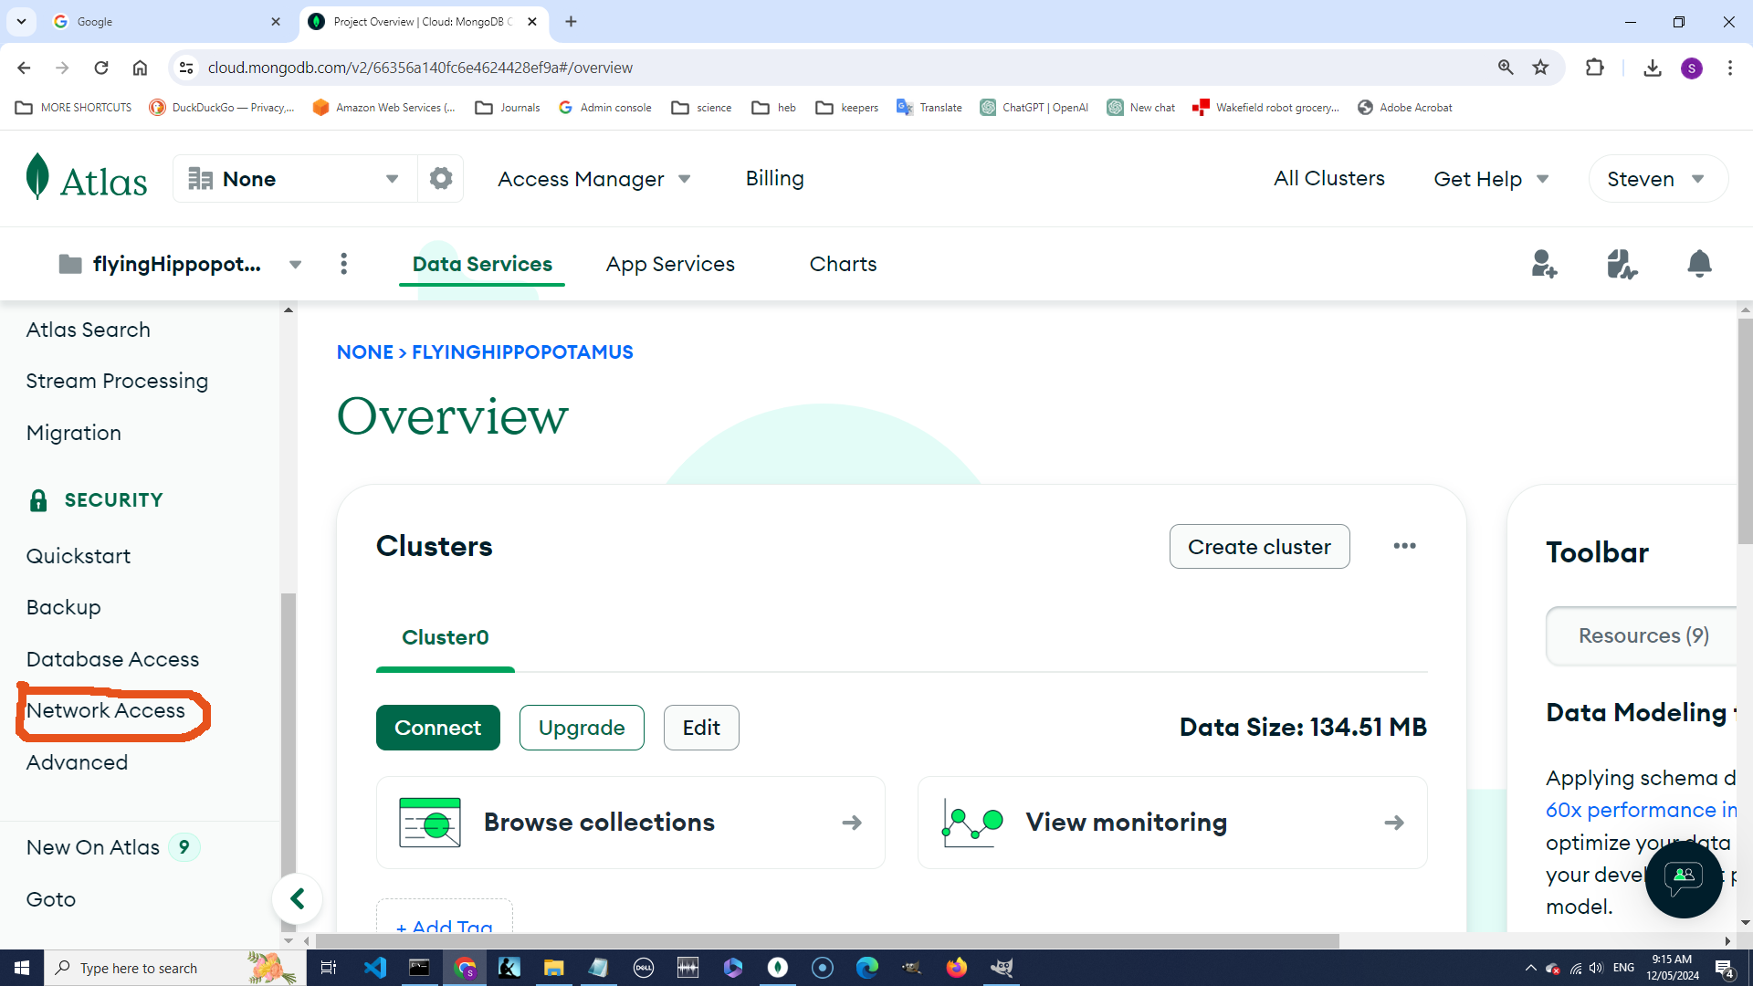

Slide 5
