Slide 1

Compass
Let’s get started with compass

Slide 2
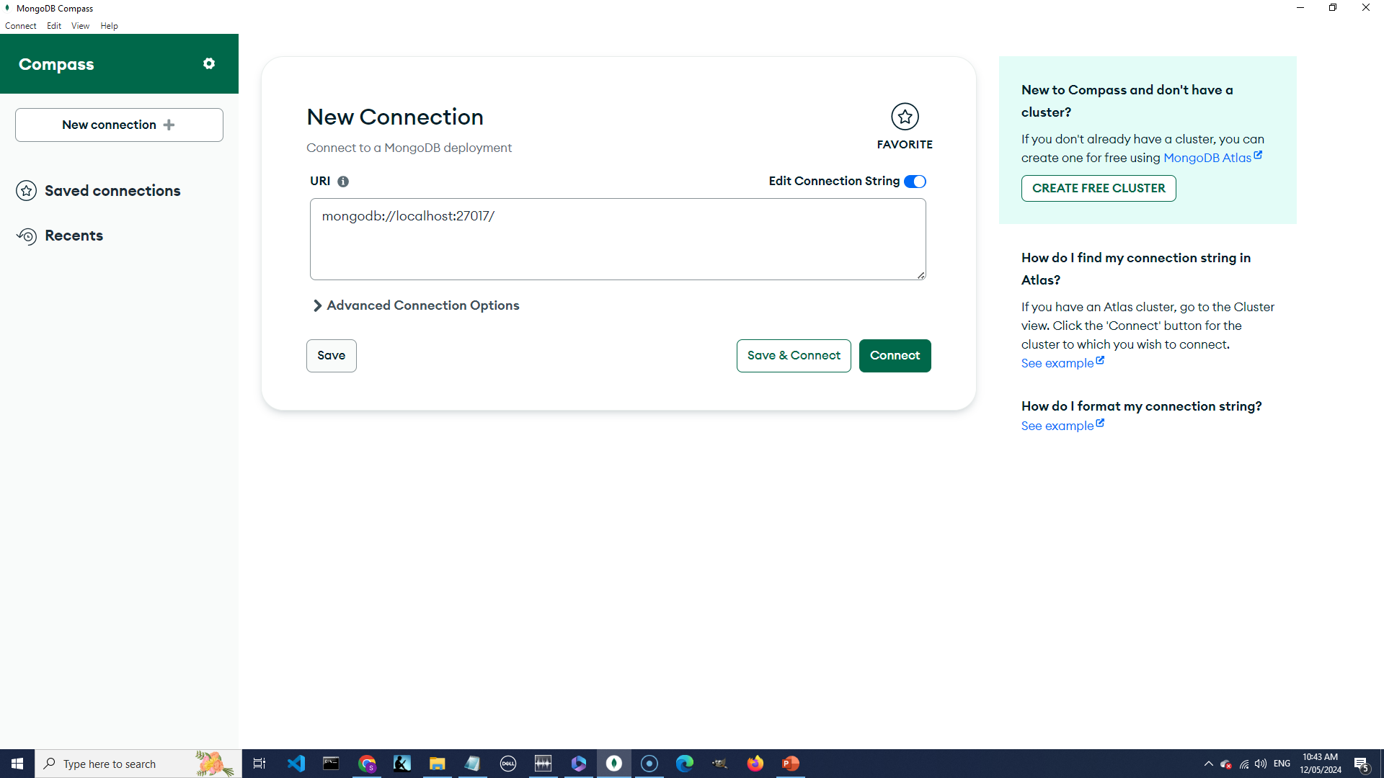

Slide 3


Slide 4
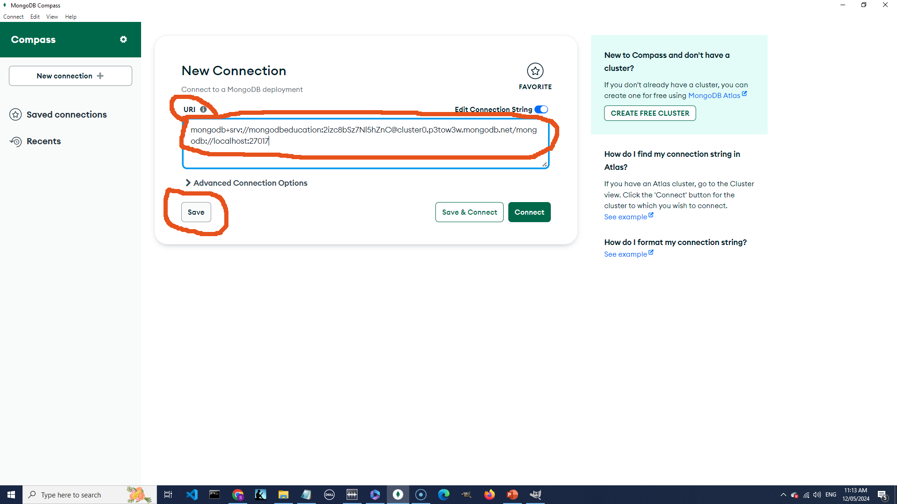

Slide 5
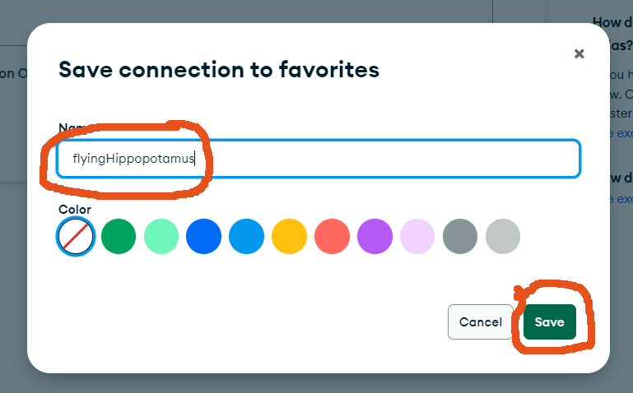

Slide 6
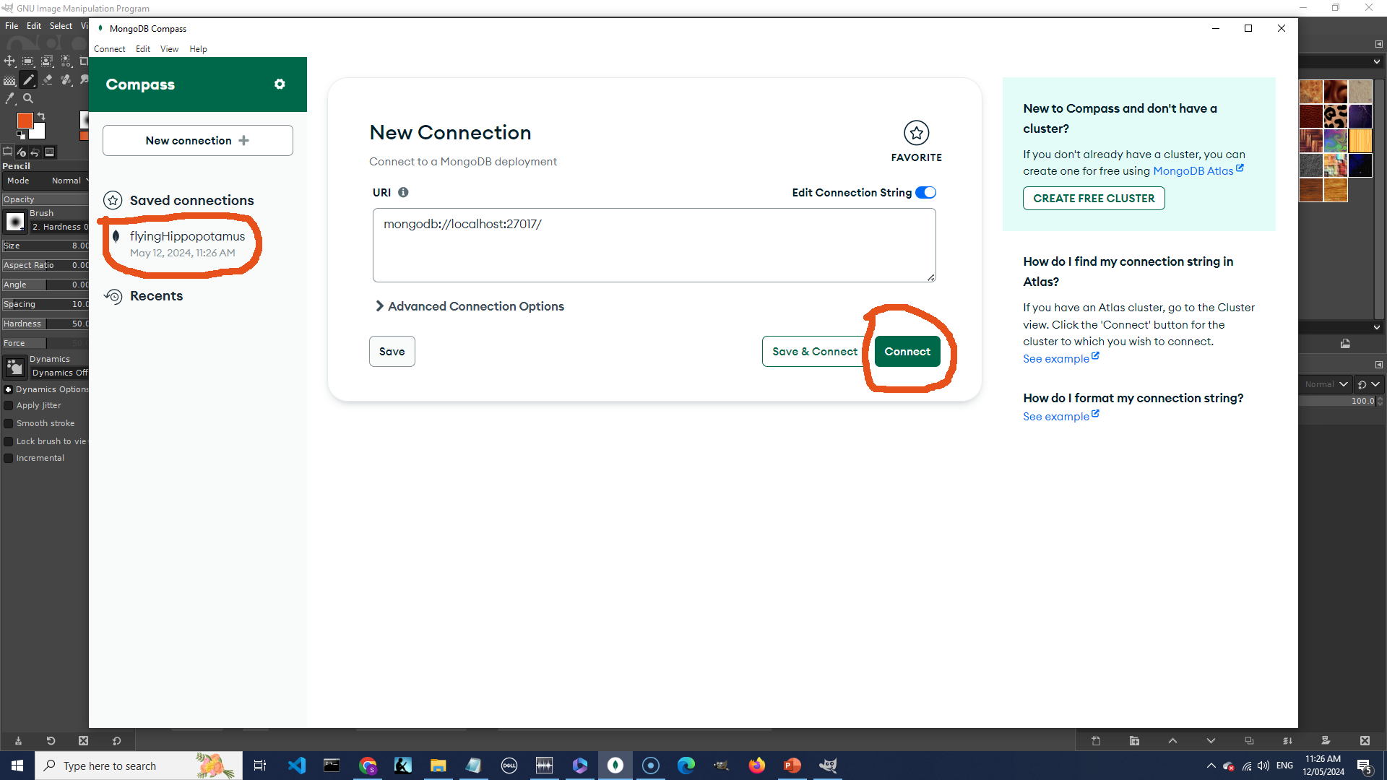

Slide 7
And that’s all I’m going to say about Compass

