Slide 1

ECE 283 Lab1 Design Review
Mingjie Ma
Chengming Li
University of California, San Diego, La Jolla, CA, USA

Slide 2
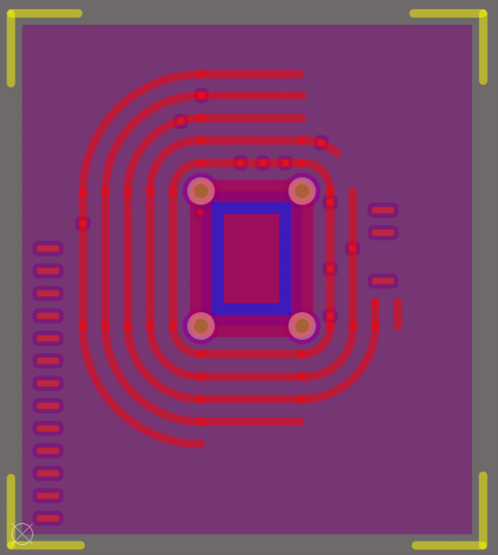
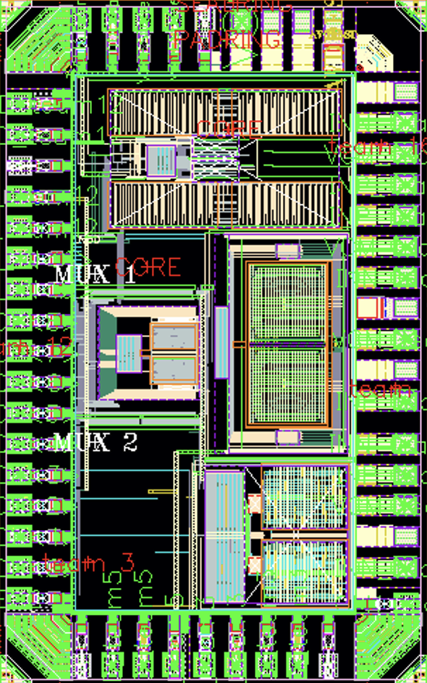
Chip Package and Wire bonding Diagram
1 VDD_ESD_T12
2 VSS_ESD_T12
44 VDD_ANA_ESD
Pin Number | Type | Description
1 | Power | VDD_ESD
2 | Power | VSS_ESD
3 | Power | DVSS_T12
4 | Power | VDD_T12
5 | Digital Input | CLK_T12
6/7 | Digital Input | MUX_SEL
8 - 16 | Digital Output | ADC_RESULT
17 | Digital Output | EOC
19/34/43/45/46/47 | Power | AVSS
32 | Analog Input | INN_T12
36/44 | Power | VDD_ANA_ESD
38 | Analog Input | VCM_T12
39 | Analog Input | INP_T12
45/46/47 AVSS
3 DVSS_T12
43 AVSS
39 INP_T12
4 VDD_T12
38 VCM_T12
5 CLK_T12
36 VDD_ANA_ESD
6 MUX<1>
34 AVSS
32 INN_T12
7 MUX<0>
8 DOUT<8>
29 AVSS
9 DOUT<7>
10 DOUT<6>
11 DOUT<5>
12 DOUT<4>
13 DOUT<3>
14 DOUT<2>
15 DOUT<1>
16 DOUT<0>
17 EOC

Slide 3
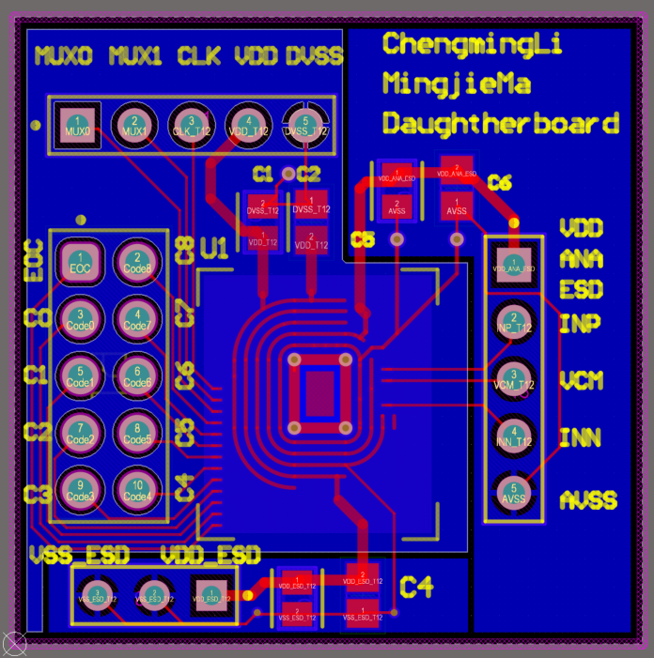
DaughterBoard Layout
1100mil
Analog_VSS
Digital_VSS
ESD_VSS
1100mil

Slide 4
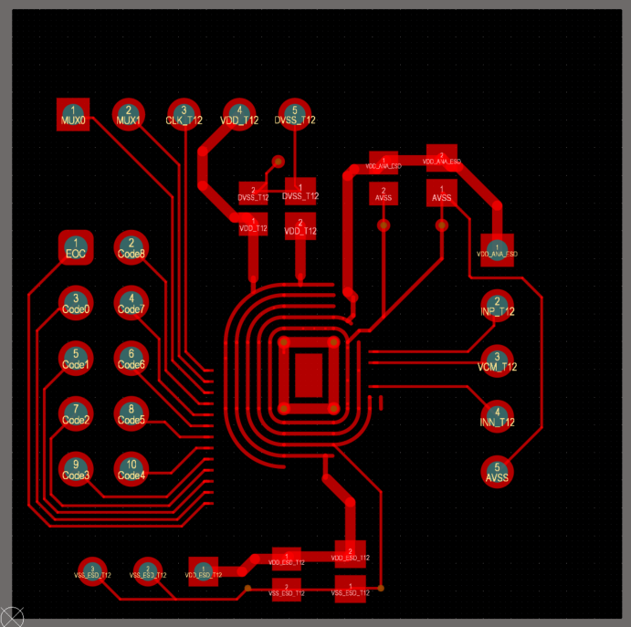
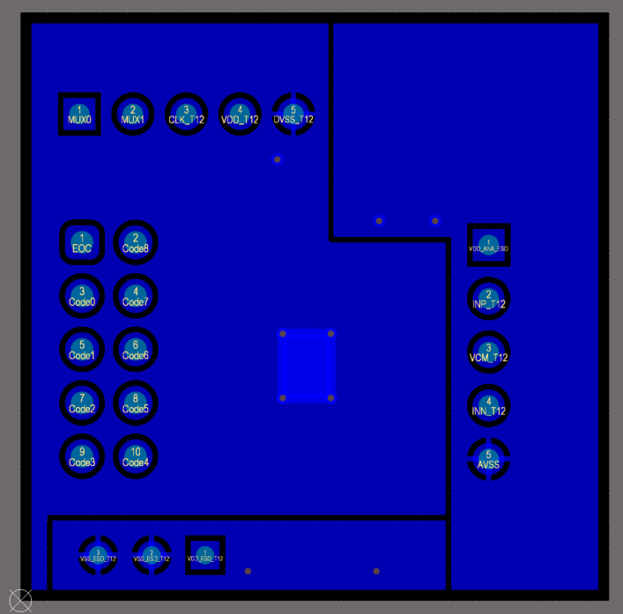
DaughterBoard Layout

Slide 5
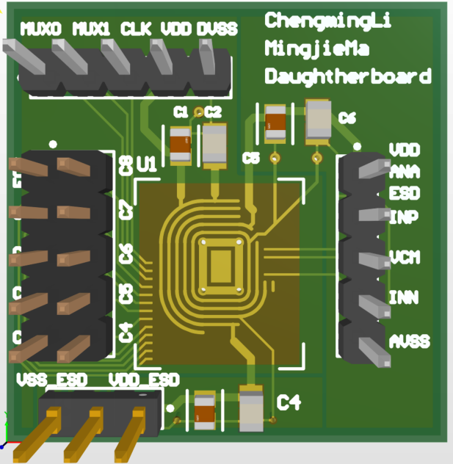
DaughterBoard 3D View
Top Layer: Signal Only
Bottom Layer: 3 VSS
Decap: 100nF and 1 uF, 0805
Try to put them as close as possible to the IC VDDs
Header: 100 mil pitch, but there is a danger of mismatching the position in the motherboard.
Solution: Record the coordinates of each corner of each header

Slide 6
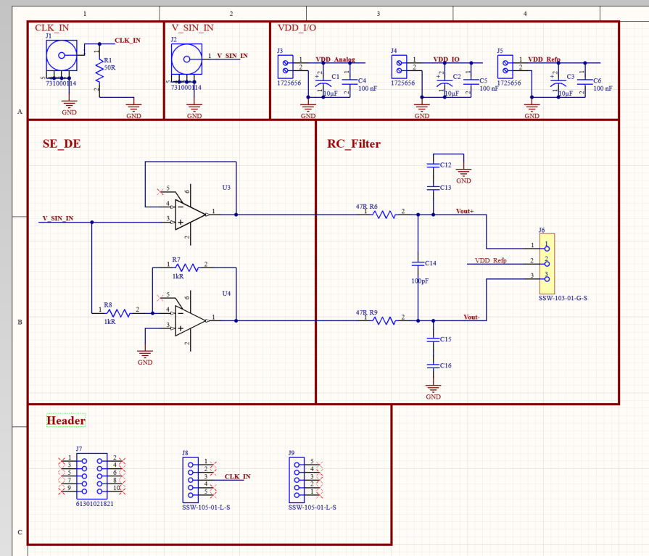
Schematic - motherboard
Opamp: LMH6611MKENOPB
Gain Bandwidth Product - 135 MHz
-3db Bandwidth - 365 MHz
Voltage - Input Offset 74 µV
CMRR - min 79dB, typ 98 dB
PSRR – min 81dB, typ 96 dB
Question: what other specs should I consider in terms of linearity?

Slide 7
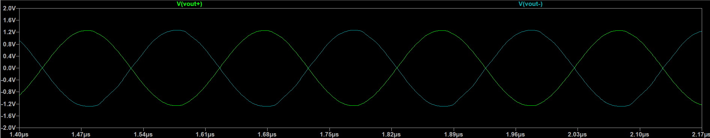
LTspice – SE-DE Simulation
SEDE Output after RC filter
Vp – 1.2V (1.8V input)
Rfilter – 47 ohm
Cfilter to gnd: 0.5nF
Cfilter_common: 0.1nF
Question: should we worry about the attenuation?

Slide 8
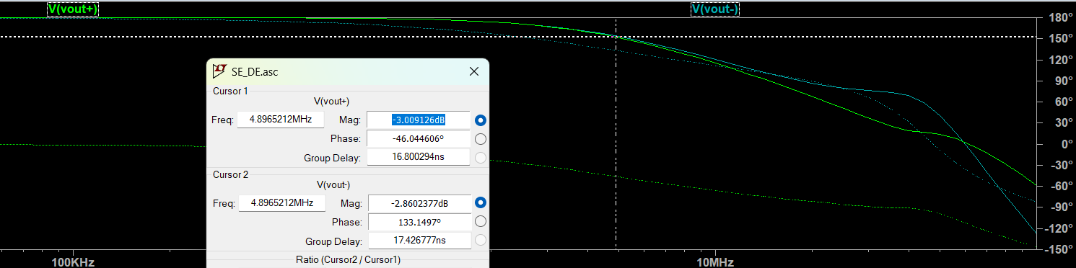
LTspice – SE-DE Simulation
SEDE AC Ouput
-3dB at 4.89MHz
Question: is this ok?

Slide 9
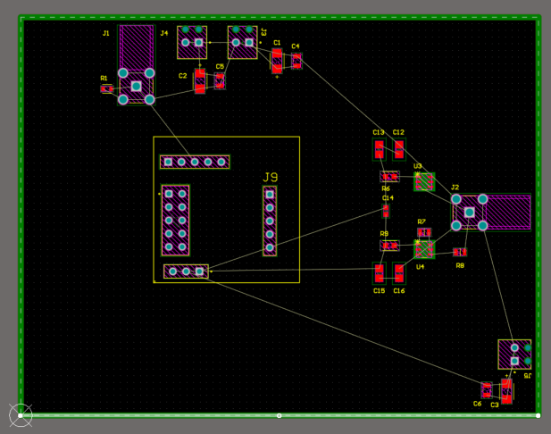
MotherBoard Layout
3900mil
Not finished yet
3000mil

Slide 10
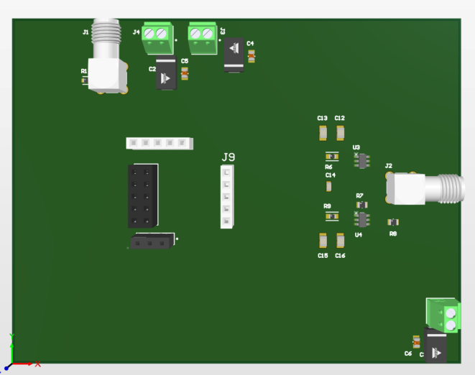
MotherBoard 3D View
3900mil
Not finished yet
3000mil

Slide 11
Q & A

