Slide 1

ECE 283 Lab2 Design Review
Mingjie Ma
Chengming Li
University of California, San Diego, La Jolla, CA, USA

Slide 2
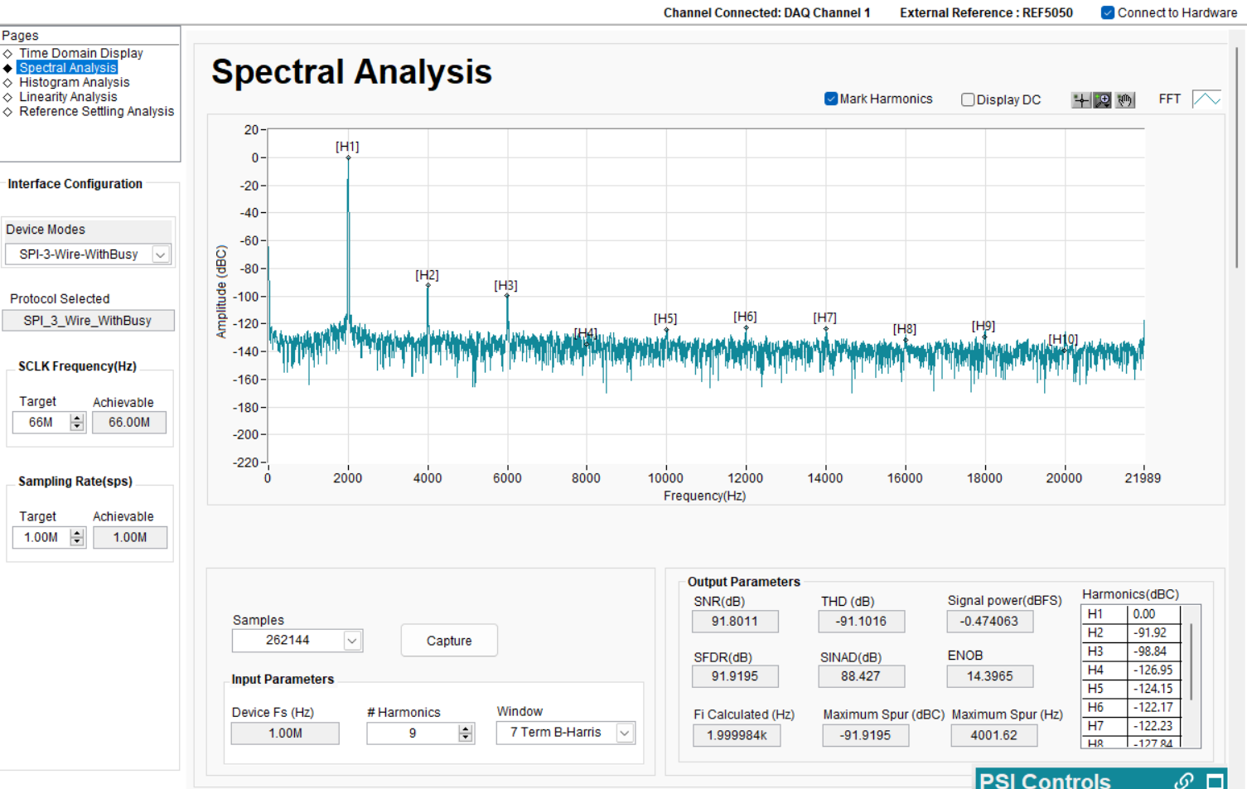
0dBFS input at 2k from EVA Board
SFDR: 91.91dB
THD: -91.10 dB
SNR: 91.80 dB
SNDR: 88.427
ENOB 14.39

Slide 3
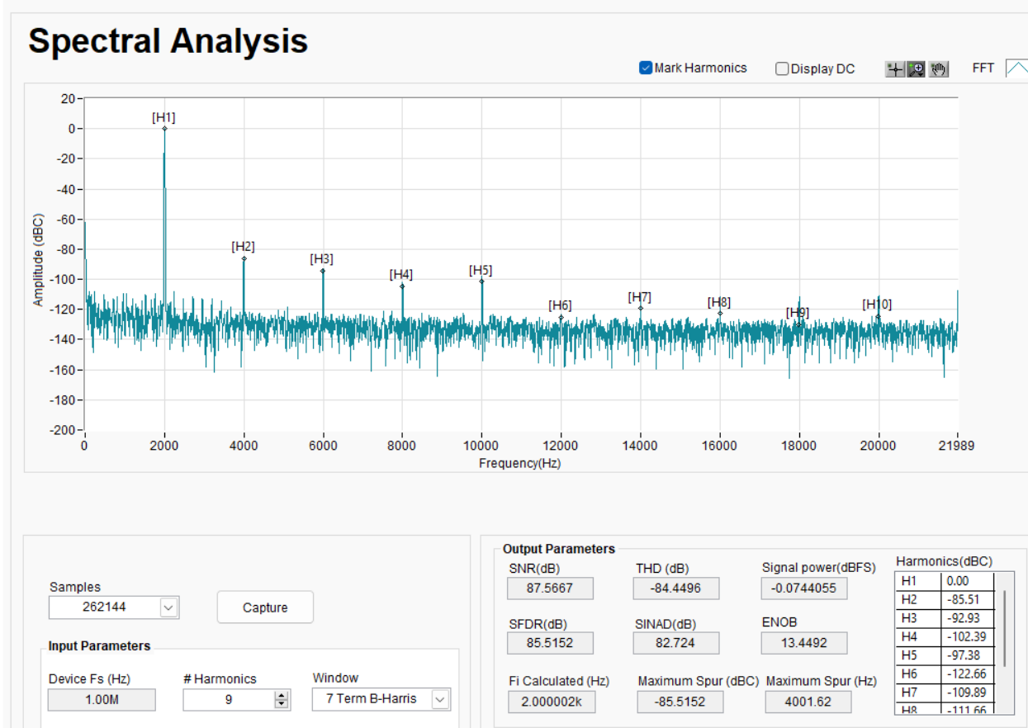
0dBFS input at 2k from FuncGen
SFDR: 85.51 dB
THD: -84.45 dB
SNR: 87.56 dB
SNDR: 82.724 dB
ENOB 13.45

Slide 4
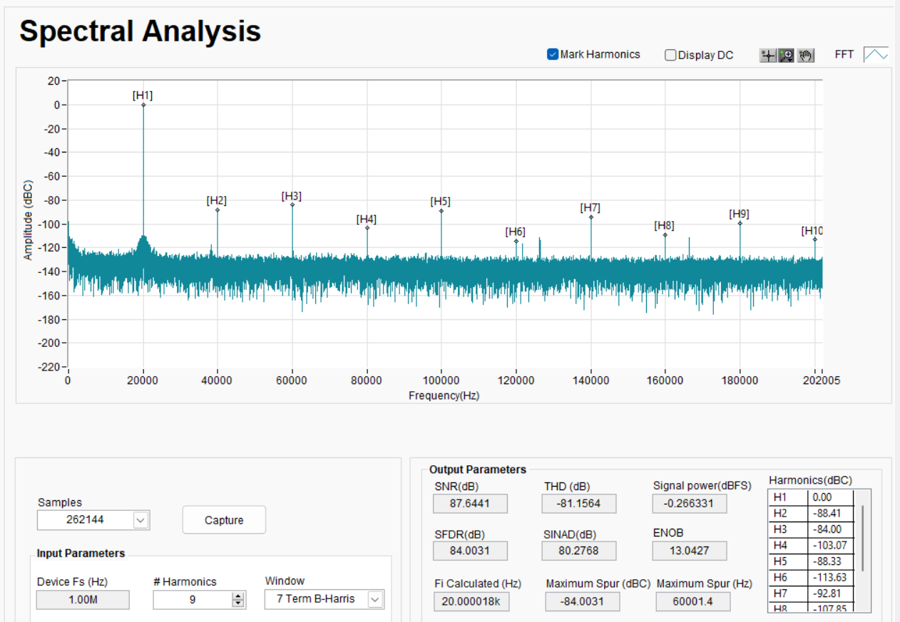
0dBFS input at 20k from FuncGen
SFDR: 84.00 dB
THD: -81.15 dB
SNR: 87.54 dB
SNDR: 80.27 dB
ENOB 13.04

Slide 5
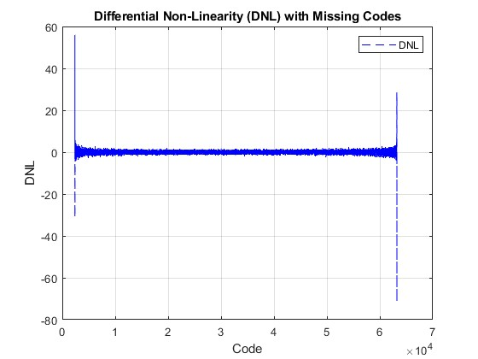
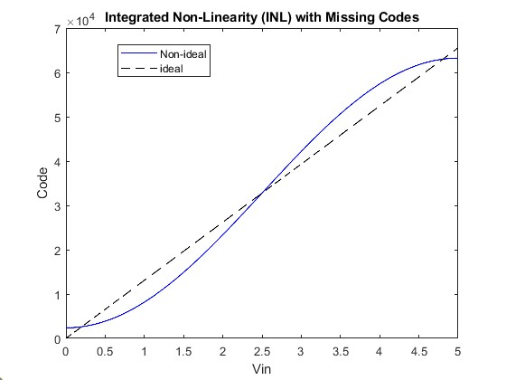

INL and DNL from TI
DNL
Missing few of codes
INL
DNL(n)$=\frac{Hit\left(n+1\right)−Hit(n)}{Ideal Hit}$
Notes: just found a canvas note about INL/DNL in Matlab, these plots will be replotted

Slide 6
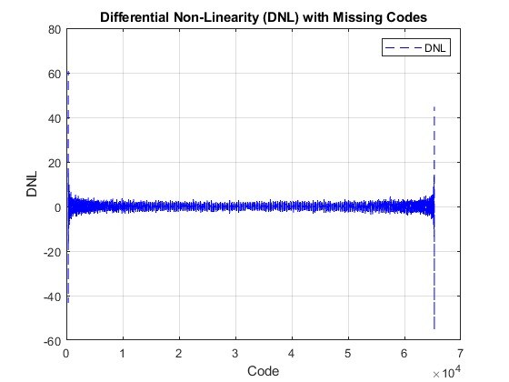
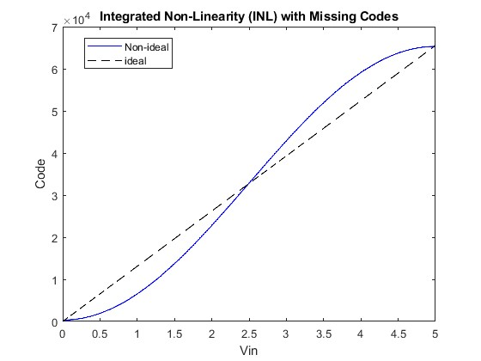
INL and DNL from FuncGen
DNL
INL
More codes are used
DNL(n)$=\frac{Hit\left(n+1\right)−Hit(n)}{Ideal Hit}$

Slide 7
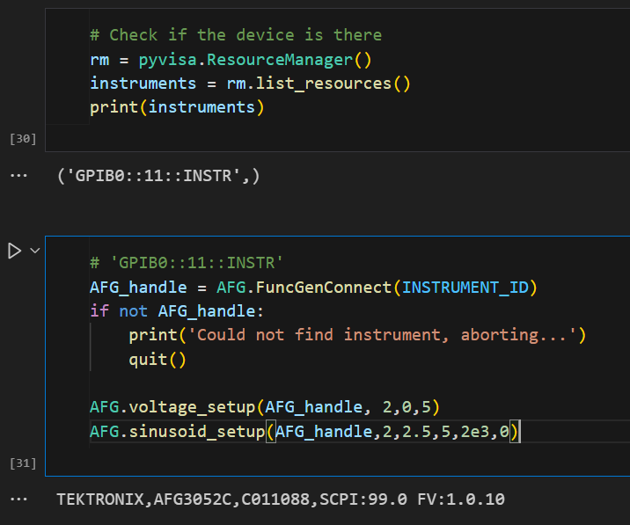
Remote Control Code
AFG3002C_Control Lib in python
FuncGenConnect
voltage_setup
sinusoid_setup
output_ON/OFF
GetADCData
Codes are developed based on the programmer’s manual
Example:
# Set the Amplitude
“SOURce1:VOLTage:LEVel:IMMediate:AMPLitude 1V”

Slide 8
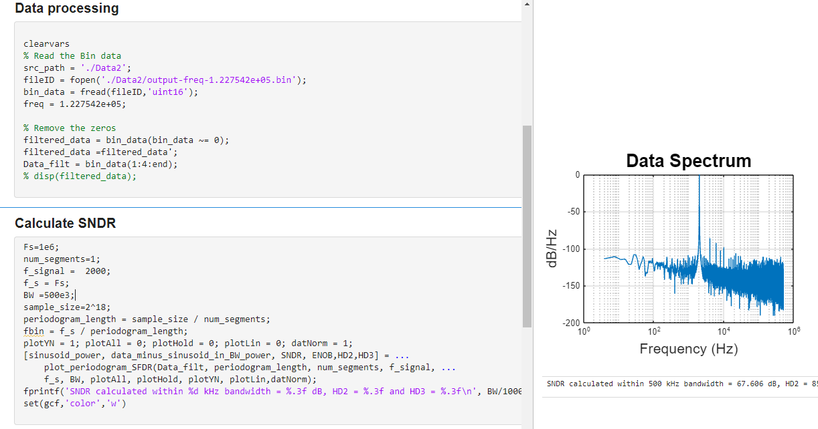
SFDR Measurement
Ongoing measurement…
More data needed to be collected on Wednesday
Code is adapted from canvas

Slide 9
Q & A

