Slide 1

ECE 266 Lab3 Design Review
Mingjie Ma
Chengming Li
University of California, San Diego, La Jolla, CA, USA

Slide 2
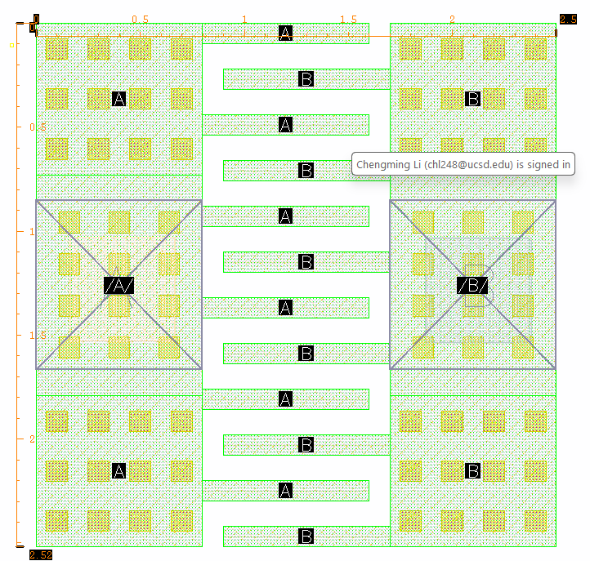
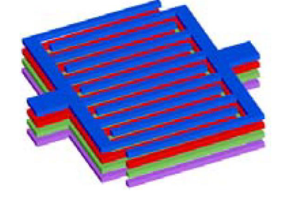
uCAP Layout
Layer: M1 to M7 stack up
Size: 2.5u by 2.52u
CC: 5fF
2.52u
2.5u

Slide 3
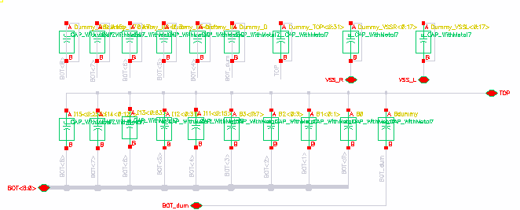
Schematic-singleDAC(cap bank)
Dummy

Slide 4
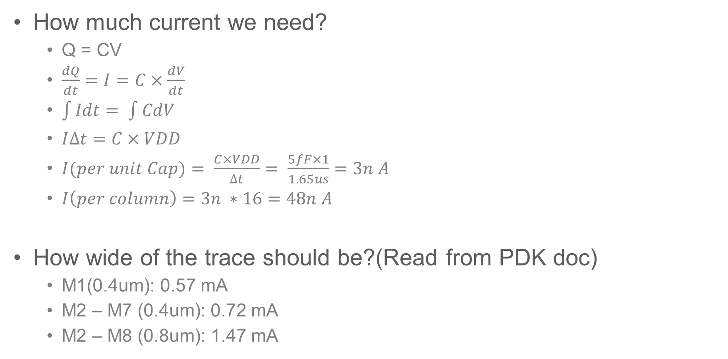
Metal Width vs. Current
How much current we need?
Q = CV
$\frac{dQ}{dt}=I=C×\frac{dV}{dt}$
$\int{Idt= \int{CdV}}$
$I∆t=C×VDD$
$I(per unit Cap)= \frac{C×VDD}{∆t}= \frac{5fF×1}{1.65us}=3n A$
$I\left(per column\right)=3n ∗16=48n A$
How wide of the trace should be?(Read from PDK doc)
M1(0.4um): 0.57 mA
M2 – M7 (0.4um): 0.72 mA
M2 – M8 (0.8um): 1.47 mA

Slide 5
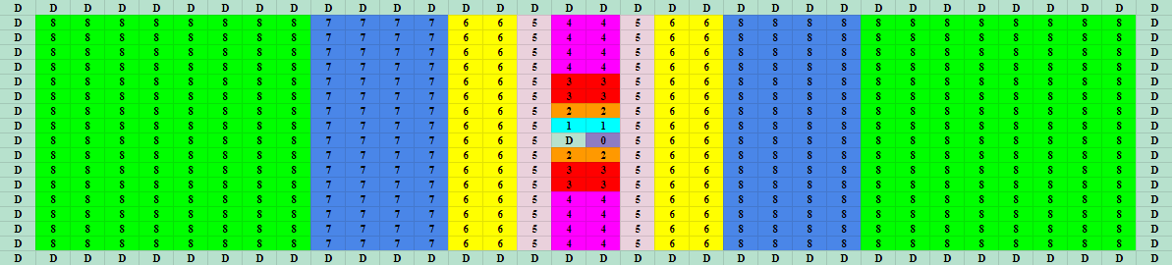
singleDAC(cap bank) Floorplan – Common Centroid
Bit | B0 | B1 | B2 | B3 | B4
CC(fF) | 10.14 | 21.8 | 44.04 | 58.25 | 101.5
Ratio |  | 2.145 | 2.02 | 1.322 | 1.74

Slide 6
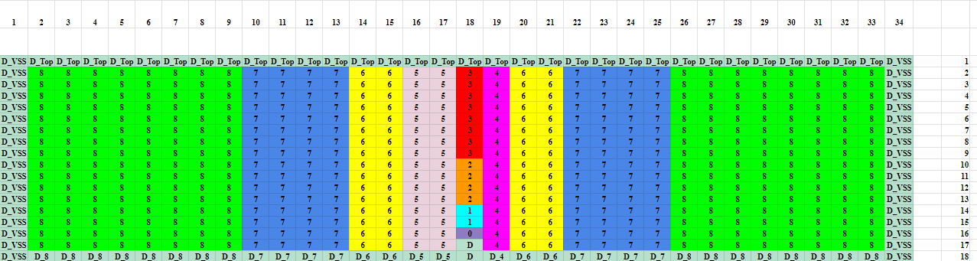
singleDAC(cap bank) Floorplan
Bit | B0 | B1 | B2 | B3 | B4
C+CC(fF) | 6.4994 | 12.333 | 23.683 | 45.248 | 86.676
Ratio |  | 1.898 | 1.920 | 1.910 | 1.916

Slide 7
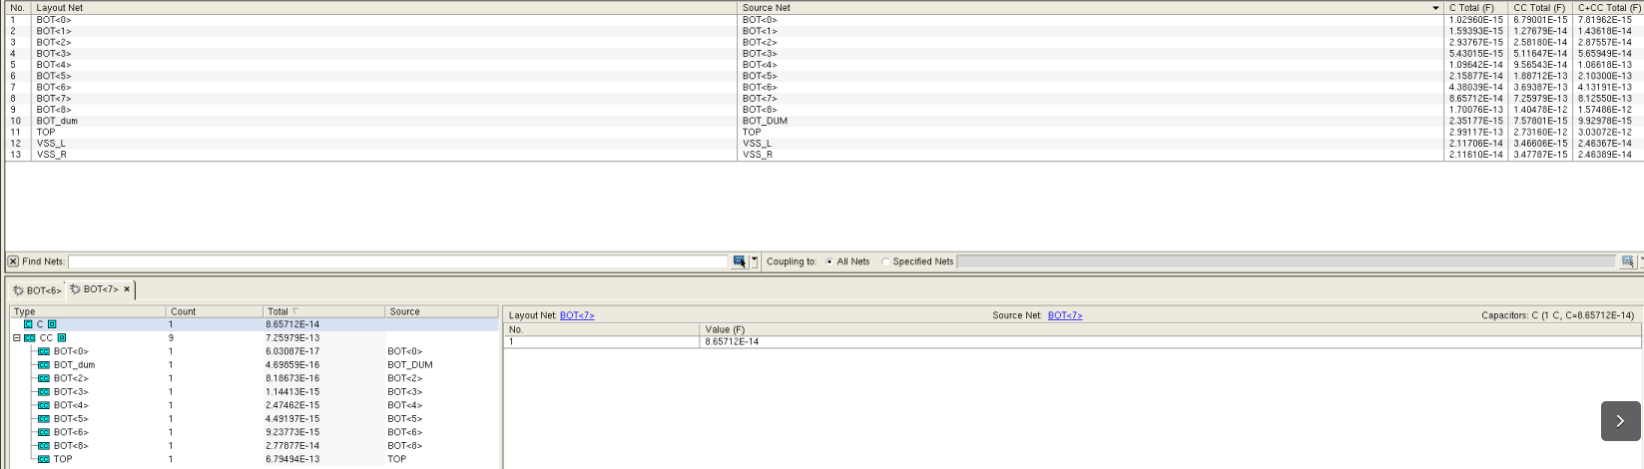
RCX Cap Table
Example:
Bot7
C: 86.5f F
CC:
1)Top 679.49f F
2)Bot6: 27.7 f F

Slide 8
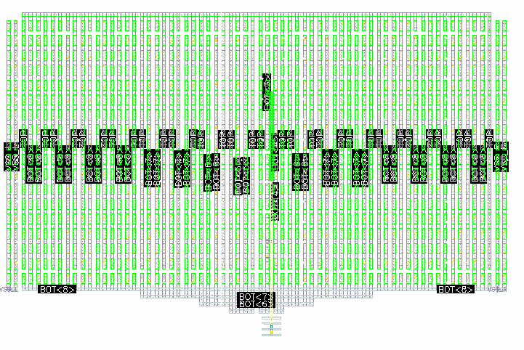
Layout - singleDAC – Bit0123 - center
Non-symmetry
Bit 0:3 (M1, M3, M5, M7) overlapping
76.74u
121.97u

Slide 9
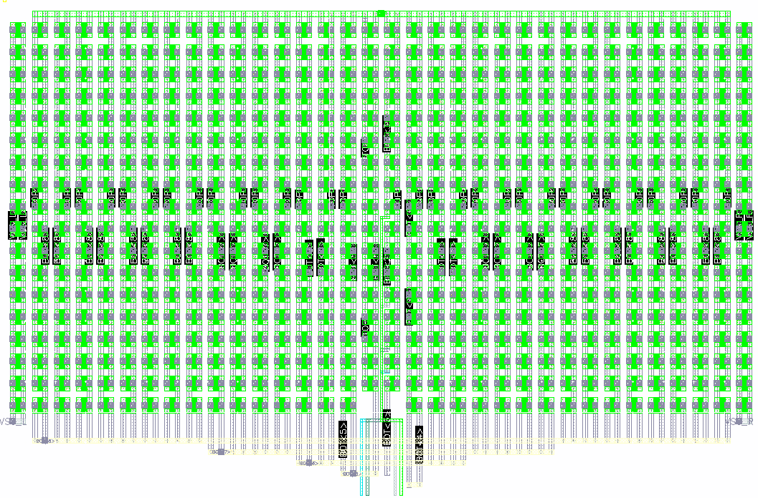
Layout - singleDAC – Remove2Dummy
Pro:
Symmetry
Less CC between Bits and
Less CC effects to the Dummy for bit0
Cons:
Sensitive to C(w.r.t substrate)
Sensitive to the length of Bit 0:3
Non-binary routing

Slide 10
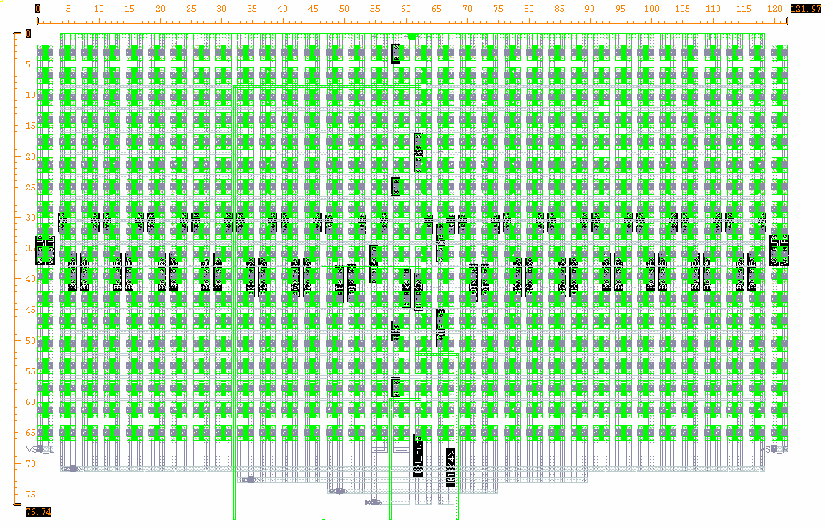
Layout - singleDAC – Robust C+CC
Improvement:
Higher metal used for M0:3
Binary routing
Robust C+CC sensitivity
76.74u
121.97u

Slide 11
RCX Cap Table
Bit | B0 | B1 | B2 | B3 | B4 | B5 | B6 | B7 | B8
C+CC(fF) | 7.819 | 14.36 | 28.755 | 56.594 | 106.62 | 210.30 | 413.19 | 812.55 | 1574.86
Ratio |  | 1.84 | 2.00 | 1.97 | 1.88 | 1.97 | 1.96 | 1.97 | 1.94

Slide 12
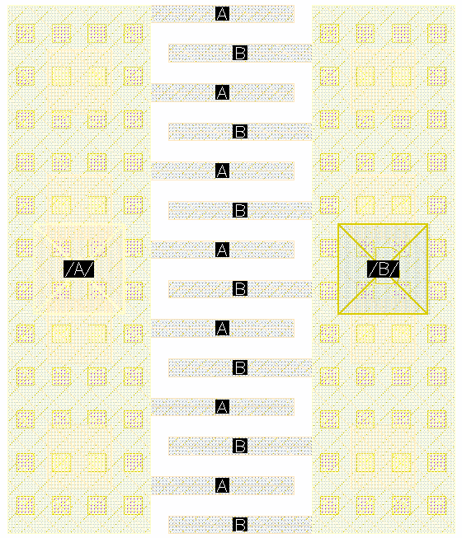
Appendix – Old Version uCap

