Slide 1

ECE 266 Lab3 Design Review
Mingjie Ma
Chengming Li
University of California, San Diego, La Jolla, CA, USA

Slide 2
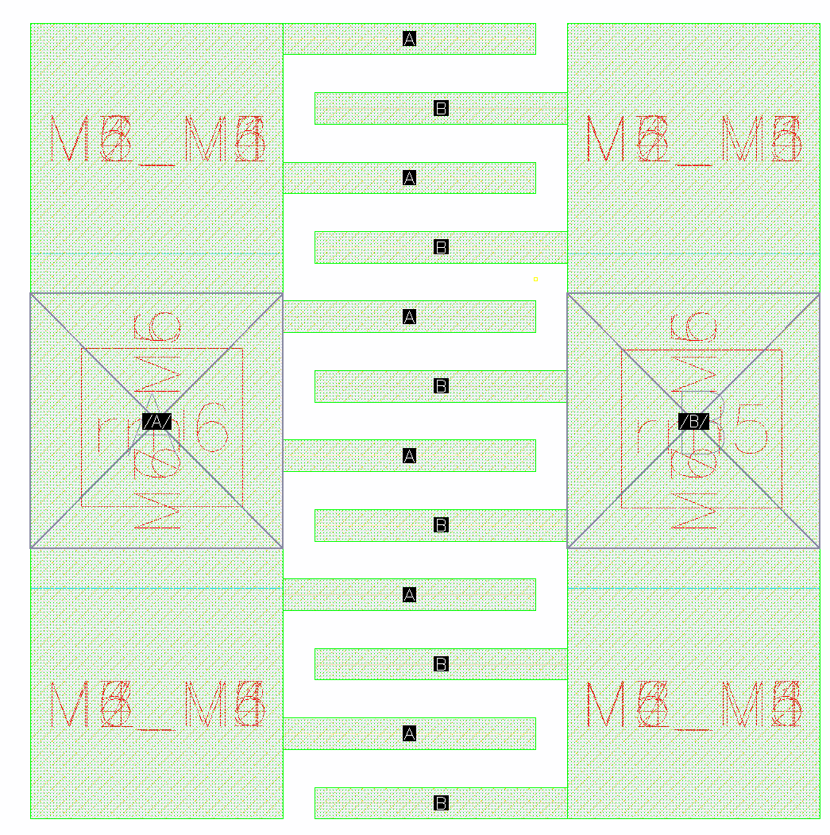
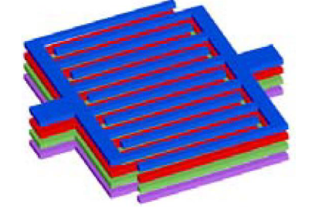
uCAP Layout
Layer: M1 to M7 stack up
Size: 2.5u by 2.52u
CC: 5fF
2.52u
2.5u

Slide 3
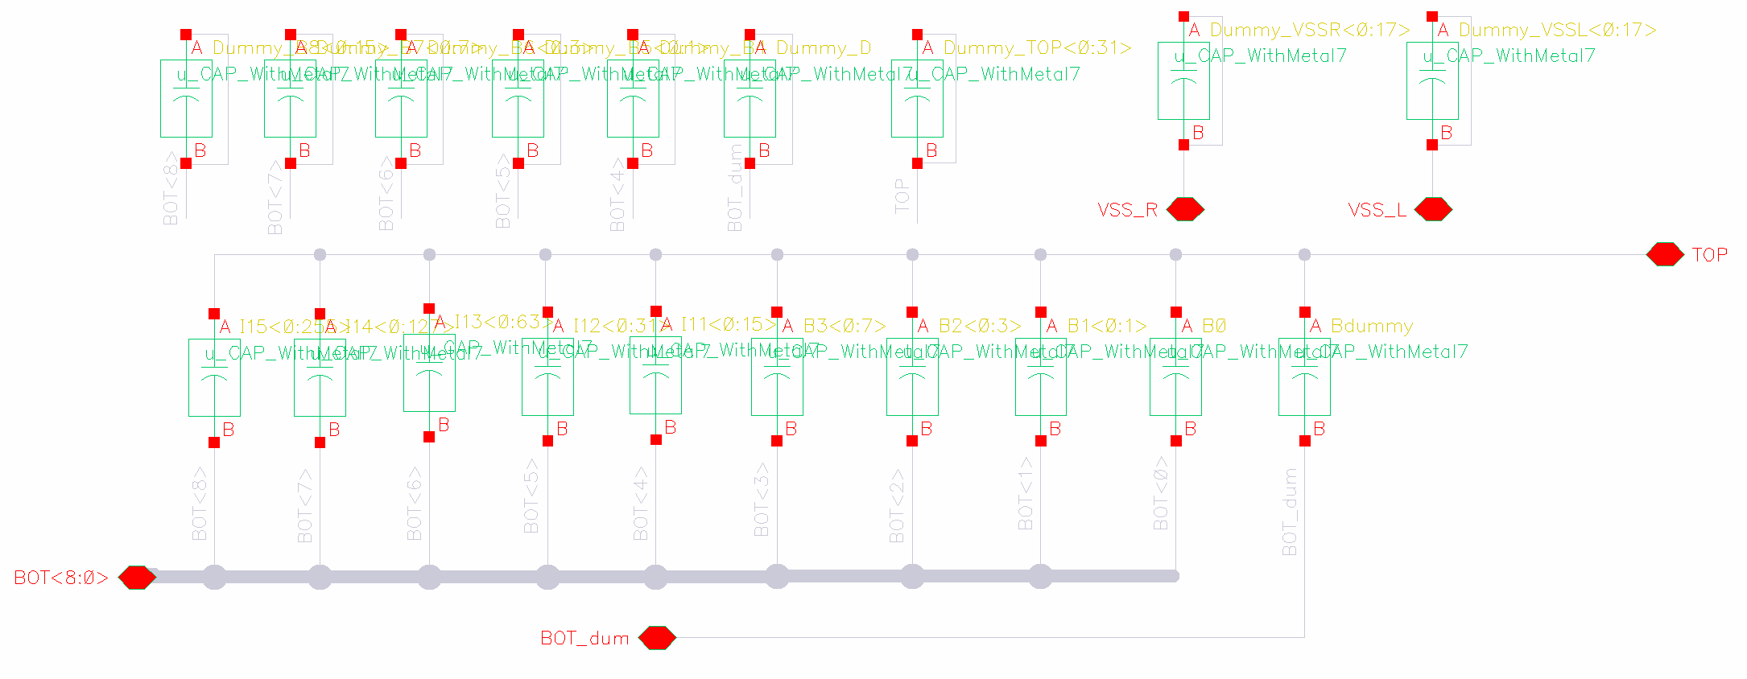
Schematic-singleDAC(cap bank)
Dummy

Slide 4
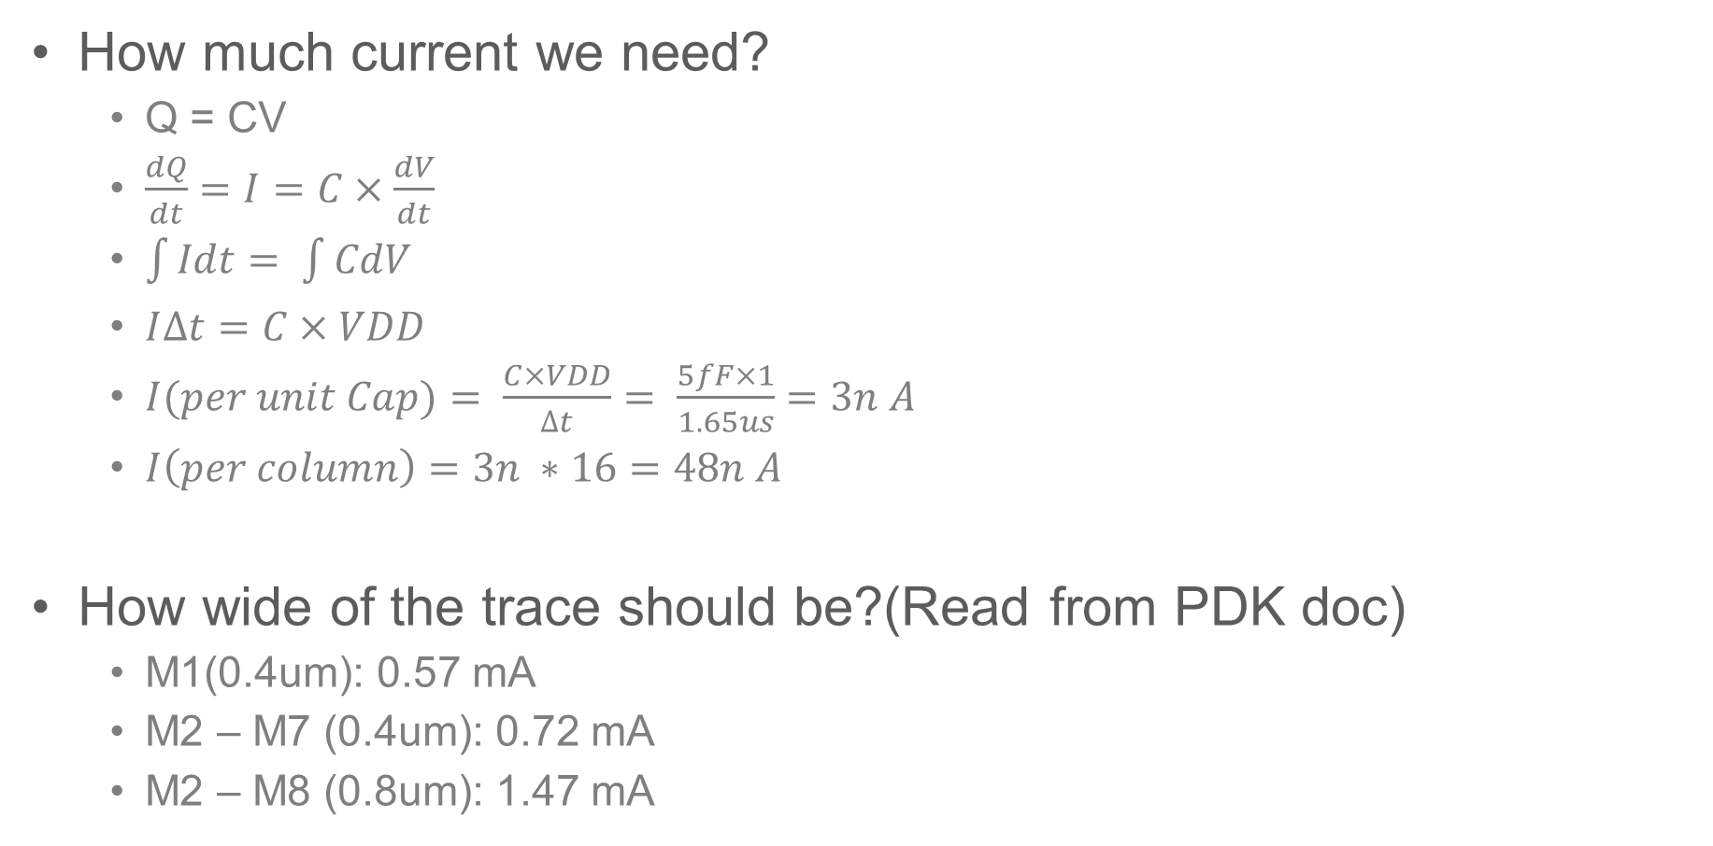
Metal Width vs. Current
How much current we need?
Q = CV
$\frac{dQ}{dt}=I=C×\frac{dV}{dt}$
$\int{Idt= \int{CdV}}$
$I∆t=C×VDD$
$I(per unit Cap)= \frac{C×VDD}{∆t}= \frac{5fF×1}{1.65us}=3n A$
$I\left(per column\right)=3n ∗16=48n A$
How wide of the trace should be?(Read from PDK doc)
M1(0.4um): 0.57 mA
M2 – M7 (0.4um): 0.72 mA
M2 – M8 (0.8um): 1.47 mA

Slide 5
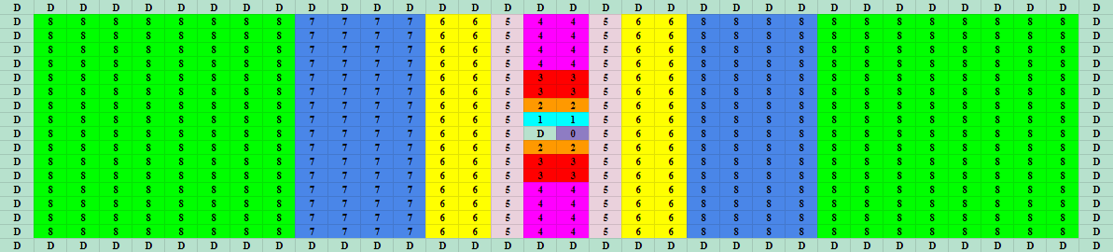
singleDAC(cap bank) Floorplan – Common Centroid
Bit | B0 | B1 | B2 | B3 | B4
CC(fF) | 10.14 | 21.8 | 44.04 | 58.25 | 101.5
Ratio |  | 2.145 | 2.02 | 1.322 | 1.74
The ratio doesn’t match, the floorplan is not used

Slide 6
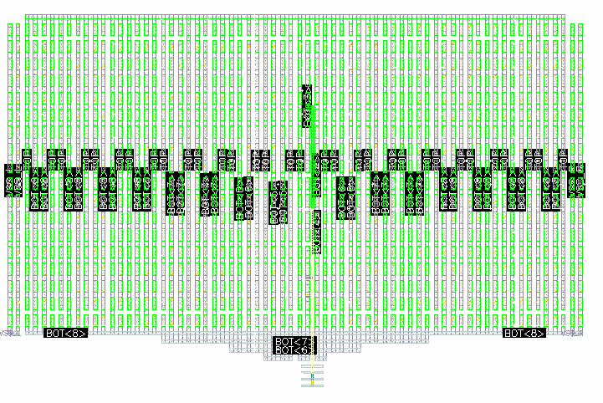
Layout Iteration1 - singleDAC – Bit0123 - center
Non-symmetry
Bit 0:3 (M1, M3, M5, M7) overlapping
76.74u
121.97u

Slide 7
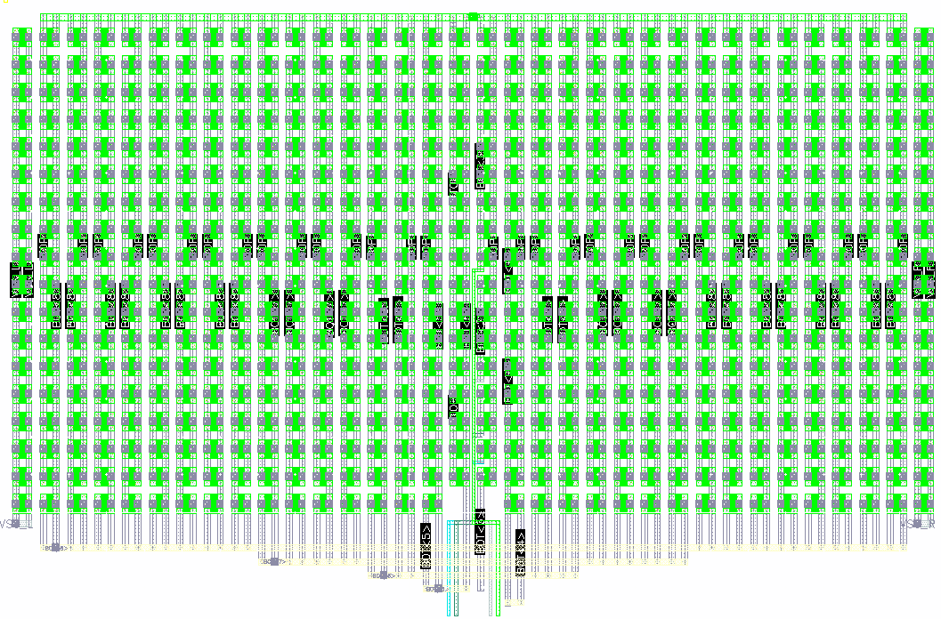
Layout Iteration2 - singleDAC – Remove2Dummy
Pro:
Symmetry
Less CC between Bits and
Less CC effects to the Dummy for bit0
Cons:
Sensitive to C(w.r.t substrate)
Sensitive to the length of Bit 0:3
Non-binary routing

Slide 8
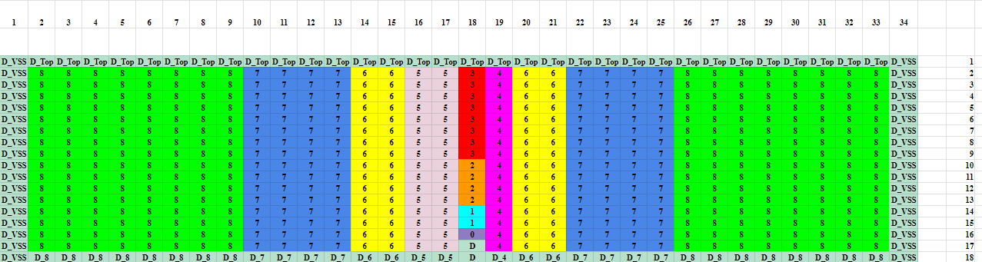
Final singleDAC(cap bank) Floorplan
Bit | B0 | B1 | B2 | B3 | B4 | B5 | B6 | B7 | B8
CC(fF) | 5.4927 | 10.985 | 21.970 | 43.944 | 87.885 | 175.77 | 351.53 | 703.08 | 1406.1
Ratio |  | 2 | 3.9999 | 8.000 | 16.000 | 32.000 | 63.999 | 128.00 | 256.00

Slide 9
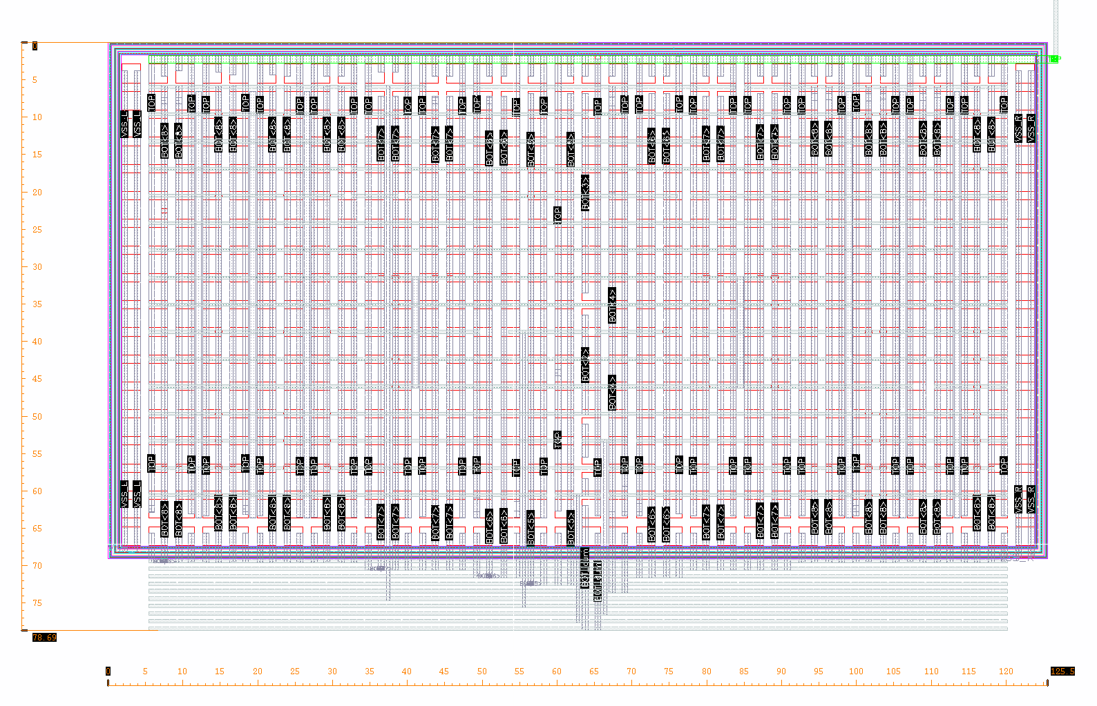
Final Layout – single DAC
Improvement:
Higher metal used for each bits
Binary routing
Compensation Capcitor to make perfect 2^n ratio
78.69u
125.5u

Slide 10
CDAC RCX Cap Table
Bit TopP | B0 | B1 | B2 | B3 | B4 | B5 | B6 | B7 | B8
CC(fF) | 5.51874 | 11.0181 | 21.9972 | 44.1238 | 88.179 | 176.362 | 352.691 | 705.664 | 1413.44
Ratio |  | 1.9996 | 3.9859 | 7.9952 | 15.9781 | 31.9569 | 63.9080 | 127.866 | 256.116
Bit TopN | B0 | B1 | B2 | B3 | B4 | B5 | B6 | B7 | B8
CC(fF) | 5.51138 | 11.0222 | 21.9988 | 44.1662 | 88.2156 | 176.425 | 352.801 | 705.712 | 1413.26
Ratio |  | 1.9998 | 3.9915 | 8.0136 | 16.0060 | 32.0110 | 64.0131 | 128.046 | 256.425

Slide 11
SAR-Core RCX Cap Table
Bit TopP | B0 | B1 | B2 | B3 | B4 | B5 | B6 | B7 | B8
CC(fF) | 5.51874 | 11.0182 | 21.9978 | 44.0338 | 88.082 | 176.21 | 352.332 | 705.239 | 1413.18
Ratio |  | 1.9965 | 3.9860 | 7.9789 | 15.9605 | 31.9293 | 63.8428 | 127.789 | 256.069
Bit TopN | B0 | B1 | B2 | B3 | B4 | B5 | B6 | B7 | B8
CC(fF) | 5.51137 | 11.0222 | 21.9987 | 44.0749 | 88.1173 | 176.271 | 352.44 | 705.293 | 1413.41
Ratio |  | 1.9999 | 3.9915 | 7.997 | 16.0060 | 31.9831 | 63.9478 | 127.970 | 256.453

Slide 12
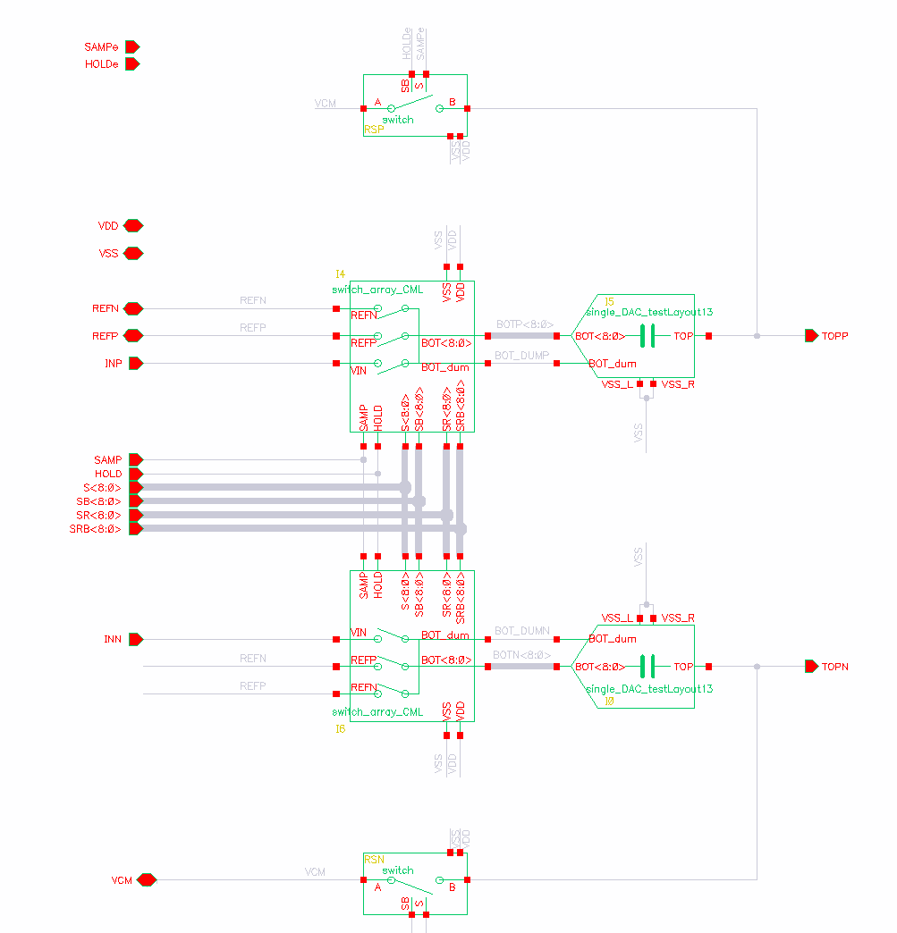
Schematic – CDAC

Slide 13
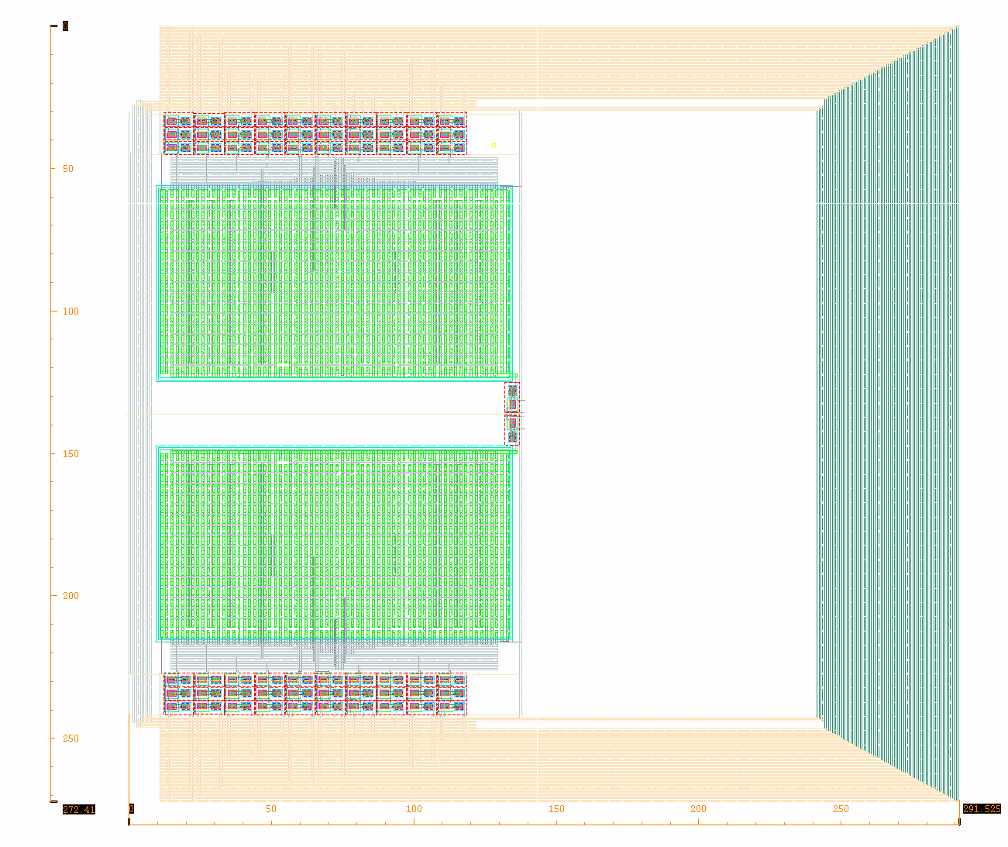
Final Layout – CDAC
272.41u
291.525u

Slide 14
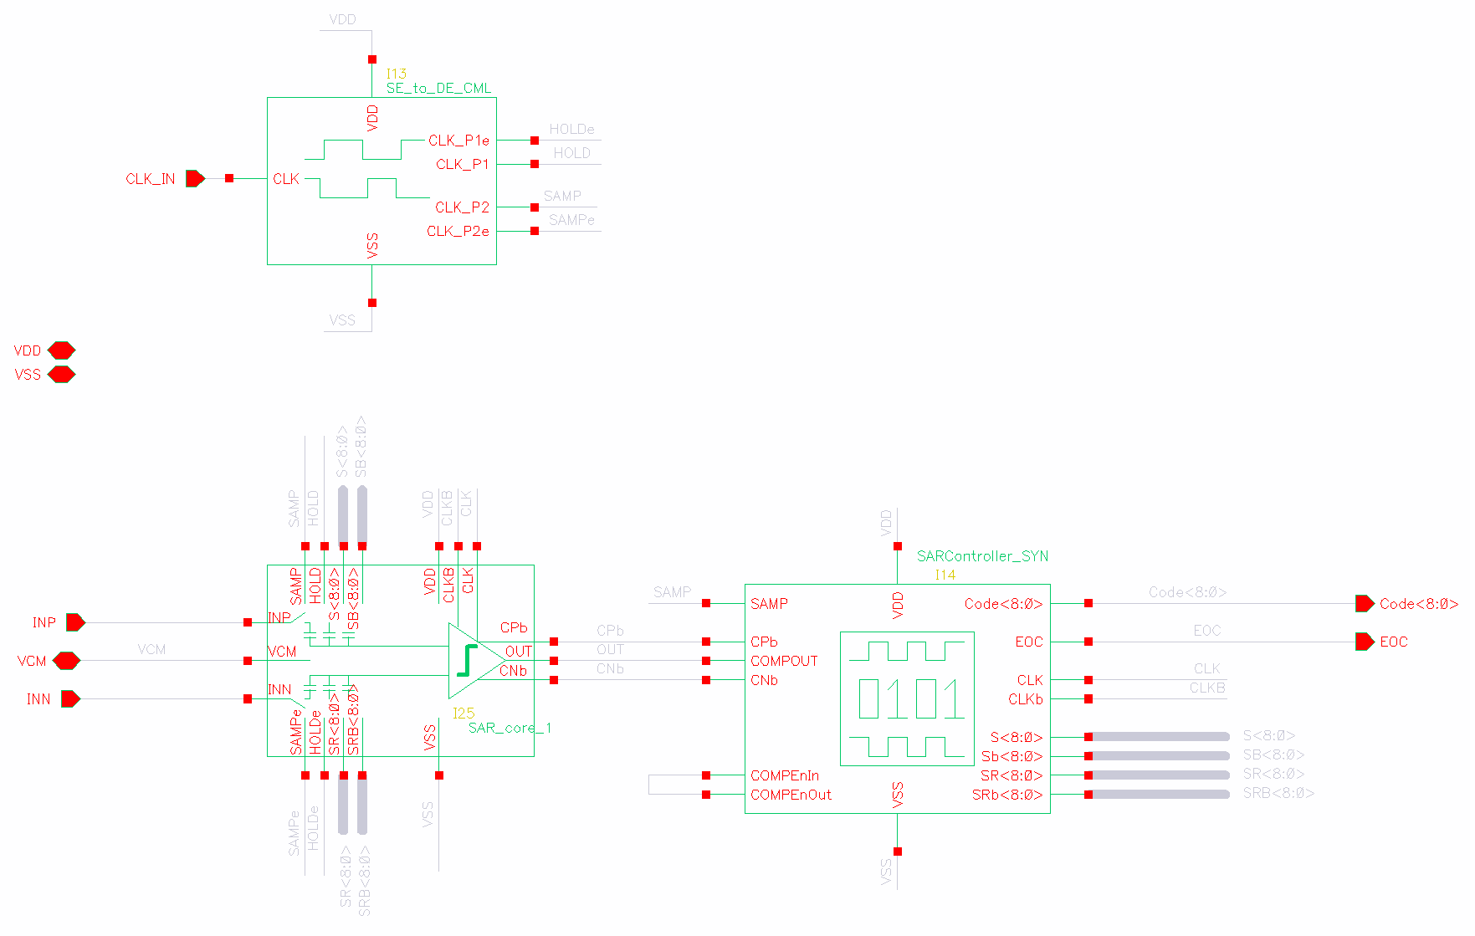
Schematic – SAR ADC

Slide 15
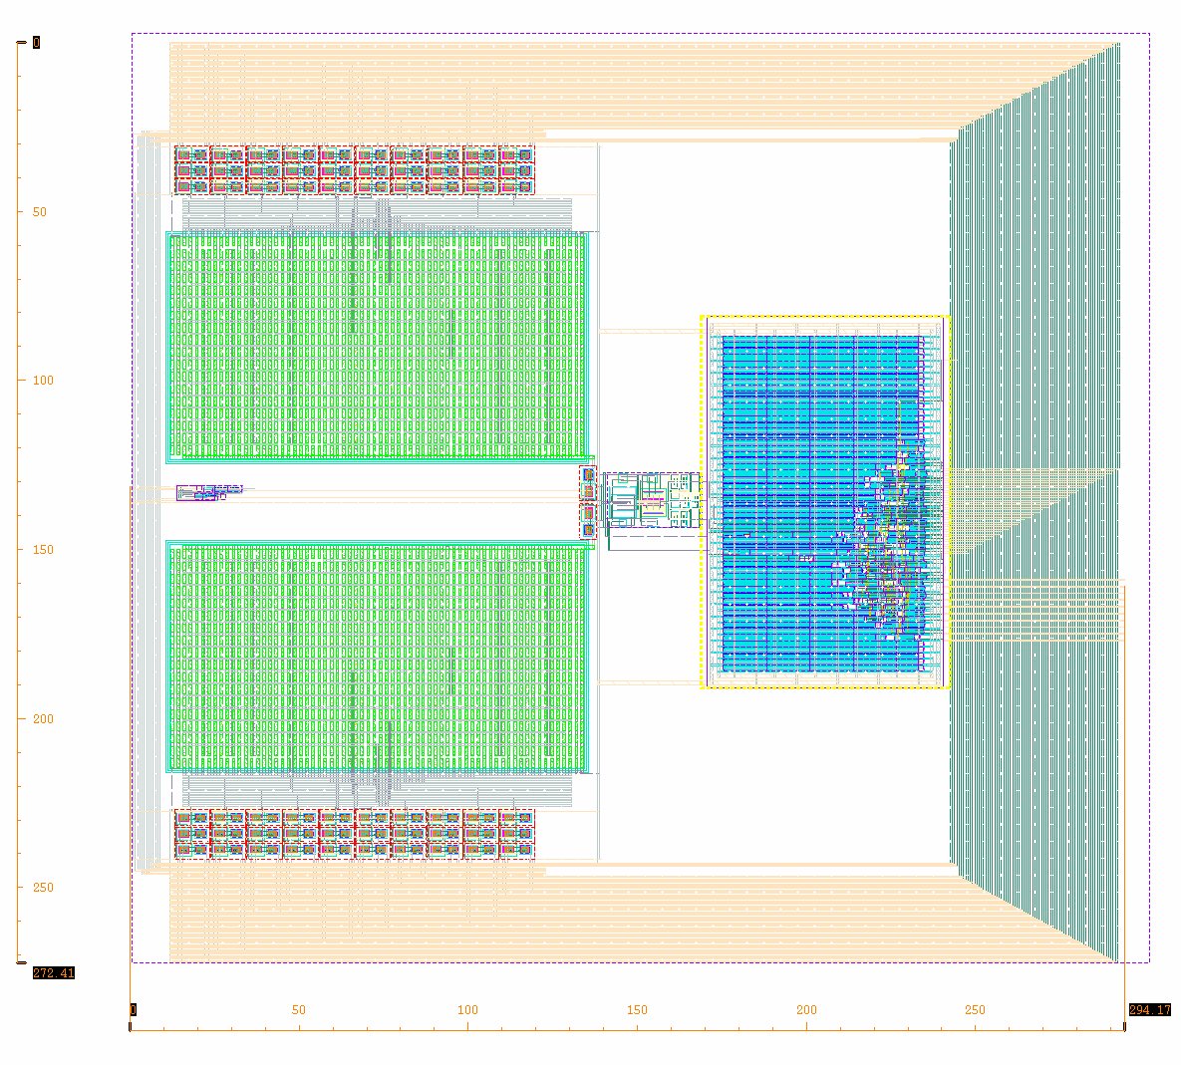
Final Layout – SAR-ADC
272.41u
294.17u

Slide 16
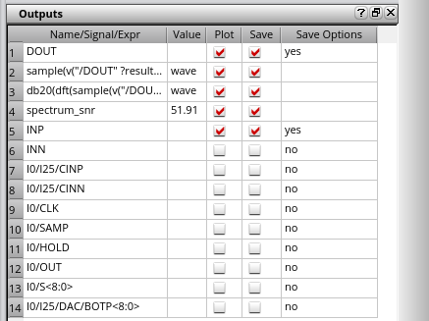
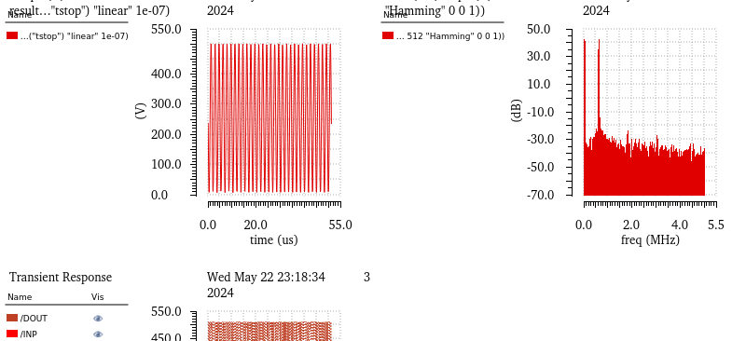
Simulation Result – SAR_ADC

