Slide 1
DRC Waiver Request
M15313

Slide 2
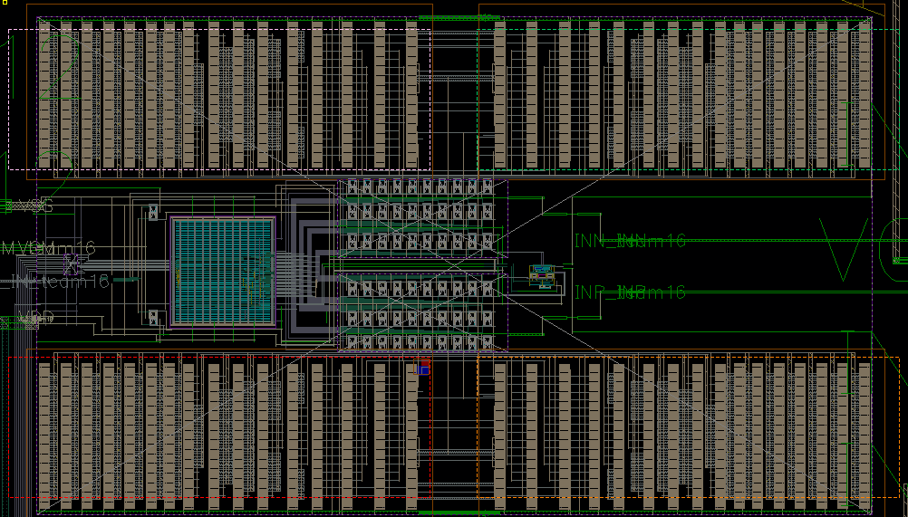
Mx.DN.1 / M9.DN.2
325 u
Error | Achieved Density in Red Rectangle | Required Density in 75um X 75um
M1.DN.1 | 0% | 10%
M2.DN.1 | 5.8% | 10%
M3.DN.1 | 0.6% | 10%
M4.DN.1 | 6.1% | 10%
M7.DN.1 | 2.5% | 10%
M8.DN.1 | 0.7% | 20%
M9.DN.2 | 0% | 20%
138 u
This is the Capacitance Array for one SAR ADC located on the top of the chip. The Cap array is very sensitive to the dummy fill which will worse the ADC’s performance. Dummy exclude layers are put on red rectangular and cause the DRC issues listed in table

Slide 3
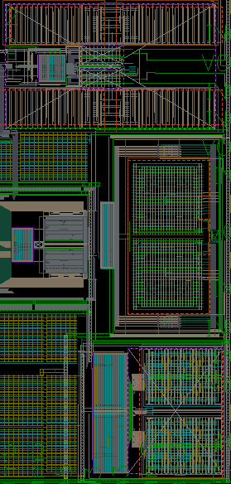
Mx.DN.1 / M9.DN.2
Error | Achieved Density in Red Rectangle | Required Density in 75um X 75um
M8.DN.1 | 0% | 20%
M9.DN.2 | 0% | 20%
180 u
This is the Capacitance Array for one SAR ADC located on the left middle of the chip. The Cap array is very sensitive to the dummy fill which will worse the ADC’s performance. Dummy exclude layers are put on red rectangular and cause the DRC issues listed in table
154 u

Slide 4
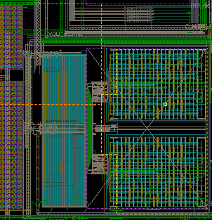
Mx.DN.1 / M9.DN.2
Error | Achieved Density in Red Rectangle | Required Density in 75um X 75um
M1.DN.1 | 5.5% | 10%
M2.DN.1 | 4.5% | 10%
M3.DN.1 | 4.1% | 10%
M4.DN.1 | 6.6% | 10%
M7.DN.1 | 4.3% | 10%
M8.DN.1 | 7.4% | 20%
M9.DN.2 | 0% | 20%
424 u
This is the Capacitance Array for one SAR ADC located on the right bottom of the chip. The Cap array is very sensitive to the dummy fill which will worse the ADC’s performance. Dummy exclude layers are put on red rectangular and cause the DRC issues listed in table
264 u

Slide 5
Mx.DN.1 / M9.DN.2
Error | Achieved Density in Red Rectangle | Required Density in 75um X 75um
M1.DN.1 | 0% | 10%
M2.DN.1 | 6.5% | 10%
M3.DN.1 | 6.8% | 10%
M4.DN.1 | 2.24% | 10%
M7.DN.1 | 8% | 10%
M8.DN.1 | 6.5% | 20%
M9.DN.2 | 0% | 20%
500 u
260 u
This is the Capacitance Array for one SAR ADC located on the right middle of the chip. The Cap array is very sensitive to the dummy fill which will worse the ADC’s performance. Dummy exclude layers are put on red rectangular and cause the DRC issues listed in table

Slide 6
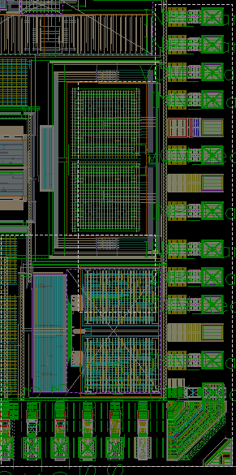
M1.DN.4
The error is caused by no filling inside the red rectangles as shown in the previous slides
Achieved ~50% density vs requirement of <40%

Slide 7
M2.DN.4
The error is caused by no filling inside the red rectangles as shown in the previous slides
Achieved ~47% density vs requirement of <40%

Slide 8
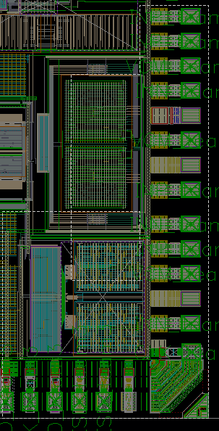
M3.DN.4
The error is caused by no filling inside the red rectangles as shown in the previous slides
Achieved ~48% density vs requirement of <40%

Slide 9
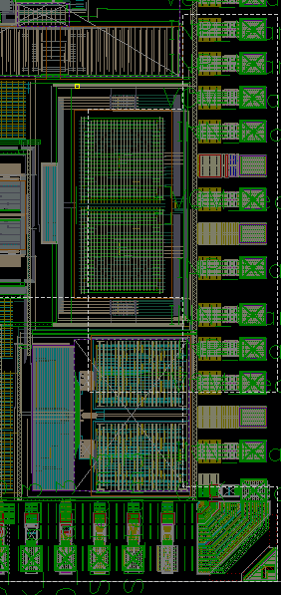
M4.DN.4
The error is caused by no filling inside the red rectangles as shown in the previous slides
Achieved ~45% density vs requirement of <40%

Slide 10
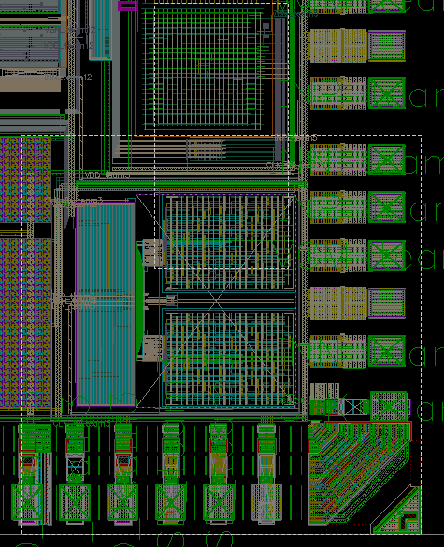
M7.DN.4
The error is caused by no filling inside the red rectangles as shown in the previous slides
Achieved ~49% density vs requirement of <40%

Slide 11
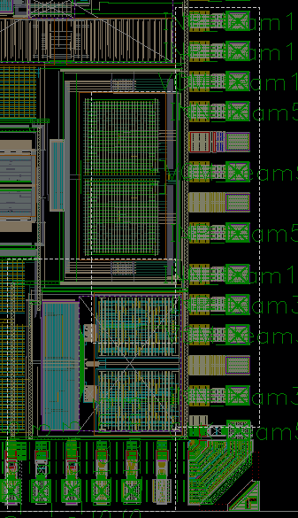
M8.DN.4
The error is caused by no filling inside the red rectangles as shown in the previous slides
Achieved ~46% density vs requirement of <40%

