Slide 1

ECE 283 Lab3 Design Review
Mingjie Ma
Chengming Li
University of California, San Diego, La Jolla, CA, USA

Slide 2
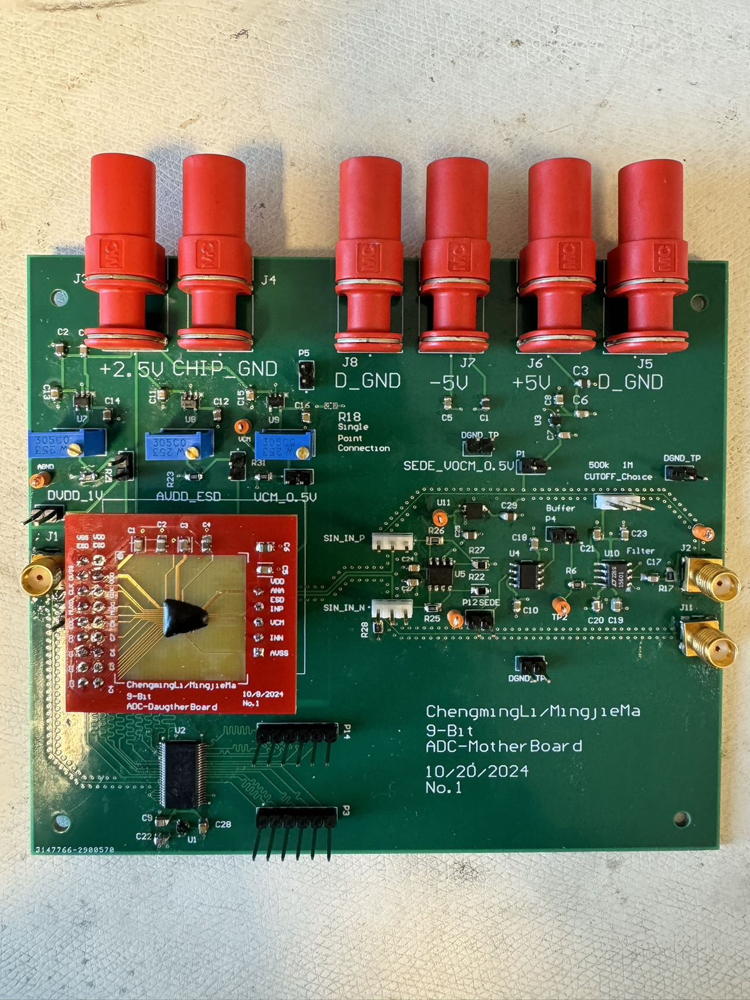
MotherBoard + DaugtherBoard
Modularized the Design
By having jumper between each IC
Testability
Jumper for GND for easy probeing
Grab & Probe
Configurability
Potentiometer for tweaking the perfect Vcm, AVDD, AVDDESD
Credit – Mingjie Ma

Slide 3
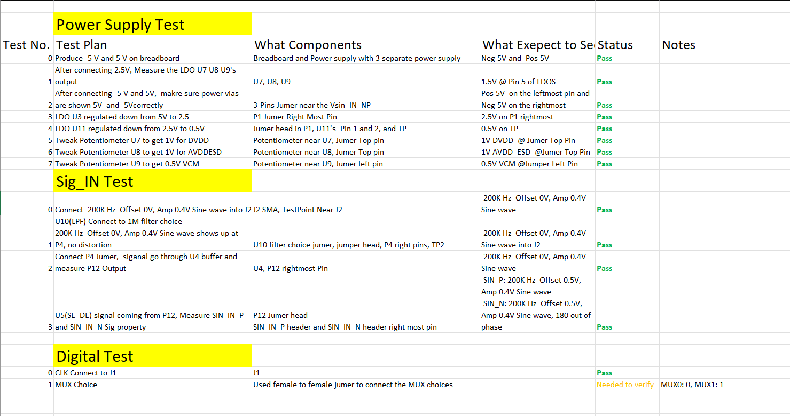
MotherBoard + DaugtherBoard BringUp TestPlan

Slide 4
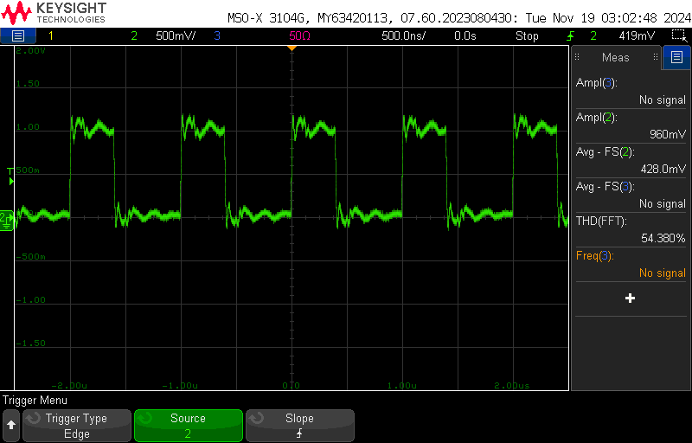
Current Issue 1.0
Period: 1u s
Freq; 1M Hz
CLK_IN
Connect the CLK onto the board
1MHz, 0.5V Offset, 1 Vpp

Slide 5
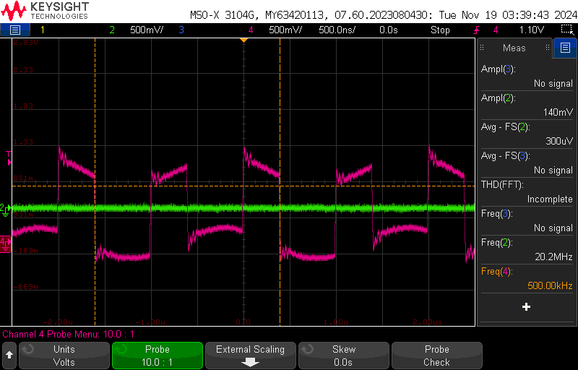
Current Issue 1
CLK_IN
Then connect the sine wave on to the board
500kHz, 0V offset, 500m Vpp
Sin_IN drags the CLK frequency downs to 500KHz

Slide 6
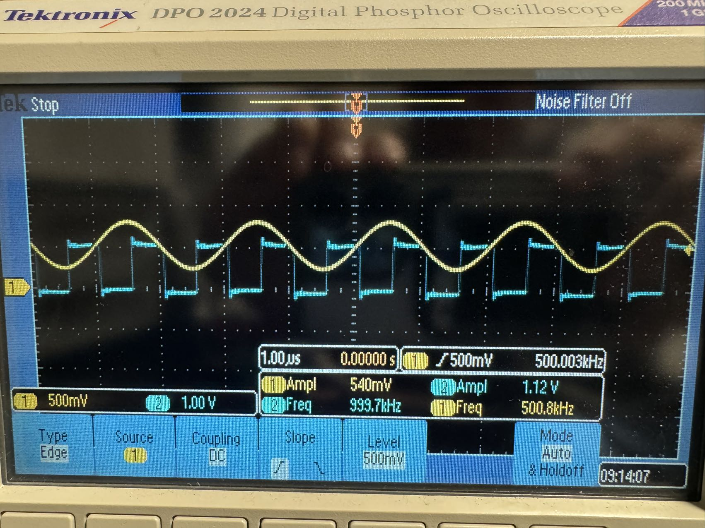
Current Issue 1 However…
SE_DE_POS: 0.5V offset, 0.5Vpp
CLK_IN: 0.5V offset, 1Vpp
We tried Mingjie’s Lab instrument
Everything looks good as expected
Had saved all the probes, function generator, oscilloscope, and power supply setup.
Will give another attempt on Wednesday in our 266B’s Lab

Slide 7
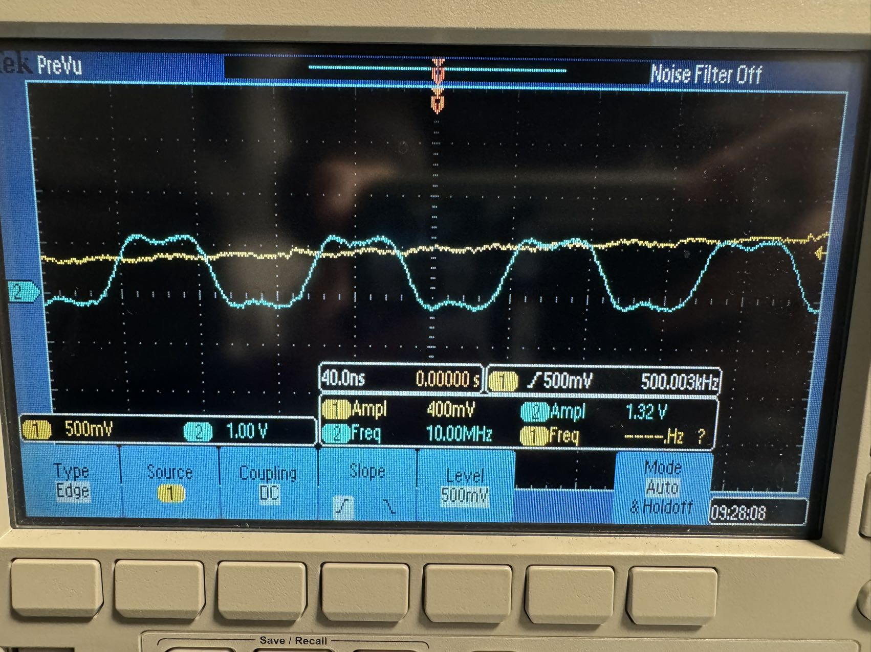
Current Issue 2
Some distortion @ 10MHz CLK_IN
Adding lots of noise on SIN IN

Slide 8
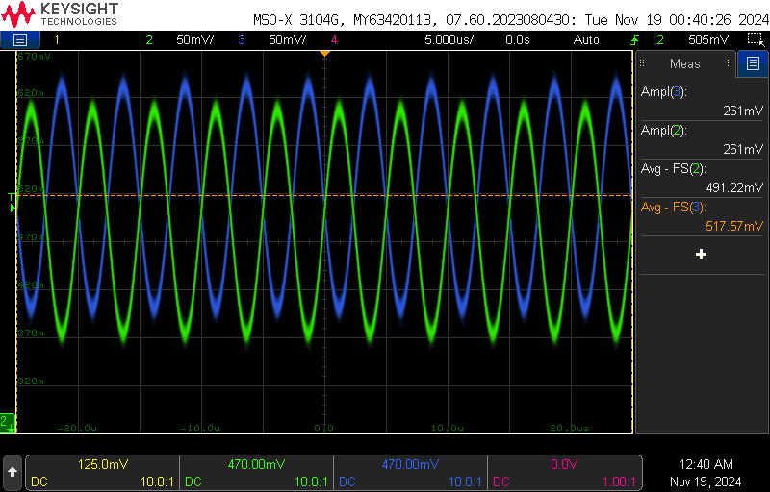
Current Issue 3 - SEDE
SE_DE_POS
SE_DE_NEG
Different DC offset after SE-DE
But similar Vpp Amplitude

Slide 9
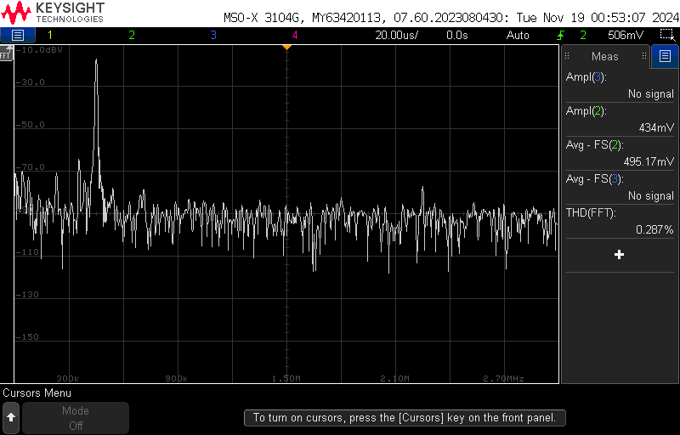
FFT – one of SINE
-15 dBV @ fundamental frequency
Other tones are below -70 dBV

Slide 10
ADC_Test_Questions
What data needs to be saved to plot SNR, THD, etc…
Digital code file from oscilloscope
FFT Data from oscilloscope
what else?

