Slide 1

ECE 283 Lab3 Final Design Review
Mingjie Ma
Chengming Li
University of California, San Diego, La Jolla, CA, USA

Slide 2
Agenda
Project Background & Introduction
Specs Overview
Chip Design Review in Cadence
Chip-Testing Review
Takeaway

Slide 3
Project Background & Introduction

Slide 4
Project Background & Introduction
ECE266A - 9-bit high speed SAR ADC
Layout-focus Design
Comparator, CDAC, Digital logic, Non-overlapping clock generator, switches
Mega-Chip combinations
4 groups of chip into one BIG CHIP
Dummy fill, seal ring, custom pads, custom-DeCaps
ECE266B – SAR ADC Testing
PCB Design
Mother(4-Layer) and daughterboard(2-Layer) combination
Custom ADC chip footprint + Wirebonding Diagram
Soldering & Assembly
0604 & 0802 Surface mount soldering
Device characterization & Automation
Test Automation using Keysight instruments in Python
Data processing and plotting in MatLab

Slide 5
Specs Overview

Slide 6
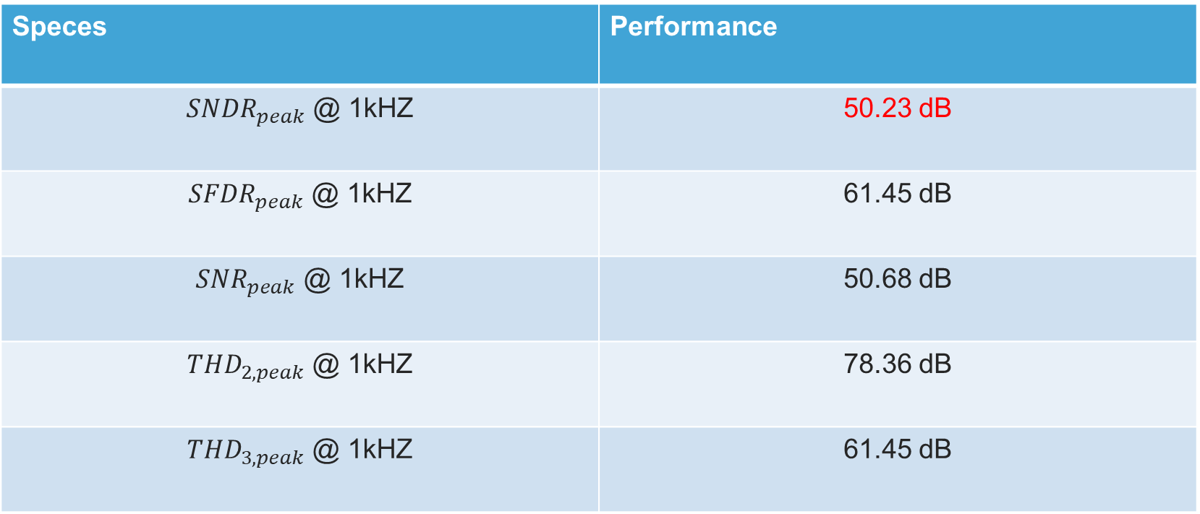
Specs Overview
Speces | Performance
${SNDR}_{peak}$ @ 1kHZ | 50.23 dB
${SFDR}_{peak}$ @ 1kHZ | 61.45 dB
${SNR}_{peak}$ @ 1kHZ | 50.68 dB
${THD}_{2,peak}$ @ 1kHZ | 78.36 dB
${THD}_{3,peak}$ @ 1kHZ | 61.45 dB

Slide 7
Chip Design Review in Cadence

Slide 8
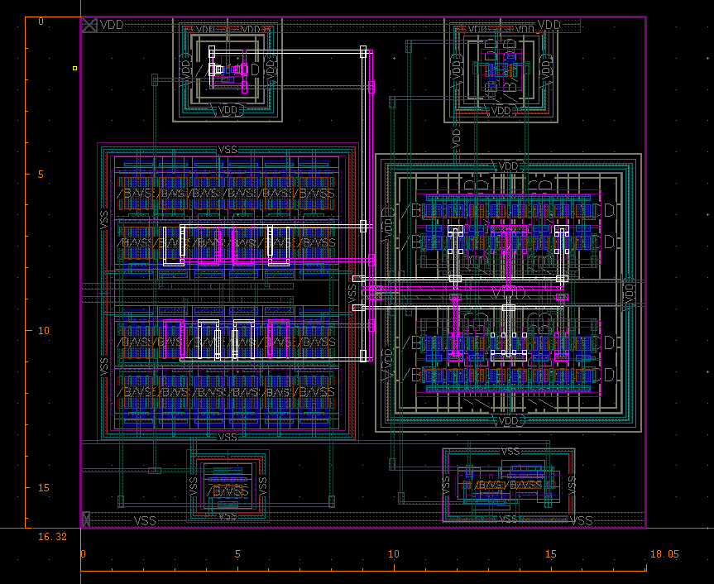
Comparator Remarks
Symmetry layout in differential pair
Achieved 90uV offset in the differential pairs

Slide 9
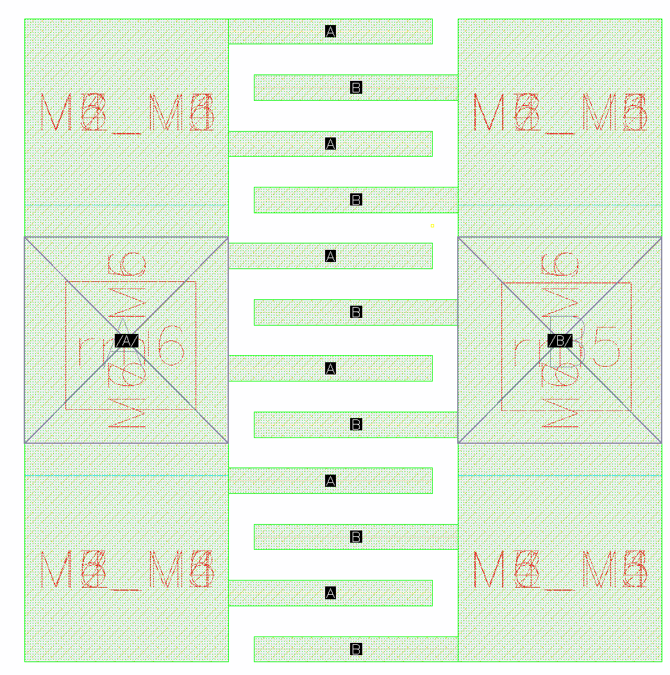
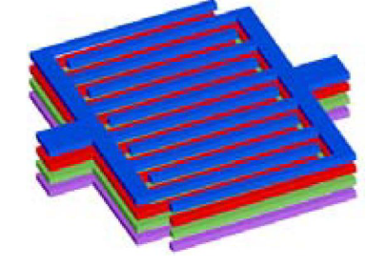
Custom unit Cap Remarks
Layer: M1 to M7 stack up
Size: 2.5u by 2.52u
CC: 5fF
2.52u
2.5u

Slide 10
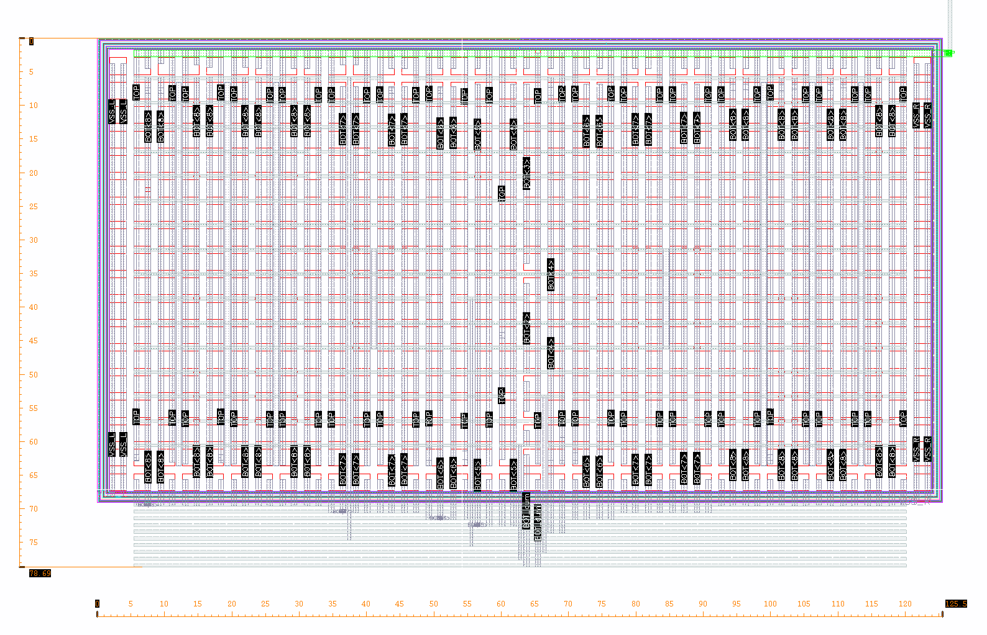
CDAC Remarks -1
78.69u
125.5u

Slide 11
CDAC Remarks -2
Bit TopP | B0 | B1 | B2 | B3 | B4 | B5 | B6 | B7 | B8
CC(fF) | 5.51874 | 11.0181 | 21.9972 | 44.1238 | 88.179 | 176.362 | 352.691 | 705.664 | 1413.44
Ratio |  | 1.9996 | 3.9859 | 7.9952 | 15.9781 | 31.9569 | 63.9080 | 127.866 | 256.116
Bit TopN | B0 | B1 | B2 | B3 | B4 | B5 | B6 | B7 | B8
CC(fF) | 5.51138 | 11.0222 | 21.9988 | 44.1662 | 88.2156 | 176.425 | 352.801 | 705.712 | 1413.26
Ratio |  | 1.9998 | 3.9915 | 8.0136 | 16.0060 | 32.0110 | 64.0131 | 128.046 | 256.425

Slide 12
Chip-Testing Review

Slide 13
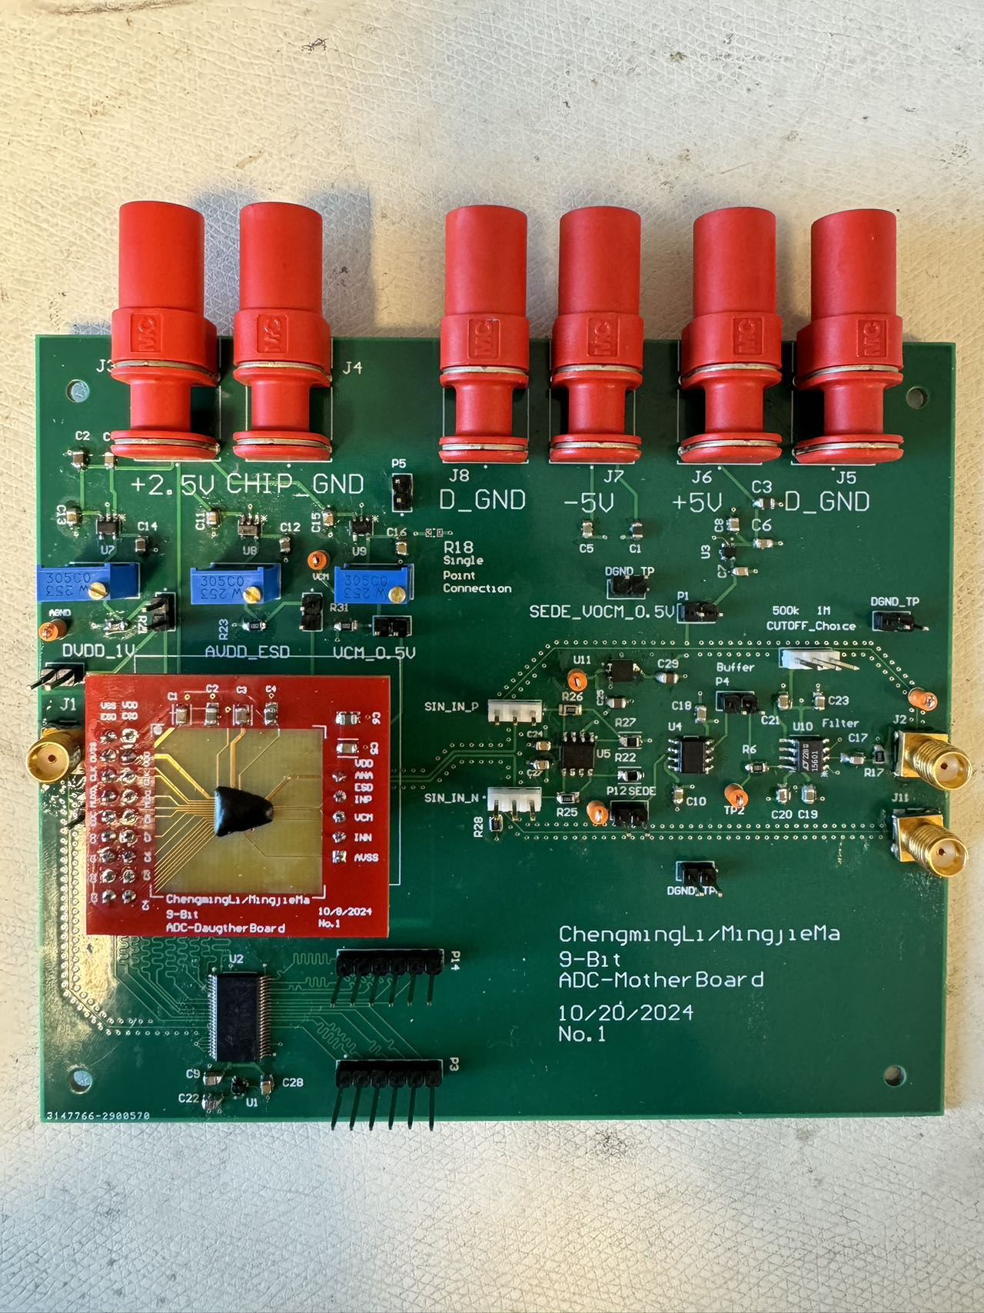
MotherBoard + DaugtherBoard
Modularized the Design
By having jumper between each IC
For debugging
SE-DE / ByPass Options
Testability
Jumper for GND for easy probeing
Grab & Probe
Configurability
Potentiometer for tweaking the perfect Vcm, AVDD, AVDDESD
4-Layer Stack
Signal
DGND + AGND
+5V
-5V

Slide 14
MotherBoard + DaugtherBoard
Modularized the Design
By having jumper between each IC
For debugging
SE-DE / ByPass Options
Testability
Jumper for GND for easy probeing
Grab & Probe
Configurability
Potentiometer for tweaking the perfect Vcm, AVDD, AVDDESD
4-Layer Stack
Signal
DGND + AGND
+5V
-5V

Slide 15
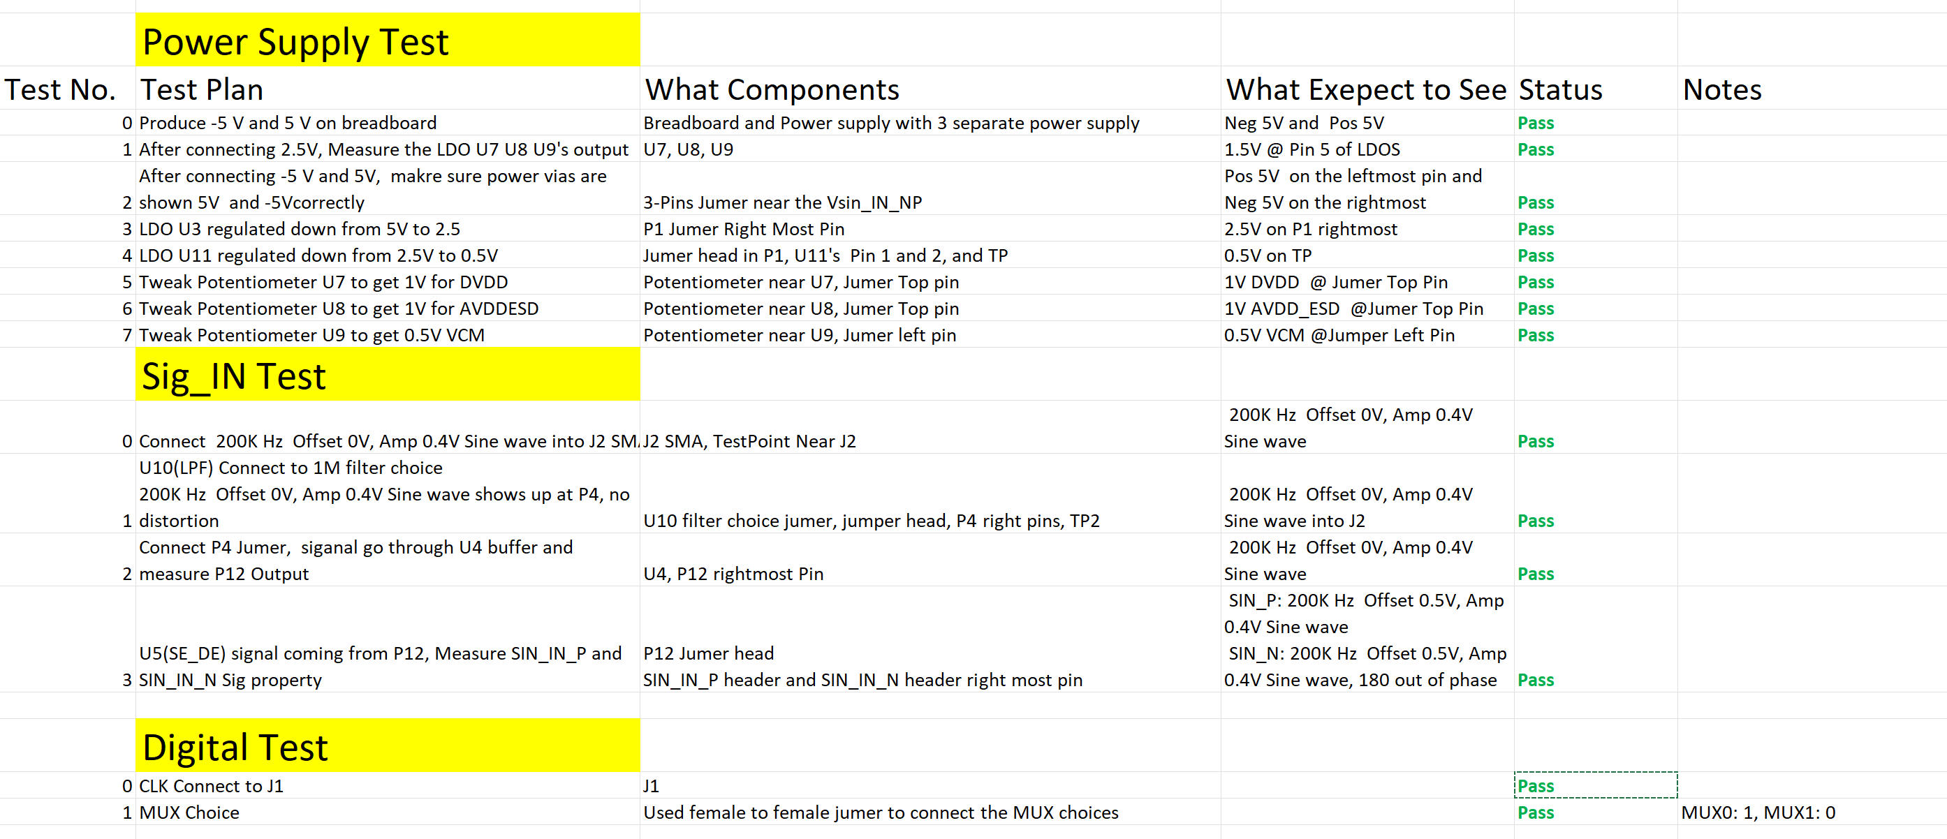
Board Bring-up Checklist

Slide 16
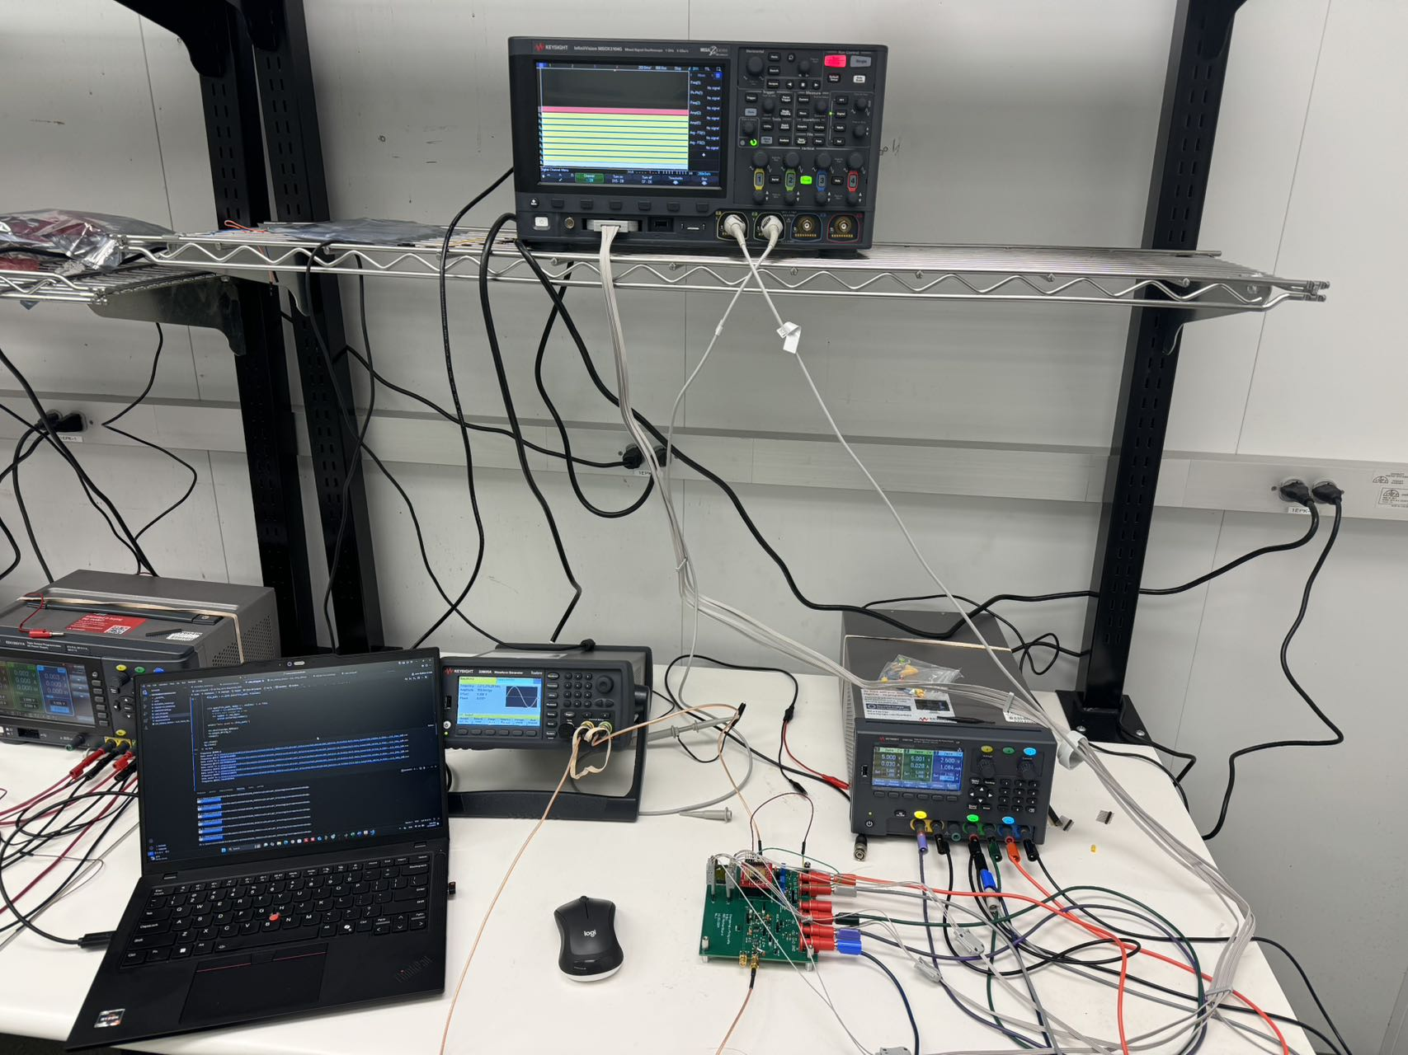
Test Automation Setup - 1
Power Supply
+5V, -5V, and 2.5V
Function Generator
CLK & SIN INPUT
Oscilloscope
Digital Analyzer
Digital Output
4-Layer Stack
Signal
DGND + AGND
+5V
-5V

Slide 17
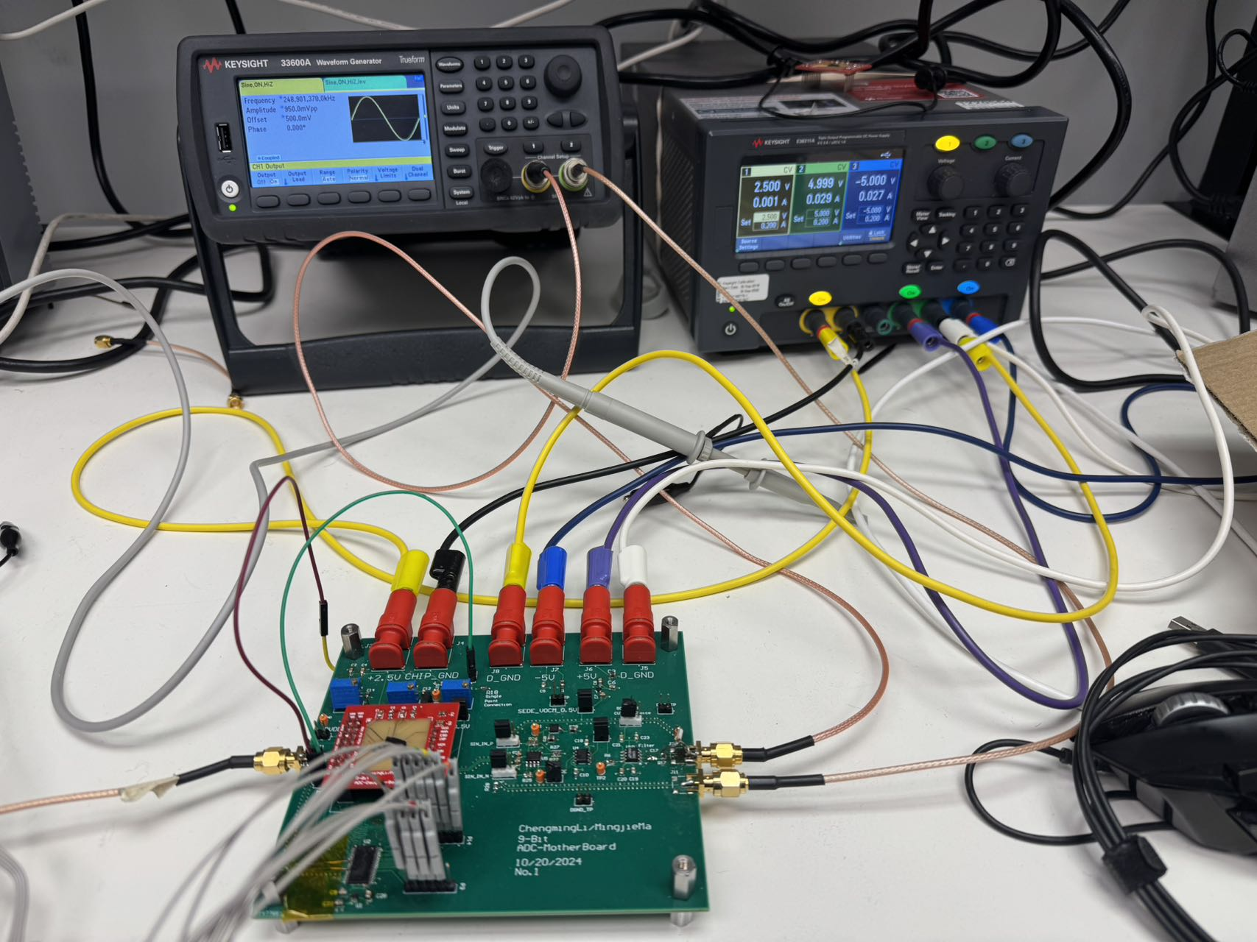
Test Automation Setup - 2
Power Supply
+5V, -5V, and 2.5V
Function Generator
CLK & SIN INPUT
Oscilloscope
Digital Analyzer
Digital Output
4-Layer Stack
Signal
DGND + AGND
+5V
-5V
2.5V -5V +5V
CLK_IN
SIN_P & SIN_N
C0-C8 + EOC

Slide 18
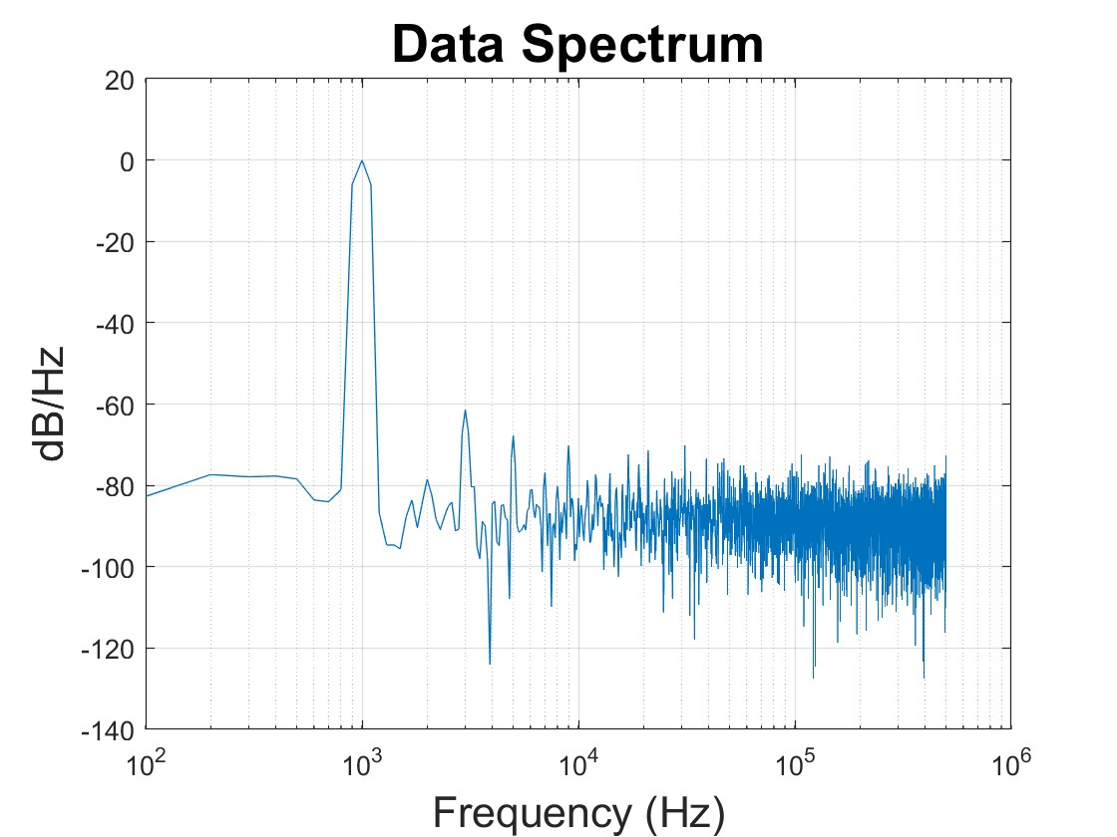
Peak SNDR Plot

