Slide 1

ECE 266 Lab2 Design Review
Mingjie Ma
Chengming Li
University of California, San Diego, La Jolla, CA, USA

Slide 2
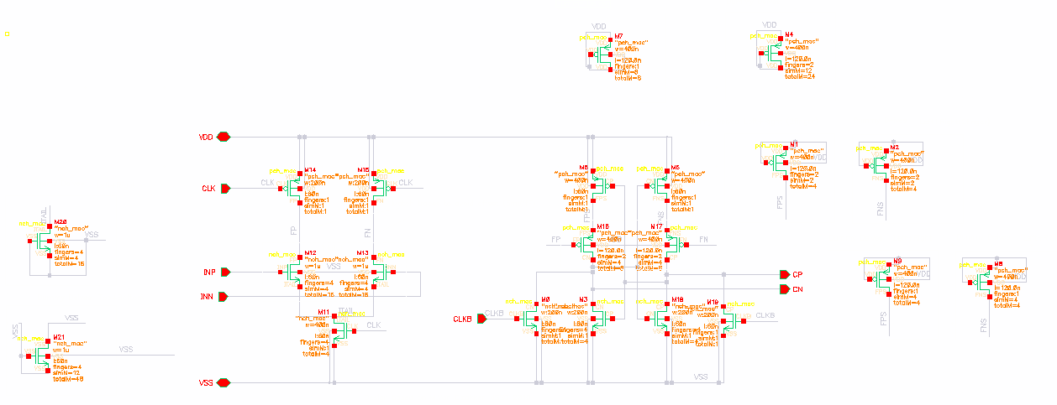
Schematic
Dummy Devices for M12 and M13:
Top+bottom(DGS are shorted to VSS): 4fin * 12m * 1u Left+Right(D-Itail, GS are shorted to VSS): 4fin * 4m *1u

Slide 3
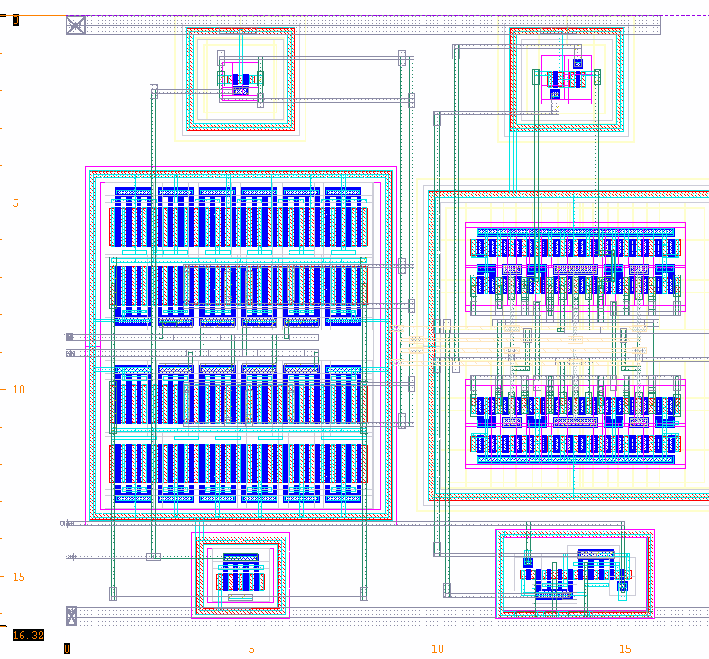
Comparator Layout
Common Centroid Pattern
ABBA
BAAB
After dummy devices
(D:2 fingers; d: 1fingers)
DDDDDD
DABBAD
DBAABD
DDDDDD

Slide 4
Schematic
Dummy Devices for M17 and M18:
Top Bottom(DGS - VDD): 1fin * 8m * 400n
2fin * 12m * 400n Left+Right(GS- VDD, D- FNS/FPS): 1fin * 8m *400n
2fin * 4m * 400n
Top + Bottom
Left + Right

Slide 5
Comparator Layout
Common Centroid Pattern
ABBA
BAAB
After dummy devices
(D:2 fingers; d: 1fingers)
DDddDDddDD
DAddBBddAD
DBddAAddBD
DDddDDddDD

Slide 6
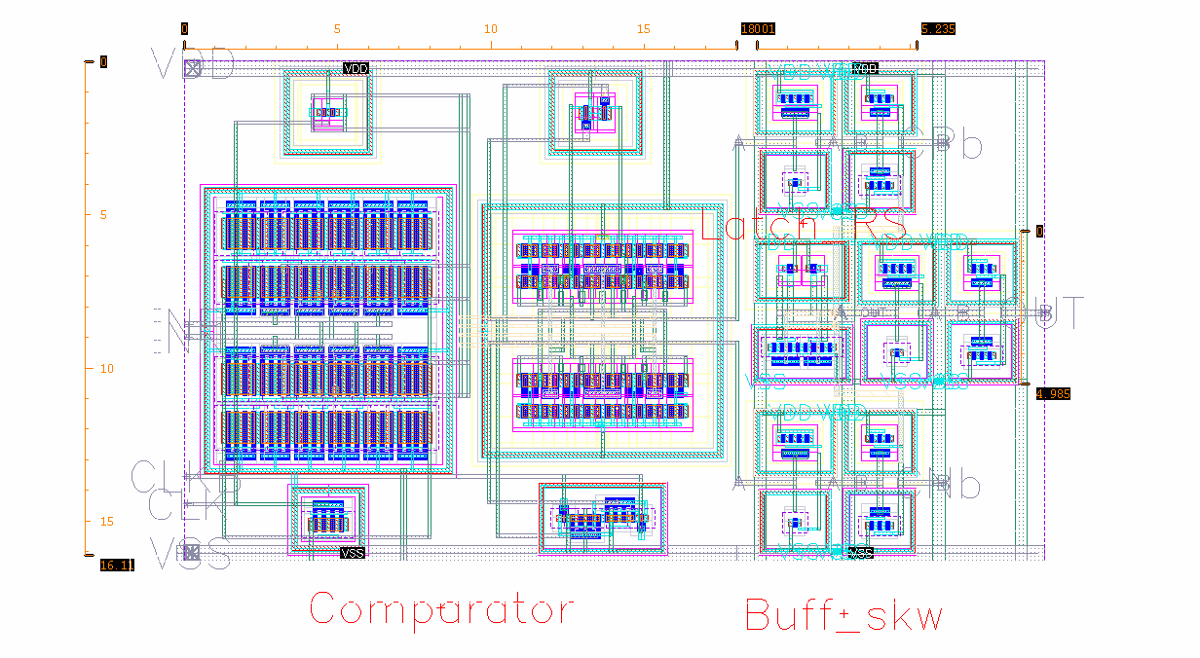
Top Level Layout
1st Stage
2nd Stage
RS_Latch
16.11u
Comparator
26.95u

Slide 7
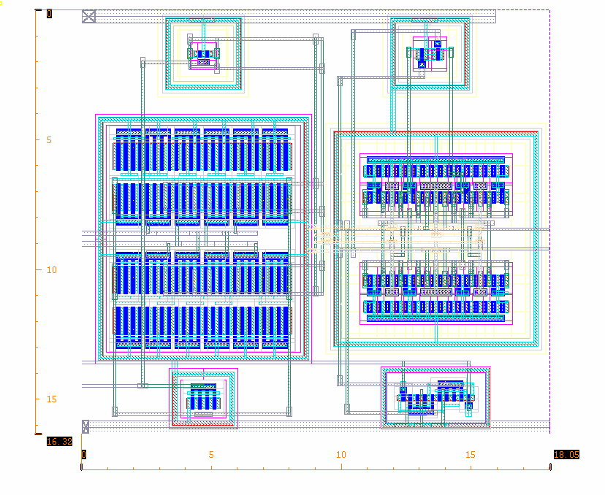
Comparator Layout
CP
INP
16.32u
INN
CLKB
CN
CLK
18.05u

Slide 8
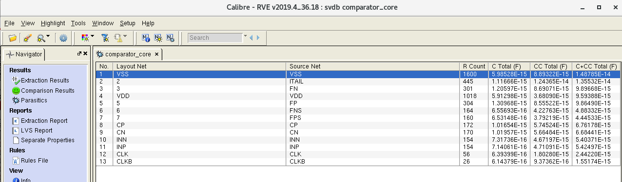
RCX Cap Table
Source Net | C+CC (F) | Difference(%)
FP(Hightlight) | 9.8649f
FN(Highlight) | 9.89668f | -0.32%
CP | 6.76178f
CN | 6.68441f | 1.144%
INP | 5.42497f
INN | 5.40371f | 0.39%

Slide 9
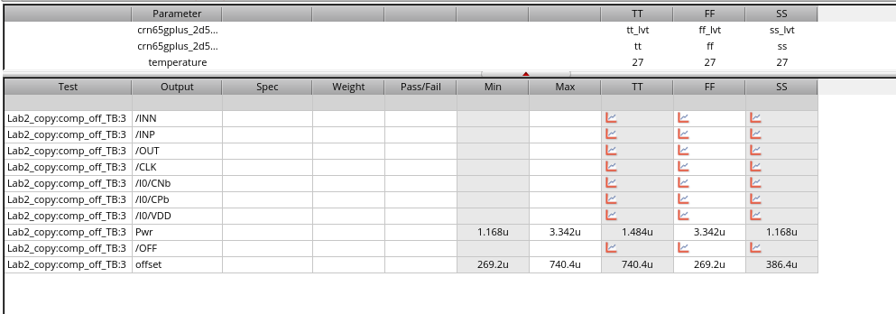
Extracted Simulation(Offset) – Process Corners
Test Corners | TT | FF | SS
This work | 740.4u | 269.2 | 386.4u
R+C+CC Extraction

Slide 10
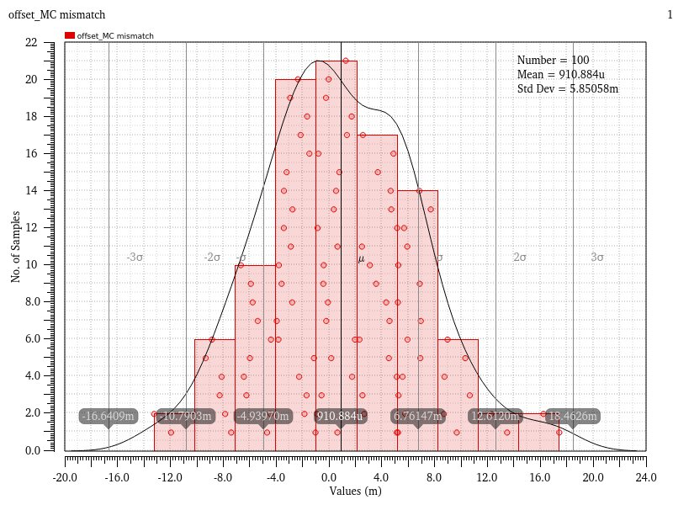
Extracted Simulation(Offset) – Mismatch
R+C+CC Extraction

Slide 11
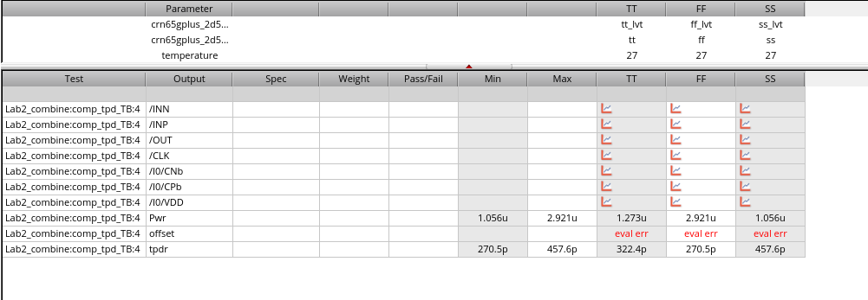
Extracted Simulation(Tpd) – Process Corners
Test Corners | TT | FF | SS
Tpd(s) | 322.4p | 270.5p | 457.6p
C+CC Extraction

Slide 12
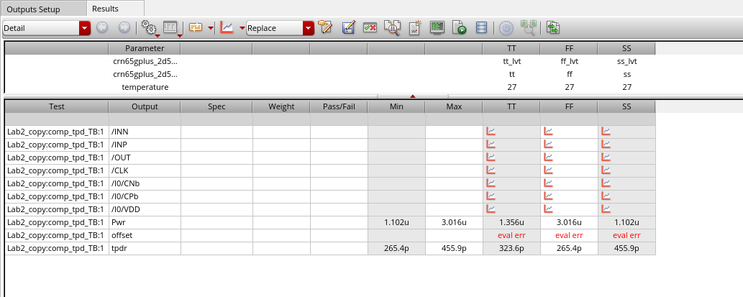
Extracted Simulation(Tpd) – Process Corners
Test Corners | TT | FF | SS
Tpd(s) | 323.6p | 265.4p | 455.9p
R+C+CC Extraction

Slide 13
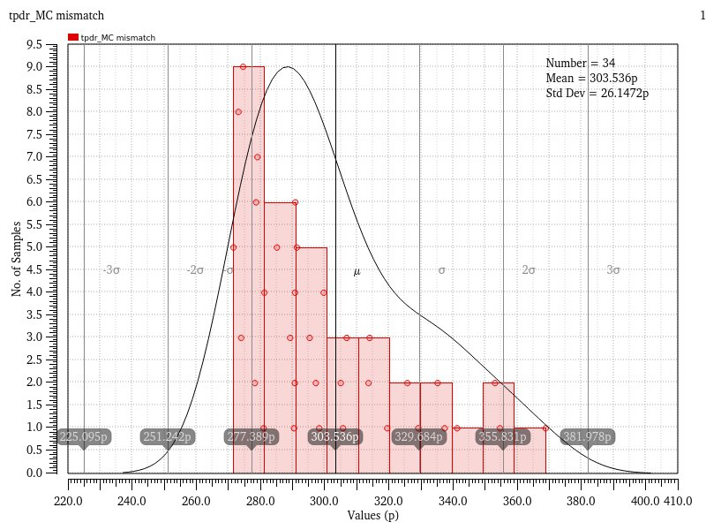
Extracted Simulation(Tpd) – Mismatch
R+C+CC Extraction

Slide 14
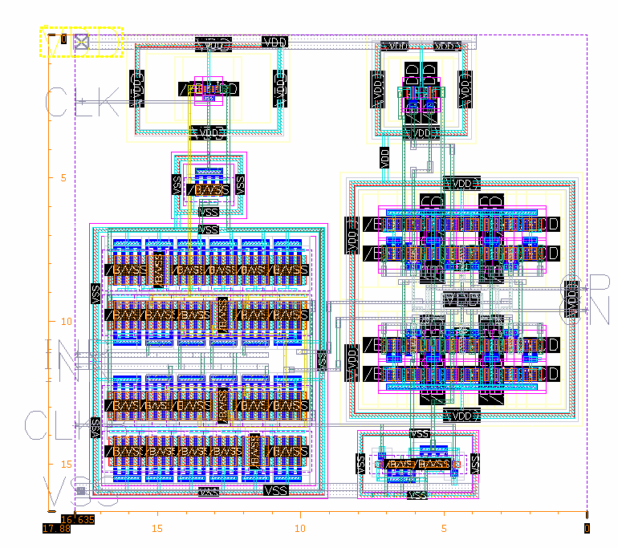
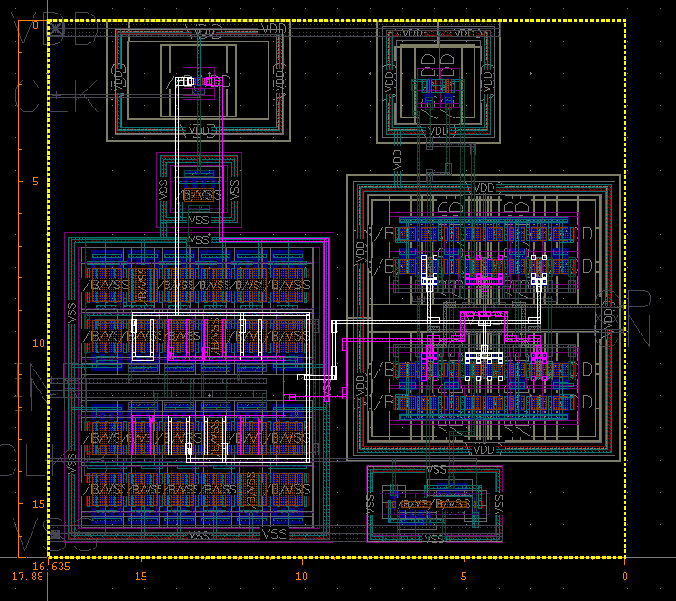
Appendix - #1 Iteration

Slide 15
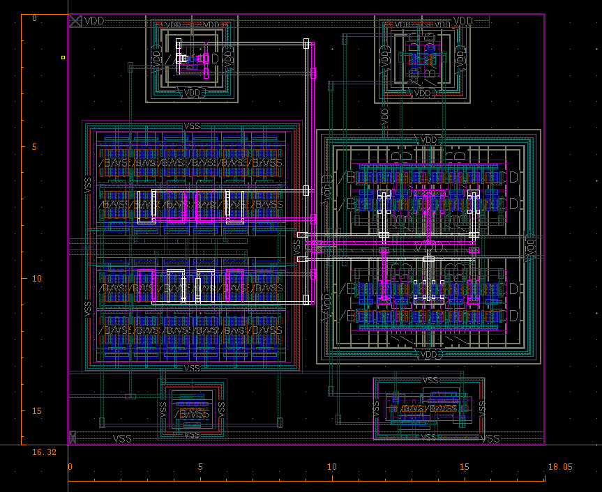
Appendix - #2 Iteration

Slide 16
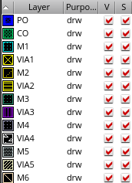
Appendix – Metal Color

