Slide 1

ECE 283 Lab3 Final Design Review
Mingjie Ma
Chengming Li
University of California, San Diego, La Jolla, CA, USA

Slide 2
Agenda
Project Background & Introduction
Specs Overview
Chip Design Review in Cadence
Chip-Testing Review
Takeaway

Slide 3
Project Background & Introduction

Slide 4
Project Background & Introduction
ECE266A - 9-bit high speed(Fs = 10M Hz) SAR ADC
Layout-focus Design
Comparator, CDAC, Digital logic, Non-overlapping clock generator, switches
Mega-Chip combinations
4 groups of chip into one BIG CHIP
Dummy fill, seal ring, custom pads, custom-DeCaps, wavier submission
ECE266B – SAR ADC Testing
PCB Design
Mother(4-Layer) and daughterboard(2-Layer) combination
Custom ADC chip footprint + Wirebonding Diagram
Soldering & Assembly
0604 & 0802 Surface mount soldering
Device characterization & Test - Automation
Test Automation using Keysight instruments in Python
Data processing and plotting in MatLab

Slide 5
Specs Overview

Slide 6
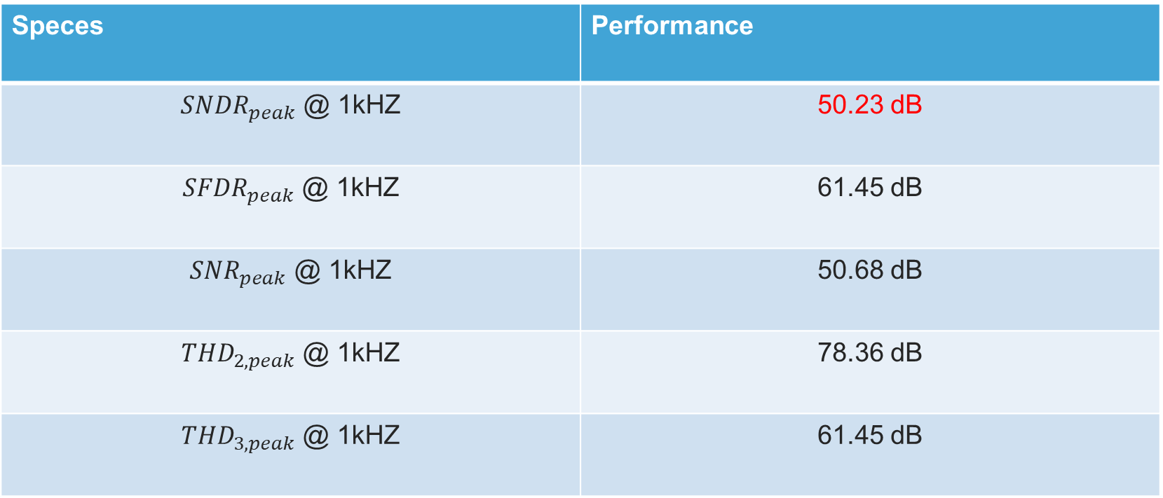
Specs Overview
Speces | Performance
${SNDR}_{peak}$ @ 1kHZ | 50.23 dB
${SFDR}_{peak}$ @ 1kHZ | 61.45 dB
${SNR}_{peak}$ @ 1kHZ | 50.68 dB
${THD}_{2,peak}$ @ 1kHZ | 78.36 dB
${THD}_{3,peak}$ @ 1kHZ | 61.45 dB

Slide 7
Chip Design Review in Cadence

Slide 8
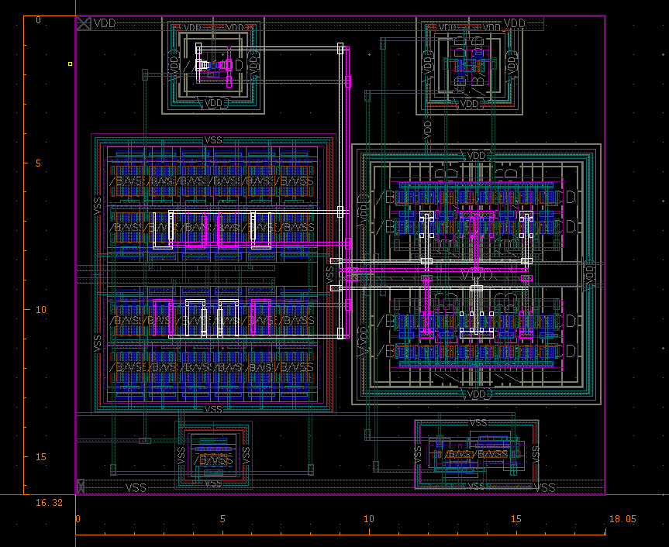
Comparator Remarks
Symmetry layout in differential pair
Achieved 90uV offset in the differential pairs

Slide 9
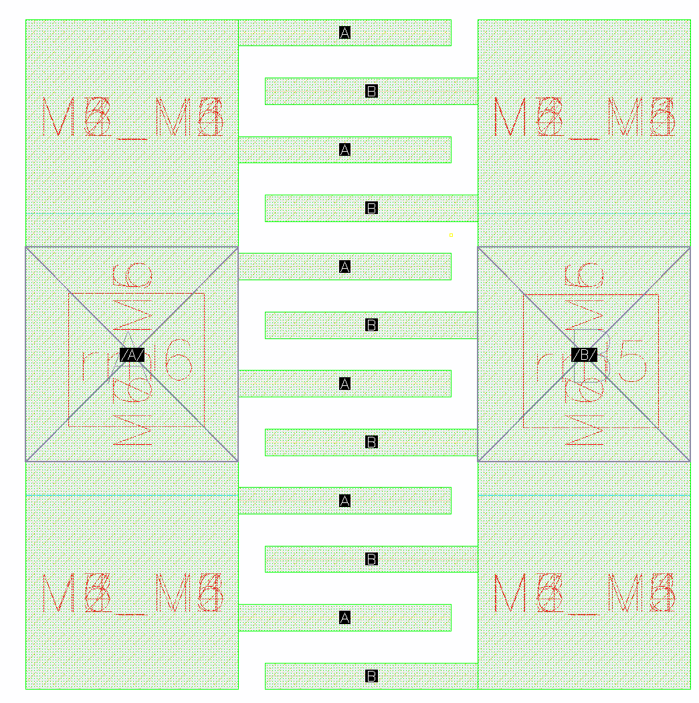
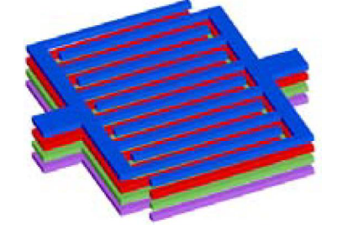
Custom unit Cap Remarks
Layer: M1 to M7 stack up
Size: 2.5u by 2.52u
CC: 5fF
2.52u
2.5u

Slide 10
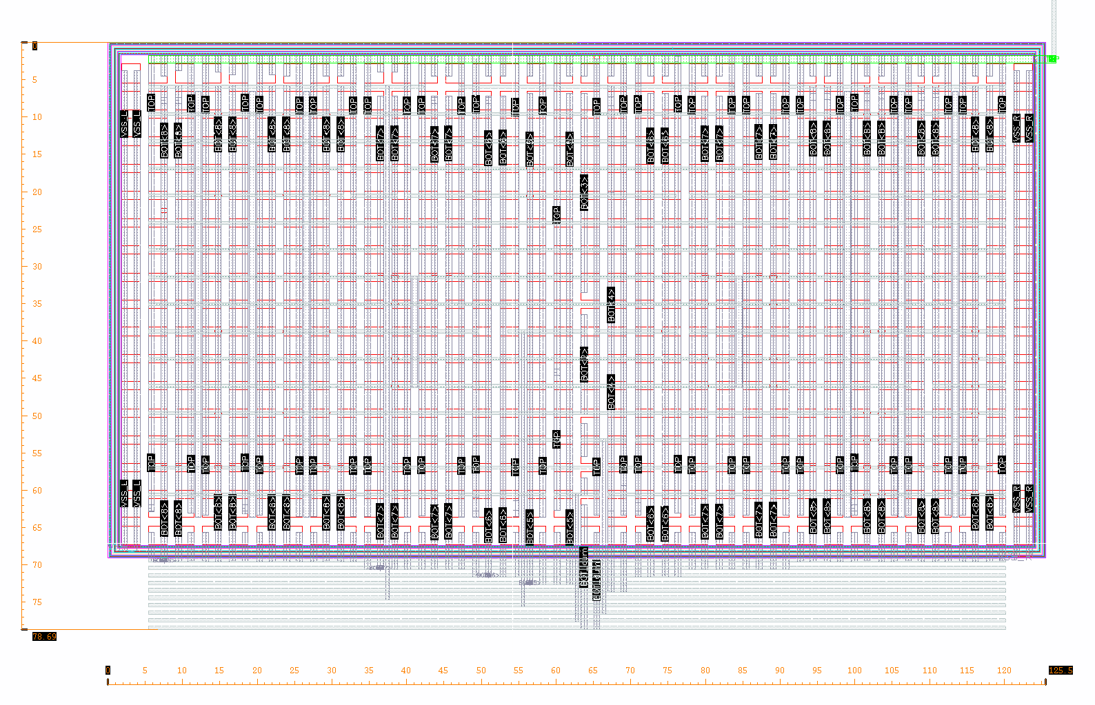
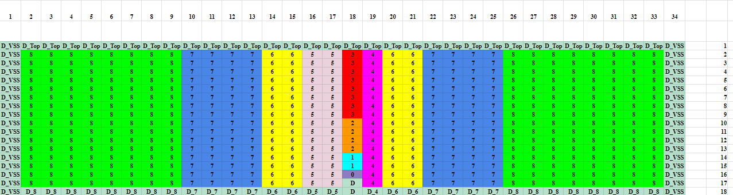
CDAC Remarks -1
78.69u
125.5u

Slide 11
CDAC Remarks -2
Bit TopP | B0 | B1 | B2 | B3 | B4 | B5 | B6 | B7 | B8
CC(fF) | 5.51874 | 11.0181 | 21.9972 | 44.1238 | 88.179 | 176.362 | 352.691 | 705.664 | 1413.44
Ratio |  | 1.9996 | 3.9859 | 7.9952 | 15.9781 | 31.9569 | 63.9080 | 127.866 | 256.116
Bit TopN | B0 | B1 | B2 | B3 | B4 | B5 | B6 | B7 | B8
CC(fF) | 5.51138 | 11.0222 | 21.9988 | 44.1662 | 88.2156 | 176.425 | 352.801 | 705.712 | 1413.26
Ratio |  | 1.9998 | 3.9915 | 8.0136 | 16.0060 | 32.0110 | 64.0131 | 128.046 | 256.425

Slide 12
Chip-Testing Review

Slide 13
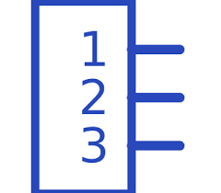
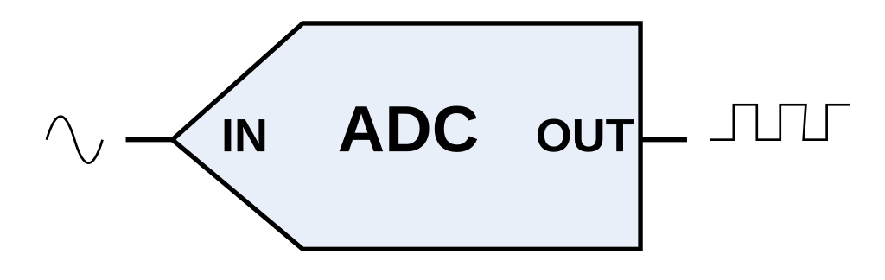

MotherBoard BlockDiagram
Bypass- Method
SE/DE- Method
SIN_P
SMA
SIN_P
LPF
Buffer
SE-DE
Jumper
Jumper
SIN_N
Low Pass Filter($F_{c}=500k or 1M Hz$)
Buffer Signal (Maintain drive strengthen)
Single-ended to Differential Ended
SIN_N
SMA
CLK
Bypass- Method

Slide 14
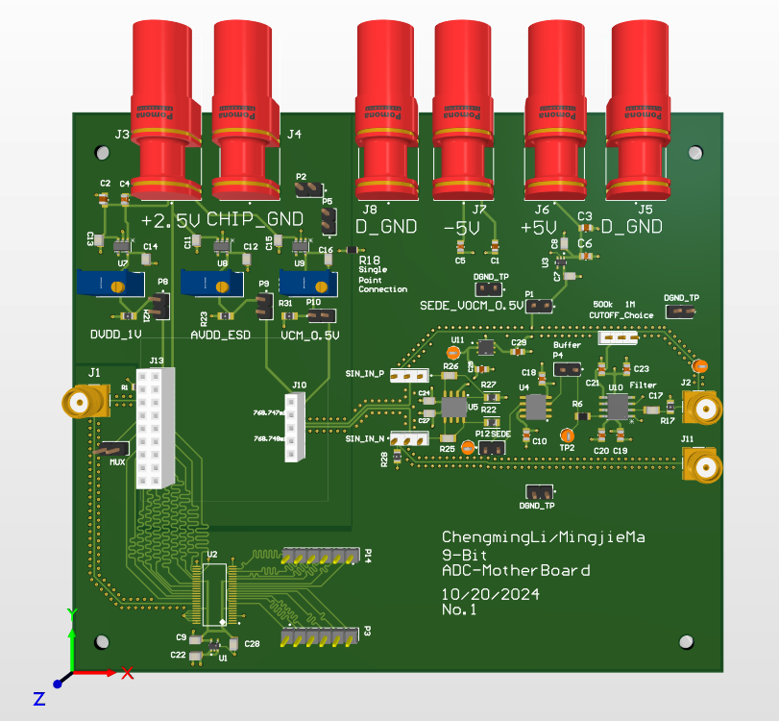
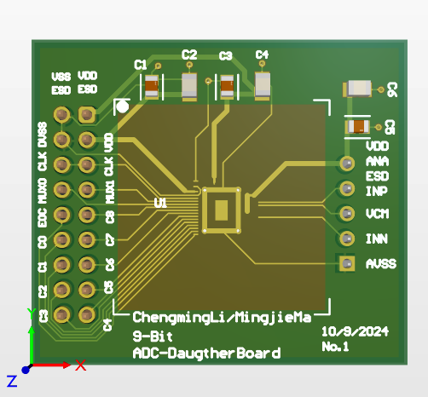
MotherBoard + DaugtherBoard 3D

Slide 15
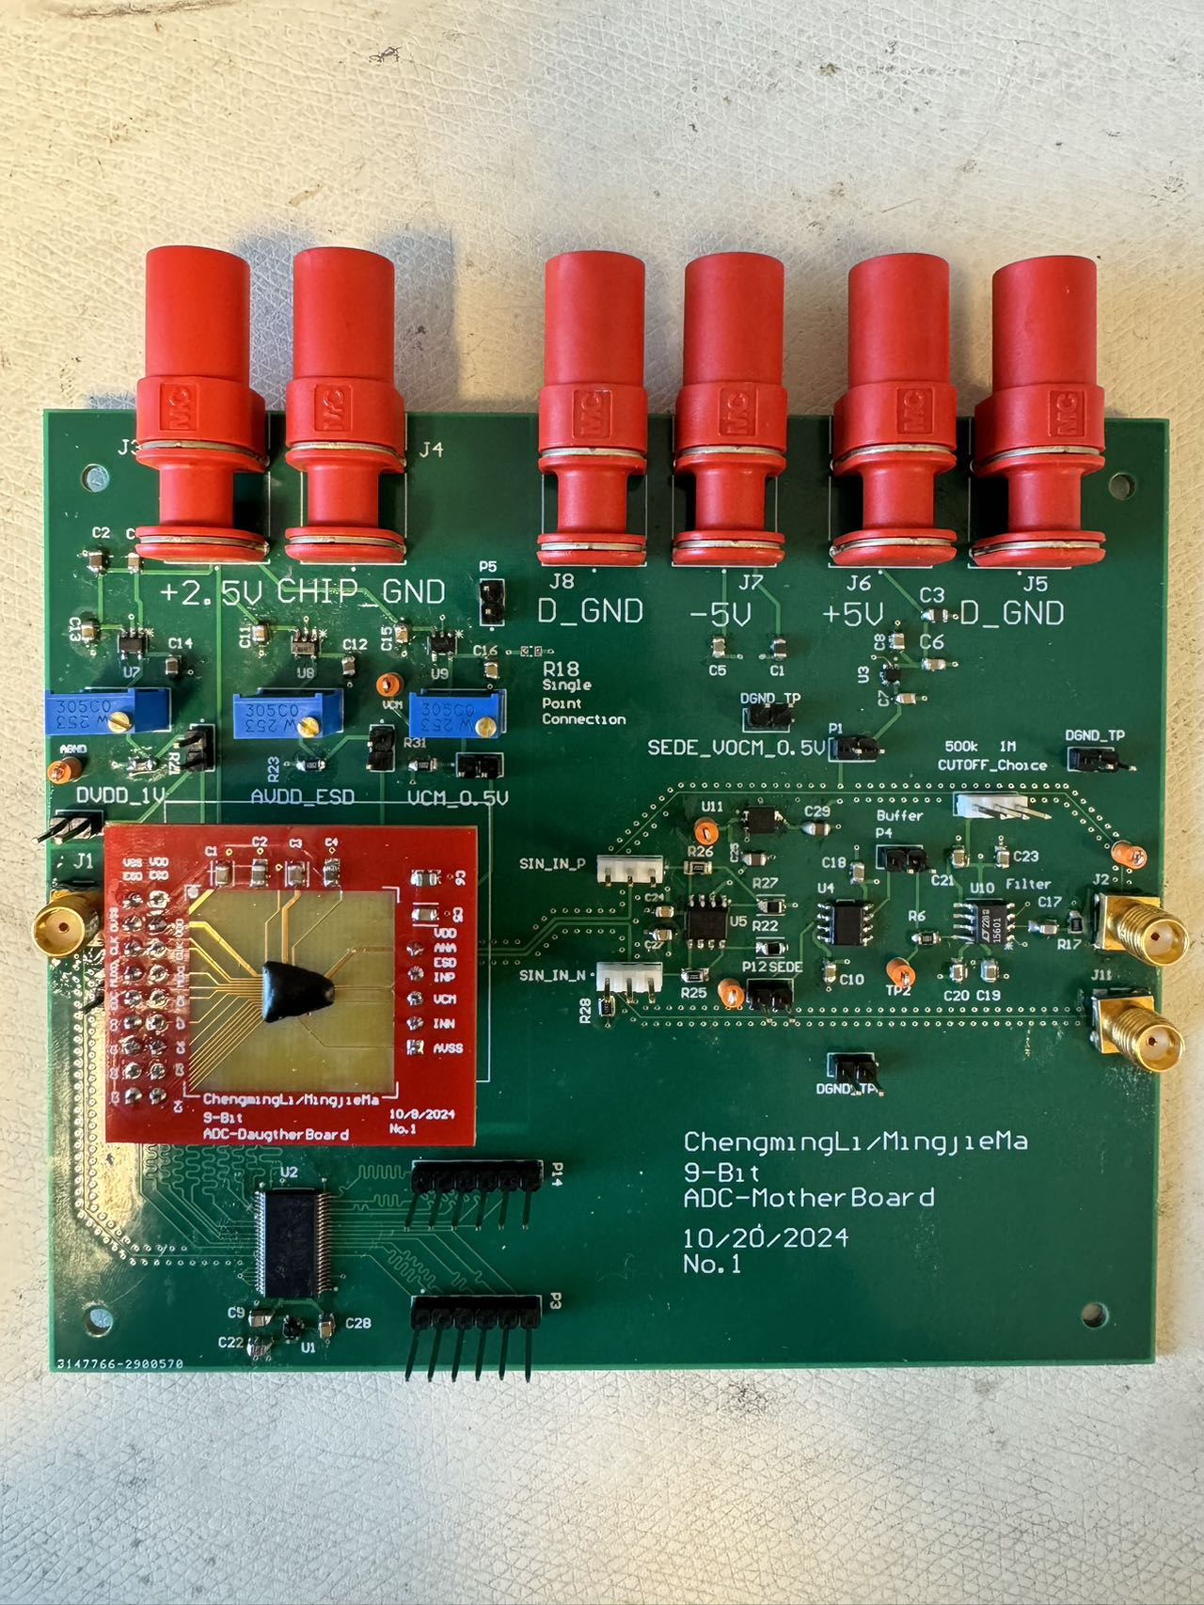
MotherBoard + DaugtherBoard
Modularized the Design
By having jumper between each IC
For debugging
SE-DE / ByPass Options
Testability
Jumper for GND for easy probeing
Grab & Probe
Configurability
Potentiometer for tweaking the perfect Vcm, AVDD, AVDDESD
4-Layer Stack
Signal
DGND + AGND
+5V
-5V

Slide 16
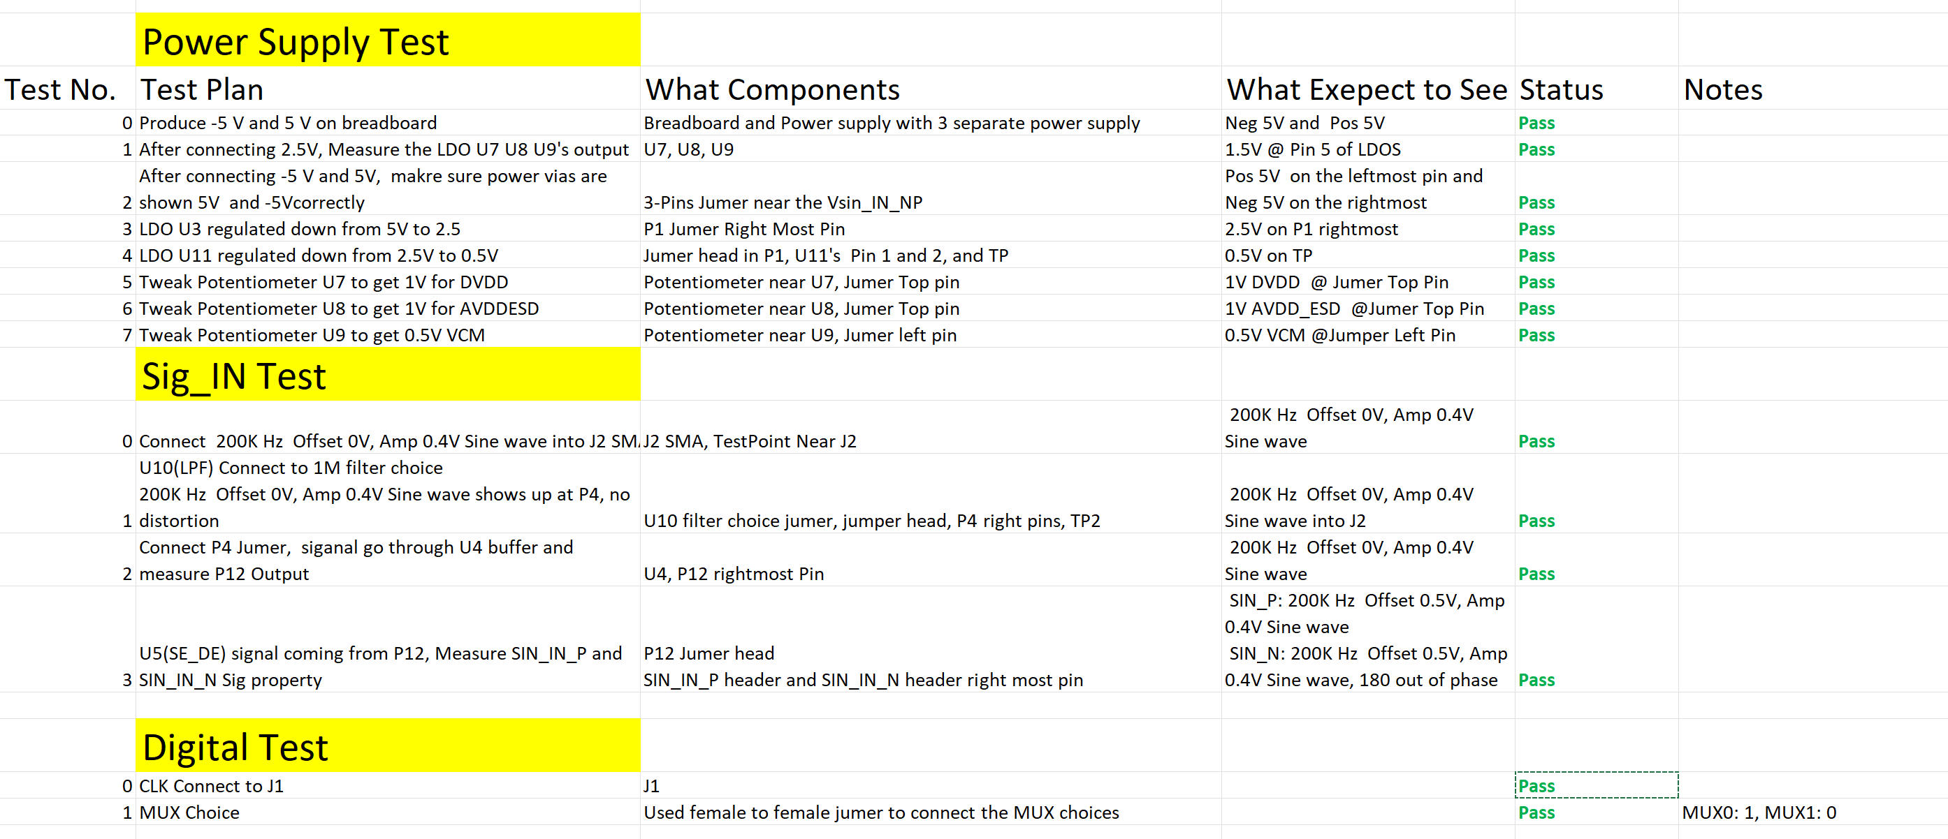
Board Bring-up Checklist
By knowing what to expect after each IC
Actual vs. Expect
Handy to debug the problem

Slide 17
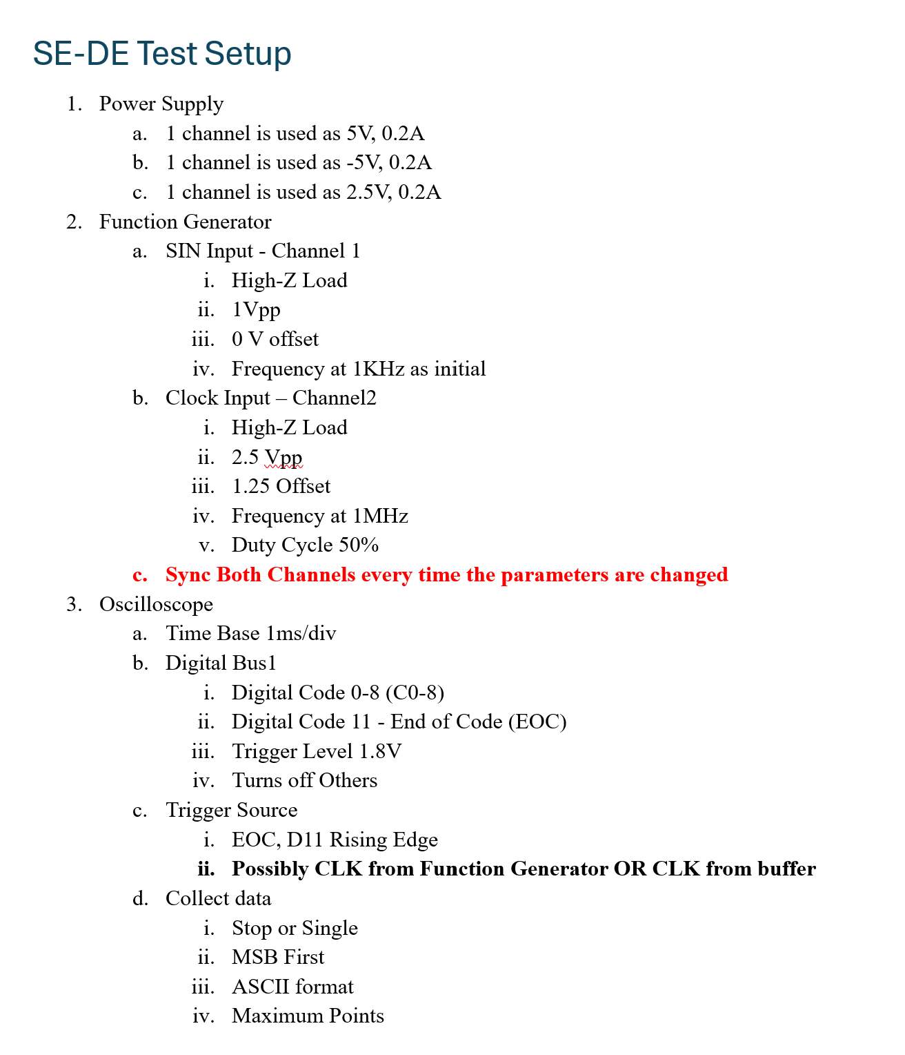
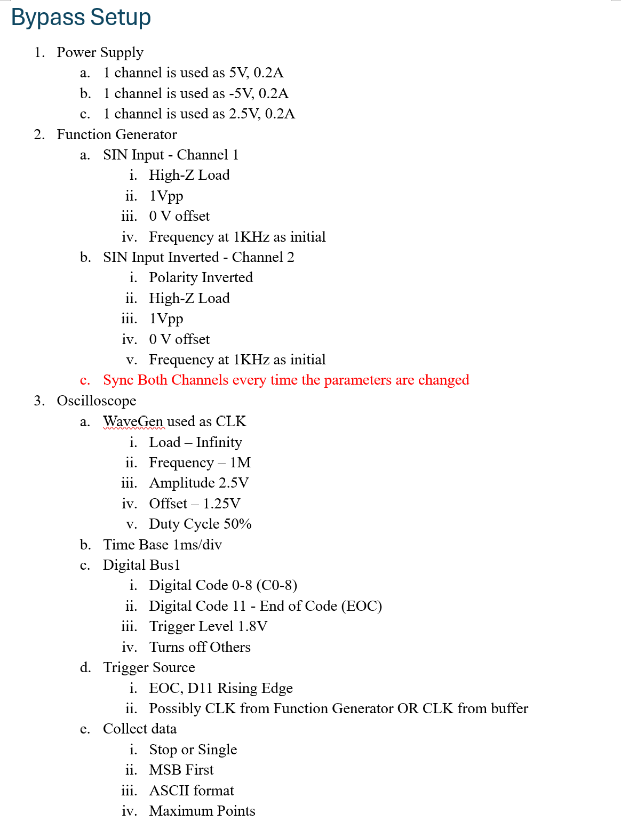
Test Setup Documentation

Slide 18
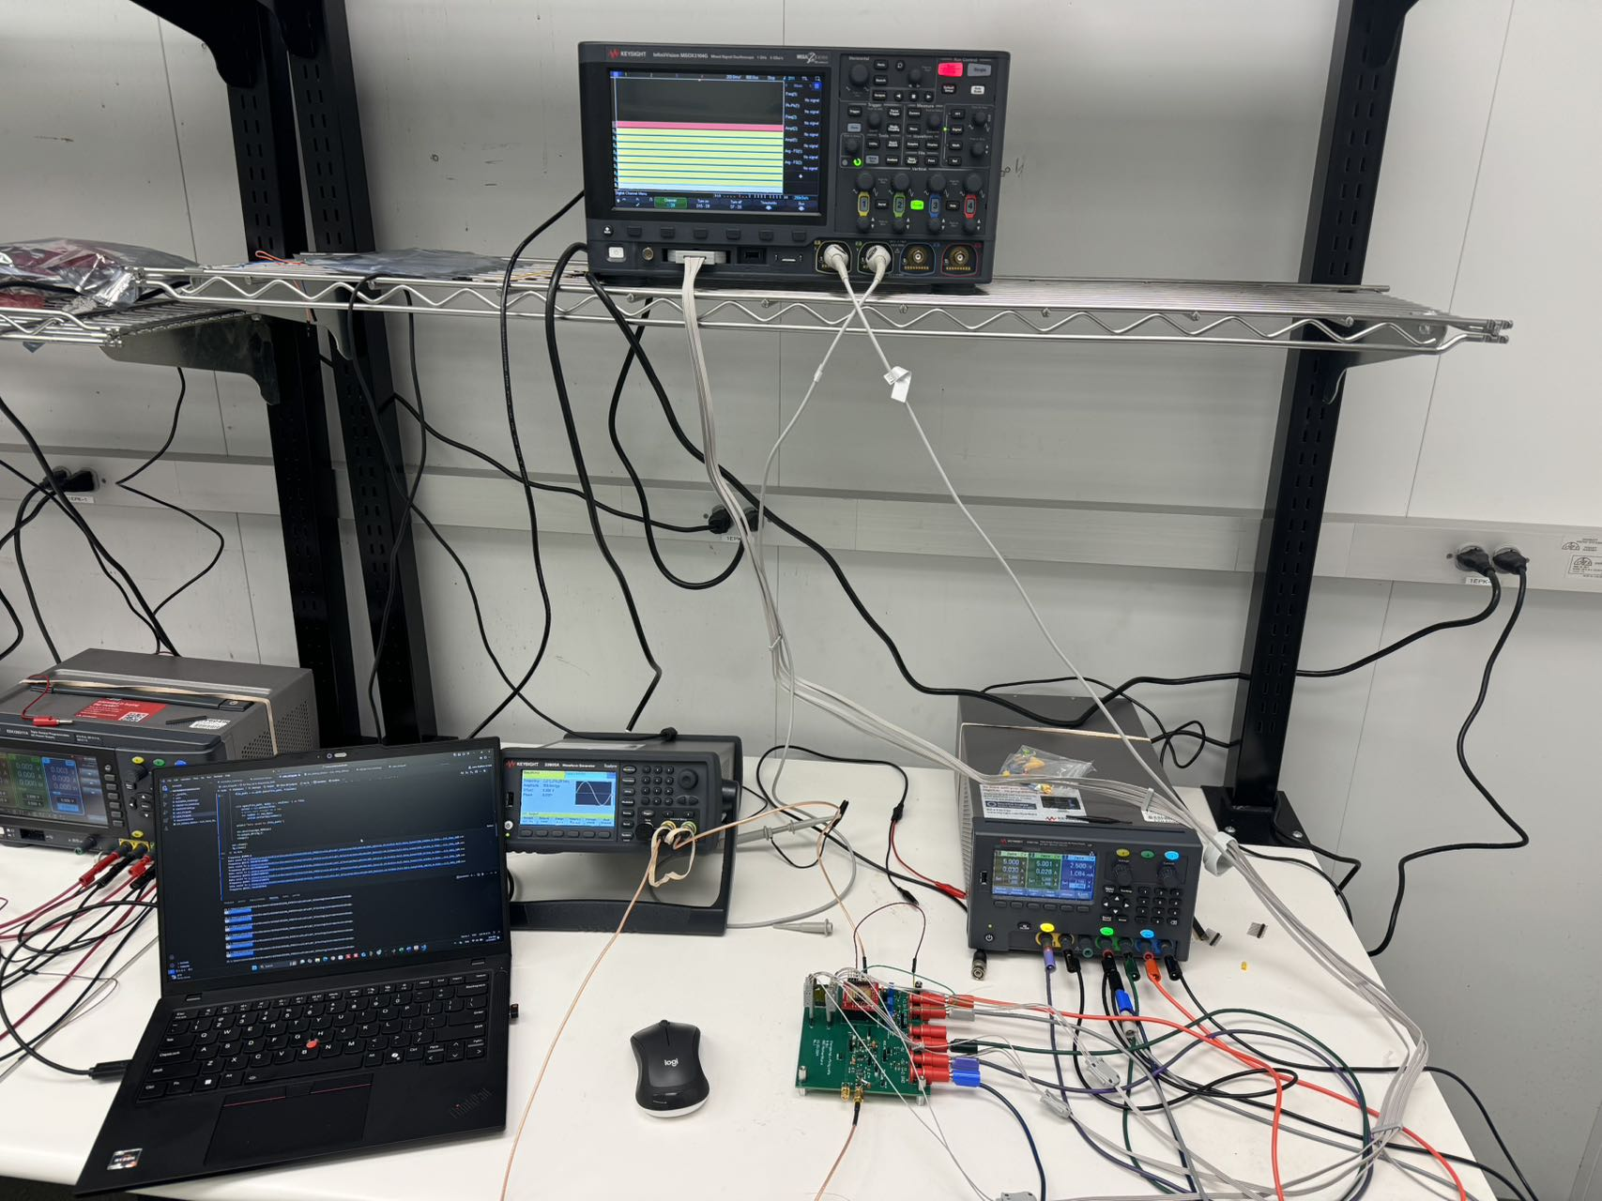
Test Automation Setup - 1
Power Supply
+5V, -5V, and 2.5V
Function Generator
CLK & SIN INPUT
Oscilloscope
Digital Analyzer
Digital Output
4-Layer Stack
Signal
DGND + AGND
+5V
-5V

Slide 19
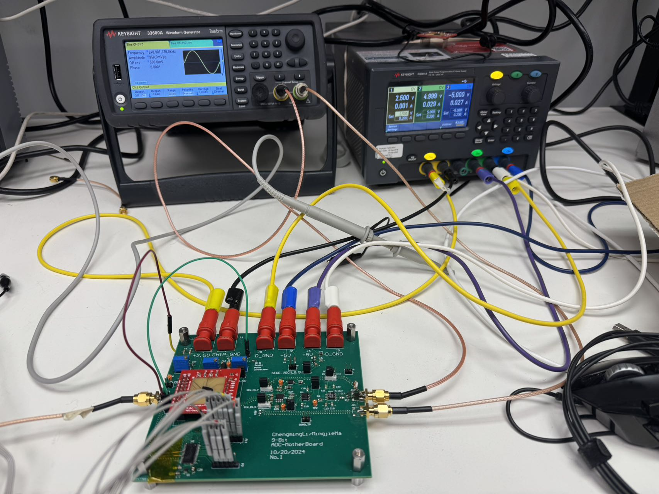
Test Automation Setup - 2
Power Supply
+5V, -5V, and 2.5V
Function Generator
CLK & SIN INPUT
Oscilloscope
Digital Analyzer
Digital Output
4-Layer Stack
Signal
DGND + AGND
+5V
-5V
2.5V -5V +5V
CLK_IN
SIN_P & SIN_N
C0-C8 + EOC

Slide 20
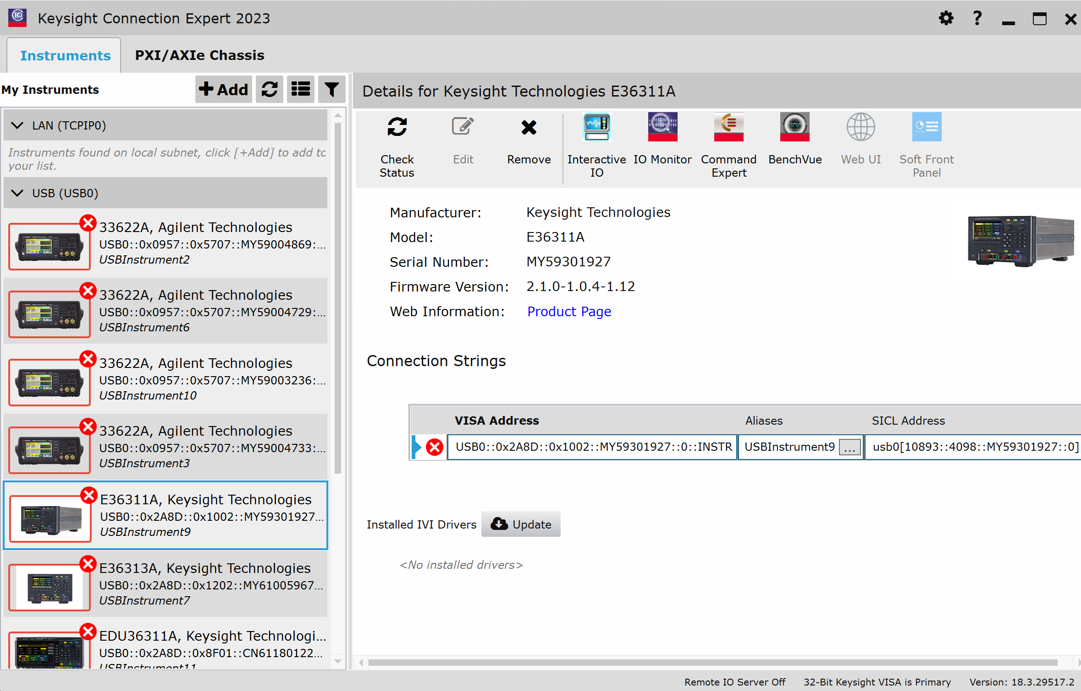
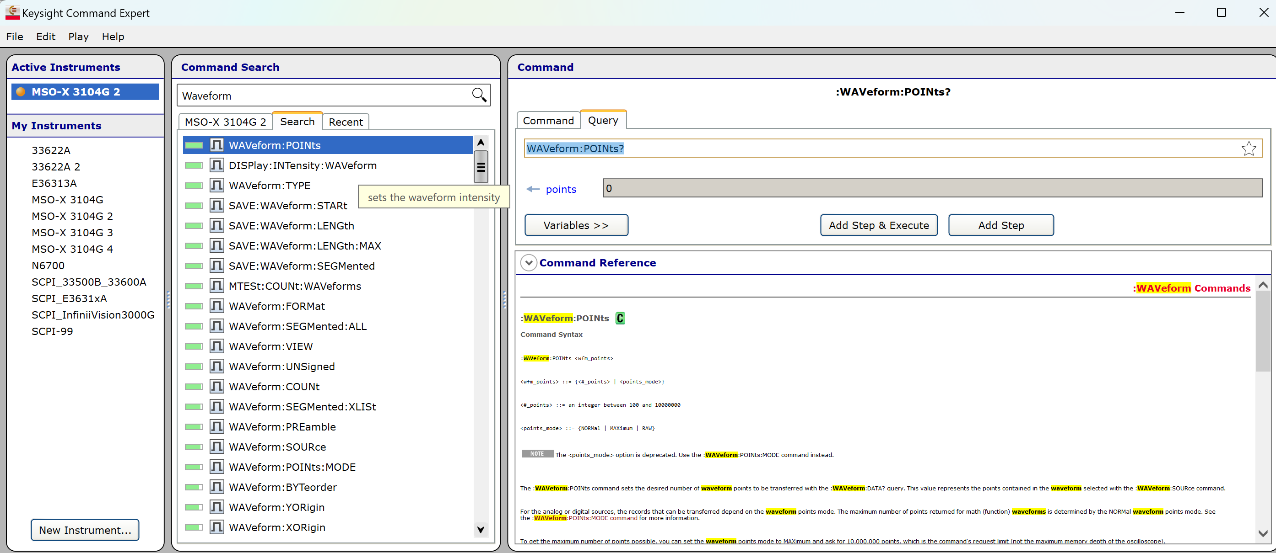
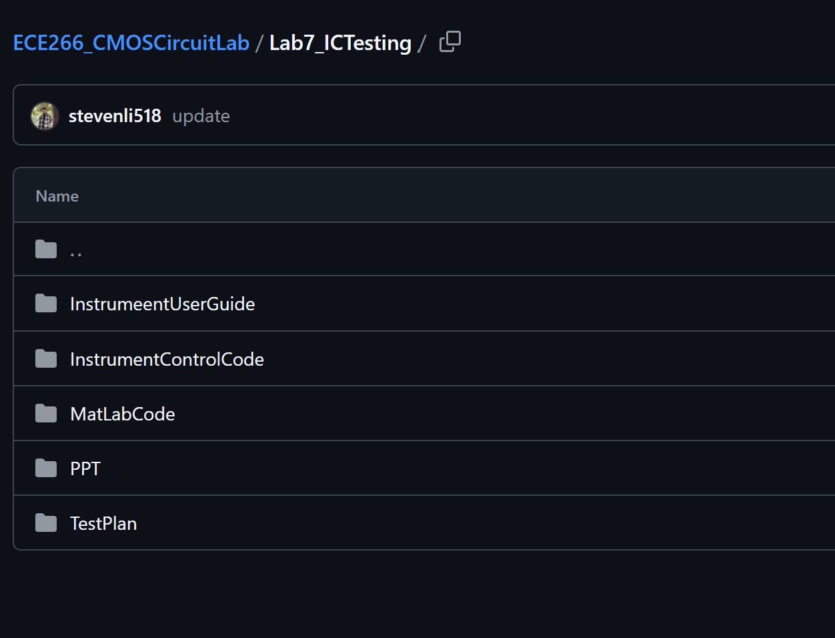
Test Automation Code Prep
Keysight Connection Expert & Keysight Command Expert
Extremely accelerate the code development time
And check if the instrument is there
Python Test Automation
Function Generator
Freq_coupling', 'FuncGenConnect', 'Load__setup', 'PWM_setup', 'Polarity_invert', 'Sin_setup', 'Sync_phase', 'UnitVpp_setup', 'Voltage_coupling', 'output_OFF', 'output_ON
PowerSupply
'Channel_Select', 'Current_Setup', 'Output_OFF', 'Output_ON', 'PowerSupply_Connect', 'Voltage_Setup'
Oscilloscope
'DigitalDisplay_ON', 'Digitalizer_ON_OFF', 'Oscilloscope_Connect', 'Oscilloscope_RUN', 'Oscilloscope_SetBUS', 'Oscilloscope_Single', 'Oscilloscope_Stop', 'Oscilloscope_TimeBase', 'Oscilloscope_Trigger_Dchan', 'Oscilloscope_Trigger_External', 'Oscilloscope_WGen_Square', 'Oscilloscope_WGen_Square_OFF', 'Oscilloscope_WGen_Square_ON', 'Save_waveform', 'SetDigital_Threshold’
Code Version Control
GitHub
Never lost what I did on “Yesterday”

Slide 21
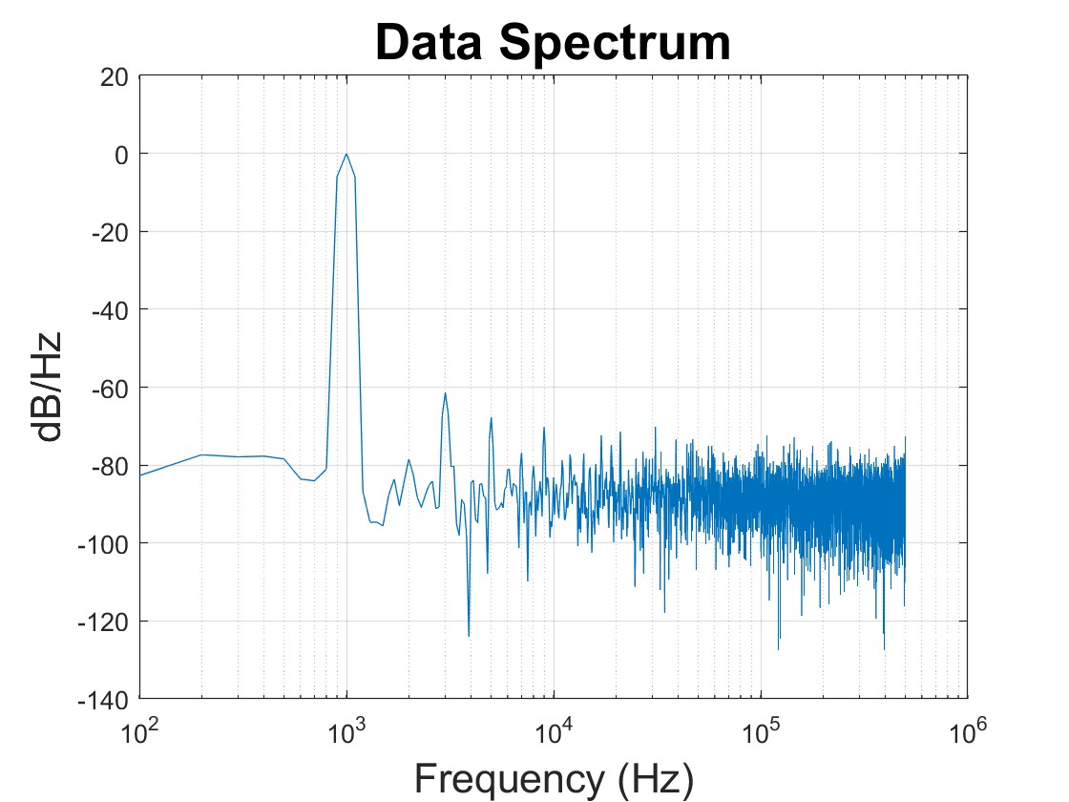
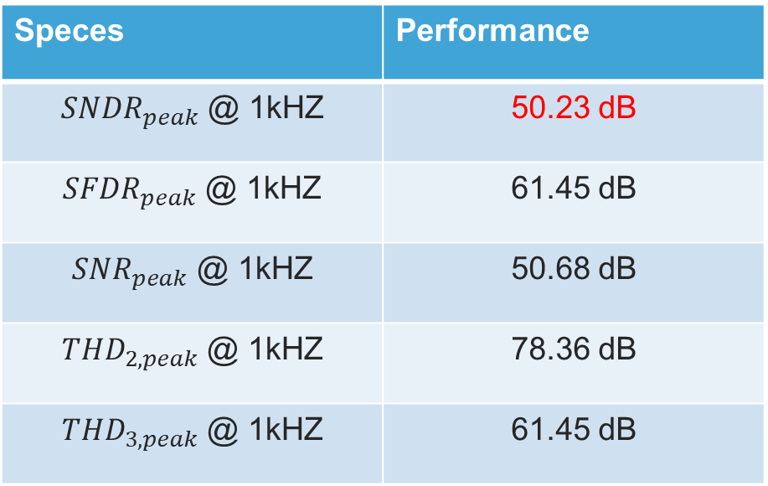
Peak SNDR Plot
Speces | Performance
${SNDR}_{peak}$ @ 1kHZ | 50.23 dB
${SFDR}_{peak}$ @ 1kHZ | 61.45 dB
${SNR}_{peak}$ @ 1kHZ | 50.68 dB
${THD}_{2,peak}$ @ 1kHZ | 78.36 dB
${THD}_{3,peak}$ @ 1kHZ | 61.45 dB

Slide 22
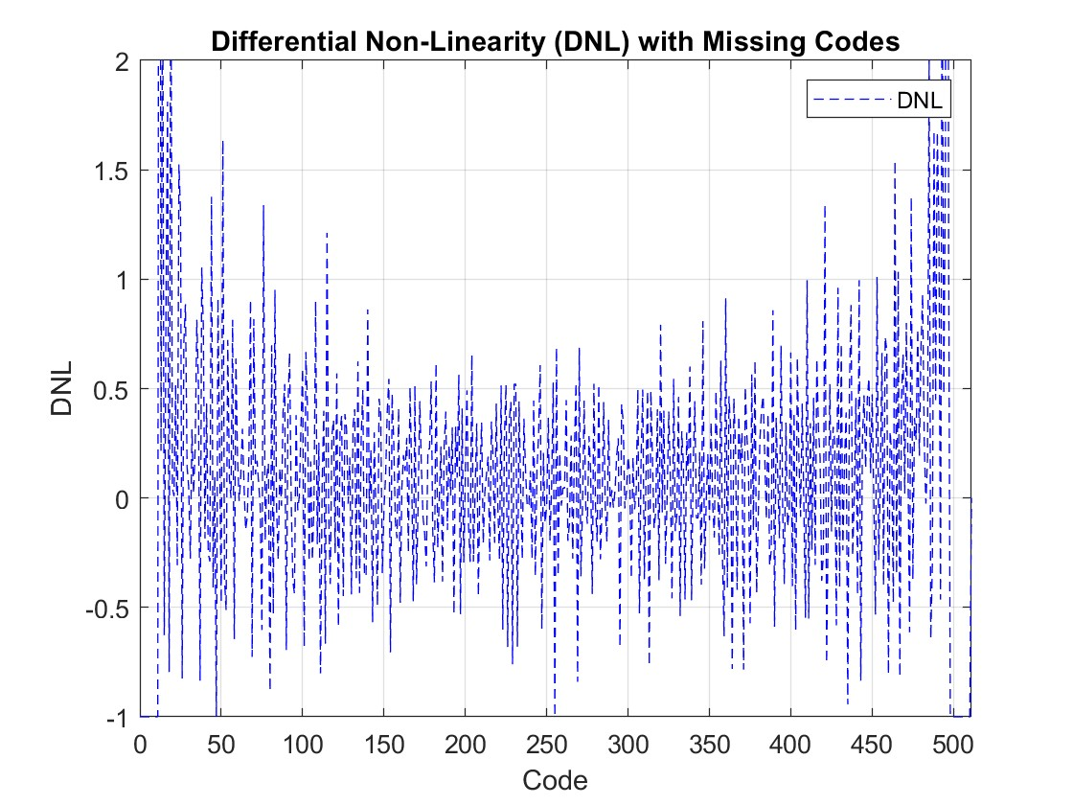
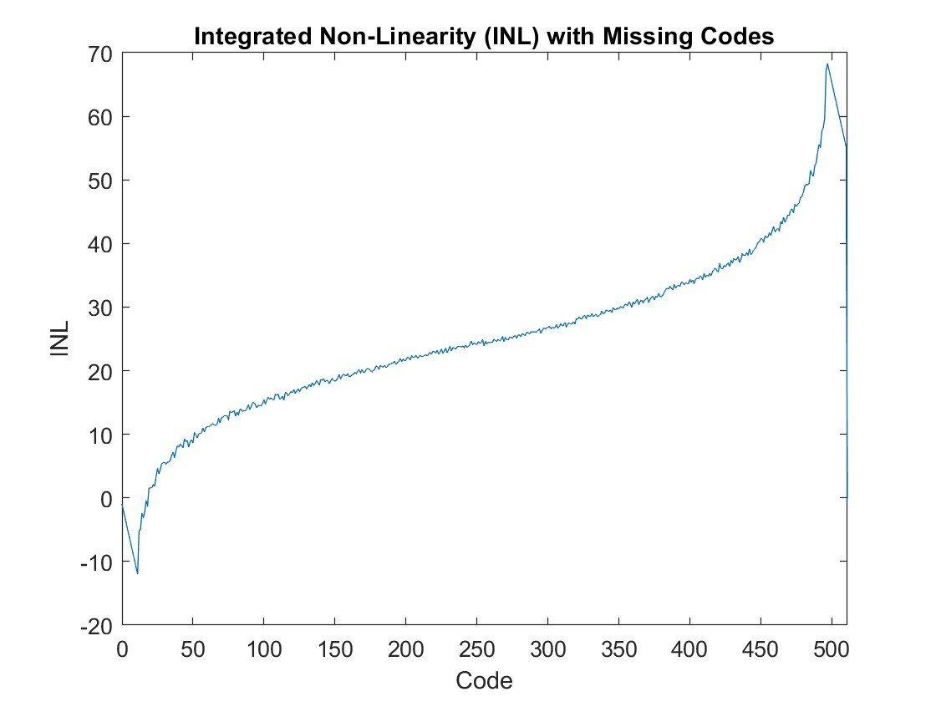
Peak SNDR Plot

Slide 23
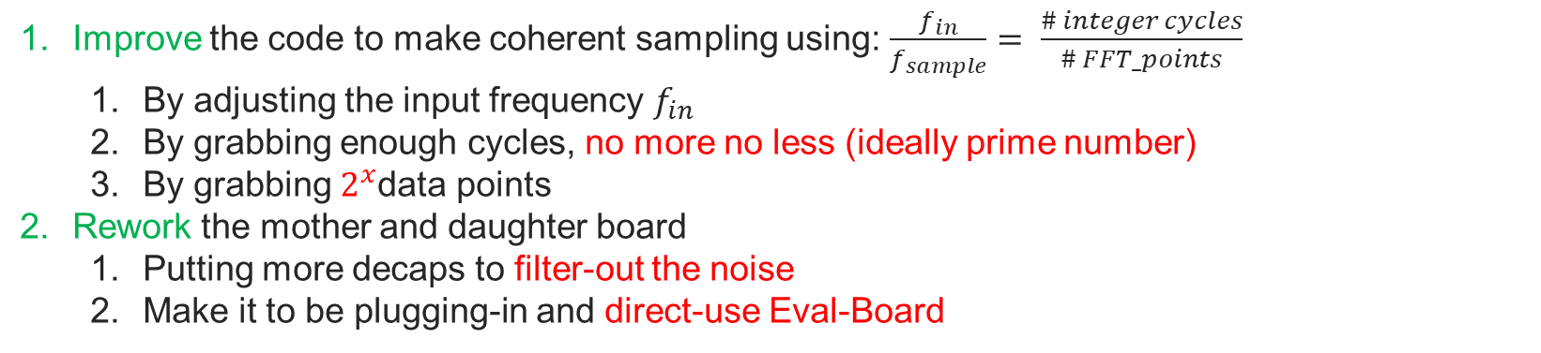
Future Work
Improve the code to make coherent sampling using: $\frac{f_{in}}{f_{sample}}= \frac{\# integer cycles}{\# FFT_points}$
By adjusting the input frequency $f_{in}$
By grabbing enough cycles, no more no less (ideally prime number)
By grabbing $2^{x}$data points
Rework the mother and daughter board
Putting more decaps to filter-out the noise
Make it to be plugging-in and direct-use Eval-Board

Slide 24
Takeaway

Slide 25
Takeaway
Always Always Always document everything
Simple Eval-board Design = Robust Debuggability & Reconfigurality
Cross-check everything with partners

Slide 26
Acknowledgement
Prof. Hall
For running this 6-months course/projects
Helping us debug the problems
TA: Darshan
Supporting the Lab work
Extending the Lab Hours
Apple
For sponsoring this projects, buying the chips, PCBs, components,etc
Keysight
Instruments, instrument command & connection expert

