Slide 1
Intern Exit
Presentation
Chengming Li

Slide 2
Agenda
About Me & Future Journey
Accomplished Projects
Key takeaways
Acknowledgement
Q&A

Slide 3
About me
Chengming(Steven) Li
BS Electrical & Computer Engineering Degree at University of Colorado, Boulder
Will be MS Electrical & Computer Engineering student at University of California, San Diego
Here, at Eridan, RF Test Engineering Intern from June- Aug

Slide 4
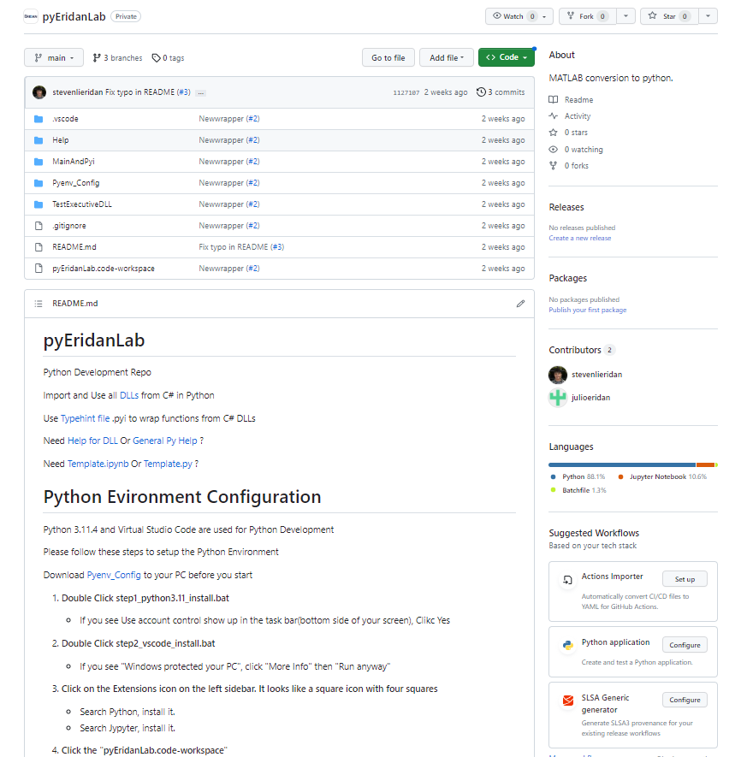
Accomplished Projects
pyEridanLab

Slide 5
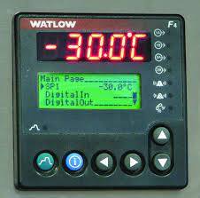
Accomplished Projects
2. Temperature Chamber

Slide 6
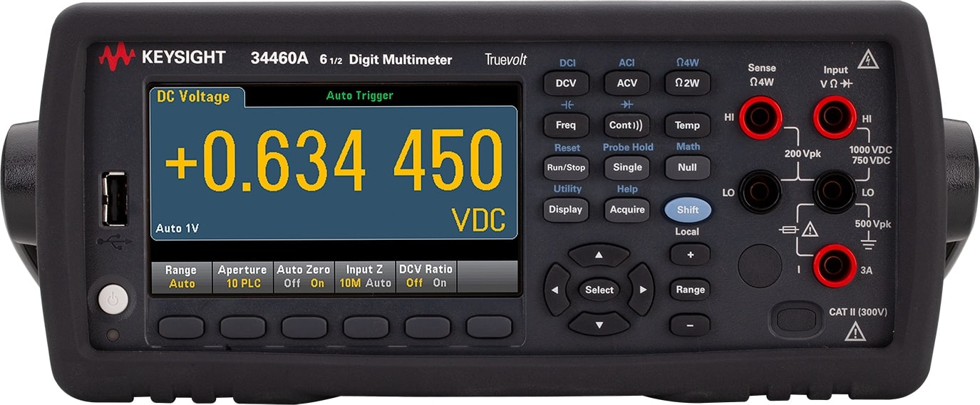
Accomplished Projects
3. Digital Multimeter

Slide 7
Key takeaways
Be Proactive
Take the Responsibility
Try First
One Problem/Thing at a time
Be Precise/Easy to Understand
Marketing Requirements

Slide 8
What skills do I learned
C#
GitHub
Instrument Interface
Batch Script
Vscode config
PID Control

Slide 9
Acknowledgement
Shawn
Julio
Tanner
Angel
Jason
Hala
Eridan

Slide 10
Q&A

