Slide 1
Predicting Disease p clusters using existing anemia classification Steven Ray, November 2024

Slide 2
Agenda
Problem Statement
Data
Approach and Models
Results
Next Steps

Slide 3

Problem Statement
A new disease has been discovered, Disease P, which has clinically been evidenced to contain variants similar to anemia.
As a pharmaceutical company, we need to create research teams per variant to devise treatments.
We want to use clustering techniques to identify the variants of Disease P.

Slide 4
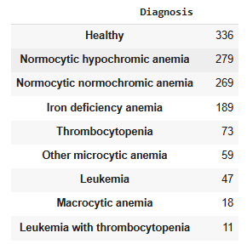
Data
The dataset was located on Kaggle at https://www.kaggle.com/datasets/ehababoelnaga/anemia-types-classification.
It contains CBC data with the diagnosis of Anemia type labeled (9 variants).
There are 14 features and 1232 observations (after some data cleaning).

Slide 5
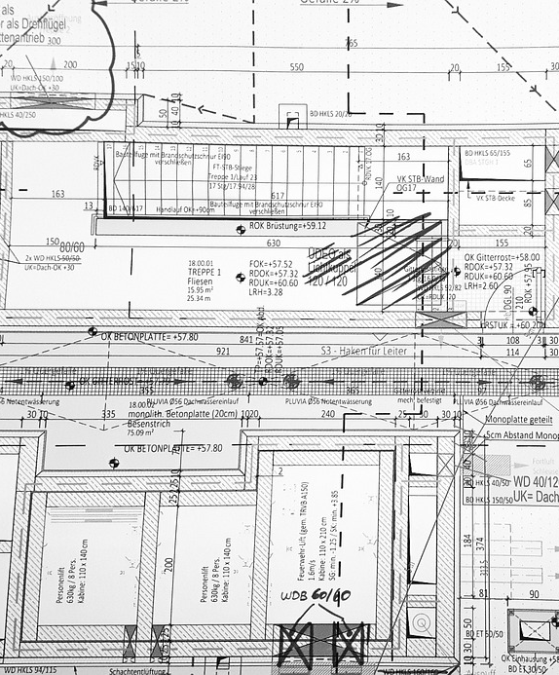
Approach and Models: Summary
We will apply standard data science techniques to prepare the data for modeling
Dimensionality reduction algorithms will be applied to allow for visual inspection of the variant clusters
Clustering algorithms will be applied
Results will be evaluated with a focus on scoring that indicates tight clustering (rather than scores which indicate alignment to ground truth)

Slide 6
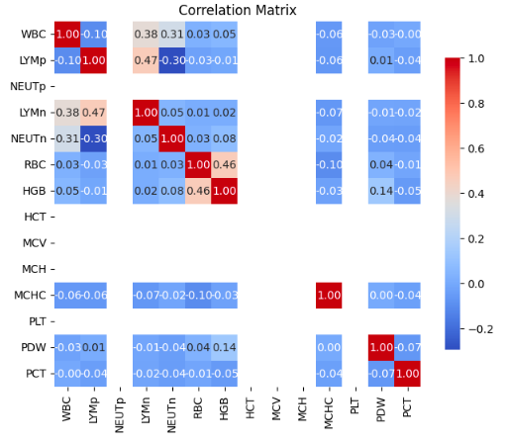
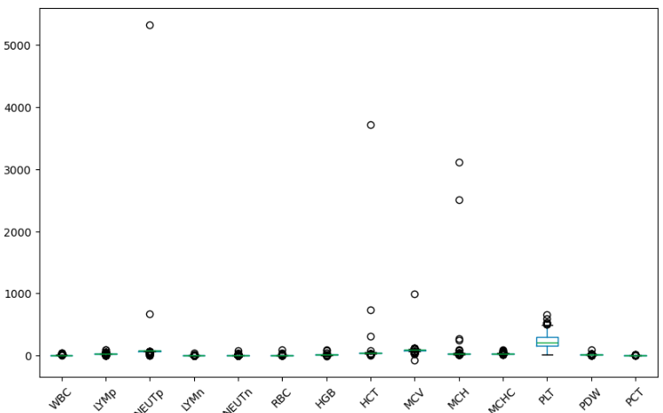
Approach and Models: Model Prep
1 feature was dropped due to significant correlation to another feature
5 features were winsorized to address outliers in the data
Features were then standardized so that all were on the same scale

Slide 7
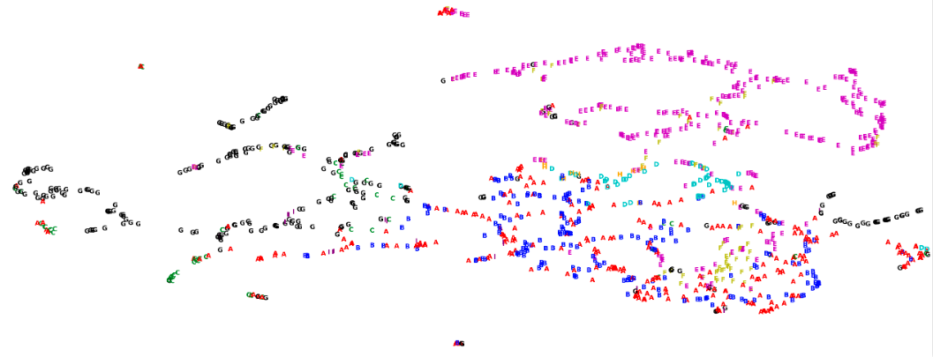
Approach and Models: Visualization
T-SNE and UMAP were selected to aid in visualization
These are powerful modern approaches for dimensionality reduction

Slide 8

Approach and Models: Clustering
3 Clustering Models were created:
Hierarchical
DBSCAN
Gaussian
ARI and Silhouette scores were recorded for each

Slide 9
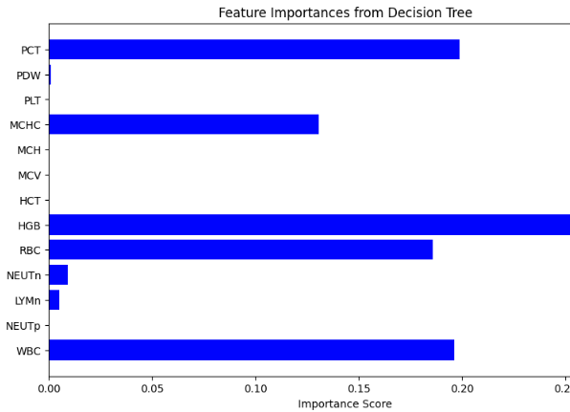
Approach and Models: Further Feature Optimization
A decision tree was trained on the data
Further suspected insignificant features were removed
The top-performing model was retrained and scored on the new dataset

Slide 10
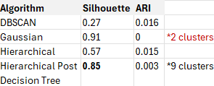
Results
A post decision-tree feature reduction hierarchical clustering algorithm was the best performer
While the final Silhouette score for Hierarchical is good, the ARI score is very concerning
Neither TSNE nor UMAP were useful in visually identifying well-delineated clusters (though UMAP was slightly better)
The Silhouette scores for both DBSCAN and Hierarchical were better than random
Gaussian's .91 Silhouette score was misleading as it only identified two clusters
Feature reduction using the decision tree approach improved the Heretical Silhouette score by 20%+
The extremely low (basically random) ARI score for all approaches is an issue

Slide 11

Results
Clustering does appear potentially viable here, but it’s not a slam dunk
It is possible that the existing feature set does not describe the target well
Bottom Line: Further research is needed

Slide 12

Next Steps
To take this further and improve results:
Further explore feature reduction:
Removal of features with low variance or low correlation to target
Using coefficients from logistic regression to identify key features
Seek out more data
Attempt other clustering algorithms and more hyperparameter tuning

Slide 13
THANK YOU
Steven Ray
steven.lynn.ray@gmail.com

