Slide 1
Managing attrition through predictive modeling Steven Ray, October 2024

Slide 2
Agenda
Problem Statement
Data
Approach and Models
Results
Next Steps

Slide 3

Problem Statement
"The cost of turnover is often understated, but losing an employee not only means losing their productivity but also the institutional knowledge and relationships they’ve built over time.” -Heather Boushey, Economist
“The cost of replacing an individual employee can range from one-half to two times the employee's annual salary.” -Gallup

Slide 4

Problem Statement
Employee attrition costs companies institutional knowledge, relationships, culture, money, and more.
Identifying causes of attrition and/or employees at risk could lead to higher retention.
We can build predictive models reduce attrition.

Slide 5

Data
The data was found at https://www.kaggle.com/datasets/colearninglounge/employee-attrition with credit to Patel Prashant
Within the dataset we have current and exited employees (tagged as such) with features such as Age, Gender, a Work Life Balance metric, etc.

Slide 6

Data
Originally 35 features and 1029 rows
7 features were dropped due to lacking variability, missing values, or clear multi-collinearity
Missing values for the Age feature were filled-in using a simple linear regression model
Categorical columns were converted to numeric values

Slide 7
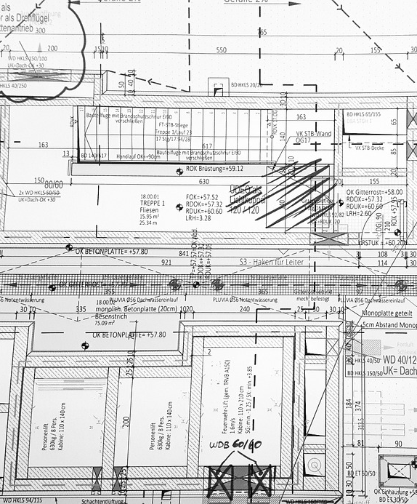
Approach and Models
A logistic regression model was trained with all remaining features
Based on the coefficients of the resultant model, 3 additional features were dropped

Slide 8

Approach and Models
Logistic Regression, Random Forest, and Gradient Boosting models were created using default parameters and 5-fold cross validation
With these three models above, grid search 5-fold cross validation was used to try different parameters for each
Best average accuracy scores were stored for each model

Slide 9
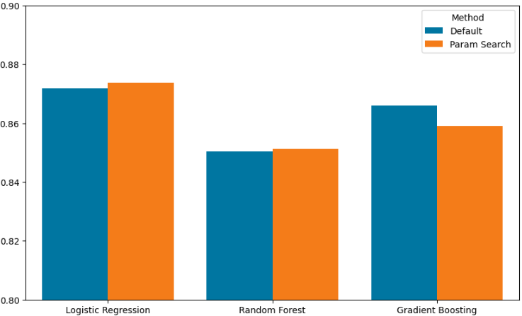
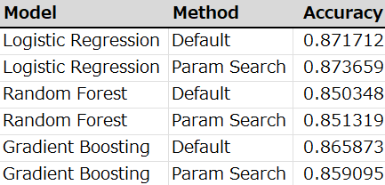
Results
A Parameter-Tuned Liblinear Logistic Regression model was the best performer
Given these accuracy scores, we can expect predictive modeling to be a valuable aid in employee retention

Slide 10

Next Steps
To take this further and improve results:
Scale the data. This might improve overall performance and could allow for other LR solvers to be used.
Execute PCA to further streamline the feature set.
The target variable is not well-balanced. It might be wise to apply some resampling or weight classes.
Use the variable Age crossed with some other variable (e.g. Work Life Balance) to create a new feature to see if that may be useful.

Slide 11
THANK YOU
Steven Ray
steven.lynn.ray@gmail.com
https://github.com/stevenlray/workplaceAttritionModeling

