Slide 1
STOCK PRICE PREDICTOR
Team Member: Hoang Dao
Advisor: Dr. Ali Minai

Slide 2
Project Goals
● Stock Price Predictor is the project on technical analysis, visualization and prediction using stock datasets from multiple sources provided by Yahoo! Finance and Google Finance APIs. This project aims to build a recurrent neural network with long short-term memory (LSTM) cell using Tensorflow to predict stock market prices.
● The model will then be deployed as a REST API and become available to the users by accessing the web application through the browser. Users will then be required to enter the stock name to get the predicted stock value from the trained model.

Slide 3
Intellectual Merits
Predicting the stock market price has been one of the most difficult tasks and risky businesses. Trying to predict the stock market by using different forecasting techniques to predict future stock values based on past returns is an interesting challenge which has gained much traction recently from data scientists.
Millions of people are traded every day in financial markets, and most of them share seek to predict the potential value of stock. Using this technique to determine the future prices of stock will help users to invest wisely in order to generate a profitable buy and sell signals.

Slide 4
Broader Impacts
Being able to predict the future economy of the stock market can be a significant profit for users’ financial situations. This project will analyze the daily trend/ stock movement for the users to decide how much value to allocate to each prediction and whether the stock is worth buying at the price. With greater understanding of the market, users will be better equipped with the confidence needed to prevent any financial risk and become a true long-term investor.

Slide 5
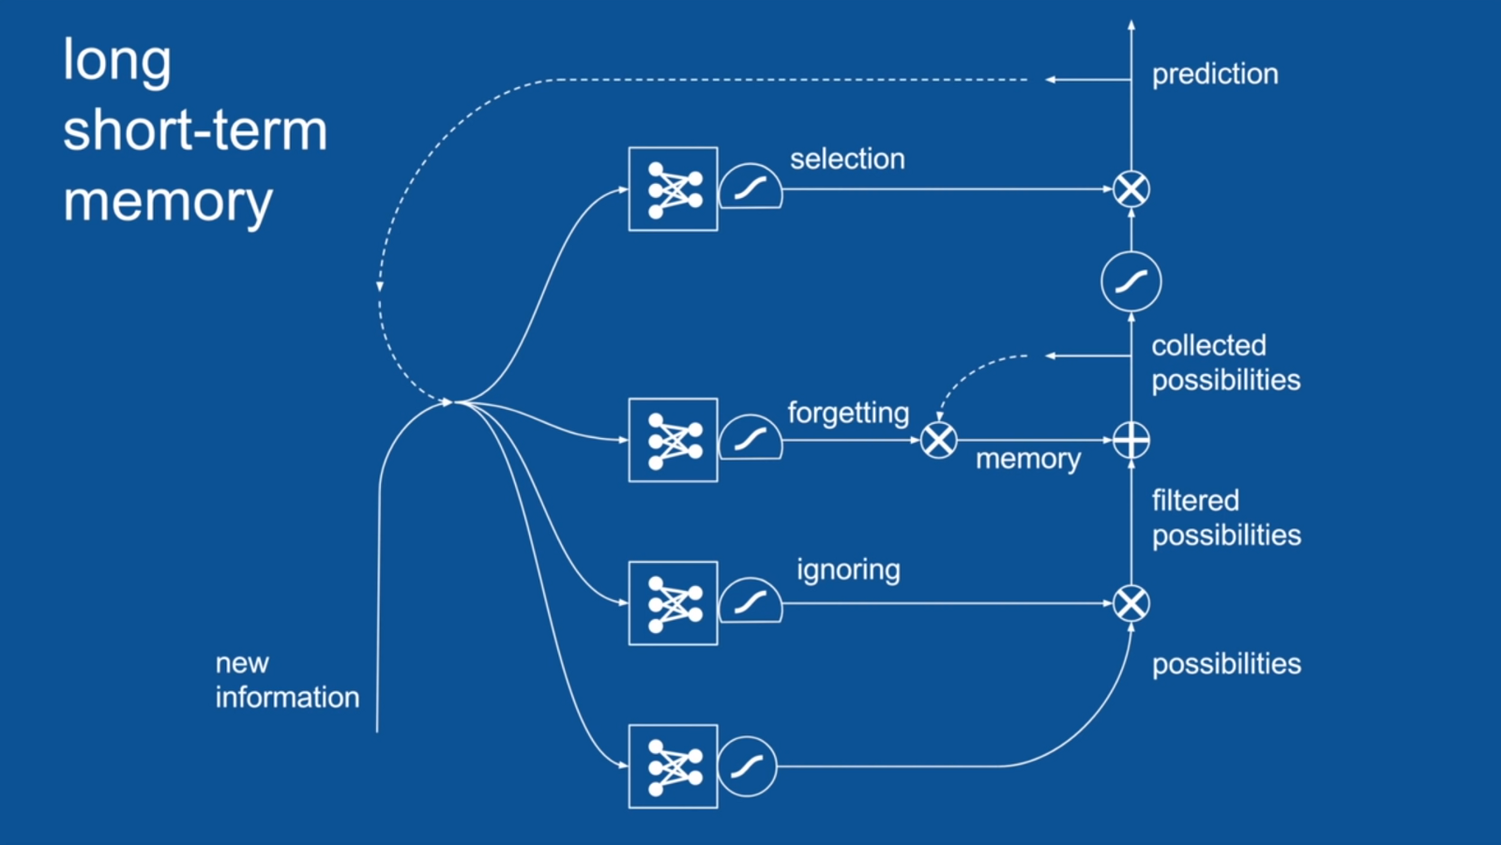
Design Specifications
Data Retrieval:
Fig. 1. Long Short Term
Memory (LSTM) neutral
network model.
● Download full dataset on Yahoo! Finance ^GSPC from 01/01/2001- 03/31/2019.
● Utilize Google Finance API to retrieve individual stock prices in S&P 500 index.
Data Processing:
● Users first enter the stock symbol they want to run training sessions or get predictions through the web input.
● The data is then fed to the LSTM neural network model to be trained to become better at predicting stock prices in the future.
● After the training sessions, Tensorboard is used to provide visualization of the data and to help users understand the results and the learning process.

Slide 6

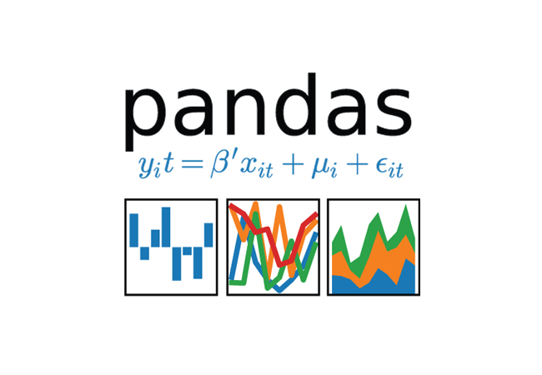



Technologies
● Numpy
● Tensorflow
● Python
● Flask
● Pandas

Slide 7
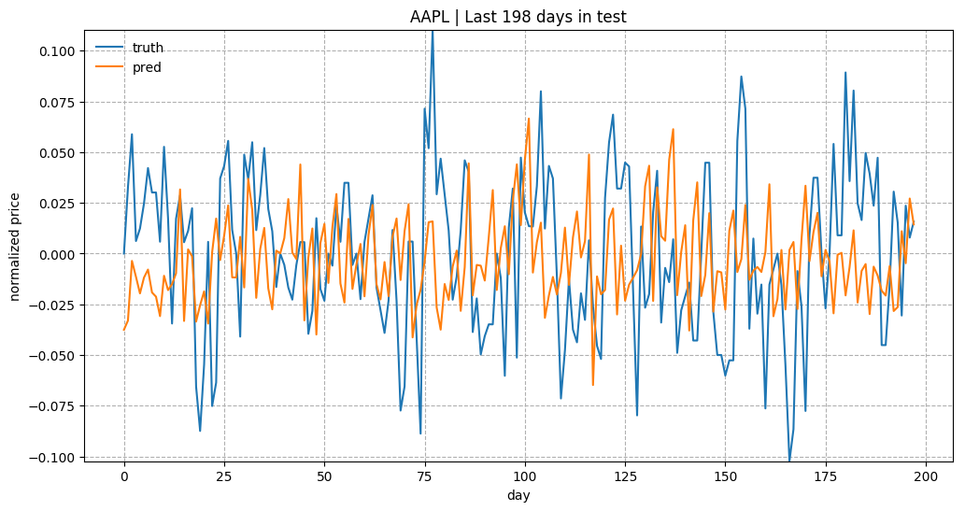
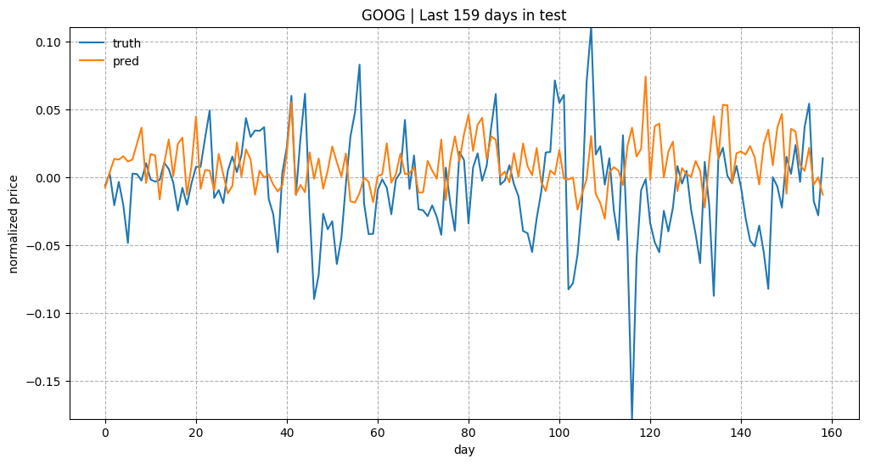
Results
AAPL | Last 200 days
Fig. 2. Actual vs Predicted latest stock prices of AAPL and GOOG in the data set.
GOOG | Last 160 days

Slide 8
Challenges
● The biggest challenges encountered during this project was the data inconsistency, inaccuracy and how to improve the model's predicted outcomes.
● This project's main focus is on building and training the Recurrent Neural Network to perform complex calculations rather than trying to improve its performance.
● Furthermore, in real life, stock prices are also affected by major events, company announcements and other external factors that is almost impossible to capture in the model or even predict beforehand.
● Nevertheless, there are still rooms for further improvements to be made for this project in the future such as adding more hidden layers to the neural network, changing the method used to fit the model data, or even using a completely different advanced machine learning algorithms to achieve a better result.

