Slide 1











Guest
(Potential Customer)
Staff / Cashier
(On - site Service)
Tennis Court
Booking System
Admin
(System Manager)
Customer
Staff
(Admin Staff)
Email Status
(STMP / Gmail)
Banking Partner
(SePay / MB Bank)
System
External Entity
Data Flow
04

Slide 2

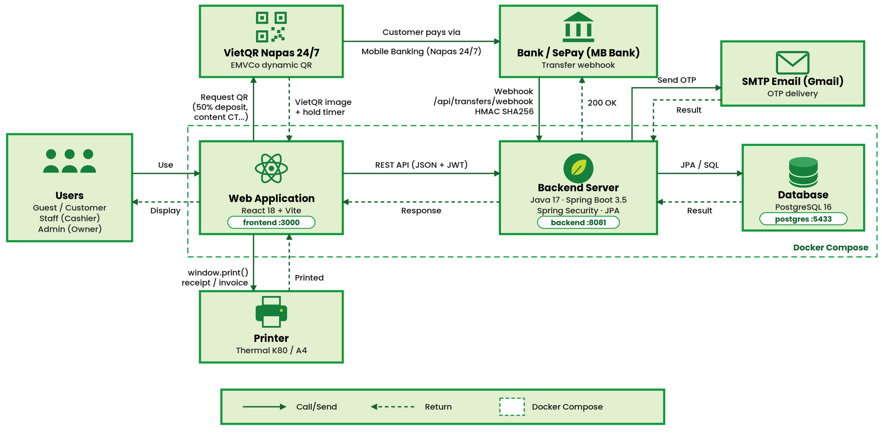
System Design

Slide 3

COURTLY
TENNIS COURT BOOKING
TIMELINE: SERVICE SETUP & SALES
Prepare courts, schedules and membership benefits for customer booking
Prepare resources
Configure benefits
Ready to book
Court details
Membership plans
Active court
Operating status
Eligible discounts
Free slot
Services & staff
ADMIN + SYSTEM
Advance booking
CUSTOMER
Valid price
✓
ADMIN
ADMIN
OUTPUT
Price & schedule
View availability
Day / time tariffs
View courts and prices
Generate 30-minute slots
See available times
Block maintenance slots
Choose eligible slots
DISTINCTIVE: pricing by time band and maintenance of individual slots
FLOW 01

Slide 4
COURTLY
TENNIS COURT BOOKING
TIMELINE: BOOKING & PAYMENT
New customers and members follow the same protected booking journey
Choose a service
Hold the court
Confirmed
Register / sign in
Recheck availability
Booking ID
View courts / ask AI
Lock selected slots
Deposit
Pick time & extras
SYSTEM
Set hold expiry
STAFF / SYSTEM
History
✓
CUSTOMER
SYSTEM
OUTPUT
Calculate the quote
Pay & verify
Check membership benefits
QR or counter payment
Apply eligible discounts
Verify received funds
Calculate required deposit
Confirm before hold expiry
DISTINCTIVE: member benefits, conflict prevention and verified deposits
FLOW 02

Slide 5
COURTLY
TENNIS COURT BOOKING
TIMELINE: BOOKING & PAYMENT
New customers and members follow the same protected booking journey
Choose a service
Hold the court
Confirmed
Register / sign in
Recheck availability
Booking ID
View courts / ask AI
Lock selected slots
Deposit
Pick time & extras
SYSTEM
Set hold expiry
STAFF / SYSTEM
History
✓
CUSTOMER
SYSTEM
OUTPUT
Calculate the quote
Pay & verify
Check membership benefits
QR or counter payment
Apply eligible discounts
Verify received funds
Calculate required deposit
Confirm before hold expiry
DISTINCTIVE: member benefits, conflict prevention and verified deposits
FLOW 02

Slide 6
Entity Relationship Diagram
CORE TABLES FOR FLOWS 01–04
court_prices
vouchers
membership
PK
FK
id
court_id
day_type
price_per_hour
PK
UQ
id
code
value
expires_at
KEY
accountId
planId
endsAt
discountPercent
N
1
via voucher_redemptions
1
1
N
1
courts
orders
accounts
PK
id
name
type (zone)
status
bookings
PK
FK
id
customer_account_id
status
total_amount
deposit_required
paid_amount
PK
UQ
id
full_name
email
role
PK
FK
id
order_id
status
check_in_at
N
1
N
1
1
N
1
court_schedules
N
1
N
PK
FK
id
court_id
schedule_date
start_time
status
booking_slots
payments
refunds
PK
FK
FK
id
booking_id
schedule_id
unit_price
PK
FK
UQ
id
order_id
amount
transaction_code
status
PK
FK
id
payment_id
amount
status
1
N
1
N
Table
JSON document
1
N
One to many
Indirect link

